Slide 1
Graphs Showing Forecasts made for 72nd Committee on Forests and the Forest Industry, UNECE/FAO Forestry and Timber Section
Kazan, Russian Federation
18-21 November 2014

Slide 2
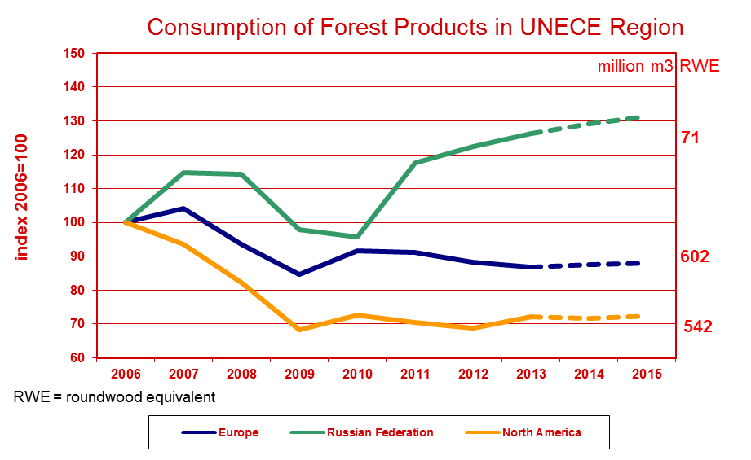
Consumption of Forest Products in UNECE Region
UNECE Committee on Forests and the Forest Industry, November 2014, Kazan

Slide 3
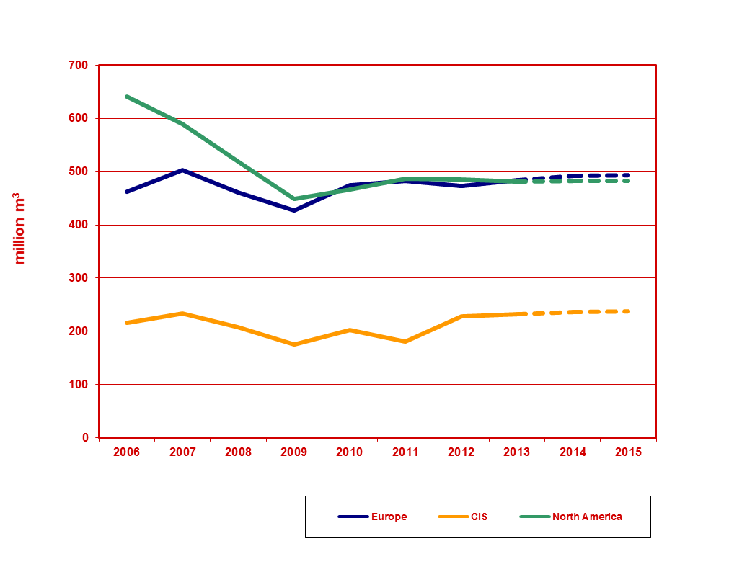
Roundwood (industrial and fuel) Removals in UNECE Region
UNECE Committee on Forests and the Forest Industry, November 2014, Kazan

Slide 4
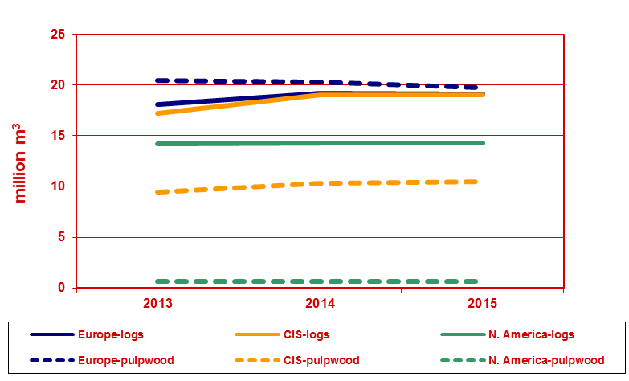
Log and Pulpwood Exports in UNECE Region
UNECE Committee on Forests and the Forest Industry, November 2014, Kazan

Slide 5
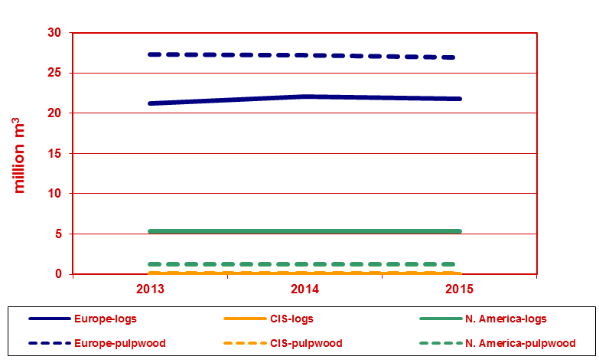
Log and Pulpwood Imports in UNECE Region
UNECE Committee on Forests and the Forest Industry, November 2014, Kazan

Slide 6
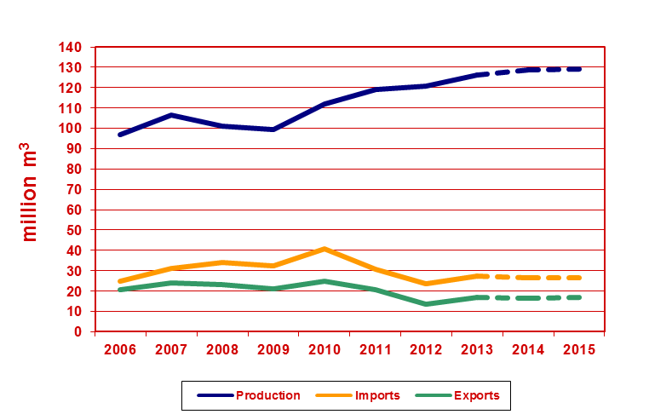
Chips, particles and residues in Europe
UNECE Committee on Forests and the Forest Industry, November 2014, Kazan

Slide 7
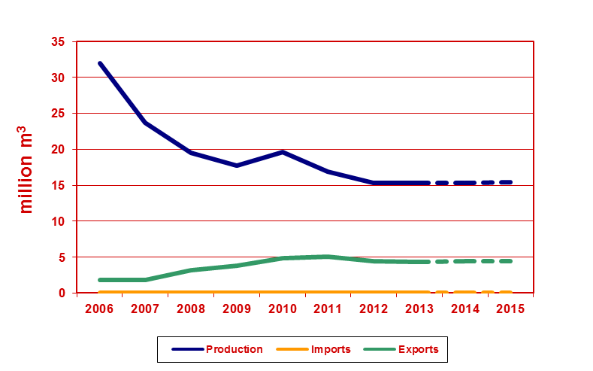
Chips, particles and residues in CIS
UNECE Committee on Forests and the Forest Industry, November 2014, Kazan

Slide 8
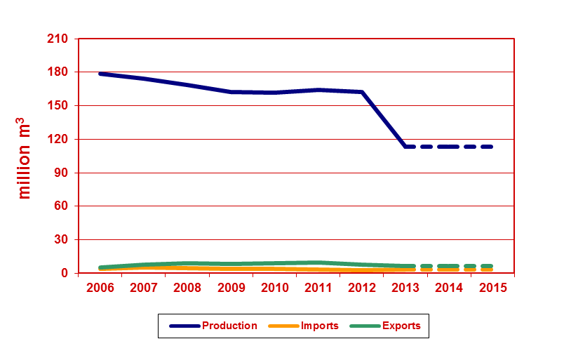
Chips, particles and residues in North America
UNECE Committee on Forests and the Forest Industry, November 2014, Kazan

Slide 9
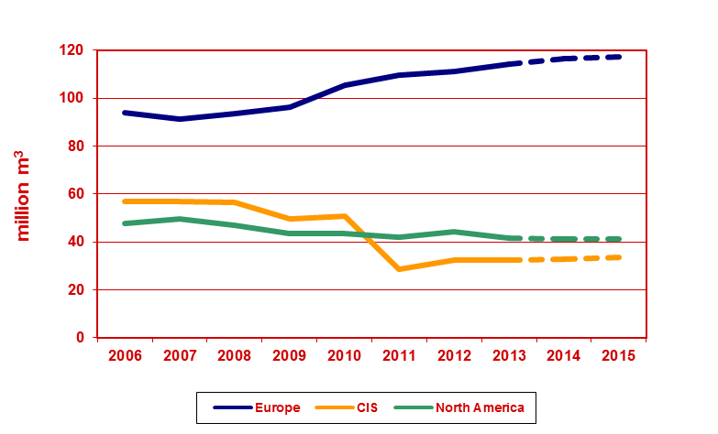
Wood Fuel Removals in UNECE Region
UNECE Committee on Forests and the Forest Industry, November 2014, Kazan

Slide 10
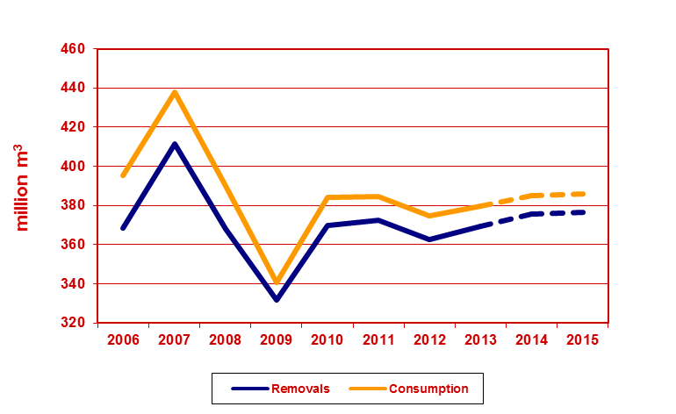
Industrial Roundwood Europe
UNECE Committee on Forests and the Forest Industry, November 2014, Kazan

Slide 11
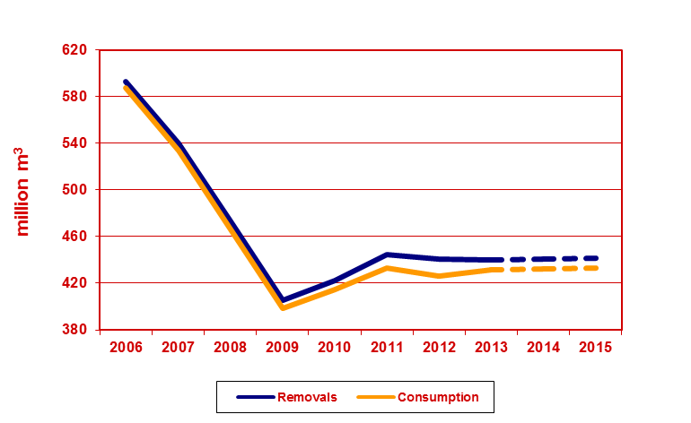
Industrial Roundwood North America
UNECE Committee on Forests and the Forest Industry, November 2014, Kazan

Slide 12
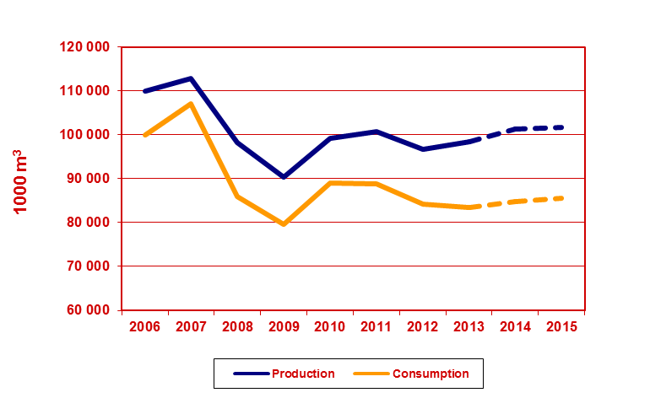
Sawn Softwood – Europe (1)
UNECE Committee on Forests and the Forest Industry, November 2014, Kazan

Slide 13
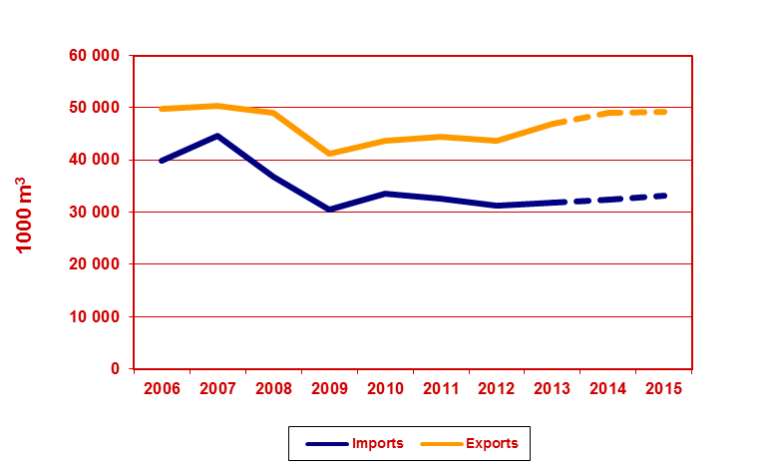
Sawn Softwood – Europe (2)
UNECE Committee on Forests and the Forest Industry, November 2014, Kazan

Slide 14
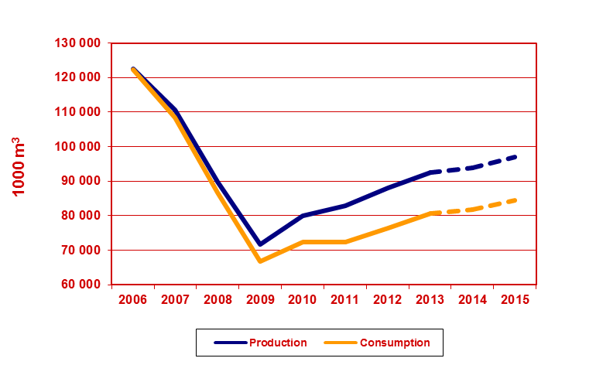
Sawn Softwood – North America (1)
UNECE Committee on Forests and the Forest Industry, November 2014, Kazan

Slide 15
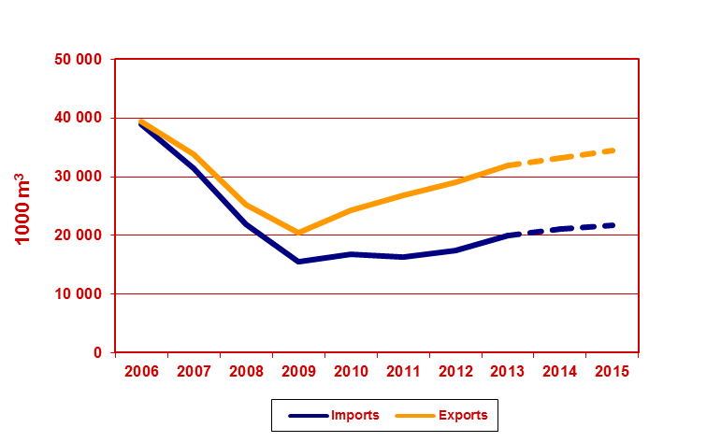
Sawn Softwood – North America (2)
UNECE Committee on Forests and the Forest Industry, November 2014, Kazan

Slide 16
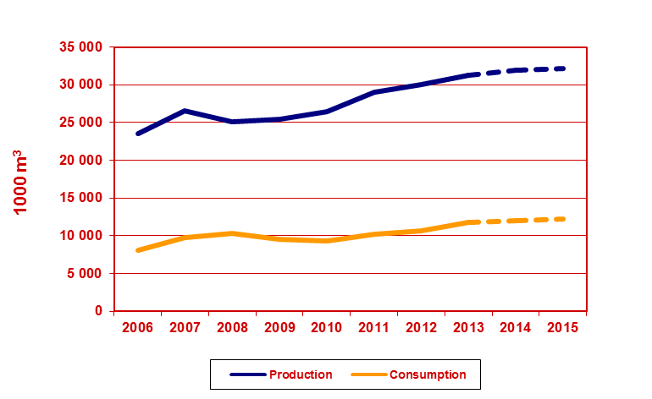
Sawn Softwood – Russian Federation (1)
UNECE Committee on Forests and the Forest Industry, November 2014, Kazan

Slide 17
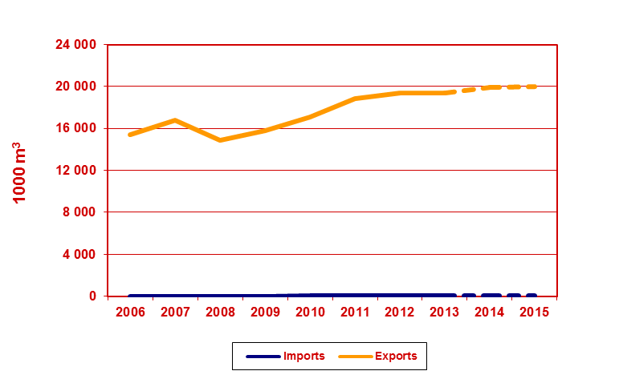
Sawn Softwood – Russian Federation (2)
UNECE Committee on Forests and the Forest Industry, November 2014, Kazan

Slide 18
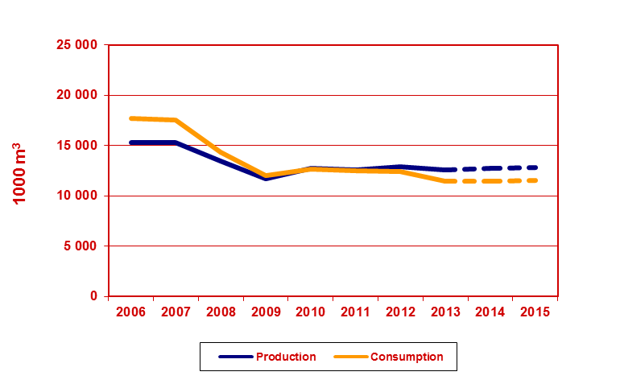
Sawn Hardwood – Europe (1)
UNECE Committee on Forests and the Forest Industry, November 2014, Kazan

Slide 19
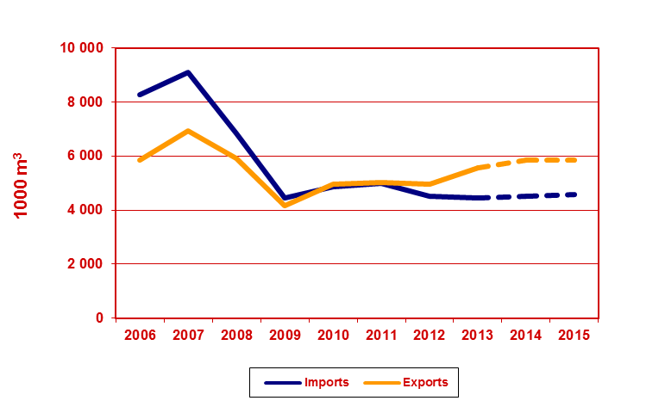
Sawn Hardwood – Europe (2)
UNECE Committee on Forests and the Forest Industry, November 2014, Kazan

Slide 20
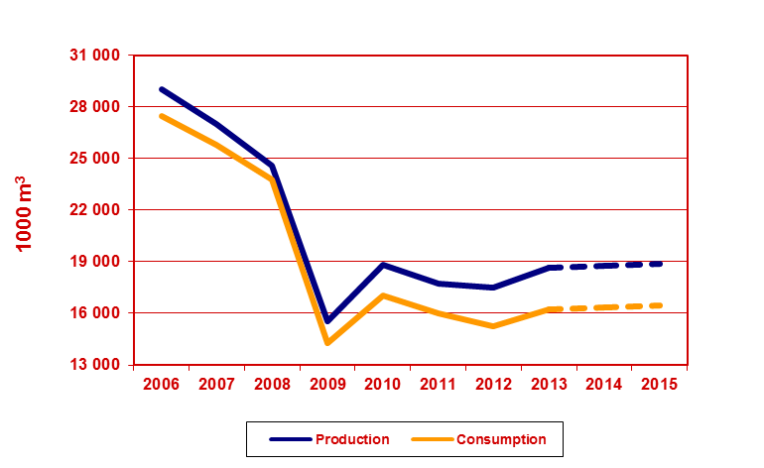
Sawn Hardwood – North America (1)
UNECE Committee on Forests and the Forest Industry, November 2014, Kazan

Slide 21
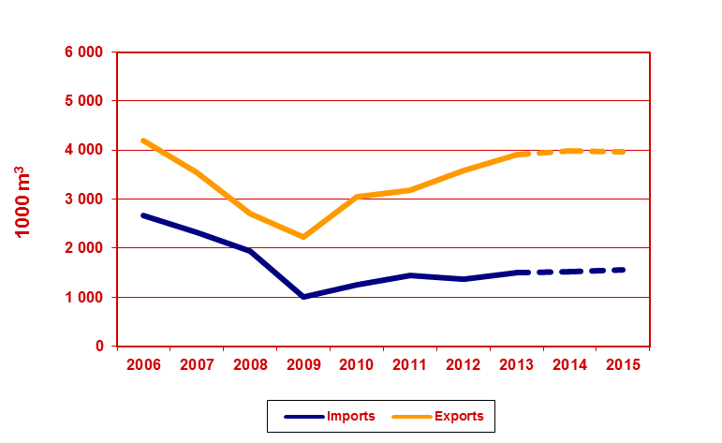
Sawn Hardwood – North America (2)
UNECE Committee on Forests and the Forest Industry, November 2014, Kazan

Slide 22
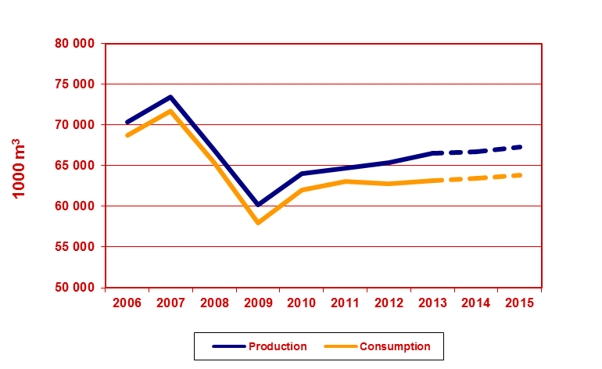
Wood-based Panels - Europe
UNECE Committee on Forests and the Forest Industry, November 2014, Kazan

Slide 23
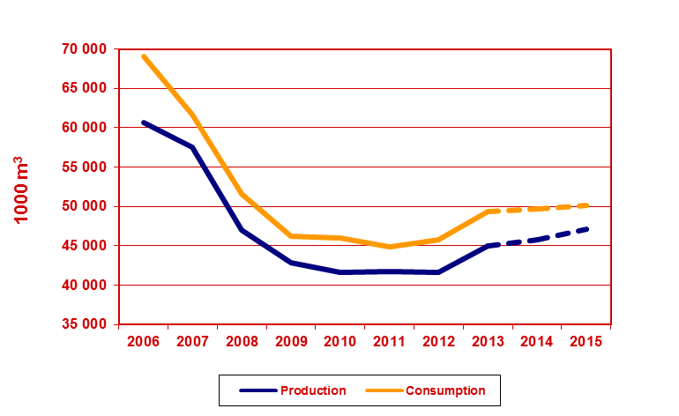
Wood-based Panels – North America
UNECE Committee on Forests and the Forest Industry, November 2014, Kazan

Slide 24
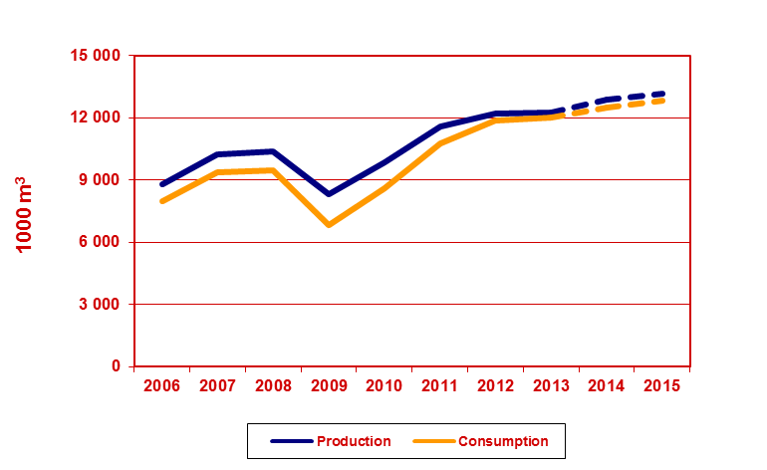
Wood-based Panels – Russian Federation
UNECE Committee on Forests and the Forest Industry, November 2014, Kazan

Slide 25
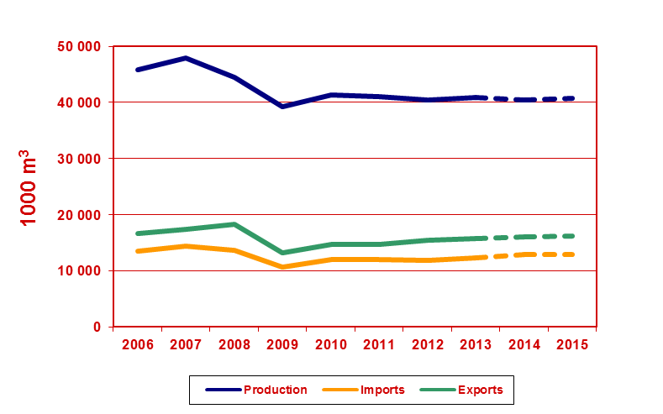
Particle Board (including OSB) – Europe
UNECE Committee on Forests and the Forest Industry, November 2014, Kazan

Slide 26
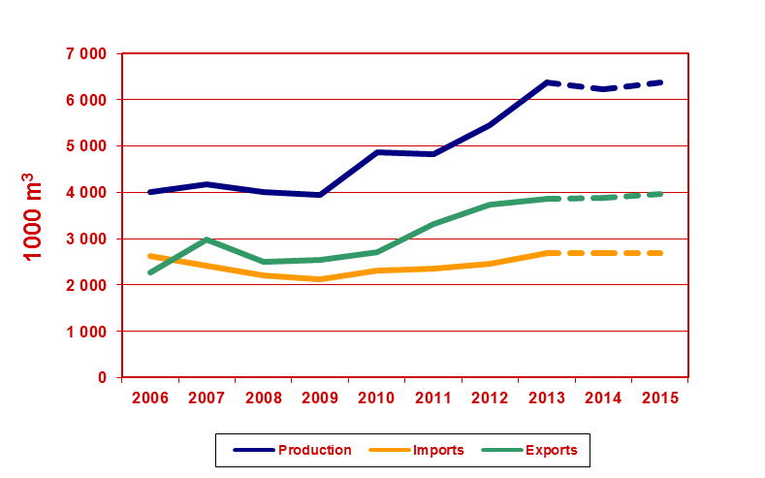
OSB – Europe
UNECE Committee on Forests and the Forest Industry, November 2014, Kazan

Slide 27
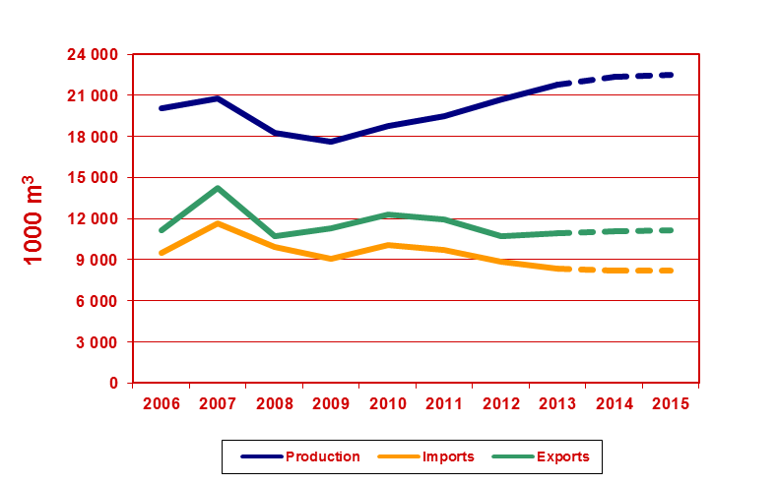
Fibreboard – Europe
UNECE Committee on Forests and the Forest Industry, November 2014, Kazan

Slide 28
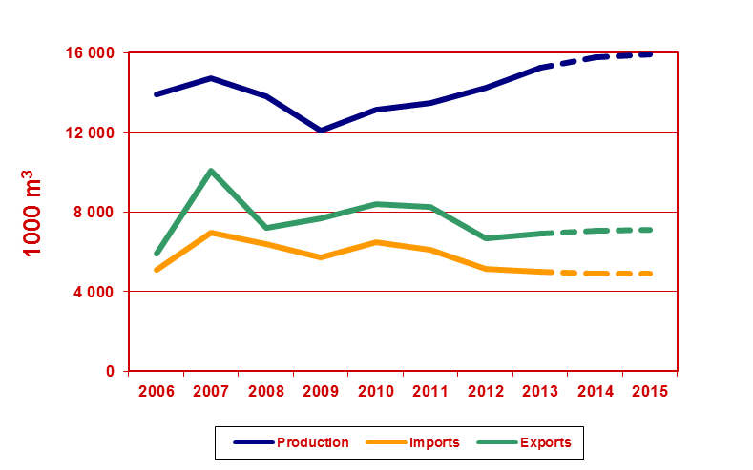
MDF – Europe
UNECE Committee on Forests and the Forest Industry, November 2014, Kazan

Slide 29
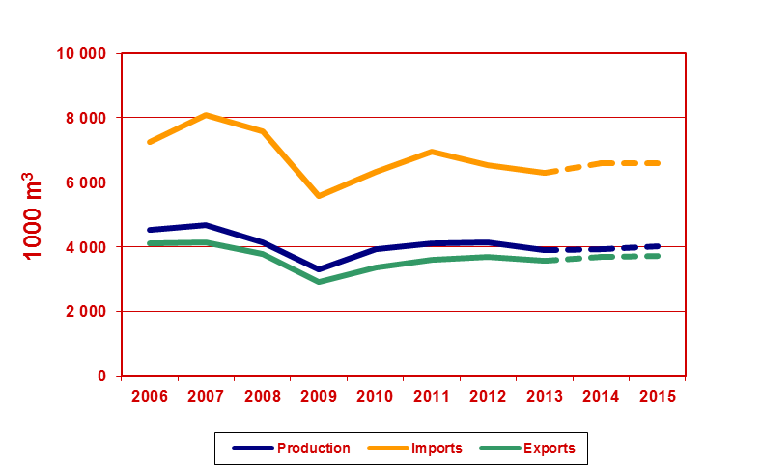
Plywood – Europe
UNECE Committee on Forests and the Forest Industry, November 2014, Kazan

Slide 30
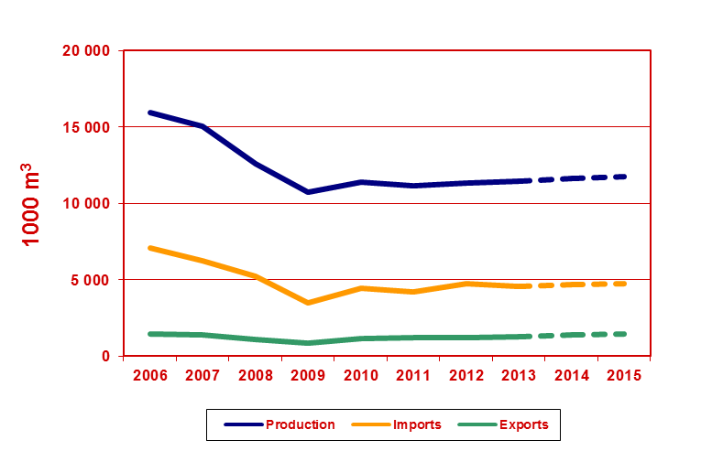
Plywood – North America
UNECE Committee on Forests and the Forest Industry, November 2014, Kazan

Slide 31
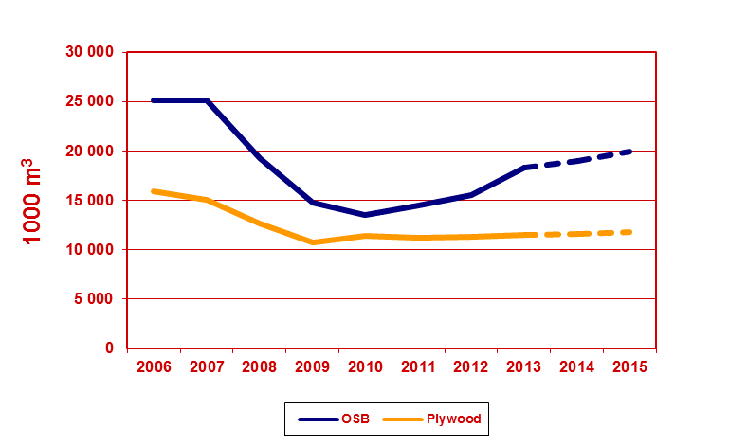
Structural Panel Production – North America
UNECE Committee on Forests and the Forest Industry, November 2014, Kazan

Slide 32
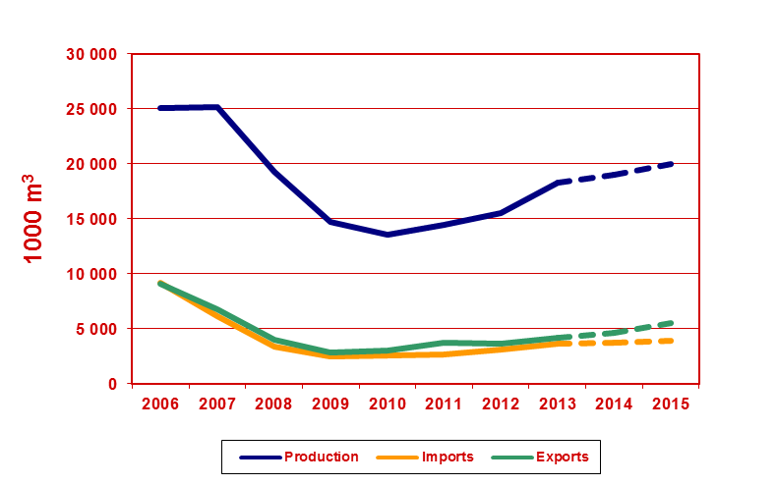
OSB – North America
UNECE Committee on Forests and the Forest Industry, November 2014, Kazan

Slide 33
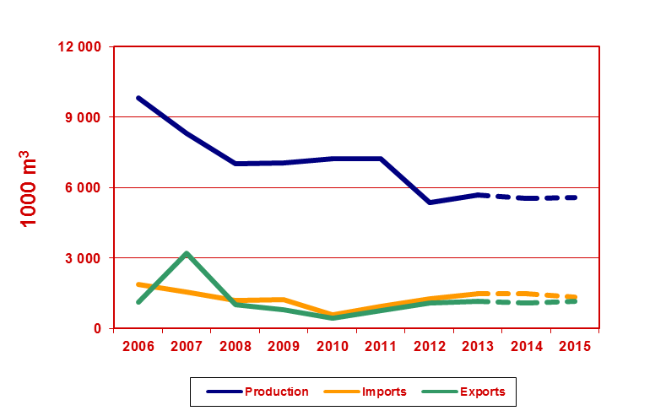
Particle Board (excluding OSB) – North America
UNECE Committee on Forests and the Forest Industry, November 2014, Kazan

Slide 34
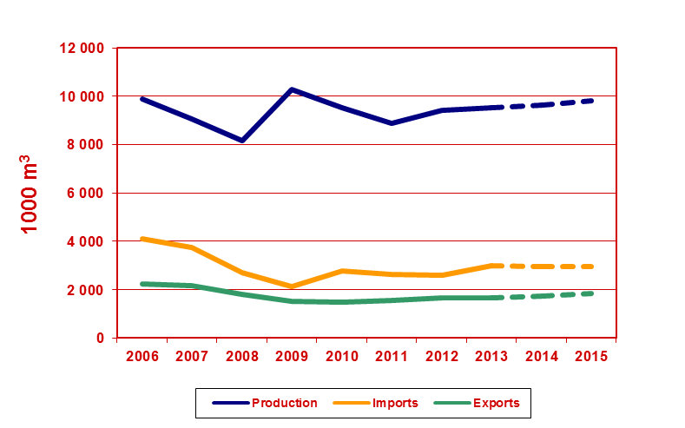
Fibreboard – North America
UNECE Committee on Forests and the Forest Industry, November 2014, Kazan

Slide 35
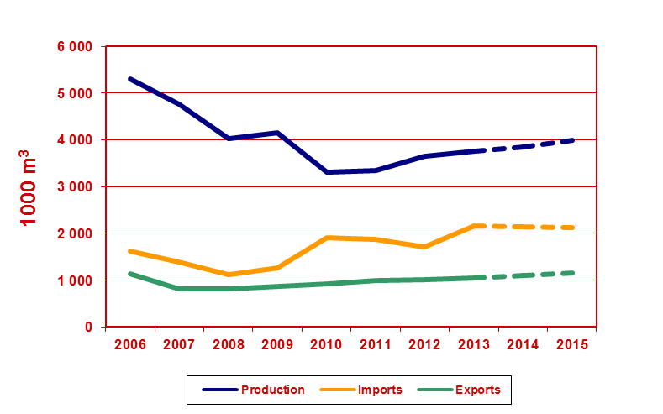
MDF – North America
UNECE Committee on Forests and the Forest Industry, November 2014, Kazan

Slide 36
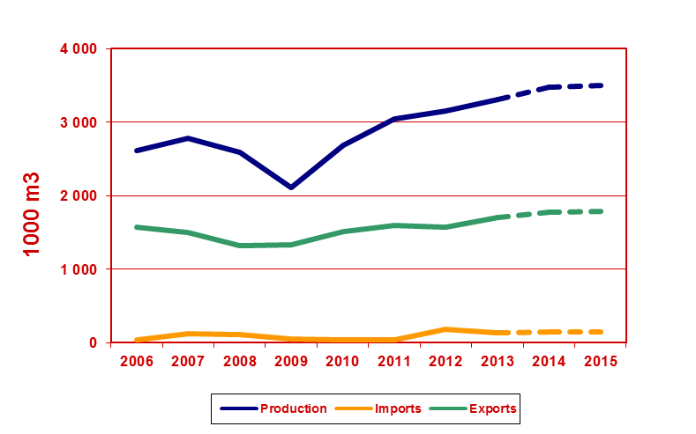
Plywood – Russian Federation
UNECE Committee on Forests and the Forest Industry, November 2014, Kazan

Slide 37
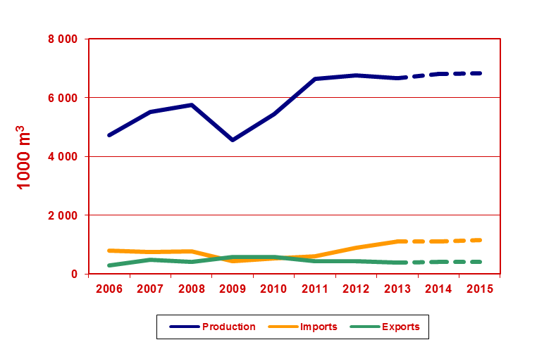
Particle Board – Russian Federation
UNECE Committee on Forests and the Forest Industry, November 2014, Kazan

Slide 38
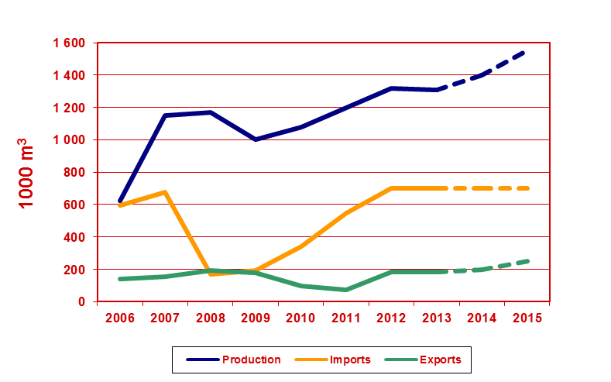
MDF – Russian Federation
UNECE Committee on Forests and the Forest Industry, November 2014, Kazan

Slide 39
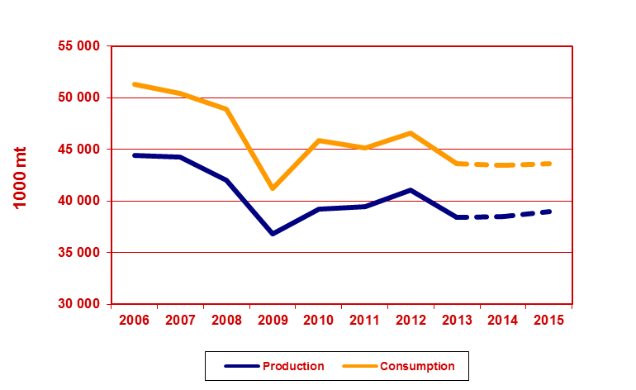
Wood Pulp – Europe (1)
UNECE Committee on Forests and the Forest Industry, November 2014, Kazan

Slide 40
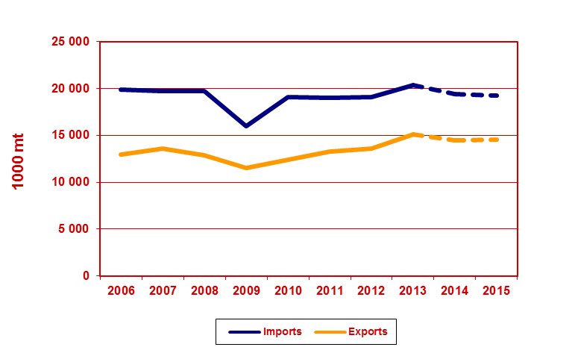
Wood Pulp – Europe (2)
UNECE Committee on Forests and the Forest Industry, November 2014, Kazan

Slide 41
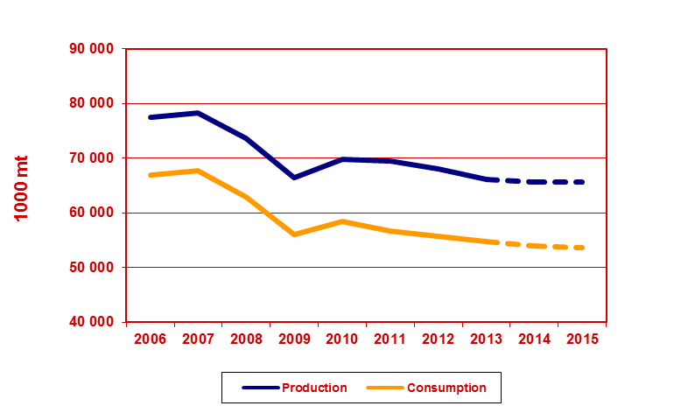
Wood Pulp – North America (1)
UNECE Committee on Forests and the Forest Industry, November 2014, Kazan

Slide 42
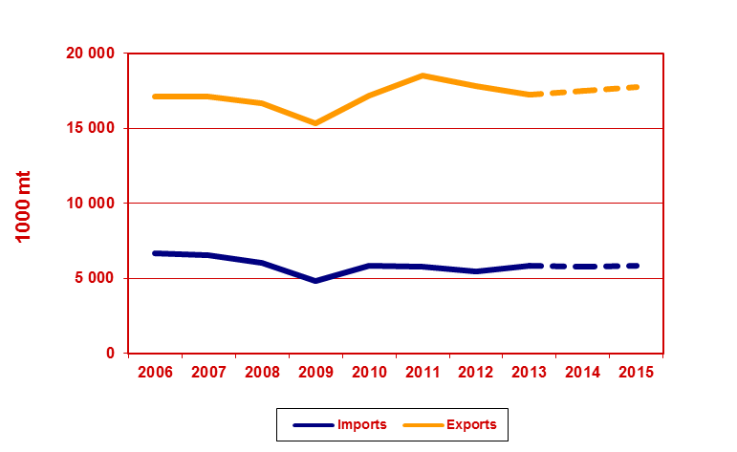
Wood Pulp – North America (2)
UNECE Committee on Forests and the Forest Industry, November 2014, Kazan

Slide 43
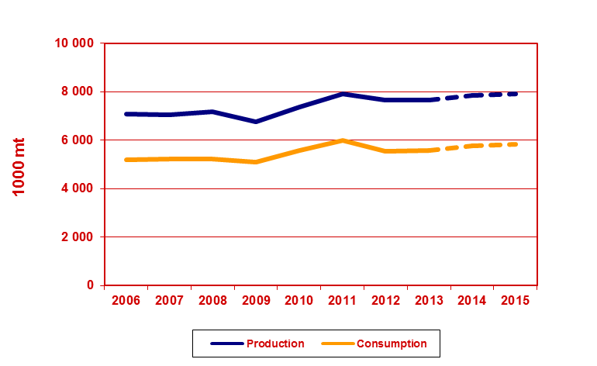
Wood Pulp – Russian Federation (1)
UNECE Committee on Forests and the Forest Industry, November 2014, Kazan

Slide 44
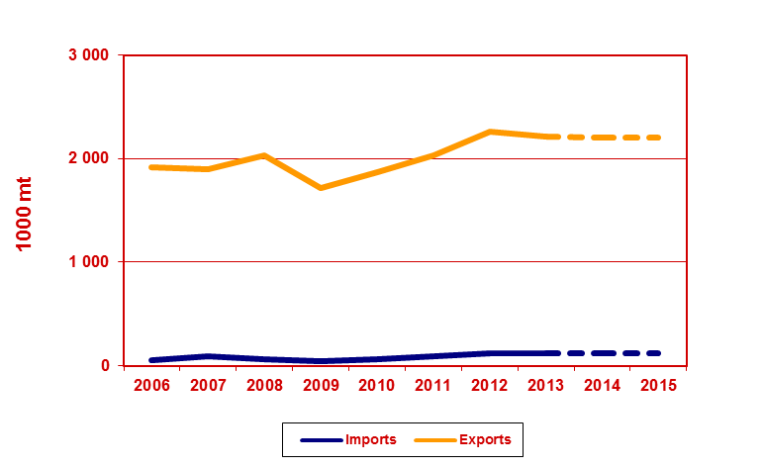
Wood Pulp – Russian Federation (2)
UNECE Committee on Forests and the Forest Industry, November 2014, Kazan

Slide 45
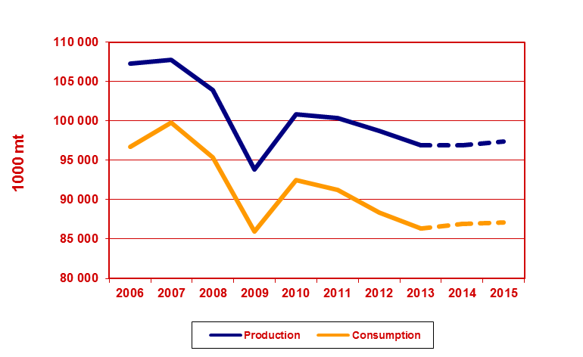
Paper and Board – Europe (1)
UNECE Committee on Forests and the Forest Industry, November 2014, Kazan

Slide 46
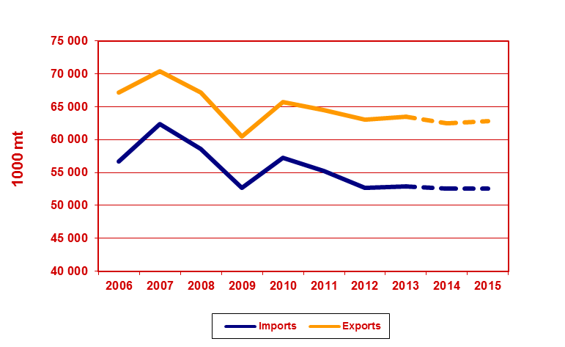
Paper and Board – Europe (2)
UNECE Committee on Forests and the Forest Industry, November 2014, Kazan

Slide 47
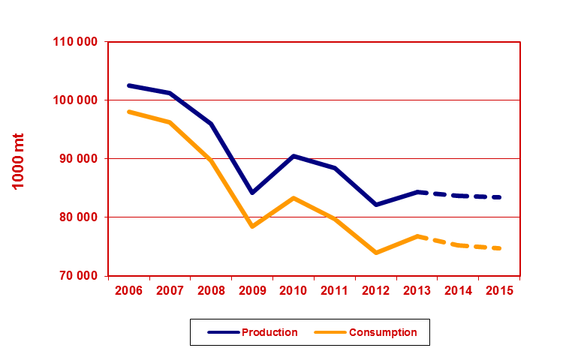
Paper and Board – North America (1)
UNECE Committee on Forests and the Forest Industry, November 2014, Kazan

Slide 48
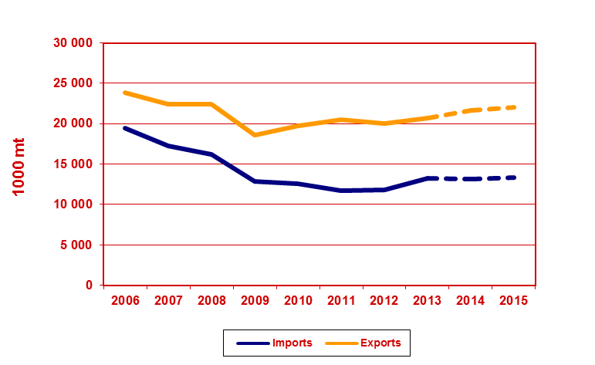
Paper and Board – North America (2)
UNECE Committee on Forests and the Forest Industry, November 2014, Kazan

Slide 49
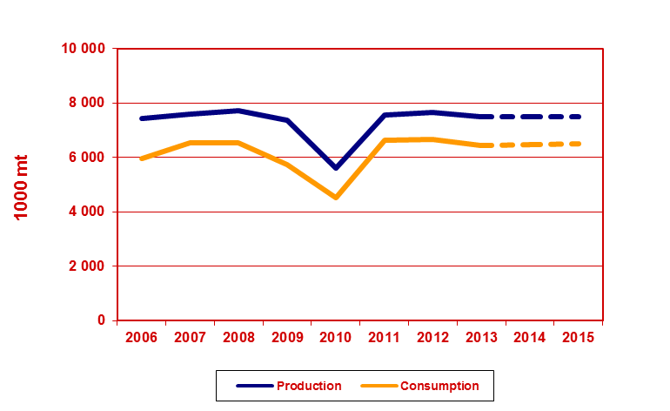
Paper and Board – Russian Federation (1)
UNECE Committee on Forests and the Forest Industry, November 2014, Kazan

Slide 50
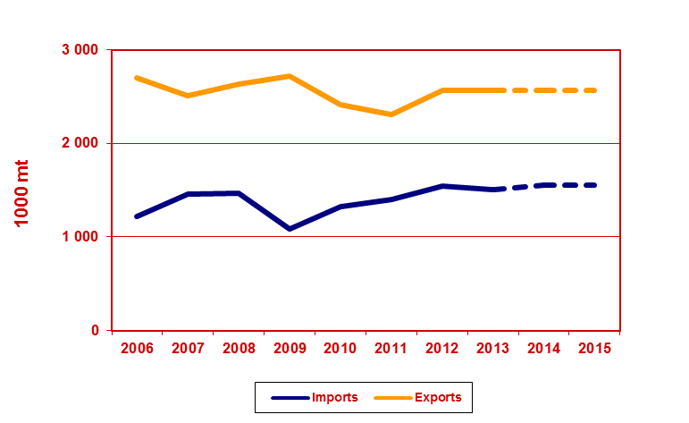
Paper and Board – Russian Federation (2)
UNECE Committee on Forests and the Forest Industry, November 2014, Kazan

Slide 51
Contact
For additional information
please contact Alex McCusker
+41 (22) 917-2880 stats.timber@unece.org

