Slide 1
Fresh fruit and vegetable exports from Greece: solutions
Summary of identified challenges

Slide 2
Programme of the day
Time | Subject
09:00-09:15 | Welcome - Representative UN ECE Presentation of participants
09:15-09:30 | Purpose and scope of the meeting Dr Heiner Lehr
09:30-10:00 | Summary of initial workshop and identified challenges Dr Heiner Lehr
10:00-11:00 | International good practice as benchmarks for Greece Part I EXPORT PROMOTION BOARDS COOPERATIVES as models to get economies of scale Dr Heiner Lehr
11:00-11:30 | Coffee break
11:30-13:00 | International good practice as benchmarks for Greece Part II EXTENSION SERVICES ELECTRONIC SUPPY CHAIN TRANSPORT AUTOMATION AND SCHEDULING OF INSPECTIONS Dr Heiner Lehr
14:00-14:30 | Light Lunch
14:30-16:00 | Discussion of solutions Dr Heiner Lehr
16:00-16:20 | The smarter food vision Dr Heiner Lehr
16:20 | Closure Representative UN ECE

Slide 3
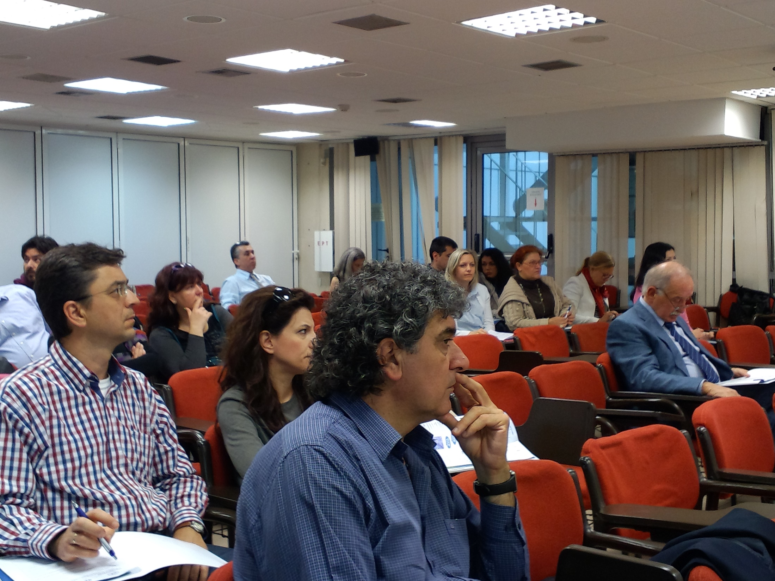
Workshop May 6th 2014
A one day workshop was held on May 6th, 2014 in Athens
27 persons attended the workshop
Exporters fresh fruit, canned tomato exporters
DAOK inspectors and other MRDF personnel
Logistics companies and associations
Pan-hellenic export association
State chemical laboratory
Customs representatives
Bank/insurance companies
TFGR
UN ECE and other
The exporters dealt in
Fresh grapes to UK and Central Europe (family company)
Fruits in general to diverse destinations both EU and 3rd countries

Slide 5
List of identified issues in the workshop
Exporters are not always aware of latest improvement in procedures and technologies (ICISNET, approved exporter, freedom of choosing customs broker,…)
Action: exporters to better follow up on regulatory improvements and invest in capacity building; reduce reliance on intermediaries
MRDF requires customs to make 100% document checks if a CC/EC has been issued.
Action: find ministerial decree; check whether CC exports can be run through the standard Customs risk assessment
Logistics and transport costs are high; transport capacity during peak harvest season is limited.
Action: Joint WG on between Ministry of Transport, Exporters association and 3LP to discuss costs, alternative modes of transport, economies for scale,…

Slide 6
List of identified issues in the workshop
Until now exporters phone DAOK on the spot to schedule inspections. This creates capacity bottlenecks in DAOK.
Action: In the future exports should use the electronic system to schedule in advances.
Warehouses would have big advantages for Greek fresh fruits and vegetable exporters (logistics, purchasing of transport capacity during high season, regrouping of cargo for SMEs, ..)
Action: Exporters and 3PL should discuss possibility of warehouses in core areas (perhaps starting at Thessaloniki and Athens).
Greek agricultural products have certain weaknesses (small producers, climate, energy costs, distance to markets, strong competitors etc.). There are certain strengths (quality and taste of Greek products, good reputation on the market, small producers and stakeholders, ...).
Action: Look whether weaknesses can be turned into strength (organic food, corporate social responsibility (CSR) in production, branding of Greek products, new varieties, …)

Slide 7
Discussion items
LOGISTICS
Exporters estimated that for watermelons, transport costs are about 10-30% of sales price. For higher value fruits, the percentage is somewhat lower. For canned peaches the transport costs are about 11-20% of the sales price.
Availability of transport – in particular overland transport – is also an issue. For smaller producers it is very difficult to obtain transport in peak season, given that there are only about 2,000 export trucks in Greece. The estimated need (peak season) is about 10,000 trucks. This also drives the transport cost, in addition to unusually high toll road costs for inner Greek transport (250€ for transport from Thessaloniki to Athens).
Additional question or comments
What about sea transport? Why is the time to arrange sea transport so high?

Slide 8
Discussion items
TRAINING/AWARENESS ON NEW CUSTOMS PROCEDURES
Since about 95% of customs transactions are made by customs brokers, exporters are shielded from the new developments in Customs and have little knowledge about them.
Exporters expressed a need to better understand the new procedures in order to better understand the requirements and also evaluate their use of external service providers.
Additional question or comments

Slide 9
Discussion items
INTEROPERABILITY
While bureaucracy was cited as a general obstacle to export, it became clear that exporters were quite satisfied with the progress already made in the last times.
One exporter even stated categorically that he had no issue with the administrative process at all now.
The level of documentary checks requested by MRDF and other Ministries was mentioned as a burden to the process.
It is hoped that by sequentially integrating the different Ministries that the rate of documentary check of 100% for fresh fruits and vegetables can be lowered at least to the standard rate of about 30-40%, depending on the product category.
Additional question or comments

Slide 10
Discussion items
EXPORT COSTS AND AVAILABILITY
No conclusion was reached on the cost of export. The data presented in the kiwi BPA was challenged by both the exporters and the logistic providers. Also the need for cold treatment equipment was challenged, given that refrigerated containers are available. It was suggested to reconsider these costs.
Export costs can vary dramatically with the size of the commitment the exporter can make and the season. A truck to Poland out of season can cost about 3,000€, whereas in season it can cost 4,500€.
It was suggested to consider building distribution centres and logistic platforms where smaller exporters could join forces and auction larger amounts of transport off. Such platforms could also consider other modes of transport, such as cargo planes if enough exporters join forces.
A general issue with logistics is the large trade imbalance which has the natural consequences that trucks spend more time outside of Greece (waiting for a suitable load back) than inside Greece.

Slide 11
Discussion items
SCHEDULING OF INSPECTIONS
A critical process in the export timeline is the visit of inspectors.
Since many 3rd countries request a phyto-sanitary certificate that in turn requires a physical inspection, an efficient scheduling is important.
Exporters agreed that they could pre-schedule visits 3-7 days in advance in most of the cases.
Scheduling could be also done on fixed time slots where an inspector visits an exporter every day at a fixed time and inspects all those cargoes ready for inspection or simply by filing an inspection request 3-7 days in advance and having expert dispatchers that organise schedules efficiently.
Additional question or comments

Slide 12
Discussion items
MARKETING AND MARKET DIFFERENTIATION OPPORTUNITIES
The need for market intelligence, research and export promotion was highlighted.
Since Greece has many smaller food businesses, market intelligence is not generally available in particular when it comes to market needs and preferences, e.g. on social responsibility, carbon footprint, organic food.
There is very little practical research that smaller producers and exporters can benefit from and there is no common export promotion that provides a marketing platform for Greek products in the exterior world.
Additional question or comments

Slide 13
Additional export issues identified by Greek experts
FINANCIAL
Availability of credit letters
Return of VAT
SECTOR INTERNAL
No investment in equipment and as a result:
Inability to satisfy large orders
Lack of reliability in order delivery
No economy of scale due to small players
EXTERNAL
Access to transport
Cost of transport
KNOWLEDGE AND SUPPORT
Lack of understanding of choices in certification and measure to be taken
No extension services to guide producers

Slide 14
Need for policy
It was agreed that a targeted policy is needed for economy of scale, marketing and in general turning the characteristics of the sector into an advantage.
UN ECE has developed a holistic strategy called the Smarter Food Single Window that can serve as a basis for discussion.

Slide 15
List of benchmark items
The Operational Steering Committee decided to look into the following items for international benchmarking:
EXPORT PROMOTION BOARDS
COOPERATIVES as models to get economies of scale
EXTENSION SERVICES
ELECTRONIC SUPPLY CHAIN
TRANSPORT
AUTOMATION AND SCHEDULING OF INSPECTIONS

Slide 16
Thank you for your attention!
Dr Heiner Lehr
Syntesa Partners & Associates
heiner@syntesa.eu

