Slide 1






R(EU) 543/2011
Checks on conformity to FFV Marketing Standards

Slide 2

Checks on conformity
Checks on conformity to marketing standards will be carried out at all marketing stages, in order to verify that products are conformed to MS.
The conformity checks are carried out selectively, based on a risk analysis, and with appropriate frequency, to ensure the compliance with the marketing standards.

Slide 3
Responsibilities
EU and Internal Market Inspection
- Responsibility: shared by Soivre and Regional Inspection Bodies.
- Place: Companies (Packing stations)
Third countries inspection (export – import)
Lots inspection
- Responsibility: Soivre.
- Places: Packing Stations and Border Inspection Points.

Slide 4

What checking ?
- Documents
(Identity/marking: origin, classification, amount, dispatcher)
- Products
- FFV Marketing Standard

Slide 5

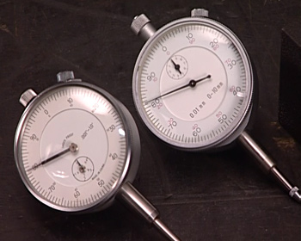
Marketing standards
  EU Standard R(EC) 543/2011
  - Specific Marketing Standard
  (10 products: apples, citrus, kiwi, lettuces-endivias, peaches-nectarines, pears, strawberries, sweet peppers, table grapes, tomatoes)
  - General Marketing Standard
  UNECE
  56 FV Standards (not compulsory)

Slide 6

Whom?
Traders’ Database
Packers.
Wholesalers at origin.
Wholesalers at destination.
Importers.

Slide 7

Conformity Check Programme
Different visit frequencies
Priority to high risk traders
Inspection records are entered into traders database system
Problems found on visits to traders are taken into account in traders classification.
Surveillance based on signal, disappointing results.
Frequency

Slide 8
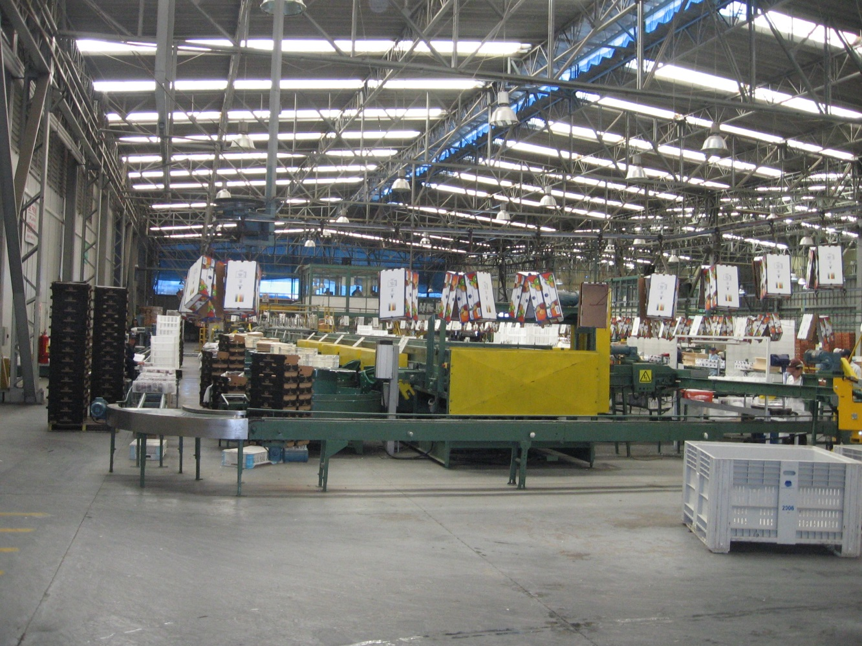
Where?
Pack Stations

Slide 9
Pack Station
Inspection
Act

Slide 10
Labelling
Presentation
Quality
Category
Size

Slide 11
Approved traders Scheme
Member States may authorise traders classified in the lowest risk category and providing special guarantees on conformity to marketing standards to use a logo in the labelling of each package at the stage of dispatch and/or to sign the conformity certificate.

Slide 12
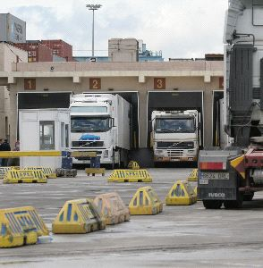
Where?
Border Inspection Points
(Ports, Airports)
BIPs Official Services in charge
- Custom Service
- Human Health Official Service
- Plant Health Service
- Livestock Health Service
- Soivre

Slide 13

Why?
Certificate of conformity
The Certificate of conformity is the compulsory document in foreign trade of FFV according to R(EU) 543/2011
Certificates of conformity can only be issued by a competent authority to confirm that the products concerned conform to the relevant marketing standard.
The certificates may be issued either in paper format with original signature or in verified electronic format with electronic signature.

Slide 14
Third countries conformity checks
- The Commission may approve checks on conformity to specific marketing standards carried out by that third country prior to import into Union.
- The approval may only apply to products originating in the third country concerned and may be limited to certain products.
- The third countries approved, and the products concerned, shall be set out in Official Publications of Comission.
- The approval will be considered as a criteria of low risk.

Slide 15
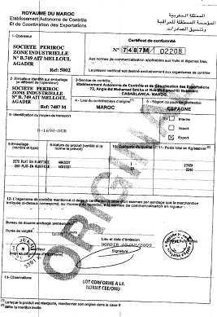

Slide 16
sampling
How?

Slide 17
Sampling procedure

Slide 18
UNE 66020-1:2001 SAMPLING PROCEDURES FOR INSPECTION BY ATTRIBUTES. PART 1: SAMPLING SCHEMES INDEXED BY ACCEPTANCE QUALITY LIMIT (AQL) FOR LOT-BY-LOT INSPECTION.
Acceptable Quality Level (AQL) is limit of a satisfactory process average at particular quality level when a continuing series of lot is considered
  Acceptance quality limit (AQL) 10 %
  Packaging - Labelling
  Quality – Sizing
  Requierements
  Acceptance quality limit (AQL) 6.5 %

Slide 19
SAMPLING PROCEDURE
Lot: 25.000 units ----- 1st sample: 5 units
2nd sample: When 1 faulty unit is detected in 1st sample, a 2nd sample of 5 units is taken.
Rejection: Faulty units ≥ 2 units out (units total sample).
Tamaño del Lote | Muestra | Tamaño de la muestra | Tamaño acumulado | NCA 6,5% |  | NCA 10%
 |  |  |  | Ac | Rc | Ac | Rc
2 a 150 | Primera | 2 | 2 | 0 | 1
151 a 500 | Primera | 3 | 3 | 0 | 2 | 0 | 2
 | Segunda | 3 | 6 | 1 | 2 | 1 | 2
501 a 35.000 | Primera | 5 | 5 | 0 | 2 | 0 | 3
 | Segunda | 5 | 10 | 1 | 2 | 3 | 4
35.001 en adelante | Primera | 8 | 8 | 0 | 3 | 1 | 3
 | Segunda | 8 | 16 | 3 | 4 | 4 | 5

Slide 20
Inspection Process
Human Health
Lot
Inspection
SOIVRE
Plant Health
DISPATCH CODES
CUSTOM INSPECTION

Slide 21
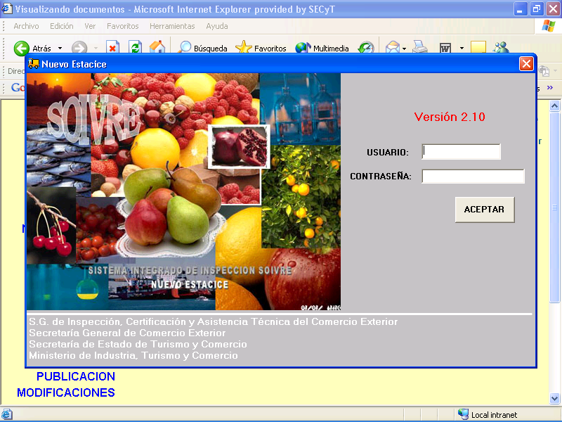
Integrated Inspection System ESTACICE
Notes:
Importers and exporters (from/to third countries) have to request quality inspection for all import and export lots. They send the request via Internet through a specific electronic application named ESTACICE, to the SOIVRE regional office where the import/export is going to be done.

Slide 23
SOIVRE Custom Clearance System

Slide 24

Re-inspection
Company differs in opinion with SOIVRE inspector report.
Head inspector must be informed.
Performing of new inspection based upon the marked samples of the first inspection and a new sample to obtain a higher accuracy.

Slide 25

Acceptance of declarations by customs
Customs may only accept export declarations and/or declarations for release for free circulations for the products subject to specific marketing standards.
The competent inspection body has informed the customs authority that the lots concerned have been issued a conformity certificate or they do not need to be checked in the light of risk assesment.

Slide 26

Inspection system
Software support tools

Slide 27
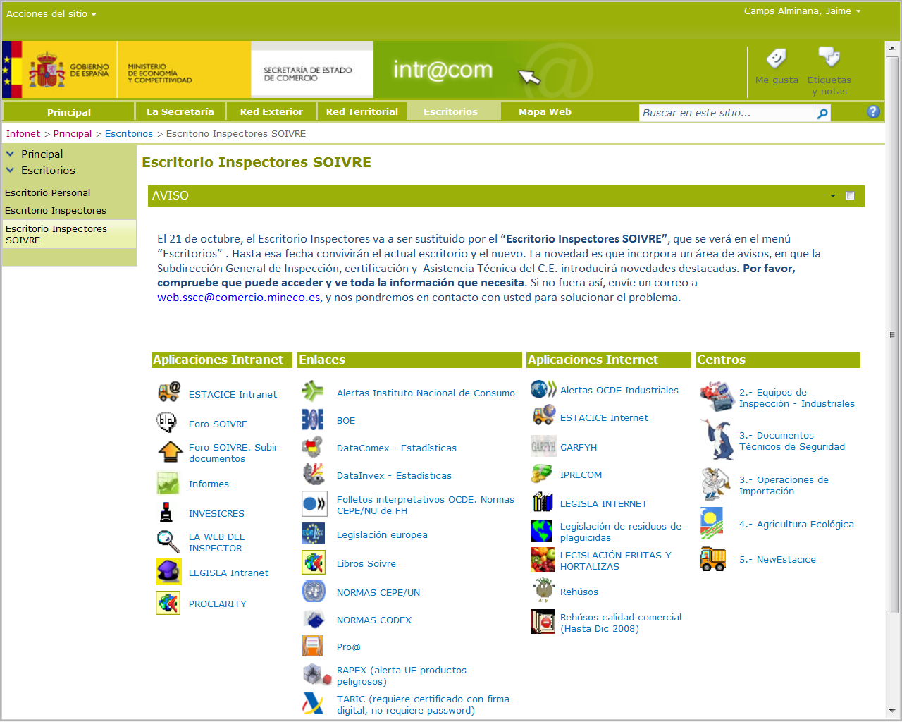
Inspection software support tools
The Inspectors’ Desk

Slide 28
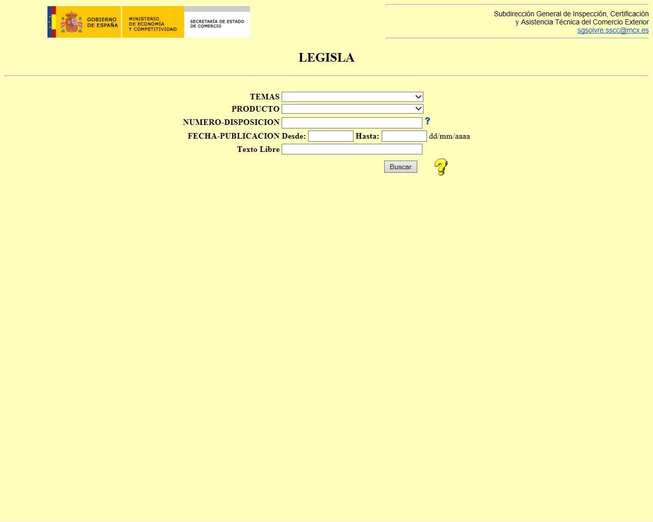
Software support tools
LEGISLA
A database of specific legislation, standards, instructions, newsletters, campaigns reports

Slide 29
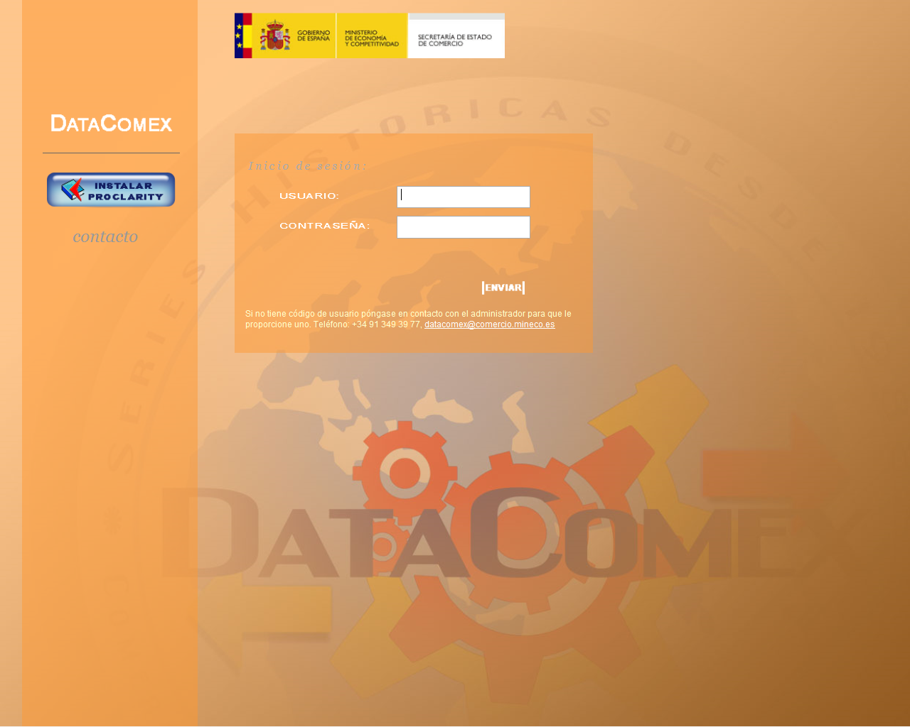
Software support tools
PROCLARITY - Datacomex
Statistic tool

Slide 30
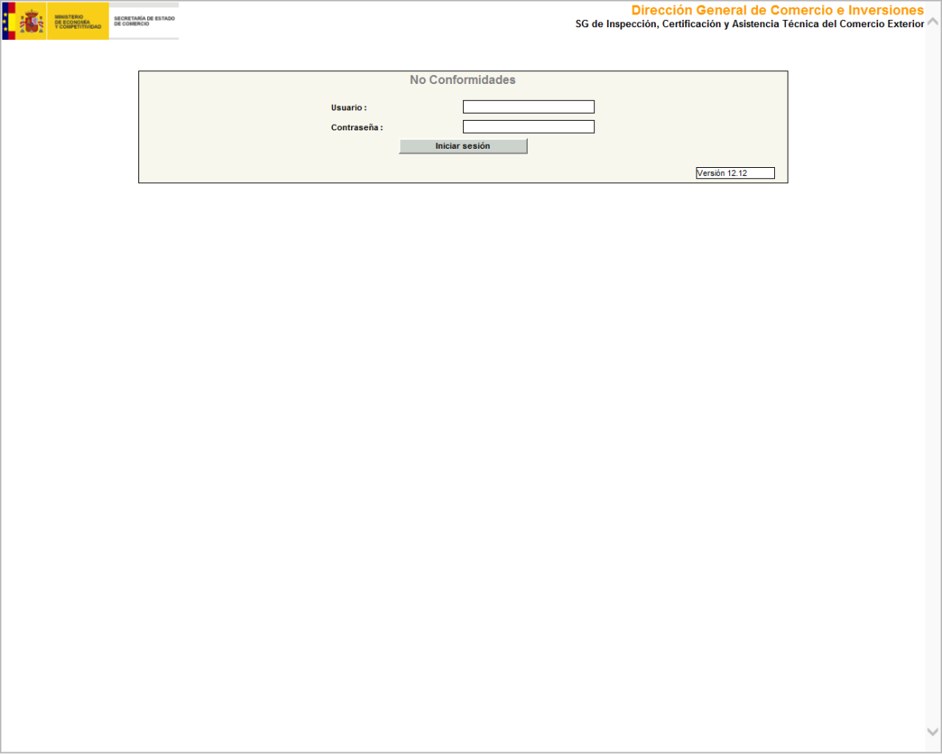
Software support tools
Non conformity notifications

Slide 31
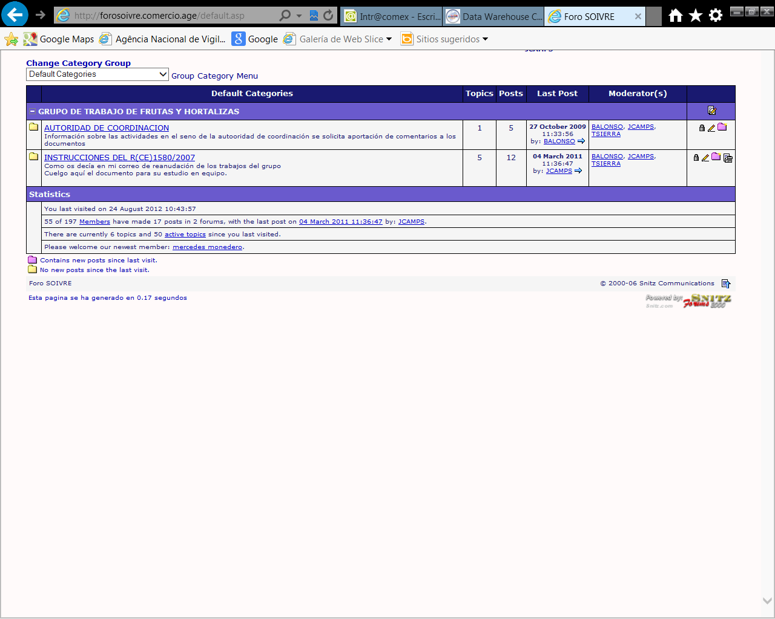
Software support tools
Inspectors’ forum
Notes:
forum through the Web where doubts and consultations may be posted and answers become harmonized actions

Slide 32
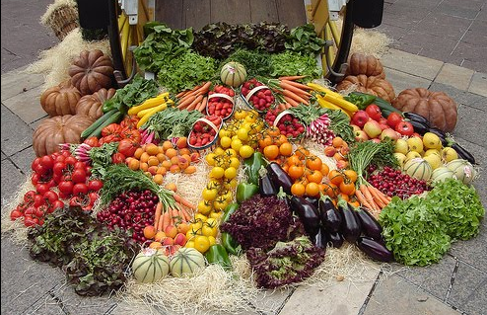
Thank you for your attention.
SOIVRE

