Slide 1
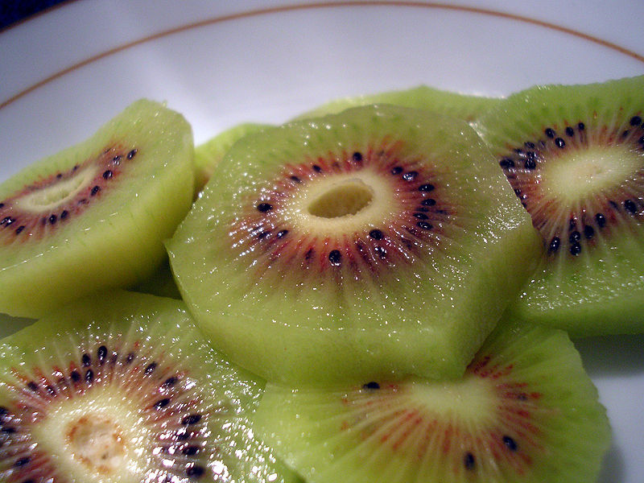
Fresh fruit and vegetable exports from Greece: challenges
Mapping of the fresh fruit and vegetable supply chain

Slide 2
Programme of the day
Time | Subject
09:00-09:15 | Welcome - Representative UN ECE Presentation of participants
09:15-09:30 | Purpose and scope of the meeting Dr Heiner Lehr
09:30-10:00 | Mapping / Presentation of the fresh fruit and vegetable supply chain. Dr Heiner Lehr
10:00-10:50 | Electronic export processes (Joint presentation) for Fresh Fruits and Vegetables Pre customs : Electronic quality certification processes with Meno 2.0 Representative MRDF Customs :Electronic processes with ICISnet Representative Customs
10:50-11:00 | Coffee break
11:00-11:30 | Findings based on BPA ‘s : Kiwi ,Olive Oil , Peach ( export chain with basic timeline) Dr Heiner Lehr
11:30-14:00 | Discussion of export chain and identification of challenges Facilitator: Dr Heiner Lehr
14:00-14:30 | Light Lunch
14:30-15:30 | Presentation preliminary competitiveness analysis Dr Heiner Lehr
15:30-17:00 | Identification of crucial influencing factors towards (a) Time to Export (b) Cost to Export Discussion possible solutions / Next Steps Facilitator: Dr Heiner Lehr
17:00 | Closure Representative UN ECE

Slide 3
Supply chain
Primary production
Primary production
Primary production
Traders?
Packing house and exporter
MRDF
Logistics providers
Greece
Customs
Banks
Customs
Destination
Importer
Retail
Retail
Retail

Slide 4
Export processes
Quality certificate
Electronic system: Meno
Phyto-sanitary certificate
fruit sensors calibration document
Certificate of origin
Export permit
Electronic system: ICISnet

Slide 5
Target countries
Which target countries to include?
Important business partners | Important prospects
Russia | China

Slide 6
Thank you for your attention!
Dr Heiner Lehr
Syntesa Partners & Associates
heiner@syntesa.eu

