Slide 1

Fresh fruit and vegetable exports from Greece: challenges
Preliminary competitiveness analysis

Slide 2
Programme of the day
Time | Subject
09:00-09:15 | Welcome - Representative UN ECE Presentation of participants
09:15-09:30 | Purpose and scope of the meeting Dr Heiner Lehr
09:30-10:00 | Mapping / Presentation of the fresh fruit and vegetable supply chain. Dr Heiner Lehr
10:00-10:50 | Electronic export processes (Joint presentation) for Fresh Fruits and Vegetables Pre customs : Electronic quality certification processes with Meno 2.0 Representative MRDF Customs :Electronic processes with ICISnet Representative Customs
10:50-11:00 | Coffee break
11:00-11:30 | Findings based on BPAs: Kiwi, Olive Oil , Peach ( export chain with basic timeline) Dr Heiner Lehr
11:30-14:00 | Discussion of export chain and identification of challenges Facilitator: Dr Heiner Lehr
14:00-14:30 | Light Lunch
14:30-15:30 | Presentation preliminary competitiveness analysis Dr Heiner Lehr
15:30-17:00 | Identification of crucial influencing factors towards (a) Time to Export (b) Cost to Export Discussion possible solutions / Next Steps Facilitator: Dr Heiner Lehr
17:00 | Closure Representative UN ECE

Slide 3
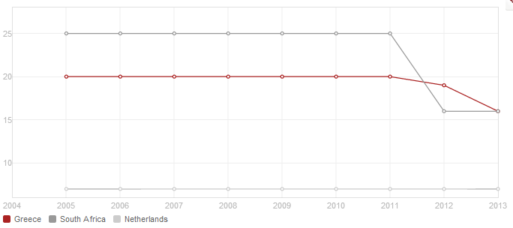
Time to export
© 2014 The World Bank Group, All Rights Reserved.

Slide 4
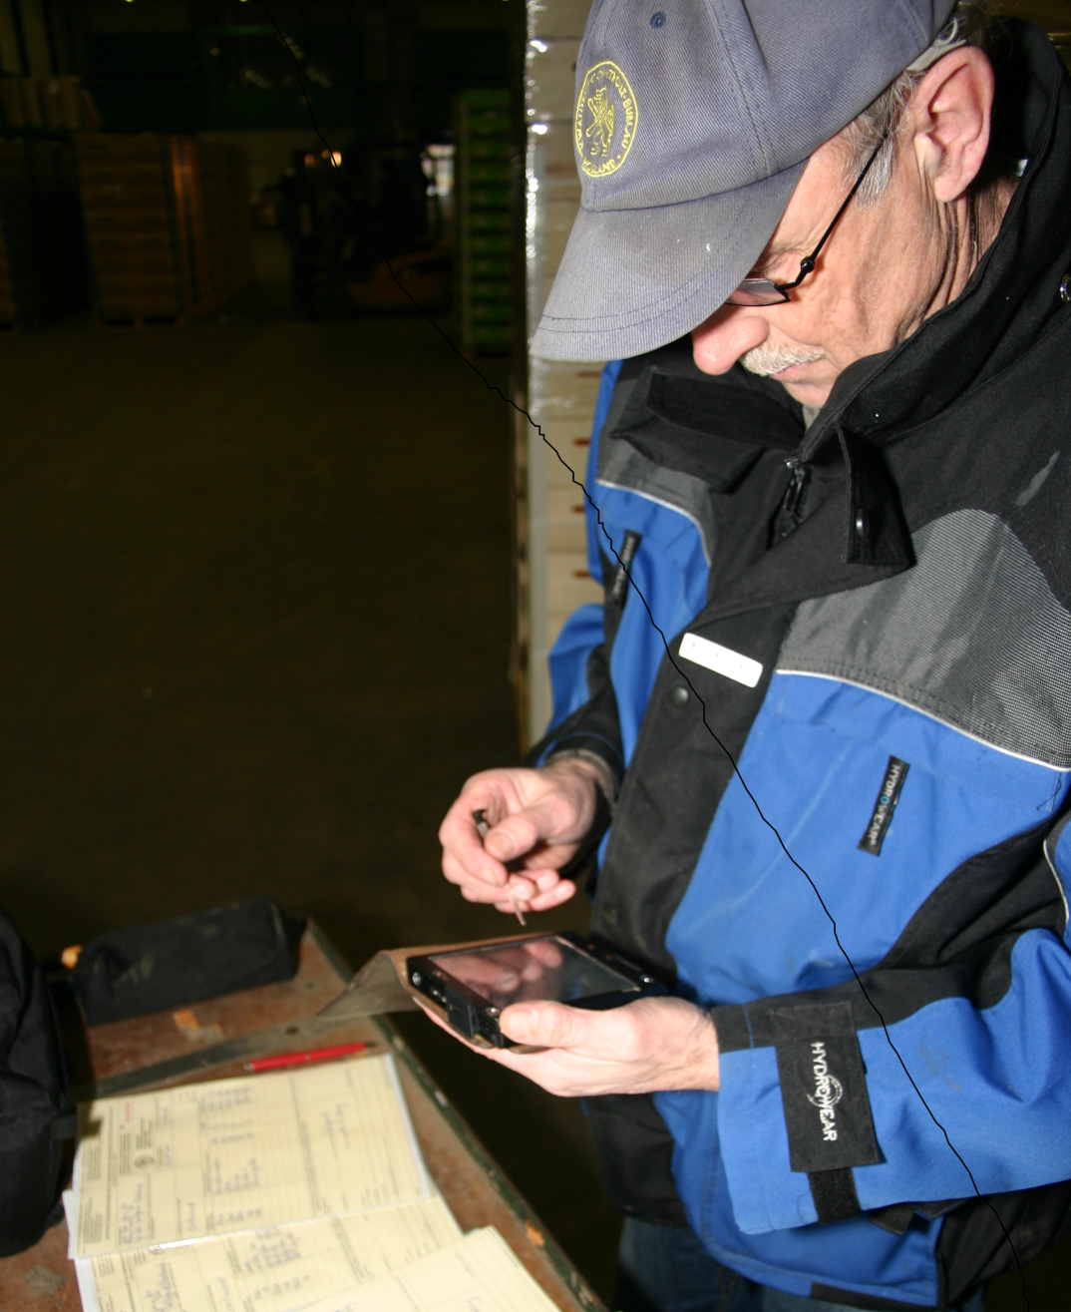
OVERVIEW ICT KCB.
Martin Waasdorp
2014.

Slide 5
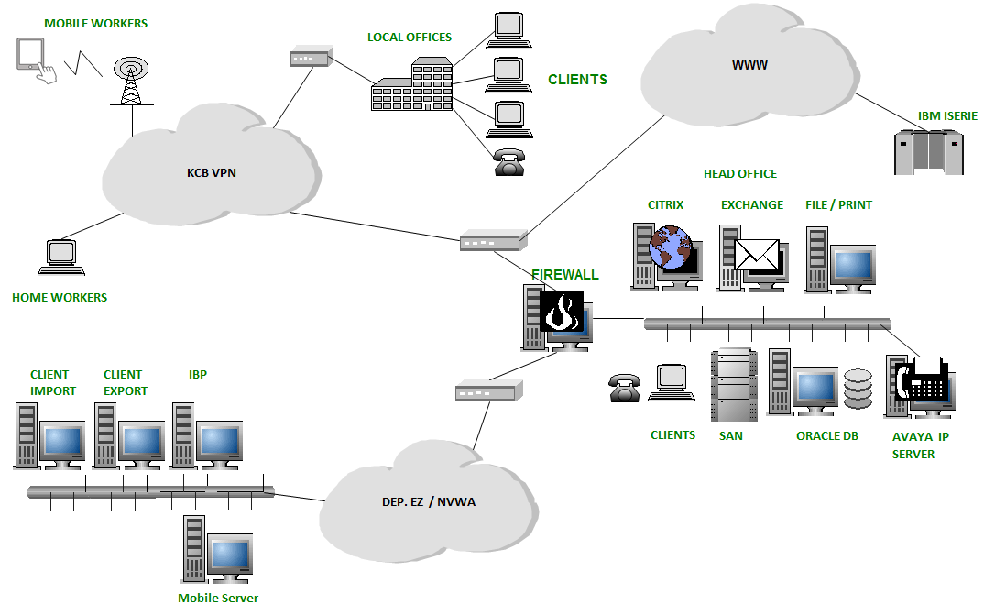
ICT LANDSCAPE KCB : INFASTRUCTURE

Slide 6
ICT LANDSCAPE KCB : INFORMATIONSYSTEMS
TASK
IMPORT | INTERNAL MARKET | EXPORT | QUALITY MANAGEMENT SYSTEM
CLIENT IMPORT CLI | DATABASE TRADERS AND GROWERS DMD | CLIENT EXPORT CLE
INSPECTION MANAGEMENT SYSTEM IBP
MOBILE INSPECTION REPORT MIR
TIME REGISTRATION SYSTEM PTS
BILLING SYSTEM FAC
FINANCIAL SYSTEM FMS
SUPPORTING
SYSTEMS

Slide 8
CLIENT IMPORT 1
Phytosanitary and quality inspections prior to customs procedures
Risk Analysis (product/country of origin)
Selection of the goods to be inspected
Analysis and selection based on data from the declaration of the goods
Selection of goods - which is based on profiles – is fully automated

Slide 9
CLIENT IMPORT 2
Inspection request sent to Inspection Management System
Non selected shipments will be administrative checked for proper documents and registration in CLIENT import

Slide 10
CLIENT EXPORT
Phytosanitary inspection based on third country demands.
Quality inspections based on EU regulations (EU 543-2011). Analysis and selection on basis of data from the declaration of the shipments (manual)
Electronic handling (partial) of certifcate of conformity (agreement with Dutch Customs).
Uniform edited documents

Slide 11
INSPECTION MANAGEMENT SYSTEM (IBP)
Registration of all inspection requests
Planning of inspection requests
Registration of inspection results
Electronic feedback send to CLIENT-systems
Email feedback to import- en exportcompany

Slide 12
INVOICE SYSTEM FAC
Produces all invoices for KCB .
1250 different customers
20.000 invoices per Year (estimate 2014)
Uploading all data to the Financial system

Slide 13
Peer review 2011
The Netherlands is one of the largest exporters and importers of fruit and vegetables products in the world. The inspection system has to be well organised in order to manage the large volume and diverse fruit and vegetable consignments.
KCB also covers phytosanitary inspection of many products
This system is fully digitalised from the request for inspection to the issuance of certificates.
The system is run by the Ministry for Economic Affairs, Agriculture and Innovation but the daily operation is the responsibility of KCB.
Most traders have a user interface for the IT system Client Import (alternative: fax)
For exports a risk assessment based inspection system is in the introduction phase

Slide 14
Peer review 2011
The consignments which are subject to inspection come into an electronic system where they are associated with inspectors. This planning is done by experienced experts, who take into account the place of inspection, the required type(s) of inspection, the qualification of the inspector and the capacity of the inspectors in charge of the given day.
The electronic system is usually running smoothly. However, during the visit, the central server collapsed and all the system was shut down. In this case, the coordination of inspection has to be done manually, using the traditional method of paper notifications, phone calls, faxes and paper based documentation.
The inspectors automatically receive their daily inspection plan on their PDA. They have to implement the phytosanitary and/or quality inspection of the consignment and fill in the online forms. As a result of a positive inspection, a code is sent to traders via the system. With this code, custom clearance can be done by the trader.
If the result is negative, the inspector puts the consignment on hold. The custom authorities are also informed of this decision.

Slide 15
Quality Control Board
The KCB, the Quality Control Bureau was established in 1924 by Dutch growers and traders.
  The Bureau was established with the primarily task of quality inspection of Dutch fruit and vegetables exports to Western European markets.
As of today, the KCB is still a fully independent body.

Slide 16
Efficiency of inspection
The KCB employs 78 inspectors (June 2011) responsible for quality control of fruit and vegetables before the retail phase. They belong to the Field Service within the organisational structure of the body.
  Fruit and vegetables sector produced EUR 2.6 billion in 2010.
  The sector plays a prominent role in international trade with an export value of EUR 9.3 billion, including re-exports, and an import value of EUR 7.1 billion in 2010.
  In total 15,810 lots were inspected for export in 2010. This corresponds to 2 204 000 tons, of which 1 389 000 tonnes was SMS produce.
  In comparison: Greek exports of fruits and vegetables amounted to 535.5 m€ in 2012
The 87 fruit and vegetable products which are subject to import inspection are also subject to export inspection.
As regards the inspection frequency, consignments with only SMS products or a mix of SMS and GMS products are inspected in 100 percent.
The consignments which contain only GMS products are randomly checked in a 10 percent frequency. However, the risk analysis system can further adjust the inspection frequency; e.g. for approved traders, only five percent of the shipments is subject to inspection.

Slide 17
Inspections
When a consignment is located in a warehouse, the sample boxes are picked randomly from the total number of boxes. If an import consignment is in a transport vehicle, the sample boxes are taken from the first six pallets in the container. All the boxes in the sample are emptied for inspection.
In case of an export inspection, the total consignment must be ready for inspection. If part of the consignment is already in the transport vehicle, the vehicle has to be unloaded again.

Slide 18
Approved traders
The companies must meet the following criteria, in order to participate in the RIK (Reglement Interne Kwaliteitscontrole, Regulation on Internal Quality control) system and become an approved trader:
  To have good inspection results over a period of six consecutive months; this means less than 10% non conformities over this period; and,
  To have an operating quality control system for fruit and vegetables in place that meets the criteria that are laid down in the KCB Quality Code
The quality control system is audited, before a trader gets the RIK approval. During the audit, the KCB examines the design and implementation of the quality control system, the qualifications of the quality inspectors and the maintenance of the system.
In the first year, the company is audited two times, and in the following period only once per year. Any deviation recognised during an audit can eventually lead to the exclusion of companies from the RIK system.
Moreover, in case of severe problems, like manipulation of country of origin, transportation of produce that is in non conformity or repetitive offenses, companies can be excluded.

Slide 19
Quality control of inspections and inspectors
The KCB has an internal auditing system, in order to harmonize inspections between individual staff. The inspectors are audited yearly on each qualification which they hold. The audits are done by the Assistant Specialist of the District Office, who is nominated by the Management. The Assistant Specialists, on their turn, are audited by the Specialists of KKB Department.
Moreover, the KKB Department is analyzing the database with inspection results (IBP) on a monthly basis, in order to check if all inspections are executed by qualified inspectors, and to see the number of non conformities per inspector. Notable cases are discussed with the district manager and the Assistant Specialist in the area.
In case of large errors, an inspector may lose a qualification. This can be regained after sufficient training, followed by examination by the Specialist of the KKB Department.

Slide 20
Costs
The costs of the inspections are invoiced to the market actors.
For imports and exports, KCB applies a standard fee per inspection (for covering administrative and travelling costs), plus a fee per minute for the duration of the inspection (for covering inspection costs).
For Structural Supervision a standard price per year applies per risk category, and the inspector takes a standard time for the duration of the visit depending the type and size of the company.
The standard time varies between 1⅛ and ½ hour: 1⅛ hour in case of a (big) trader or packing house and ½ hour in case of a primary production company.
In case of necessity, the duration of the visit can be extended.

Slide 21
Phytosanitary certificates
South Africa

Slide 22
Phytosanitary Certificates
Sanitary (human and animal health) and phytosanitary (plant health) measures (called Sanitary and Phytosanitary measures or SPS measures) typically apply to trade in, or movement of, animal-based and plant-based products within or between countries.
The regulatory framework that governs international trade comes under the umbrella of the World Trade Organization (WTO).
Through agreements, WTO members operate a non-discriminatory trading system that spells out their rights and obligations. Each country receives guarantees that its exports will be treated fairly and consistently in other countries’ markets. Each WTO member promises to do the same for imports into its own market. The system gives developing countries some flexibility in implementing their commitments.

Slide 23
SPS
The WTO “SPS Agreement” requires that governments apply food safety, animal health and plant health measures without unnecessary obstacles to trade.
The SPS Agreement allows countries to set their own measures to protect their economy or environment from damage caused by the entry, establishment or spread of pests.
Governments are encouraged to use international standards, guidelines and recommendations when developing SPS measures. The SPS Agreement states that measures should be science-based and not used for trade protection.
It requires that phytosanitary measures be based on an assessment of the risk to plant health, taking into account risk assessment techniques developed by the relevant international standard setting body, and that the measures be technically justified.

Slide 24
South Africa
South Africa is a member of the WTO and a signatory to the SPS Agreement.
South Africa has issued a Draft Plant Health (Phytosanitary) Bill, 2013 for international comment.
The purpose of the proposed regulation is to “provide for phytosanitary measures to prevent the introduction, establishment and spread of regulated pests in the Republic; for the control of regulated pests; for regulation of the movement of plants, plant products and other regulated articles into, within and out of the Republic; as well as to provide for matters connected therewith”.

Slide 25
Responsibilities in food control
Responsibility for the South African food control system is shared between the Department of Agriculture, Forestry and Fisheries (DAFF), the Department of Health (DOH) and the Department of Trade and Industry (dti).
Responsibility for official control functions is divided between national, provincial and local sphere of government as well as the assignees of government. At local level, the monitoring and enforcement of food law is carried out by the municipalities and government’s assignees, one of which is the Perishable Products Export Control Board (PPECB).
The “National Plant Protection Organisation of South Africa” (NPPOZA) is responsible for the functions relating to phytosanitary control. NPPOZA’s responsibilities include:
  inspecting consignments of plants, plant products and other regulated articles
  issuing phytosanitary certificates for exports and re-exports
  Other phyto-sanitary services

Slide 26
Cold treatment
Within South Africa, the Perishable Products Export Control Board (PPECB) is responsible for cold chain management i.e. ensuring that products destined for export are handled, stored and transported at specific temperatures and optimum conditions, as well as export inspections and issuing export certificates. PPECB is authorized to apply cold treatment procedures relating to phytosanitary measures, which responsibilities extend to international destinations.

Slide 28
Export process
PPECB Inspection points

Slide 29
Specific procedures
Quality inspection, auditing and certification: Before export and phytosanitary certificates are issued, physical inspections are carried out to ensure compliance to regulations:
Product compliance (quality specification, phytosanitary and traceability requirements).
Equipment compliance (suitability to protect the cargo and operate within certain parameters).
Systems compliance (protection of the cargo against unfavourable conditions such as temperature and elements, and food safety requirements such as pollution and contamination).
Cold store and storage requirements address cold store registration; cold store construction and insulation requirements, refrigeration capacity, temperature instrumentation; relative humidity, pallet handling equipment, pre-cooling and storage protocols, temperature and relative humidity records, and cold store and storage management.

Slide 30
Phytosanitary measures
Movement controls within South Africa:
South Africa takes measures to prevent and combat the spreading of diseases within the country, e.g. the Agricultural Pests Act, 1983 (Act No.36 of 1983) prohibits movement of citrus propagation material and other citrus related material from one area to another, unless the movement is authorised by means of permit, or the material is certified.
Regulation of exports and re-exports:
Plants, plant products or other regulated articles exported from South Africa must comply with the phytosanitary import requirements of the importing country.
An exporter applies to the executive officer for the prescribed phytosanitary certificate, in the prescribed manner, and pays the prescribed fees. The point of exit must be identified or might be prescribed by the export phytosanitary protocol. The consignment must comply with the prescribed protocols and related requirements, and be made available for inspection where applicable.

Slide 31
Phytosanitary certificates
On receiving an application by an exporter, the executive officer inspects the consignment and, where the consignment meets the importing country's phytosanitary measures, issues a phytosanitary certificate and any other required declaration.
Certification is denied where requirements have not been met. A consignment that is rejected for an actionable pest may not be repacked and presented for re-inspection for that market or for any other market that lists the same actionable pest for which the consignment was rejected.
The exporter must maintain the integrity and phytosanitary security of a consignment after certification, in compliance with relevant conditions of the NPPOZA.
When a consignment is imported into South Africa for export to another country, the exporter applies to the executive officer for a prescribed phytosanitary certificate for re-export and provides all associated documentation. As with exports, the executive officer confirms that the consignment and documents presented meet the requirements of the importing country. The country of origin of the consignment must be specified on the phytosanitary certificate.
A record of violations lists the country, intercepted organism, plant species, commodity and date.

Slide 32
Phytosanitary certificates
A phytosanitary certificate indicates that a consignment of plants, plant products or/and other regulated articles complies with specified phytosanitary import requirements of the NPPO of the importing country and conforms to the certifying statement on the phytosanitary certificate. Phytosanitary certificates may also be issued to support re-export certification to other countries.
A phytosanitary certificate may not be pre- or post-dated, or issued after a consignment is despatched. The export consignment must leave South Africa within 14 days after certification.
The original phytosanitary certificate, or a certified true copy issued by the NPPO, must accompany the consignment that is presented to the relevant officials upon arrival in the importing country.

Slide 33
Special trade agreements
China PPECB Doc No: HP34C 08/05/07 | This procedure refers to the cold treatment of quarantine organisms (Ceratitis capitata, Mediterranean fruit fly and Ceratitis rosa, Natal fruit fly) in citrus, as prescribed by the General Administration of Quality Supervision, Inspection and Quarantine of the Peoples’ Republic of China (AQSIQ). This procedure will be applied by the PPECB as authorized by the South African Department of Agriculture (DOA). Also refer to PPECB ISO 9001-2000 Work Instructions AWI03 (Break Bulk) and AWI04 (Container) for loading procedures.
China PPECB Doc No: HP34G 08/05/07 | This procedure refers to the cold treatment of quarantine organisms (Ceratitis capitata, Mediterranean fruit fly and Ceratitis rosa, Natal fruit fly) in grapes, as prescribed by the General Administration of Quality Supervision, Inspection and Quarantine of the Peoples’ Republic of China (AQSIQ). This procedure will be applied by the PPECB as authorized by the South African Department of Agriculture (DAFF). Also refer to PPECB ISO 9001-2000 Work Instructions AWI03 (Break Bulk) and AWI04 (Container) for loading procedures.

Slide 34
Thank you for your attention!
Dr Heiner Lehr
Syntesa Partners & Associates
heiner@syntesa.eu

