Slide 1
JSCo “Russian Railways”
“Accessibility of Russian railroads for passengers with disabilities: current practice and planned improvements”
Geneva 2009

Slide 2
JSCo “Russian Railways”
The Government of the Russian Federation signed the Convention on the Rights of Persons with Disabilities on September 24, 2008.
In 2009, the Railway Stations Management Office started drafting a program to equip railway stations with facilities for people with disabilities.
Working Party on Rail Transport 63rd session

Slide 3
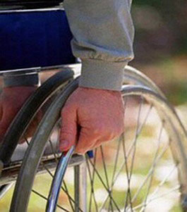
JSCo “Russian Railways”
Draft Program to make railway stations fully accessible to people with disabilities (Railway Accessibility Program)
The objective of the program:
to create comfortable and safe conditions that meet international
requirements and standards and allow people with disabilities
to access to railway infrastructure facilities.
The following tasks should be accomplished to meet the
Program’s objective:
- Ensure availability of railway station services to
people with disabilities, and
- Improve overall safety of railway stations and adjacent
areas for people with disabilities
Working Party on Rail Transport 63rd session
Notes:
MOS-RRU003-20080512-MT1wm-r_c_cf
2

Slide 4
JSCo “Russian Railways”
The following accessibility-enhancing devices and equipment will be installed at railway stations and in the adjacent areas:
Visual and audio information equipment
Telephone booths or other communication means easily accessible to disabled people
Restrooms with amenities for people with disabilities
Ramps and handrails
Access slopes
Special direction signage and station floor plans showing accessible directions for people with disabilities
Ramps with handrails in stairways at platforms or in adjacent areas in front of railway stations
Ramps at building entrances, ramps or lifting devices near stairways on elevator landings and at entrances to underpasses and overpasses
Working Party on Rail Transport 63rd session

Slide 5
JSCo “Russian Railways”
JSCo “Russian Railways” is planning to complete the Railway Accessibility Program by 2015, amount of financing is more than 3 billion rubles.
billion rubles
Working Party on Rail Transport 63rd session

Slide 6
JSCo “Russian Railways”
Installation of wheelchair lifts, units
Installation of elevators, units
Investments
Information equipment
Tactile marking
Working Party on Rail Transport 63rd session

Slide 7
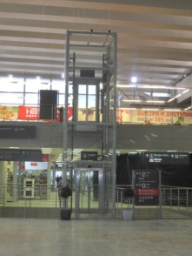
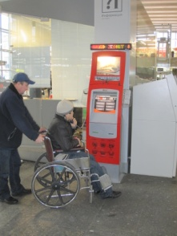
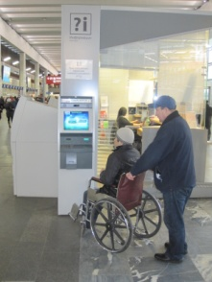
JSCo “Russian Railways”
Renovation of Kursky Rail Terminal, Moscow
Working Party on Rail Transport 63rd session

Slide 8
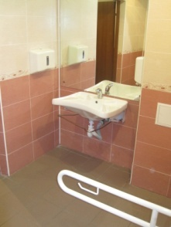
JSCo “Russian Railways”
Lavatory room for passengers with special needs
Working Party on Rail Transport 63rd session

Slide 9
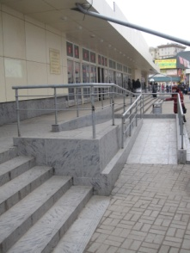
JSCo “Russian Railways”
Entrance ramps
Working Party on Rail Transport 63rd session

Slide 10
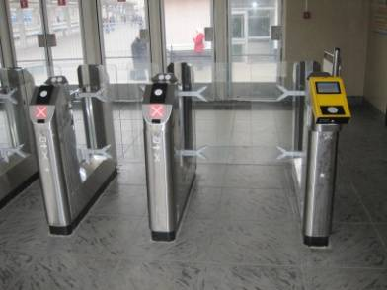
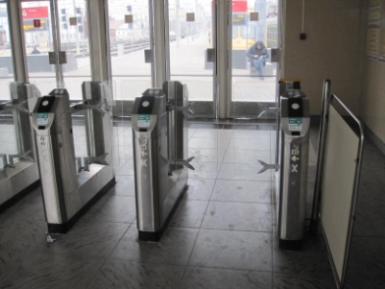
JSCo “Russian Railways”
Turnstiles for wheelchairs
Working Party on Rail Transport 63rd session

Slide 11
JSCo “Russian Railways”
Working Party on Rail Transport 63rd session

Slide 12
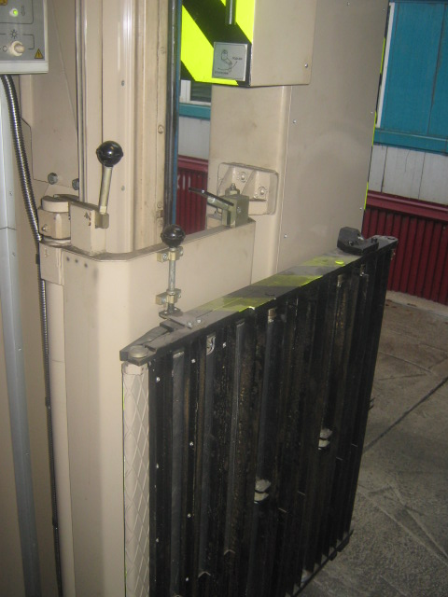
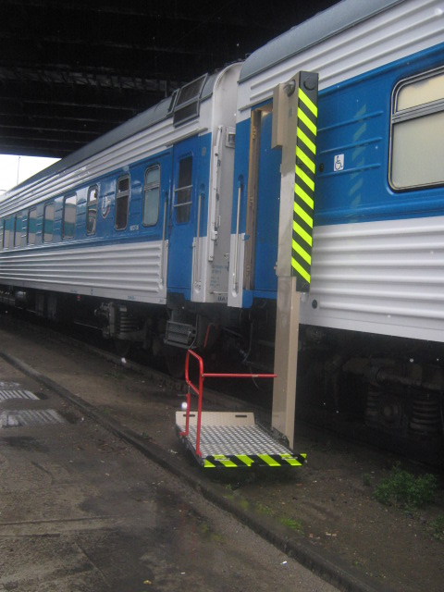
JSCo “Russian Railways”
Carriages, equipped with wheelchair lifts
Working Party on Rail Transport 63rd session

Slide 13
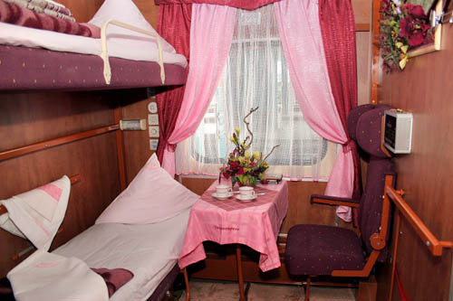
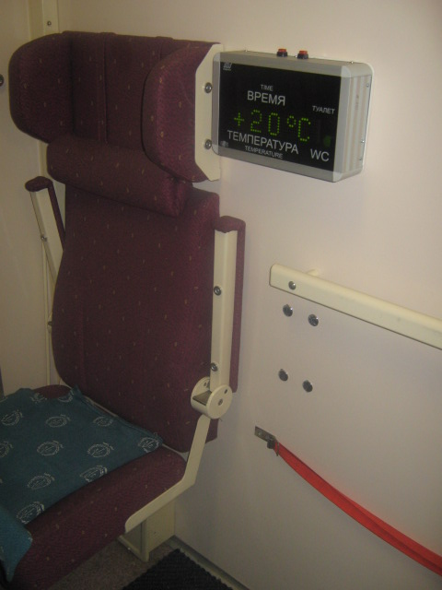
JSCo “Russian Railways”
Sound and visual information board for deaf or blind passengers
Compartment for disabled passengers
Working Party on Rail Transport 63rd session

Slide 14
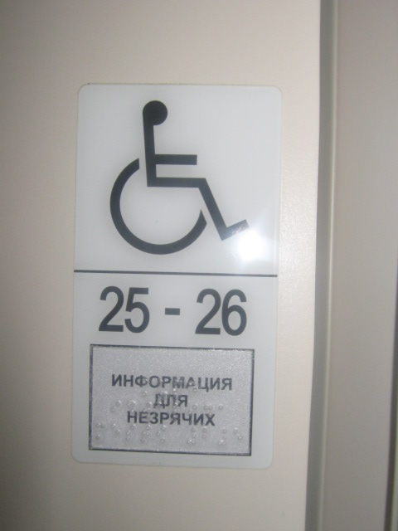
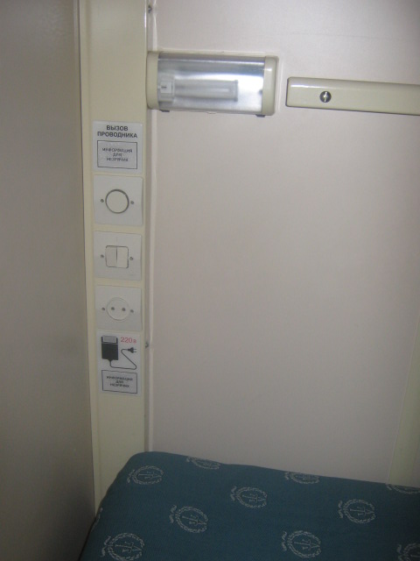
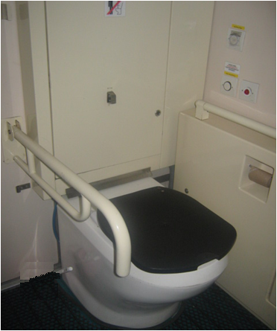
JSCo “Russian Railways”
Easily accessible
switches, sockets, and attendant call buttons
Attendant call button with raised text for partially sighted and blind passengers
Grab bars in lavatories for disabled passengers
Working Party on Rail Transport 63rd session

Slide 15
JSCo “Russian Railways”
Number of new carriages accessible to disabled passengers in 2008-2015
The Russian Railways network uses 308 carriages that have
wheelchair lifts and compartments for people with special needs
Working Party on Rail Transport 63rd session

Slide 16
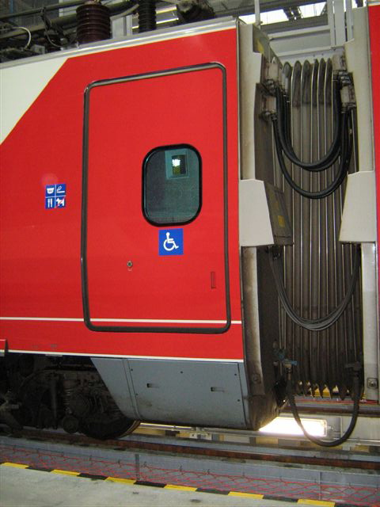
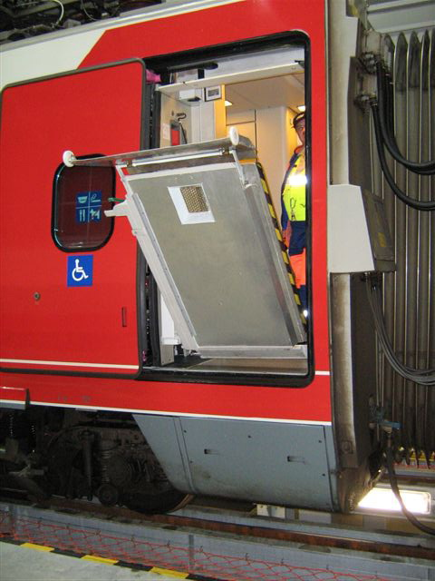
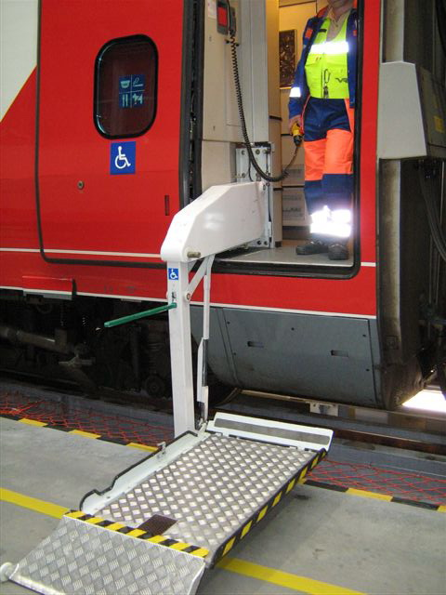
JSCo “Russian Railways”
Rapid trains have equipment for people with limited mobility, providing them the same comfort of travel as to other passengers
Working Party on Rail Transport 63rd session

Slide 17
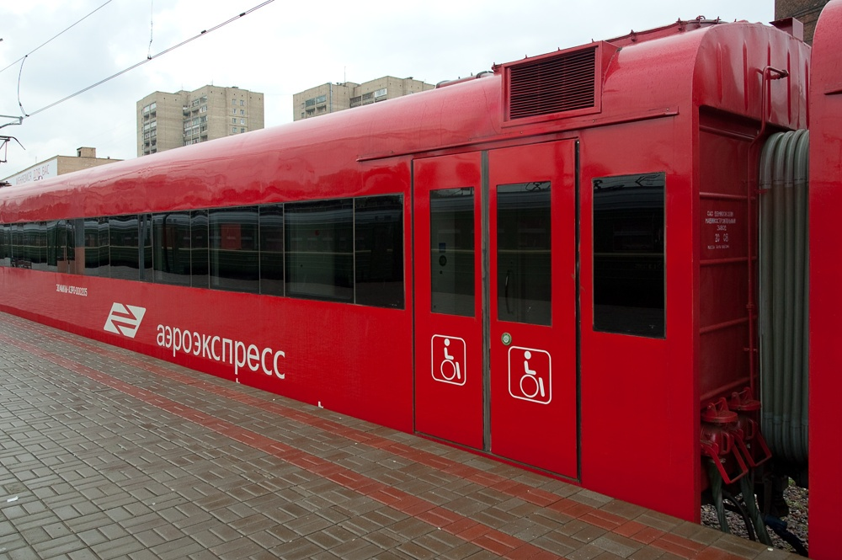
JSCo “Russian Railways”
The Program for passenger service quality improvement and providing of railways accessibility for passengers with disabilities by 2015 will be fully completed
Working Party on Rail Transport 63rd session

Slide 18
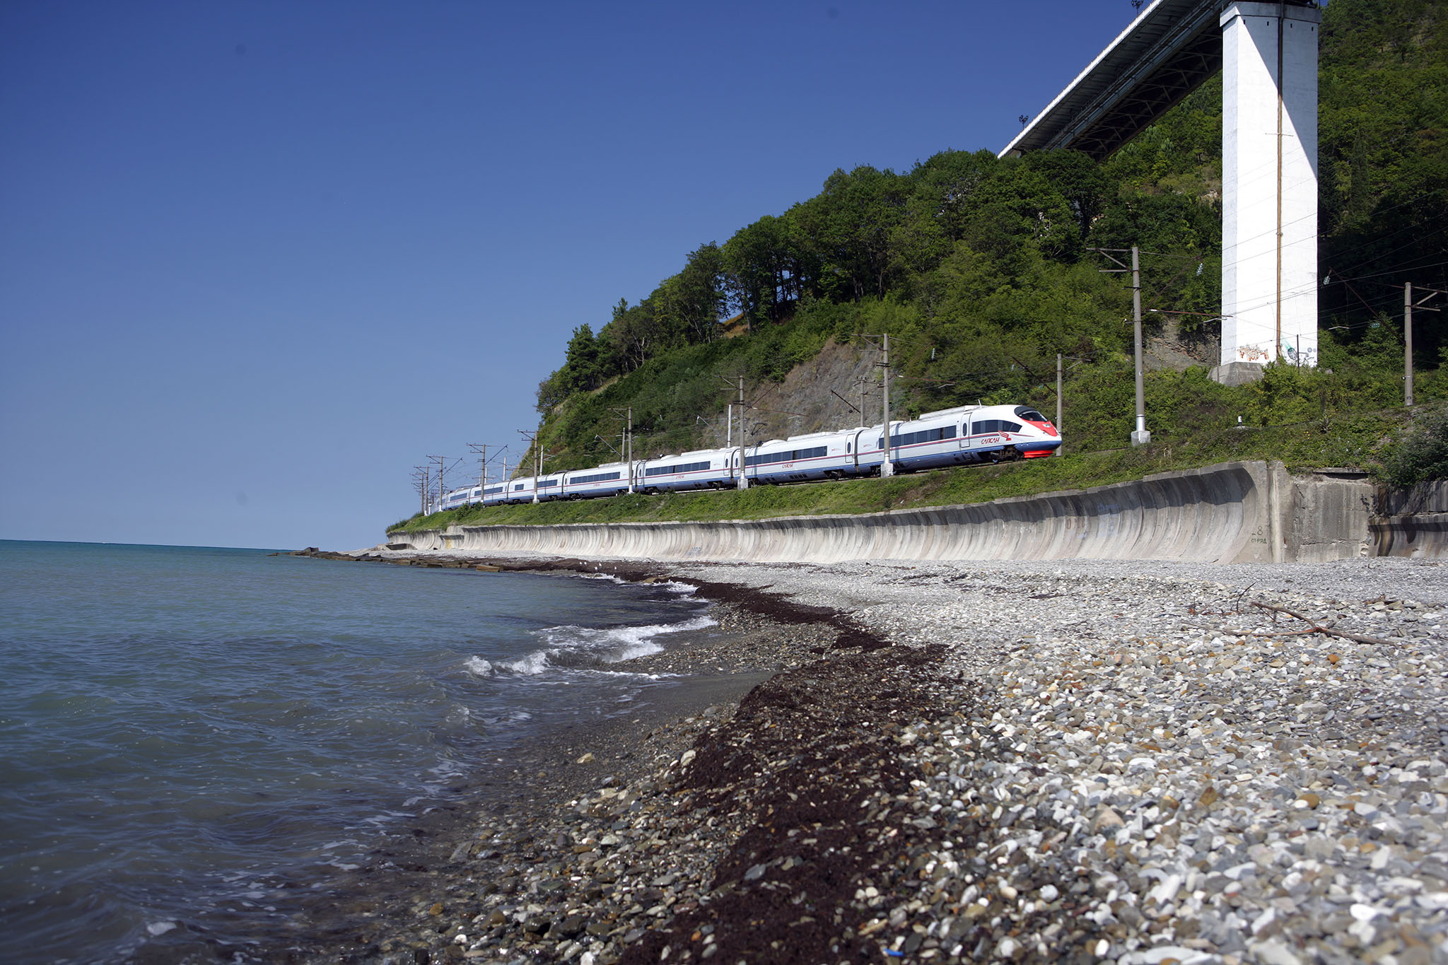
JSCo “Russian Railways”
Thank you for your attention!

