Slide 1

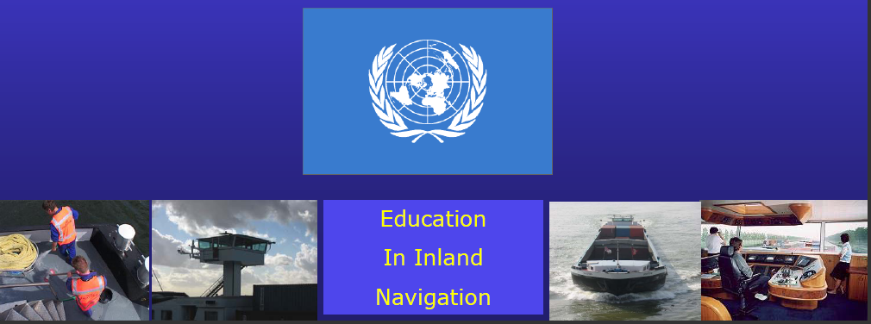
•
•
•

Slide 2


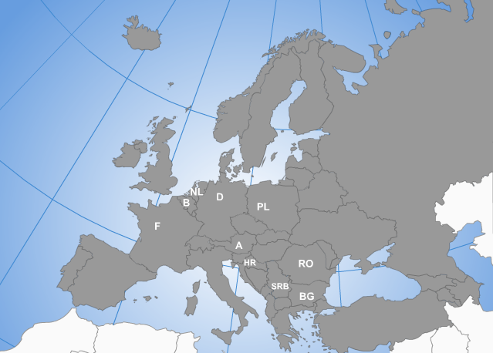














CZ
UKR
CH
SK
IT
15 countries in Europe

Slide 3


25 members
8 associated members
Recognized by the CCNR as NGO
www.edinna.eu

Slide 4
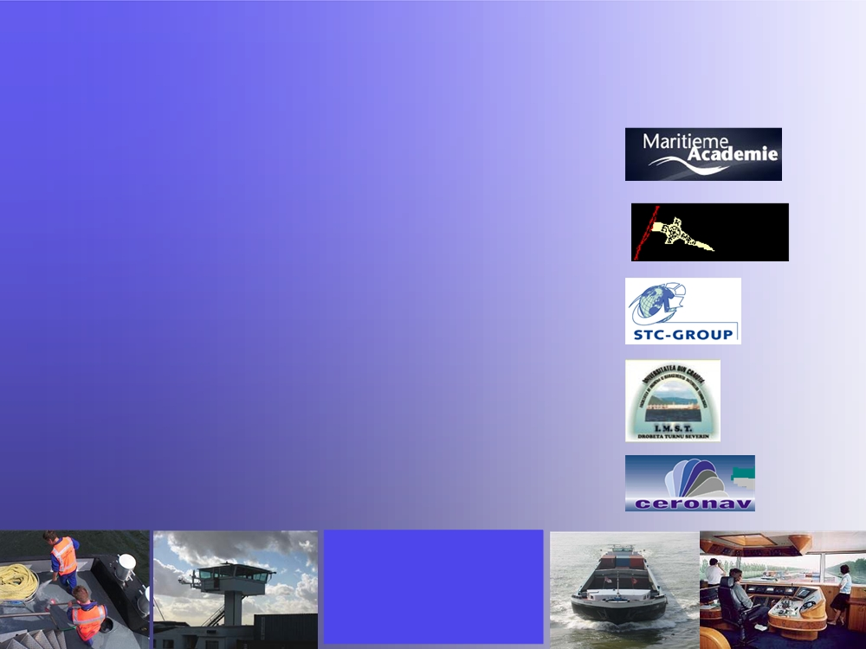
Edinna board
• Chairman - Mr. Arjen Mintjes
• Vice Chairman - Mr. Hans Gunter Portmann
• Secretary - Treasurer - Mr. Rob van Reem
• Advisory Officer - Mr. Mihai Ghiba
• Advisory Officer - Mrs. Doina Monteanu
Education
In Inland Navigation

Slide 5
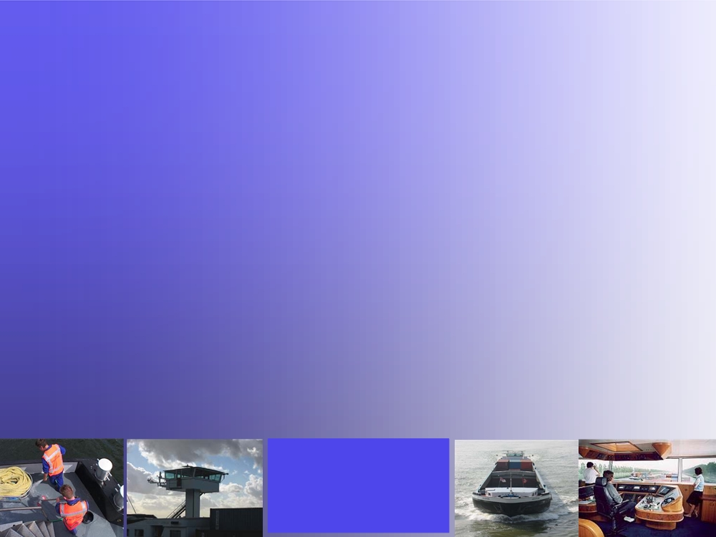
Edinna working plan
• Cooperation on the subject EU harmonisation of inland navigation education and training. • Development of the Standards of Training and Certification Inland Navigation (STCIN)
• Cooperation on the subject communication and language in navigation on inland waterways •
• Development of exchange programmes
Education
In Inland Navigation

Slide 6
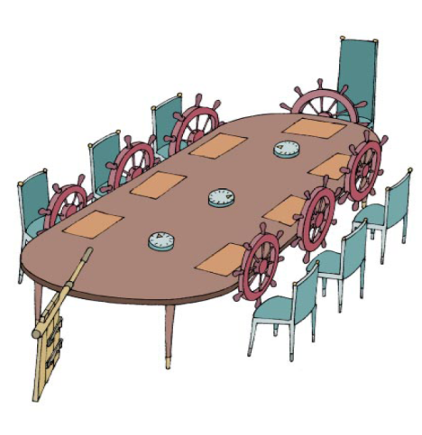
Joint Working Group
ISRBC
Notes:
International Sava River Basin Commission

Slide 7
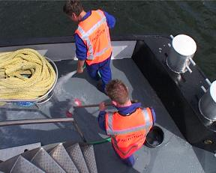
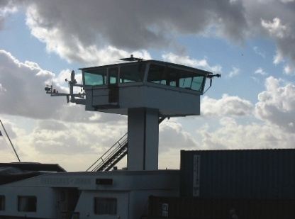
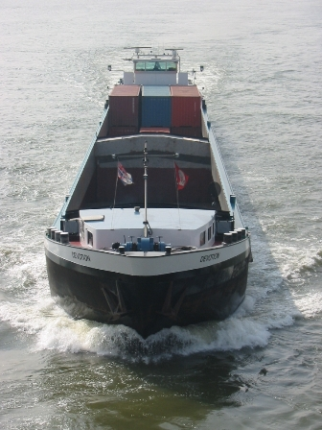
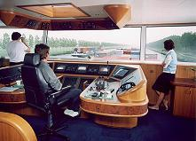
Competenties OL en ML
1. Navigation
2. Cargo Handling, stowage and passenger transport
3. Controlling the operation of the ship and care for
persons on board
4. Marine, electrical, electronic and control engineering
5. Maintenance and repair
6. Communication
7. Safety, health and environmental protection
Education
In Inland
Navigation

Slide 8
D 3.13: STCIN – consolidated tables for operational and management level
COMPETENCE | KNOWLEDGE, UNDERSTANDING AND PROFICIENCY | METHODS FOR DEMONSTRATING COMPETENCE | CRITERIA FOR EVALUATING COMPETENCE
Assists the ships management in situations of manoeuvring and handling a ship on inland waterways, using all types of waterways and ports and is able to: | Types of bollards and winches on push/tow vessels and barges, self-propelled vessels and ashore. Demonstrates handling of wires and ropes during mooring and unmooring operations, such as: Demonstrates the use of head ropes, stern ropes and springs; Demonstrates the safety measures to be taken when handling mooring ropes and wires. Demonstrates how to attach mooring ropes or wires to various types of bollards and other facilities. Demonstrates the use of various winches | Knowledge: Theoretical exam Understanding and proficiency: Practical training and exam on (school) training vessel Training record book during work placement practice. | Candidate is able to: Prepare the ship for mooring operation; Take care of the fenders and to place them in position; Select the wire or rope usable in case of a mooring operation; Understand the communication (orders) between the wheelhouse and wanted deck activities; Handle the wires and ropes in the wanted sequence taking in account the safe working rules.

Slide 9

Improvement of communication
River-speak - SINCP
Standard Inland Navigation Communication Phrases.

Slide 10
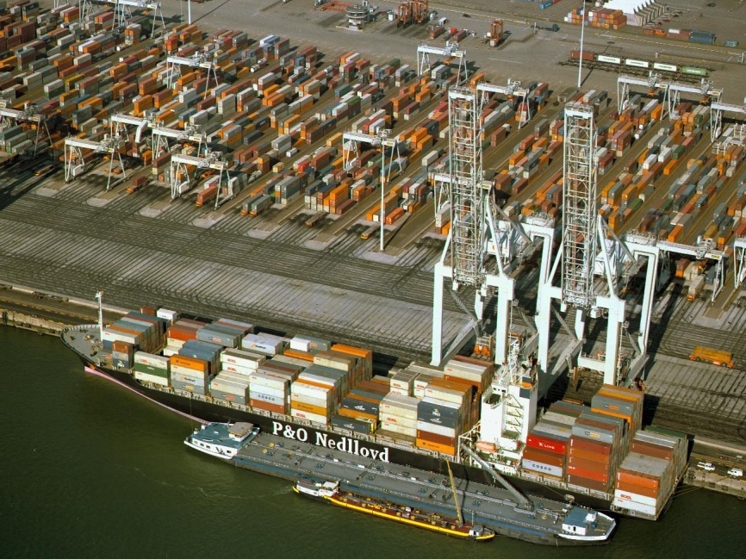
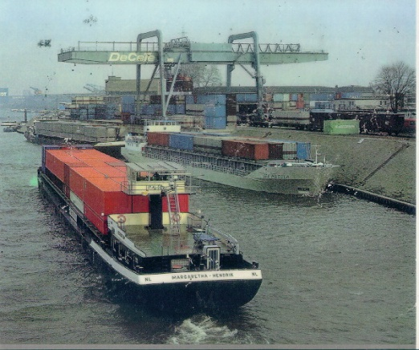
Dagelijkse praktijk in de binnenvaart communicatie
Schip - schip verkeer
Schip –wal verkeer
Havens en terminals
Intra-schip and sociale communicatie aan boord
Education
In Inland
Navigation

Slide 11
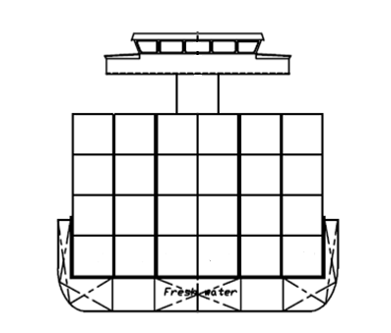
Professioneel binnenvaart jargon

Slide 12
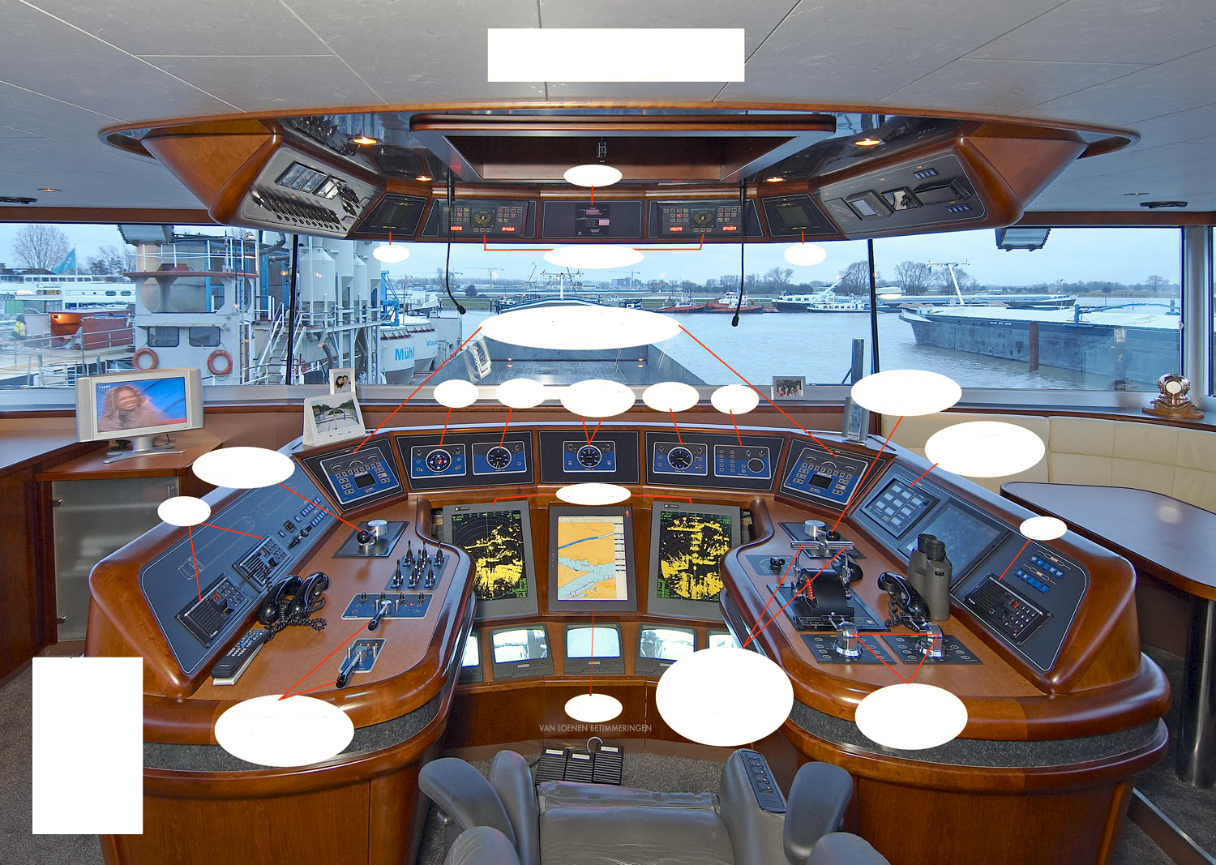

Slide 13
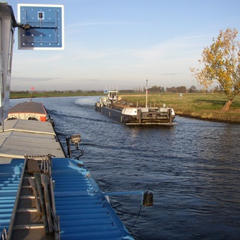
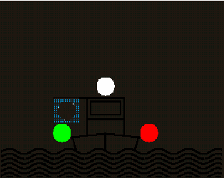

Schip – schip communicatie

Slide 14
Riverspeak – SINC
Standard Inland Navigation Communication Phrases
Verzamelen van bestaand materiaal
Aanpassen aan binnenvaart jargon
Uitbreiden vanuit specifieke binnenvaart expertise
Opstellen van een intern EDINNA concept
Bespreken concept met alle stake holders
Verwerken van commentaar
Vertalen in talen EDINNA leden
Introductie in binnenvaartonderwijs zodat er een “bottom up” benadering ontstaat

Slide 15
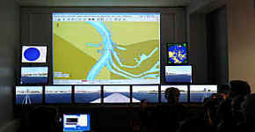
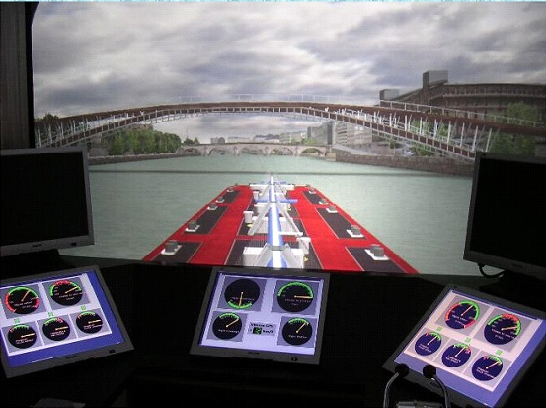
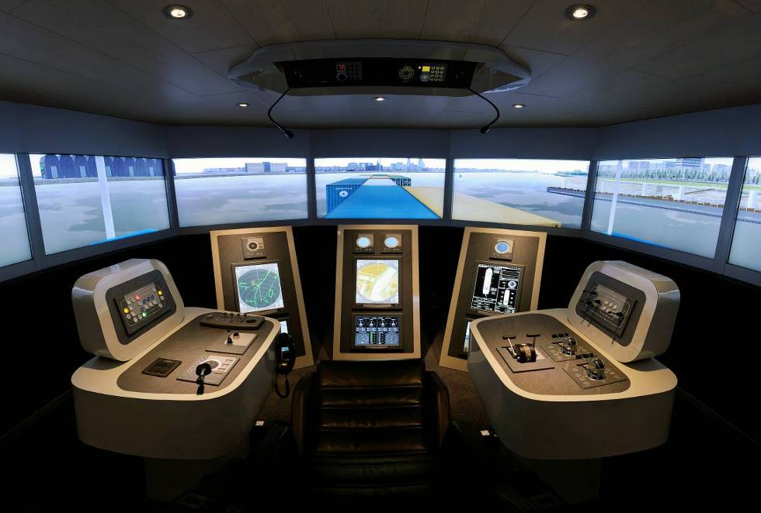
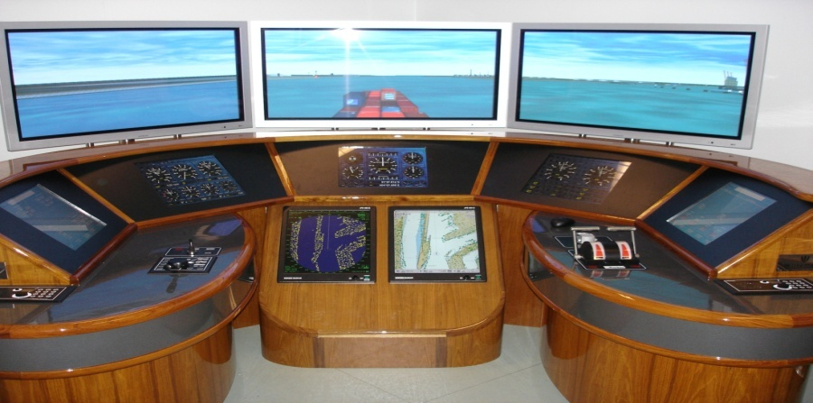

Simulators in Inland Navigation

Slide 16
INLAND WATERWAY SIMULATORS

Slide 17
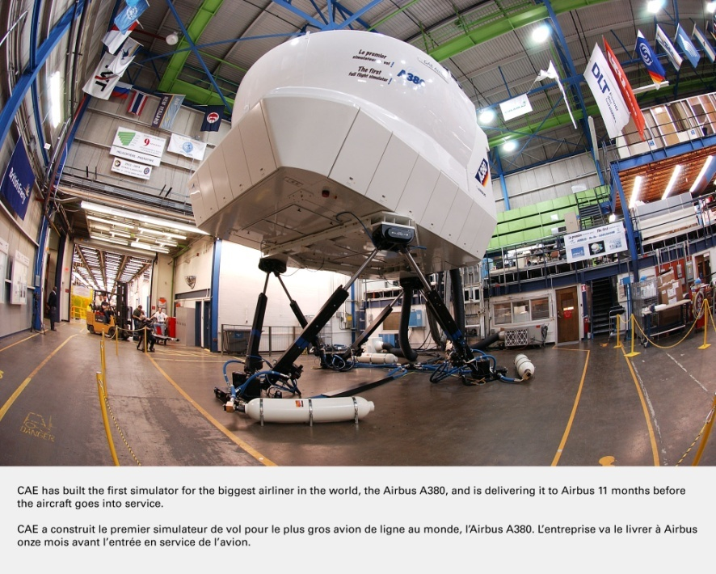
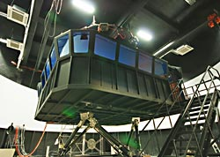
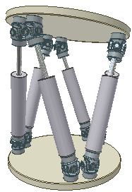
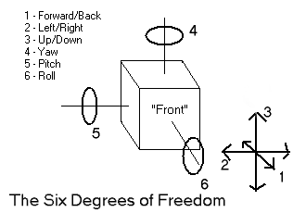
Properties of Simulators in IWT
These are the three linear movements x, y, z (lateral, longitudinal and vertical), and the three rotations pitch, roll, & yaw. The term "six-axis" platform is also used

Slide 18
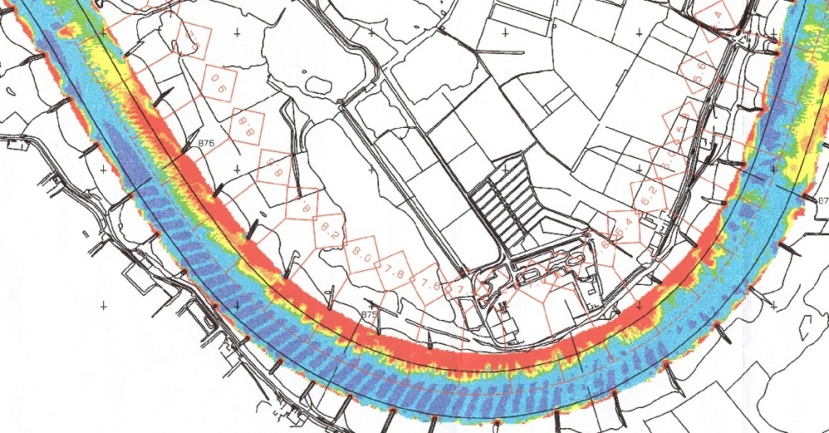
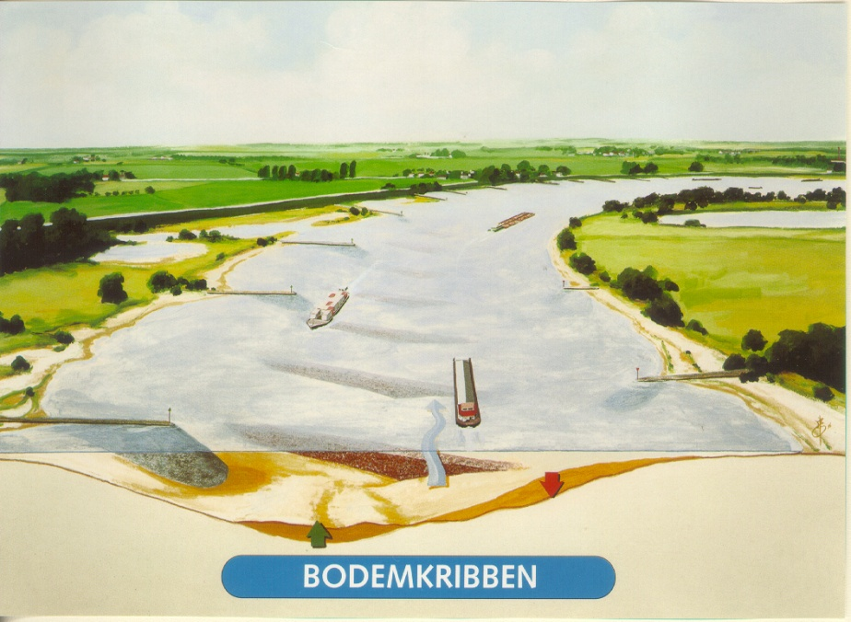
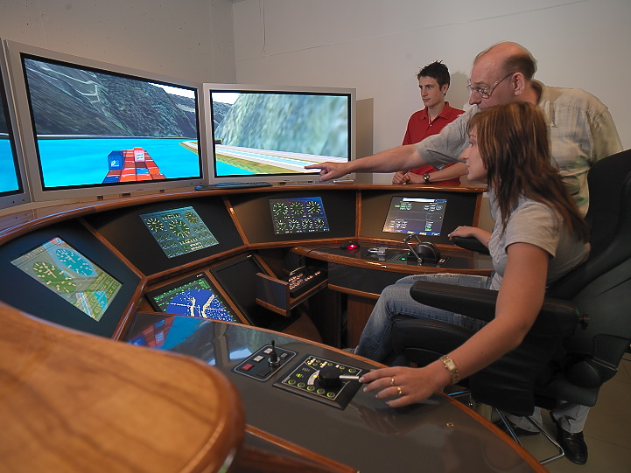
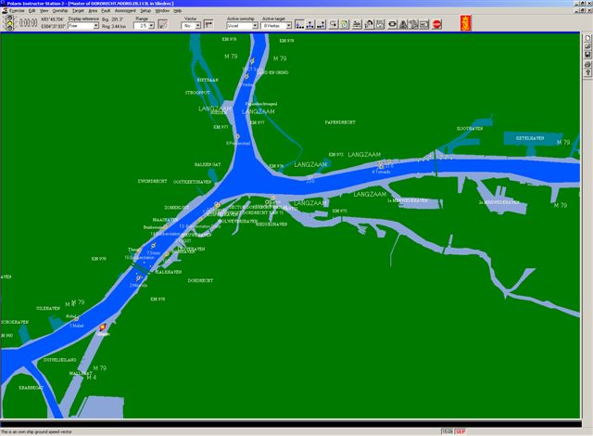
Databases

Slide 19
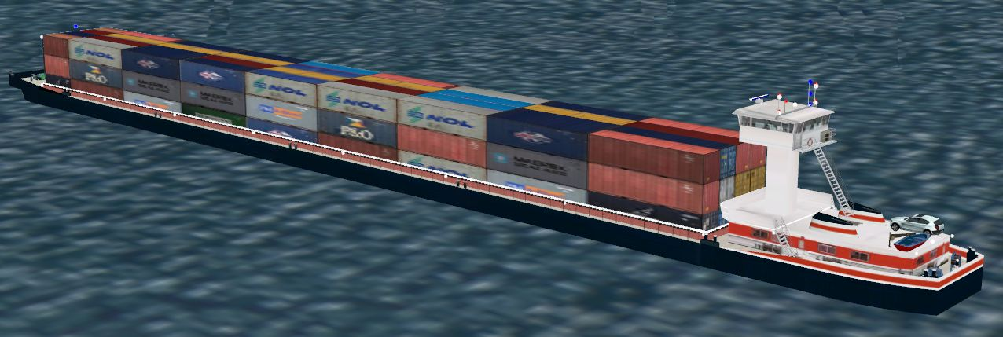
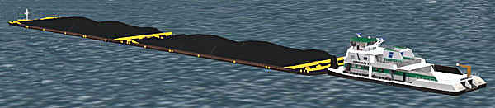
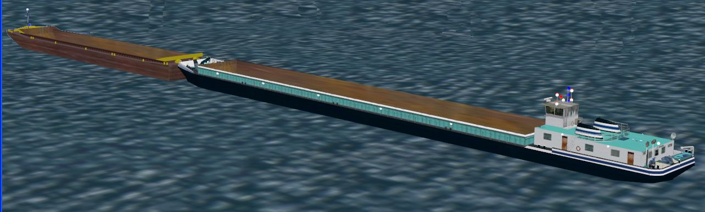

Slide 20
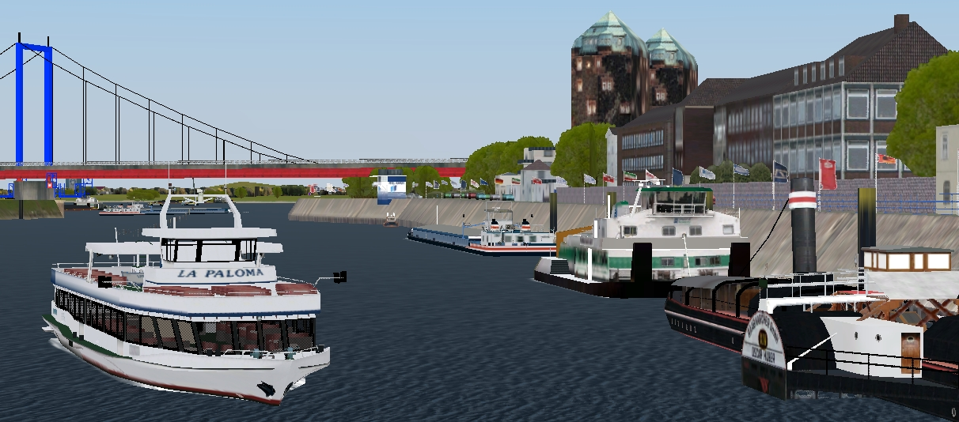
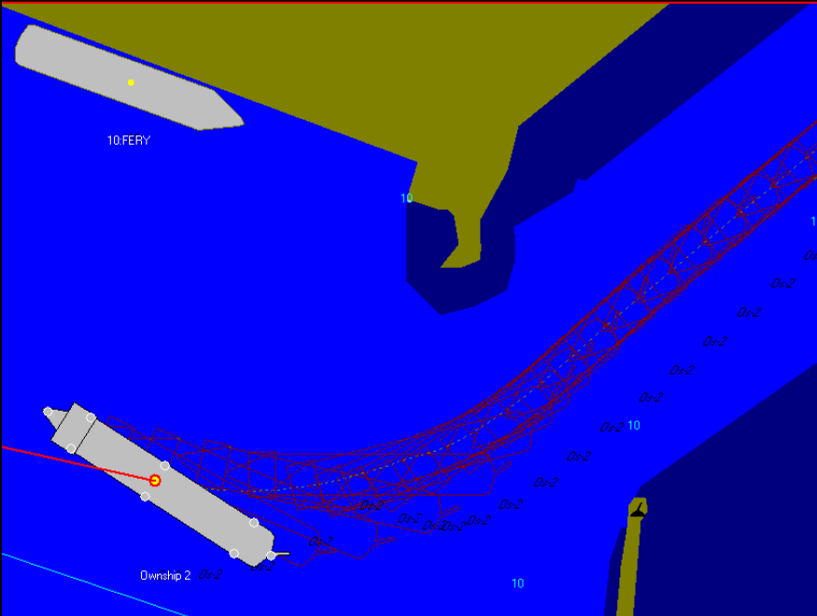

Slide 21
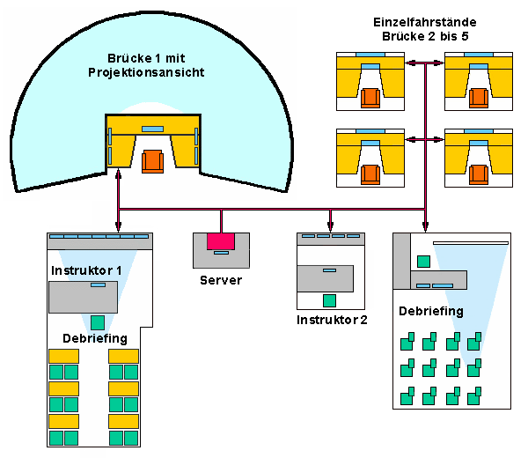

Slide 22

Inland Waterways Navigation simulator

Slide 23
Thank you for your attention
Questions

