Slide 1
WANDA – WAste management for inland Navigation on the DAnube
Harald Beutl
via donau – Austrian Waterway Company
UNECE, Geneva 20.06.2012
Notes:
1

Slide 2
Content
General Information about WANDA
Outputs
  2.1 Pilot Activities
    Upper Danube Region
    Lower Danube Region
  2.2 Financing Modell
Project Achievements
Follow up activities

Slide 3
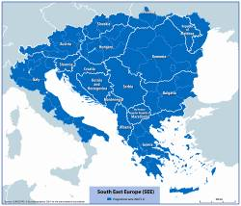







The WANDA project
1. General Information about WANDA
Programme
1st Call
Priority 2: Protection and
Improvement of Environment
Measure 2.2: Improve prevention
of environmental risks
Partner
9 institutions out of 7 countries
Duration
04/2009 – 03/2012
Total Budget
1.667.240 Mio. EURO
Funded by the European Regional Development Fund (ERDF)
Notes:
3
Organised in different sub objectives – they are called priorities and measures

Slide 4
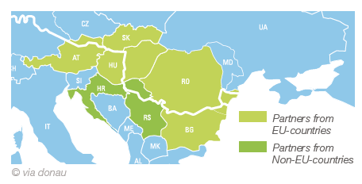
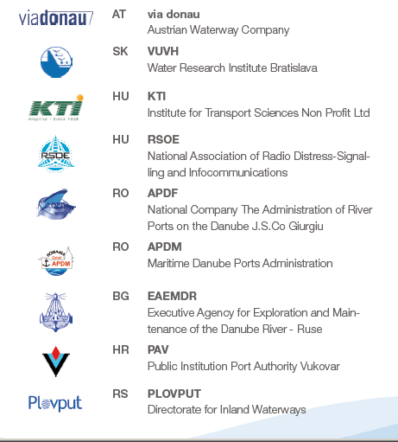





WANDA general information
Project Partner
1. General Information about WANDA

Slide 5
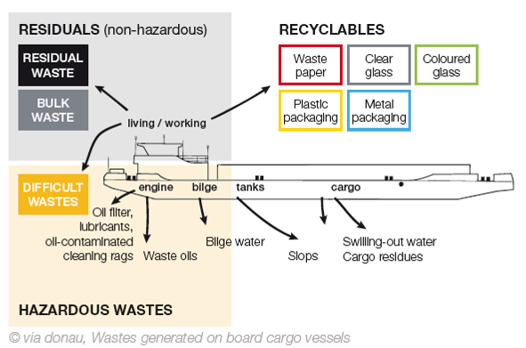
Categories of Ship Waste
1. General Information about WANDA
Passenger Vessels:
Domestic Waste Water, Sewage Sludge, Food Leftovers etc.

Slide 6
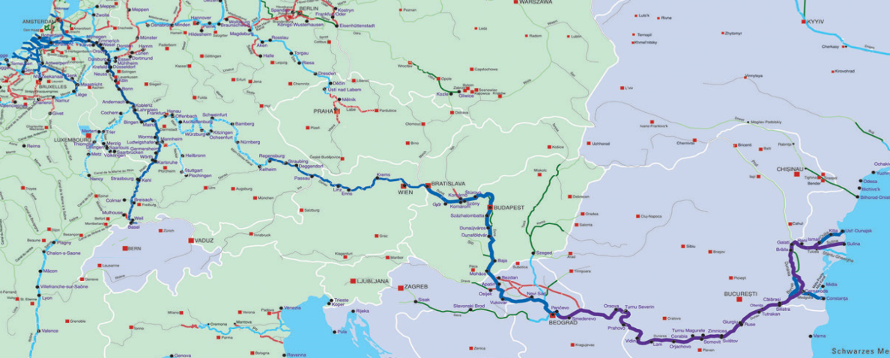
Summary of current situation of SWMC
1. General Information about WANDA
CCNR Waste Treaty (CDNI)
MARPOL
Danube Commission Recommendations
Different national systems
ISRBC
Different systems used for
        Waste disposal
        Re-financing of the costs
2. High number of unknown variables
(waste potential, costs, multitude of different users & interests,…)
Notes:
6

Slide 7
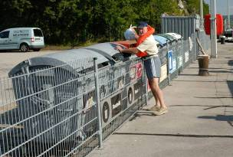
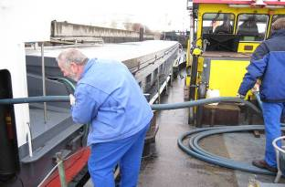
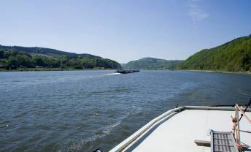
2. Outputs
Ship waste management concepts harmonised by an International Framework Concept
Pilot actions for collection of ship waste
Financing model for oily and greasy ship waste
Harmonised Joint Action Plan for follow up activities

Slide 8
2. Outputs
Ship waste management concepts harmonised by an International Framework Concept
Pilot actions for collection of ship waste
Financing model for oily and greasy ship waste
Harmonised Joint Action Plan for follow up activities

Slide 9
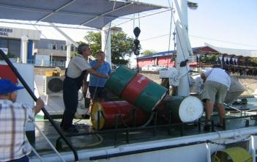
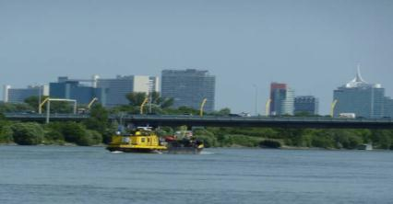
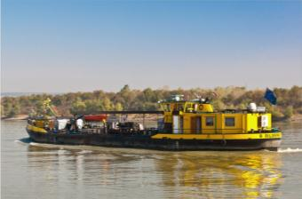
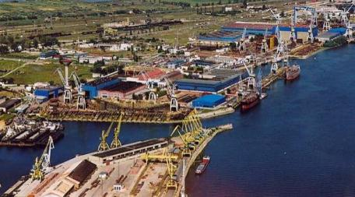
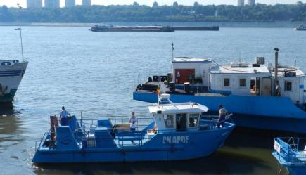
2. Outputs
Pilot Actions
Upper Danube Region
Lower Danube Region

Slide 10
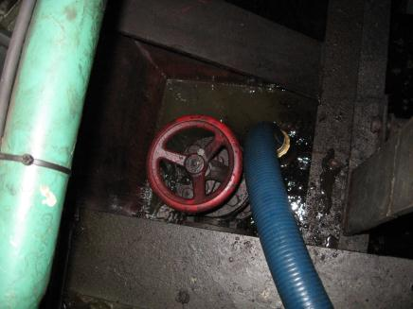
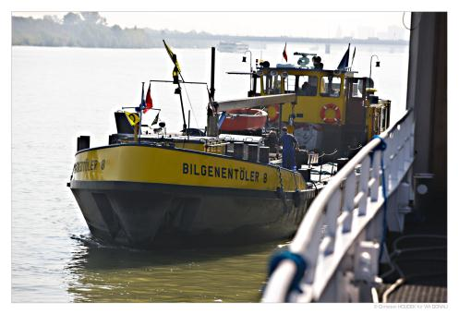
Pilot Action Upper Danube Region - AT + HU
Outputs: Pilots – Upper Danube Region
2 runs of a mobile bilge water vessel
Collection and treatment of bilge water and other oily and greasy ship
waste
Route: ‚Linz – Budapest‘ & ‚Linz – Mohács‘
Necessary legal permissions:
  Inland Waterway Regulation, Waste management right, Austrian Water Right, Commercial Law of Navigation, Trade Law

Slide 11
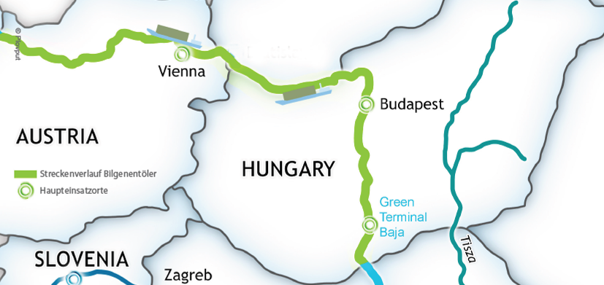
Pilot Action Upper Danube Region - AT + HU
Outputs: Pilots – Upper Danube Region
Route 2nd run: Linz (AT) to Mohács (HU)

Slide 12
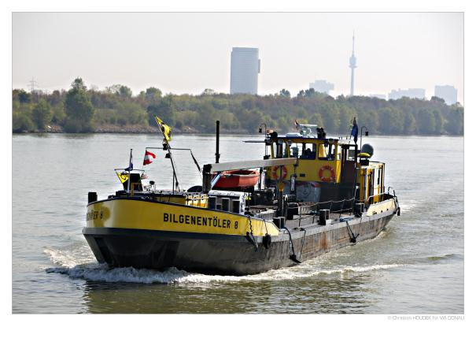
Pilot Action Upper Danube Region - AT + HU
Outputs: Pilots – Upper Danube Region
Service included the disposal of bilge water, used oils and other solid oily and greasy ship waste such as rags, filters, bins etc. free of charge
Results
  400 m³ bilgewater,
  50 m³ waste oil
  3,4 tons of solids
 | 1st run | 2nd run | Total
No. of services | 70 | 85 | 155 Services
Duration [days] | 21 | 24 | 45 days
Total amount of bilge water [l] | 157.800 | 242.350 | ~ 400 m³
Separated bilgeoil [l] | 23.520 | 45.150 | ~ 69 m³
Solids [kg] | approx. 1.270 | approx. 2.111 | 3,4 tons
Annual estimated amount of bilge water along the whole Danube ⇨ 15.000 m³/y

Slide 13
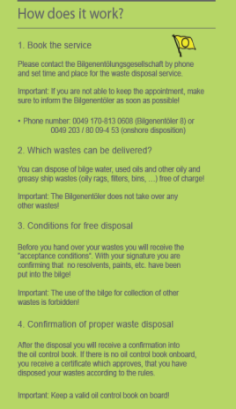
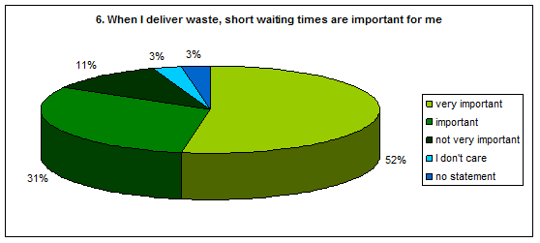
Pilot Action Upper Danube Region - AT + HU
Outputs: Pilots – Upper Danube Region
Information of pilot activities by
  RIS (River Information Services)
  leaflets
  emails and
  personal contacts
Advanced booking (setting of time and place)
Questionnaire Evaluation
Preference of short waiting times
Lack of knowledge about waste disposal costs
Preference of ‘full services’

Slide 14
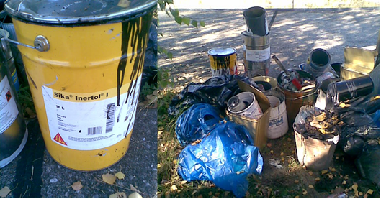
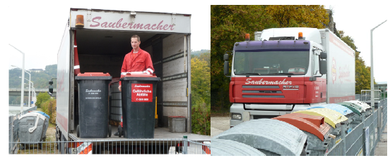
Pilot Action Upper Danube Region - AT + HU
Outputs: Pilots – Upper Danube Region
Pilots regarding ‚other hazardous ship waste‘:
  Mobile collection of: small amounts of waste oil, oily and greasy solids such as rags, paints/varnishes, solvents, fluorescent tubes, batteries by licensed company
  Skippers were prior informed about the pilot actions via email, RIS (notices to skippers) or brochures
  3 locations (AT) - 7 days - 145 kg collected – small utilisation rate (service only used by 3 vessels)

Slide 15
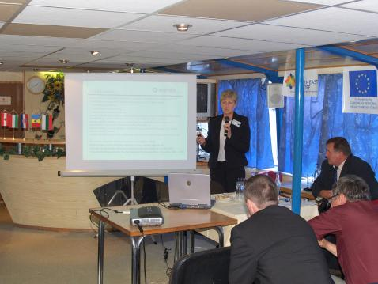
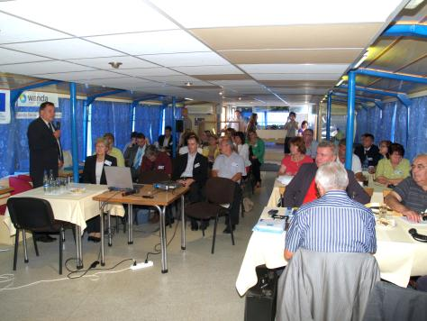
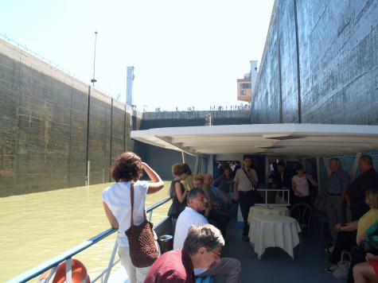
Ship waste management conference - SK
Outputs: Pilots – Upper Danube Region
No collection of foreign ship waste on SK territory due to national legislation & EC 1013/2006 – Shipment of waste
Conference on Ship Krivan (August 2011)
Start in Bratislava - downstream to Gabcikovo
National (SK) and international contributions

Slide 16
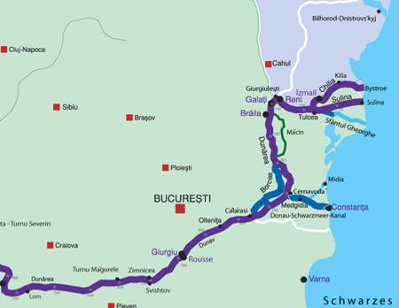
Pilot Actions – Lower Danube Region
Outputs: Pilots – Lower Danube Region
  Transnational action ⇨ RO + BG: collection & treatment of oily and greasy ship waste in the port of Giurgiu & port of Rousse
  National action in RO: Galati & Tulcea
Collection of
  oily and greasy ship
  waste
  recyclables
  waste water
  residual waste from
  ships
2.
1.

Slide 17
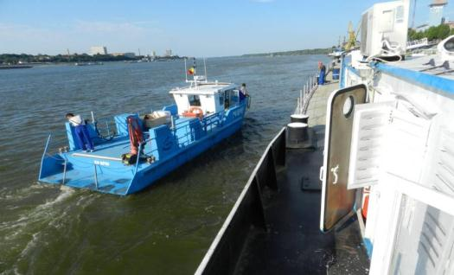
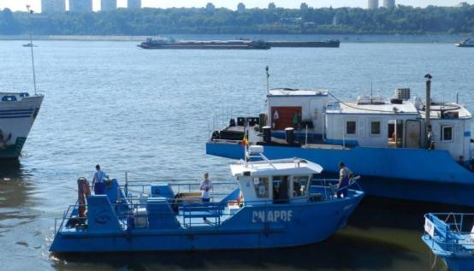
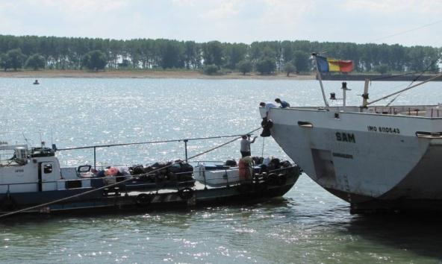
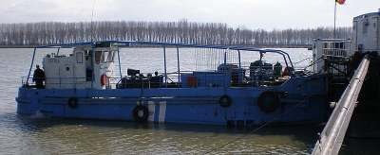
Lower Danube Region - RO + BG
Outputs: Pilots – Lower Danube Region
Collection of 109 m³ oily and greasy ship waste between Giurgiu & Rousse (August 2011)
Port of Galati (RO, 09.2011)
  54,4 m³ bilgewater
  2,35 tons garbage (+ others)

Slide 18
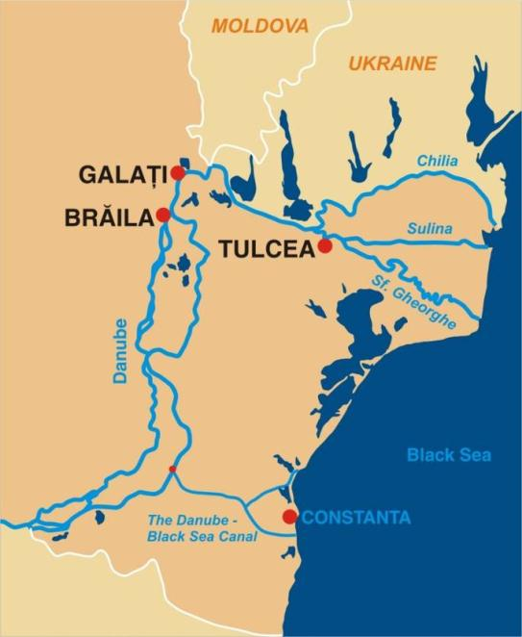
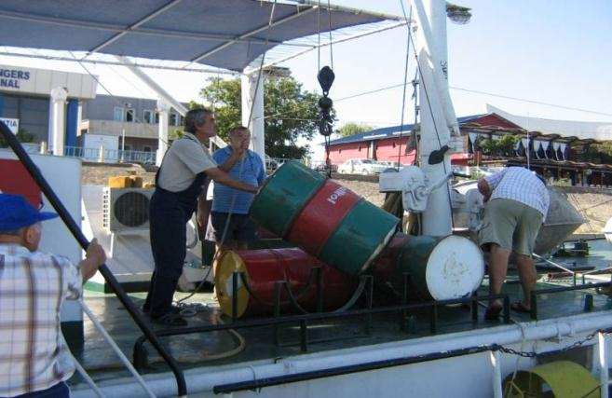
Lower Danube Region – RO + BG
Outputs: Pilots – Lower Danube Region
Port of Tulcea (RO, 09.2011)
  23,3 m³ bilgewater
  8,55 tons of garbage
  and others

Slide 19
2. Outputs - Financing Model
2.2 Development of a Financing Model for oily and greasy ship waste
Requirements
Requirements according to international and national legislation, policies and strategies (e.g. Waste Framework Directive, DC recommendations)
Socio-economic conditions of the Danube Region
Needs of IWT operators
Connection with River Information Services (RIS)

Slide 20
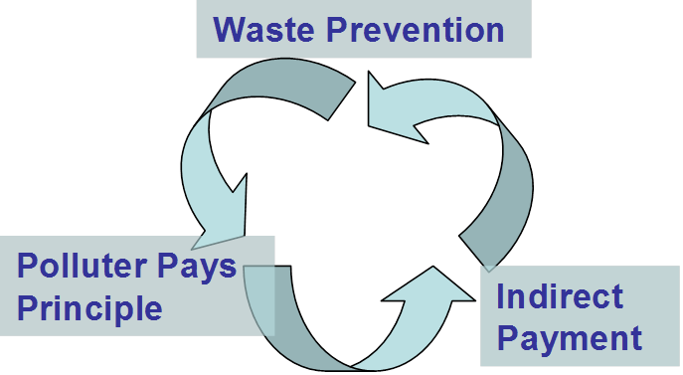
Financing Model - Basic Principles
2.2 Financing Model
A Financing Model (FM) has to
… cover the costs for waste disposal
… be applicable on international level
… be compatible with the Rhine system
…be simple & cheap to implement
Notes:
20

Slide 21
Financing Model - Payment scenarios
2.2 Financing Model
Discussion of 8 payment scenarios, 3 were investigated in more detail
Levy on gasoil
11 €/1000 l gasoil; + used in the Rhine region
Levy on port dues
15 €/port entry ; costs could range from 0 to 5500 €/vessel; no. of port entries not related to waste generation; complex administration, monitoring and controlling, market interference possible;
Vignette
Simple low administration cost, support by River Information Systems (RIS) possible, app. 1500€/ yr
Evasive reactions of vessels possible, hence higher risk for successful implementation; changes in CDNI possible; high administration costs expected;
Vessel registration fee
Vessels could avoid payment by registration outside the Danube region

Slide 22
Financing Model - Costs & Revenues of a vignette system
2.2 Financing Model
Component | Unit | Amount
Quantity of bilge water | m³ | 15,000
Price per m³ | Euro | 125
Total costs for the collection of bilge water | € | 1,875,000
Motorised vessels | No. | 1400
Average tariff per vignette based on bilge water only | € | 1,339
Costs for the collection of other oily waste | 10% | 187,500
Total costs for the collection of all oily waste |  | 2,062,500
Average tariff per vignette including other waste | € | 1,473
(NEA, 2011)

Slide 23
3. Project Achievements
7
involved countries
5
no. of observer
9
project partners
36
months of
implementation
50
meetings
35
Included project
members
1500
hits on website
avrg. / month
2000
reached through
dissemination
5000
emails
In Sum 225 outputs (events, studies, meetings, pilots etc.)

Slide 24
Results and Recommendations
3 Project Achievements
The following key elements shall be developed along the Danube:
International legally binding treaty
User-friendly waste reception facilities, following harmonised standards
A transnationally coordinated financing model
Controlling mechanism

Slide 25
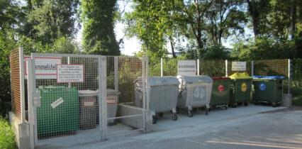

4. Follow up activities
CO-WANDA - COnvention for WAste management for inland Navigation on the DAnube
Advancement of running ship
waste management systems
Implementation of practical tests and pilot activities
Development of an International Danube Ship Waste Convention

Slide 26
Thank you for your attention!
Harald Beutl
via donau – Austrian Waterway Company
Geneva, 20.06.2012
www.wandaproject.eu

