Slide 1
Transmitted by the expert from OICA | Informal document GRE-69-45 (69th GRE, 8-11 April 2013, agenda item 5 (j))
PROGRESSIVE TURN INDICATOR ANIMATIONS

Slide 2
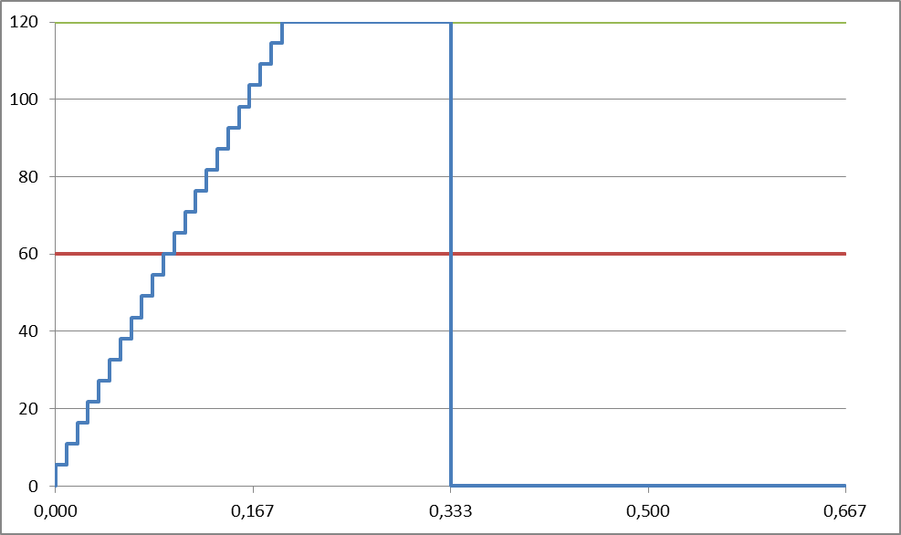
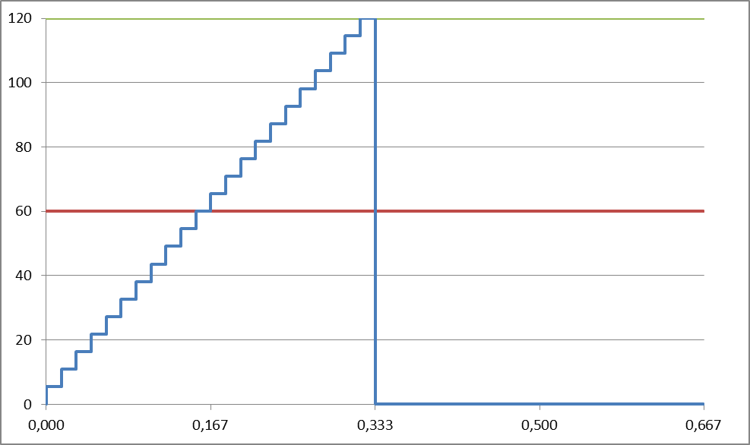
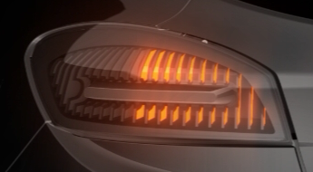
PROGRESIVE TURN INDICATOR
IMPACT OF TIMING PARAMETERS ON PROGRESSIVE TI ACTIVATION
Proposal from French-German administrations
Proposal from French industries
Lit ON appearance to fit with regulation minimum intensity.
200ms
160ms
200ms

Slide 3
PROGRESSIVE TURN INDICATOR
IMPACT OF TIMING PARAMETERS ON PROGRESSIVE TI ACTIVATION
Proposal from French and German administrations
Proposal from French industries
200ms
160ms
200ms

