Slide 1
Summary of the Future Policy for
Motor Vehicle Emission Reduction
(The 11th Report)
Transmitted by the expert from Japan
Informal document No. GRPE-65-14
(65th GRPE, 15 - 18 January 2012, agenda item 16)
Ministry of the Environment, JAPAN

Slide 2
In response to an inquiry of Minister of the Environment, the Central Environment Council has been discussing its recommendation and submitted the 11th Report of the Future Policy for Motor Vehicle Emission Reduction on 10 August, 2012.
The 11th Report consists of the following items:
1. The Future Emission Reduction Measures for Motorcycles
2. The Future Emission Reduction Measures for Heavy-Duty Diesel Motor Vehicles
Measures for the Improvement of Durability and Reliability of NOx After-Treatment System
Off-Cycle Emission Measures
3. The Future Emission Reduction Measures for Diesel Special Motor Vehicles

Slide 3
The Future Emission Reduction Measures for Motorcycles
(1) Viewpoints on Reviewing Motorcycle Emission Reduction Measures
Background
Although the emission regulation of the 2006 Standard is applied, the amount of HC and CO emissions per distance travelled is still much higher than those of four-wheeled vehicles.
Although the tailpipe emission standard has been implemented for the first time in 1998 and then reinforced in 2006, the relative contribution of evaporative gas within the emission has been higher.
It is important to control the amount of emission through monitoring the in-use malfunction of emission reduction systems.
Total Emission Amounts of Motorcycles and Passenger Vehicles (PVs)

Slide 4
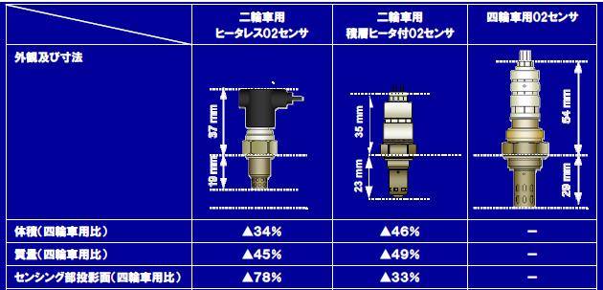
(2) Tailpipe Emission Reduction Measures
Current Technology and Challenges
Current measures for tailpipe emission reduction is based on the feedback control for theoretical air-fuel ratio, using “Electronically Controlled Gasoline Injection + Three-way Catalyst + O2 Sensor”.
Compared to four-wheeled vehicles, motorcycle emission reduction technology is constrained not only by the smaller body size, but also by consideration of contact with roads surface when inclined, as well as damages on parts and human body from release of exhaust heat and vibration.
Each part of emission reduction devices is subject to pursuit of downsizing and lightening, as well as systemic simplification and part communization for cost reduction.
O2 Sensors for Motorcycles (with and without heater) and for PVs
Resource： JAMA

Slide 5
The Forthcoming Permissible Limits of Motorcycle Tailpipe Emission
Considering the new EURO 4 becoming effective from 2016 and allowing adequate time for due technological development by motorcycle manufacturers, it is considered appropriate that application of new regulation in Japan occurs by the end of 2016.
  Emission reduction technologies expected to be developed by 2016:
  Optimization of fuel injection control
  Introduction of variable valve actuation mechanism
  Increase in catalyst volume
  Quick activation of catalyst by ascending exhaust gas temperature quickly
  High efficiency of catalyst
[Recommendation]
The new permissible emission limits are set based on WMTC classes and will begin by the end of 2016.
Unit [g/km]
Category | Class 1 |  |  | Class 2 |  |  | Class 3
Pollutants | THC | CO | NOx | THC | CO | NOx | THC | CO | NOx
Next Limit | 0.30 | 1.14 | 0.07 | 0.20 | 1.14 | 0.07 | 0.17 | 1.14 | 0.09
Current Equivalent Limit | 0.45 | 2.2 | 0.16 | 0.27 | 2.62 | 0.21 | 0.27 | 2.62 | 0.21
Reduction Rate | 33.3％ | 48.2％ | 56.3％ | 25.9％ | 56.5％ | 66.7％ | 37.0％ | 56.5％ | 57.1％
(Ref) EURO 4 | 0.38 | 1.14 | 0.07 | 0.38 | 1.14 | 0.07 | 0.17 | 1.14 | 0.09

Slide 6
  Estimated Amount of Reduction in Tailpipe Emission in 2020
The new regulation is expected to bring additional effect of 20% reduction of HC in 2020. In the future, further reduction is expected, owing to further diffusion of new types of motorcycles.
Unit [t/year]
Pollutants | Tailpipe Emission | Class 1 | Class 2 | Class 3 | Total
THC | Without New Regulation | 947 | 245 | 202 | 1,394
 | With New Regulation | 724 ▲23.5% | 216 ▲11.8% | 170 ▲15.8% | 1,110 ▲20.4%
CO | Without New Regulation | 11,561 | 6,839 | 3,107 | 21,506
 | With New Regulation | 7,245 ▲37.3% | 5,083 ▲25.7% | 2,362 ▲24.0% | 14,690 ▲31.7%
NOx | Without New Regulation | 606 | 201 | 240 | 1,047
 | With New Regulation | 355 ▲41.4% | 142 ▲29.3% | 171 ▲28.8% | 669 ▲36.1%

Slide 7
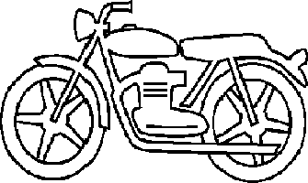
(3) Measures for Reduction of Fuel Evaporative Emission
Test Method
California State (CA) Evaporative Emission Test for Motorcycles is used by several other and will be adopted to EU regulation from EURO 4.
CA Evaporative Emission Test should be introduced for the following reasons:
  The test is regarded as an alternative of Passenger Vehicles (PVs) evaporative emission test, which consists of 24 hour Diurnal Breathing Loss (DBL) and Hot Soak Loss (HSL) tests.
  One-heating DBL test is adequate because 60 to 80% motorcycles are parked only once during the daytime in Japan.
Driving
Pre-Conditioning Soak
DBL
Driving
HSL
SHED
Analyzer
AC unit
CA Evaporative Emission Test Process

Slide 8
Permissible Evaporative Emission Limit for Motorcycles
In Japan, permissible evaporative emission limit from PVs is 2.0 g/test. Both the U.S. limit from motorcycles as well as EURO 4 limit are 2.0 g/test.
Setting 2.0 g/test as the permissible evaporative emission limit will reduce 30% motorcycle evaporative emission in FY2020.
Estimated Amount of Evaporative Emission from Motorcycles in FY2020 (t/year)
Evaporative Emission | Class 1 | Class 2 | Class 3 | Total
Without Regulation | 953 | 1,476 | 1,847 | 4,275
With Regulation | 953 | 946 | 1,086 | 2,985
Reduction Rate | 0.0％ | 35.9％ | 41.2％ | 30.2％
Estimated Tailpipe and Evaporative Emissions from Motorcycles in FY2020 (t/year)
Tailpipe and Evaporative Emissions | Class 1 | Class 2 | Class 3 | Total
Without New Regulation | 1,900 | 1,721 | 2,049 | 5,670
With New Regulation | 1,677 | 1,162 | 1,256 | 4,095
Reduction Rate | 11.7％ | 32.5％ | 38.7％ | 27.7％
[Recommendation]
The motorcycle evaporative emission regulation is modeled after the CA Evaporative Emission Test, with the permissible limit of 2.0 g/test. The regulation will be implemented by the end of 2016.

Slide 9
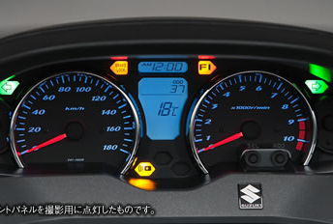
(4) On-Board Diagnostics (OBD) System
Current Motorcycle OBD System
A motorcycle OBD system that monitors malfunctions caused by a short-circuit or open electric circuits and alerts the driver has been established in Japan.
It takes several years to prepare additional measures, including monitoring system of fuel injection correction, ISO-conformed connectors for communication off-board, and modification of the malfunction warning lamp. For allowing due time for manufacturing and technical development, the application of new OBD equipment should be at the same as the forthcoming tailpipe emission regulation.
 | Items
Already Developed | Open faults of sensors in malfunction, (incl. air pressure sensor, intake pressure sensor, intake air temperature sensor, water temperature sensor, throttle position sensor, cylinder sensor, crankshaft angle sensor, O2 sensor, O2 sensor heater, primary ignition system, air injection system, etc.), release of alert after recovery, malfunction information storage and functional confirmation at the start
To be developed | Monitors of malfunction by fuel injection correction, ISO connectors for communication off-board, change of the malfunction alert lamp
Malfunction Alert
[Recommendation]
The OBD equipment that monitors malfunctions caused by a short-circuit or open electric circuits is now mandated. The implementation will occur by the end of 2016.

Slide 10
The Future Emission Reduction Measures for
Heavy-Duty Diesel Motor Vehicles
(1) Measures for the Improvement of Durability and Reliability of NOx After-Treatment System
Urea Selective Catalytic Reaction (SCR) Systems
In Japan, Urea SCR Systems were first equipped with New Long-Term (NLT, the 2005 Standard) heavy-duty (HD) diesel vehicles and followed by Post New Long-Term (PNLT, 2009 Standard) HD diesel vehicles.
The Urea SCR System for NLT consists of a Pre-Diesel Oxidation Catalyst (Pre-DOC), a SCR catalyst, and a Post-DOC. In the Urea SCR System for PNLT, a Diesel Particulate Filter (DPF) system is installed between a Pre-DOC and a SCR catalyst.
Tailpipe Emission Gas
Urea Injector Nozzle
Pre-DOC
Post-DOC
SCR Catalyst
Exhaust Gas Emitted Directly from the Engine
SCR Systems for NLT (Image)

Slide 11
Emission Test Results of In-Use NLT HD Diesel Vehicles
With Urea SCR Systems
The chassis-dynamo emission tests based on the JE05 mode were conducted on 5 in-use NLT HD Diesel Vehicles with Urea SCR systems. All NOx emission values greatly exceeded the NLT limit and N₂O and NH₃ values were much larger than that of NLT HD Diesel Vehicles with new Urea SCR system installed.
Increase of NOx emission might be caused by catalyst poisoning with unburned hydrocarbon, sulfur, phosphorus or metal, as well as deterioration of catalysts.
JE05 Test, In-Use Emission
JE05 Test, In-Use Emission
D
Average direct-NH₃
161ppm
D
B
NLT ave./upper limit
B
A
E
C
A
C
E
Chassis-Dynamo Emission Test Results (5 NLT HD Diesel Vehicles)

Slide 12
After recovery operation of 30 minutes (ARO30) for removing hydrocarbon poisoning, additional emission tests were conducted for one of the vehicles.
As a result, NOx emission was reduced but still beyond the NLT limit. NH₃ emission decreased while N₂O increased. These results imply the deterioration of Pre-DOC.
Chassis-Dynamo Emission Test Results

Slide 13
Measures for In-Use NLT HD Diesel Vehicles With Urea SCR Systems
In case that emission gas temperature is kept relatively low, HC poisoning has influence on the NOx reduction capacity of the Urea SCR System. For removing hydrocarbon poisoning, periodic heating of the System is a possible solution.
After heating the System to reduce HC poisoning, the oxidative capacity of pre-DOC may not be recovered to the level as brand-new. This is considered due to deterioration of pre-DOC, owing to other factors than HC poisoning, although the specific cause is yet to be identified.
PNLT HD diesel vehicles are equipped with the DPF system as a reinforcement for the PM regulation. Periodical heating of PM when regenerating the DPF system is considered effective for improving the condition of each catalyst of the Urea SCR System such as HC poisoning and other problems. As there seems no immediate need of further measures for PNLT, we will continue monitoring the performance of in-use Urea SCR Systems for PNLT.
[Recommendation]
Manufactures should consider the implementation of periodic heating measures of in-use Urea SCR systems for NLT HD diesel vehicles. The investigation of factors deteriorating pre-DOC should be kept and measures for the deterioration of pre-DOC should be considered consequently.

Slide 14
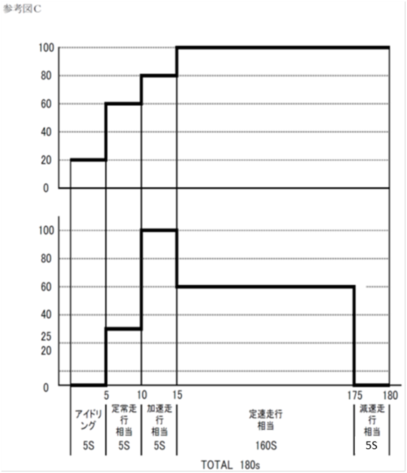
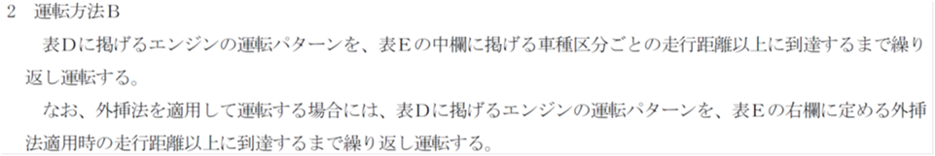
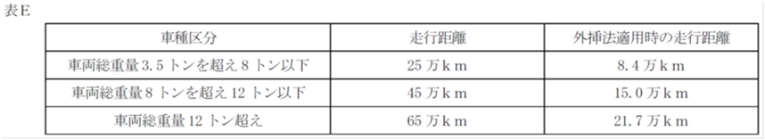
Review of Durability Test Procedure
A Major purpose of durability test within the type approval is to evaluate heat deterioration by applying the test engine with high speed and heavy load. To shorten the test time, extrapolation on change in emission is applied.
As the emission temperature at high speed and heavy load areas is relatively high, the catalysts might not be poisoned by hydrocarbon, while actual vehicles might drive at low speed with light load.
Example of Durability Test Mode for Diesel Heavy Duty Engine
[Recommendation]
The durability test procedure should be reviewed for the stringent condition for Urea SCR systems.

Slide 15
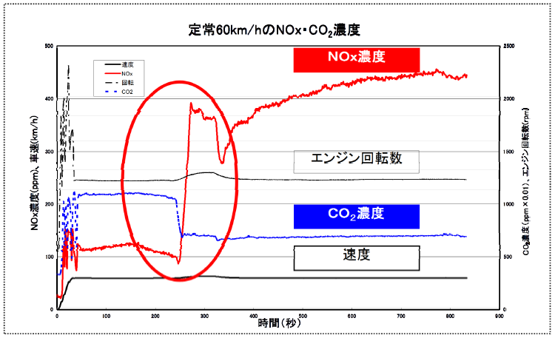
(2) Off-Cycle Emission Measures
Background
For further reduction of emissions, a sophisticated electronic control technology has been introduced to HD diesel engines.
There is a possibility of vehicles, which emission is regulated under the type approval test cycle, while fuel consumption is improved but emission of NOx and other gases are increased in conditions other than the type approval test cycle (“off-cycle”).
Based on the 10th Report of Central Environment Council, the new regulation called Global Technical Regulation (GTR) on measures for Off-Cycle Emissions (OCE) will be introduced. However, there is a need for an immediate measure to ban so-called “defeat strategy” , a nullifying function of emission reduction devices at off-cycle, prior to the GTR implementation by 2016.
Example of “Defeat Strategy”
(After the vehicle has driven at 60km/h of constant speed for 240 seconds, NOx emission jumps up, while CO2 emission decreases.)

Slide 16
Prohibition on Application of “Defeat Strategy”
Although the application of the engine control regarded as “defeat strategy” should be prohibited, some engine controls seem necessary to protect engines or vehicles despite the emission increase.
【Operational Conditions Permitting Precautionary Measures】
Operating at continuously low engine speed, heavy loads and high speed, possible overheating, driving at high altitude, low temperature, any malfunction indicated for engine via MIL light
When starting and warming up the engine, the emission control devices may not function properly owing to low functional capacity of catalysts under cold condition or other unintentional reasons.
Once the operational condition becomes one that does not require engine protection, the engine control system should be removed immediately. Furthermore, the conditions for engine protection should be restricted to ones that rarely occur in normal use, and yet this application should be kept minimal.
[Recommendation]
The government should define “defeat strategy” as the HD diesel engine control which increases emission and prohibit its application. This definition does not apply to precautionary measures for engine protection and safety, nor to the necessary conditions at start-up and warm-up, and the permissible conditions, need to be clarified in regulations.

Slide 17
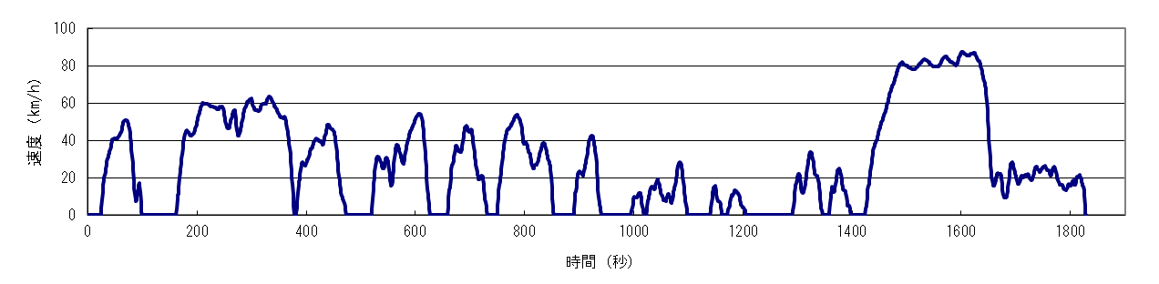
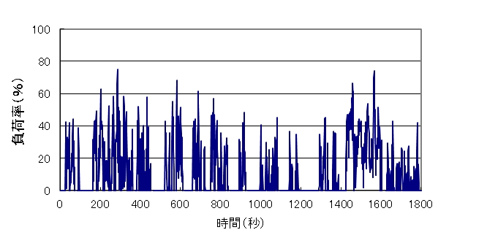
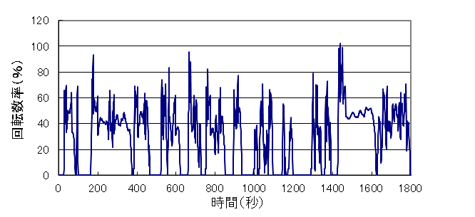
Determining Whether “Defeat Strategy” or Not
The emission test of HD diesel vehicles is conducted based on the “Vehicle Standard Specification” with engine dynamometer. The fuel consumption rate is calculated by inserting actual vehicle spec by each vehicle model on “Engine Fuel Consumption Map” and simulated on the JE05 mode for the indication of the rate, in addition to evaluation for standard conformity.
Emission Test
JE05 (Vehicle Speed Mode)
Transformed based on Vehicle Standard Spec (incl. weight, dimension, and gear number and ratio)
Simulation of
Fuel Consumption
Calculated by using Engine Fuel Consumption Map based on Vehicle Standard Spec (incl. weight and dimension) and the actual vehicle spec (gear number and ratio) and simulated on the JE05 mode
Engine Torque Rate (%))
“Engine Fuel Consumption Map”
based on the static fuel consumption rates of engine speed (6+ points) & torque (5+ points) combination
Time (s)
Engine Speed Rate (%)
Engine Torque (N･m)
Engine Torque (N･m)
Time (s)
Measured emission gas by using engine dynamometer based on torque and engine speed
Engine Speed (rpm)
Engine Speed (rpm)
The Actual Static Fuel Consumption Rate (L/s)

Slide 18
Currently, emission and fuel consumption tests for HD diesel vehicles are conducted separately. As the users tend to place higher value on fuel efficiency than reducing NOx emission, there might be a defeat strategy which does not appear on emission tests but does on fuel consumption tests or during the actual driving.
It is difficult to confirm the results by comparing of the actual engine dynamometer test and the “Engine Emission Map” simulation, as the emission amount is greatly influenced by the transient cycle.
The additional test cycle is not a good solution because the engine strategy might be changed in order to disappear in the certain test cycle.
[Recommendation]
If the difference between a calculated simulation and the actual measurement of fuel consumption during the emission test is within 3%, then the emission test is considered as “Valid” and the test result has to fulfill the emission standard. Otherwise, we consider that the defeat strategy is applied to the engine.
In addition, the government should confirm the defeat strategy application by the emission amount in the actual driving, rather than allowing to take additional tests for type approval.

Slide 19
Agenda for Off-Cycle Emissions
  Review of Condition for Engine Dynamometer Test
The NOx reduction performance of the Urea SCR System depends on the catalyst temperature. The system stops injecting urea below certain temperature so as to prevent the urea crystallization.
According to chassis-dynamometer tests of two HD vehicles equipped with the same type of engine both the temperatures of SCR catalyst and hence the emission amounts differ, due to the different layouts of Urea SCR Systems.
Urea Injection
Exhaust
SCR
DPF
Vehicle B
Vehicle A
Example of various Urea SCR System layouts
Therefore, it is appropriate that the test condition concerning the NOx after-treatment system be reflected by the most stringent among actual layout conditions.
  Introduction of Portable Emissions Measurement Systems (PEMS)
Portable Emissions Measurement Systems (PEMS) is considered as one of the measurements for emissions at actual driving.
It is desirable for consideration, despite some technical issues to be resolved, such as the test method, the permissible limit of emission, and calculation errors and calibration.

Slide 20
The Future Emission Reduction Measures for
Diesel Special Motor Vehicles
(1) Review of The Black Smoke Control
Abolition of The Black Smoke Test Using C1 Mode
The diesel special motor vehicles conforming to the 2011 Standard are equipped with Diesel Particulate Filter (DPF) and consequently the results of the Black Smoke Test on C1 mode show zero and expected to be so under the 2014 Standard.
2006 Standard Vehicle (without DPF)
2011 Standard Vehicle (with DPF)
2011 Standard Limit
[Recommendation]
For streamlining regulations, the Black Smoke Test of diesel special motor vehicles using C1 Mode is to be abolished.

Slide 21
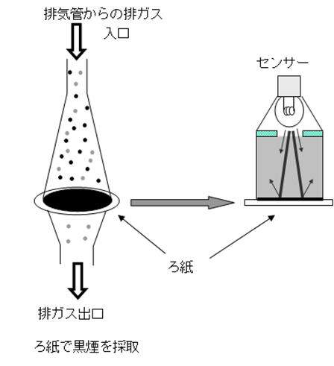
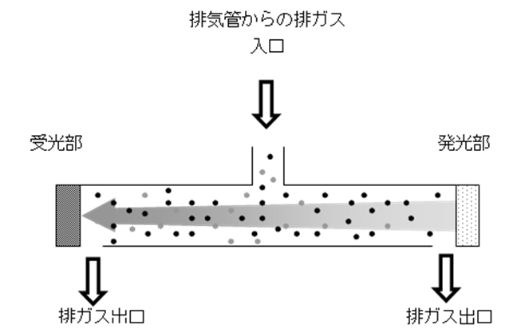
Permissible Diesel Smoke Emission Limit for In-Use Special Motor Vehicles
The diesel smoke emission of in-use special motor vehicles is measured by the density of the black smoke through the level of reflected light on filter paper, while light-absorption coefficient (opacity) measurement has been introduced upon PNLT installation.
The opacity measurement can detect Soluble Organic Fractions (SOF), while the former density measurement cannot.
Tailpipe Emission
Tailpipe Emission
Entry
Sensor
Entry
Reception Part
Irradiation Part
Filter Paper
Exit
Collected Black Smoke w/ Filter Paper
Exit
Exit
A sensor radiates light on the filter paper that collects the black smoke.
The irradiated light is attenuated by the black smoke and reflected on the filter paper.
The quantity of reduction in the reflected light is measured by this device to see the level of density in black smoke pollution.
Light from the irradiation part is attenuated by the diesel smoke by the time it reaches the reception part.
The opacity meter measures the level of opacity from this attenuated light.
The Black Smoke Density Measurement Device
Smoke Opacity Meter
[Recommendation]
The measurement system of diesel smoke emissions from in-use special motor vehicles has been changed to the opacity measurement and the permissible limit is set at 0.5 m⁻¹. This method is applied to the forthcoming standards: by the end of 2014 for vehicles with 130 to 560 kW engines, by the end of 2015 for vehicles with 56 to 130 kW engines, and by the end of 2016 for vehicles with 19 to 56 kW engines.

Slide 22



(2) Additional Measurements for Harmonization with
Non-Road Mobile Machinery (NRMM) Global Technical Regulation
Measures for Crankcase Emission
While prohibiting the release of crankcase emission is appropriate, some of the diesel special motor vehicles, particularly those used in high-pitched construction fields, have a risk of going out-of-control by leaking the engine oil into the air intake duct through the blow-by gas pipe when overturned.
Comparing the results of Non-Methane Hydrocarbons (NMHC) tailpipe emission with tailpipe plus crankcase emissions, the difference is negligible and both are far below the NMHC limit of the 2009 Standard.
Power Shovel
Wheel Type Loader
Skid Steer Loader
Examples of Special Motor Vehicles with Safety Problem
[Recommendation]
In principle, no crankcase emissions from diesel special motor vehicle engines shall be discharged directly into the ambient atmosphere. However, in case of vehicles necessary to release the crankcase emissions, the permissible limit of emissions of the vehicle will be applied to the overall exhaust emissions from the tailpipe and the blow-by gas to be released in the air. This regulation will be applied to the forthcoming standards.

Slide 23
Introduction of Ramped Modal Cycle (RMC)
RMC has the same steady operational points in its emission test with C1 Mode. Although RMC includes measurement of transition between the points, both tests have almost the same weighting factors.
The results of the two emission tests are almost the same, and thus considered that RMC is equivalent to C1 Mode.
Weighting Factors of C1 Mode
Time Ratio of RMC Steady Operational Points
RMC
[Recommendation]
RMC is regarded as equivalent to C1 Mode and will be added as an option of steady-state test cycles to the forthcoming standards.

Slide 24
Thank you !
Ministry of the Environment, JAPAN

