Slide 1
Fire suppression systems in the engine and heater compartments
Informal document GRSG-105-32
(105th GRSG, 8-11 October 2013,
agenda item 2(a))
Proposal for amendment to UN Regulation No. 107

Slide 2
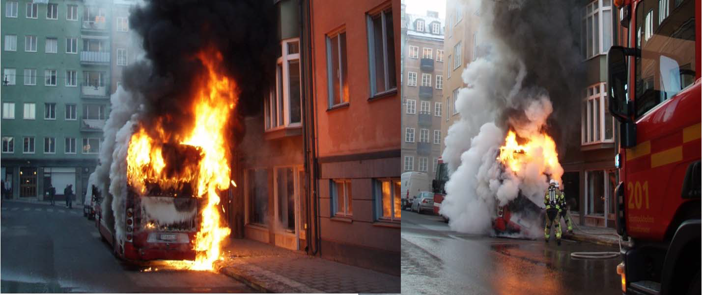
The problem:

Slide 3
The problem:
About 10 % of all buses and coaches in Sweden are involved in a fire incident during their lifespan.
350 – 400 bus and coach fires are reported in Germany every year.
The number of bus and coach fires in Finland has almost doubled over the last ten years.
The risks with CNG.
Statistics show that a significant number of fires start in the engine or heater compartment.

Slide 4
The proposal:
An annex with requirements for type approval of suppression systems is inserted. The system´s ability to extinguish fires in the environment of an engine compartment shall be tested.
Administrative provisions for type approval are added.
Annex 3 is supplemented with installation requirements. Buses and coaches with an internal combustion engine located to the rear of the driver´s compartment shall be equipped with a fire suppression system.

Slide 5
The benefit:
+ Reduced risk for passengers, drivers and other persons
+ Reduced costs for the society (the bus, infrastructure, buildings etc.)
+ Less risk for negative publicity for the public transport – a bus fire is spectacular.

Slide 6
Estimated costs:
– Engine mockup (technical service): 12 – 17.000 €.
– Test cost (system manufacturer): maximum 17.000 € for each type.
– Suppression system (vehicle manufacturer): around 1.100 € for each vehicle, installation excluded.

