Slide 1
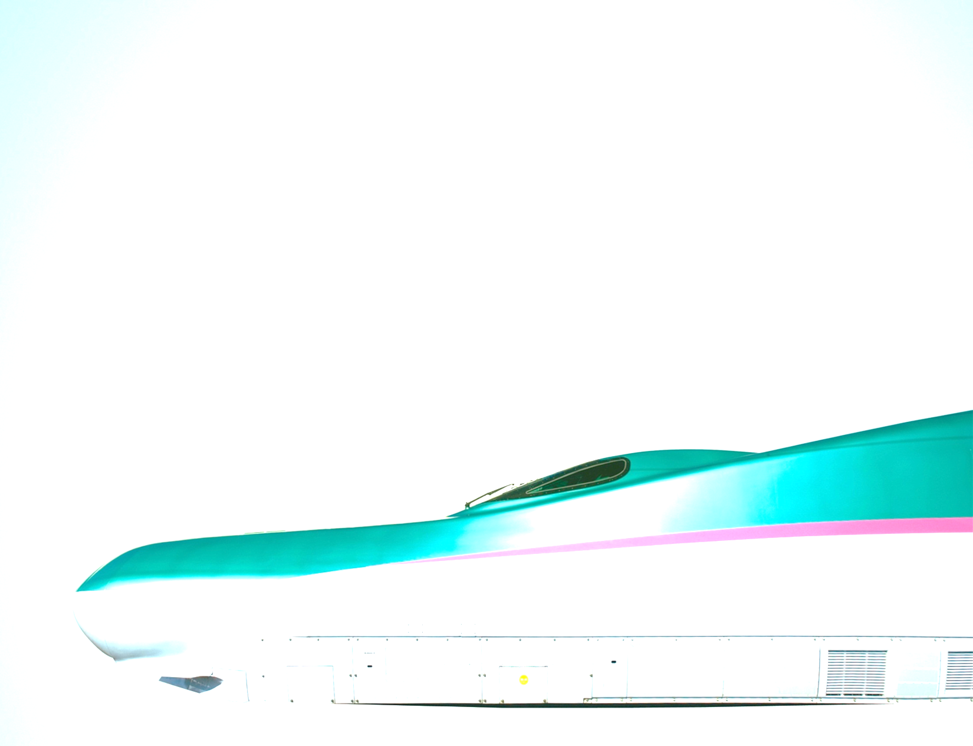
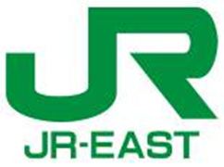
How to make increase railways sustainable
25 November 2014, Geneva
Hiroyuki WATANABE, Senior Manager
East Japan Railway Company (JR East), Brussels Branch
1

Slide 2
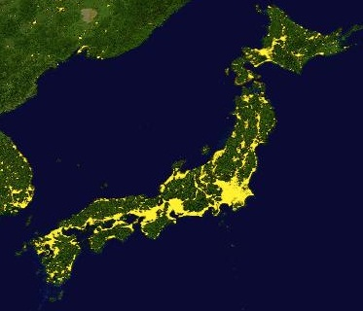
Geographical features of Japan
Narrow island country
- Surrounded on all four sides by the sea.
- High mountain ranges through the central axis of the country.
High concentration of population in the plain fields.
Large cities located in lines
55% population concentrated in the million cities. (EU: 23%)
- High ratio of rail in modal share
(about 50 % in Tokyo 23 ward)
Better conditions for railway business
2

Slide 3
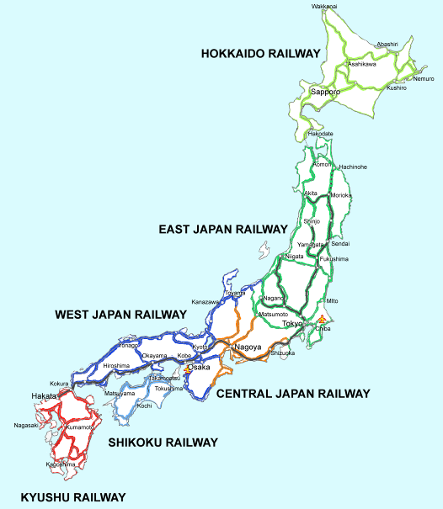
Competition between private railways
More than 200 railway companies in Japan.
Most of them are private which owns infrastructure.
Severe competitions in metropolitan areas.
-
Private railway companies
In Kyoto-Osaka-Kobe area
-
-
Private railway companies
In Tokyo Metropolitan area
Compete with
JR East
Compete with
JR West
Compete with
JR Central
Private railway companies
In Nagoya area
3

Slide 4
Vital private railway companies
Autonomic management with minimum political effects
Regional development along railway lines and diversification
- Increase of the residents and customers
- Expanding the non-railway business (Office building, Shopping center, Housing development, etc.)
- Synergistic effect of the railway business
Business model of private railway companies is successful.
4

Slide 5
Main causes of JNR’s bankruptcy
Rapid motorization
- Rapid reduction of modal share
Passenger: 50% (1960) ⇒ 22%(1987)
Organizational form of the company “Public corporation”
Lack of independent management
(Budget, investment, Personnel, Management plan etc.)
Bureaucratic culture
(Lack of volition for improving the productivity and cost)
Centralized Nation-wide Organization
Inability to manage well due to its large structure
Uniform management
(Timetable, Investment etc.)
Notes:
Japanese National Railways was bankrupt in 1987. The main cause was
① Rapid motorization,
Before motorization JNR has the dominant share of the domestic transport market, but could not cope with this changing, and lost share rapidly.
② Organizational form of company, public corporation, the state owned company,
Centralized national-wide organization
JNR had 400 thousand employees.
There were several labor unions and difficult to cope with them.
Uniform management, Uniform management could not meet the regional needs, like time table, investment, etc.
And JRN tuned to red figures at 1964 when Shinkansen operaiton started for the first time. Since this year, Japanese government subsidized every year until bankrupt.
Unlike European countries, Japan had not a system to transfer the JNR’s debt to its general accounts.
The government lent money to JNR with interest as same rate of government bond. As a result, JNR’s long-term debt reached 25 trillion yen (about 250 Billion US dollars) when bankrupt. 27 years ago.

Slide 6
JNR Reform
The model; the historical structure of vertically integrated system by private railway companies.
JNR was privatized and divided into 6 passenger and 1 freight railway companies in 1987.
East Japan Railway Company (JR East) is one of the 6 passenger companies.
6
Notes:
Unlike privatization in EU, JNR was split regionally. 6 passenger companies own infrastructure and operate trains.
There are no financial or personnel relationship among these companies. These companies are totally independent different companies.
However, these companies cooperate each other such as connections, long-distance trains , under the code of conduct.

Slide 7
JR East (1)
We own all the infrastructure of railway, operate and maintain as an integrated company.
Network: 7.513 km
Rolling stock: 13.000
Trains: 13.000 /day
Passengers: 17 mil./day
More than 30% of revenue comes from non-transport business.
Tokyo
JR East Group: $26,2 bil.
7

Slide 8
JR East (2)
No government-owned shares
(JR East is listed on the stock market)
No subsidies from national or local governments
(Approximately 30% of the shares owned by foreign institutional investors)
No red account ever ( Current Total Return Ratio*： over 30 %)
* Total Return Ratio: cash dividend and share buybacks
No PSO (Passenger Service Obligation)
No limitation on non-transport business
No government intervention (Train schedule, Fare, Capital Investment etc.)
8

Slide 9
About JR East (3)
Since privatization in 1987
No raise of fares and charges (except the consumption tax increases)
Railway accidents decreased to 1/3
Increase of 20% in passengers volume
Increase of 30% in transportation capacity
High punctuality of operation
(average operational delay per train: Shinkansen: 0.3 min.; Conventional lines: 1.1 min.)
9

Slide 10
Conclusions - Essence to be shared
Success factors for making railways sustainable are
Autonomic management
No political intervention
Possible to face customers and community
Efficient operation requiring less infrastructure and rolling stock
Possible of efficient management
Ways to meet their needs are various, not one solution.
These efforts can lead to strengthen the competiveness of railways.
10
Notes:
I think that Railway companies in European countries facing the government, not passengers.
If railway is more reliable and punctual, people will chose railway for traveling. And result railway can compete against other transport modes.

Slide 11
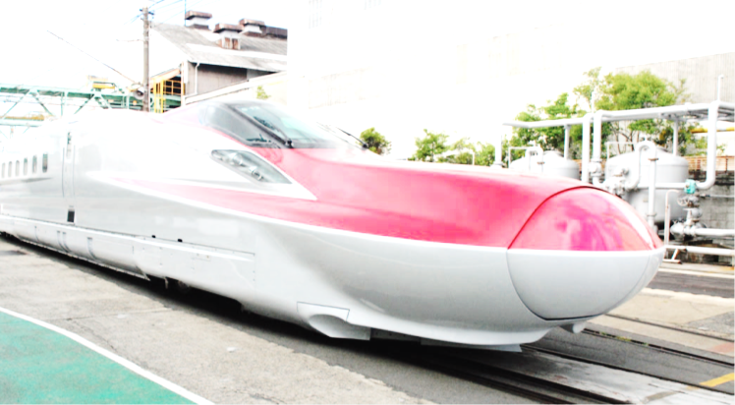
Thank you for your kind attention
Hiroyuki WATANABE
watanabe@japanrail.be

