Slide 1
Note by the secretariat (25/03/2014)
Informal document GRE-71-21
71st GRE, 1 March - 3 April 2014
Agenda item 5(a)
DETA: Database for the Exchange of Type Approvals documentation General information
DETA
Context: Revision 3 of the 1958 Agreement
Why: Modernization (replacing paperwork)
Priority: Exchange of UN Regulation No. 0 Type Approvals (IWVTA)
Add-on: Unique Identifier
➔ Can be used for the purpose of marking
Decision: WP.29 endorsed the proposal by the DETA IWG See ECE/TRANS/WP.29/1104, para. 63

Slide 2
DETA: Database for the Exchange of Type Approvals documentation Project organisation
2003
R & D
Definition of specifications
Software development
Testing
Implementation in Germany (CERON) and then in the EU (https://www.etaes.eu/)
Big scale testing phase during several years
UNECE
Migration: KBA agreed to provide support
Doc
Creation of the documentation (User Guide)
Start
Formal mandate from WP.29 to go on with DETA
UNECE project start (Budget, HR, etc.)
Administrative and technical feasibility study of ISU for the migration to UNECE/ISU and UNOG/ITCS
Implementation into the UNECE IT structure (UNECE/ISU and/or UNOG/ICTS)
Technical feasibility study
Project lead by the UK and Germany
(KBA)
Then, project lead by the informal group experts on DETA
2007
2011
2013
Project taken over by UNECE
~2016
Productive Phase
Notes:
This slide in showing the timing of the DETA project concerning essential aspects of an IT project like the R&D, the documentation, the testing and the migration on a productive system. The R&D started in 2003 (specification, software programming)
Then the supplier of the software solution created the documentation
Tests were performed on Germany. The deployment of a similar application limited to the EU was launched in the EU (ETEAS)
All these items were free of charge for UNECE, during 10 years.
In June 2013, WP.29 voted on the implementation of the project in the productive phase.
The consequences of bilateral talks between ISU and VTRIS is this presentation, requesting the validation of various aspects of the project and the migration of DETA, especially the budget.

Slide 3
DETA: Database for the Exchange of Type Approvals documentation Status at the March 2014 session of WP.29
Questions raised by the secretariat:
Can DETA be “MS SQL” based instead of “Oracle” based?
➔ WP.29 agreed with the “MS SQL” platform
Are there countries willing to make donation for DETA?
➔ No donor. Germany & KBA agreed to support UNECE
Timeline: Completion by?
➔ WP.29 agreed that end of 2016 would be sufficient
➔ IT division of UNECE is checking details with the software house, whether end of 2016 can be targeted

Slide 4
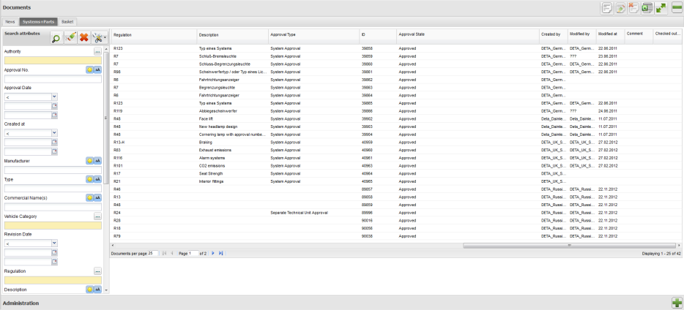
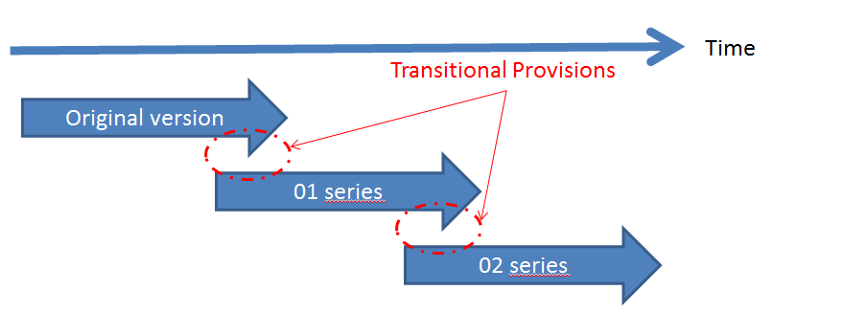
DETA: Database for the Exchange of Type Approvals documentation Impact on marking simplification for GRE
DETA will be available «just in time»
<UI> is already implemented in the software
Transitional provisions will be necessary
~ 2016
UI

