Slide 1

Environmental Control Technology Office, Policy Planning Division, Environmental Management Bureau,
Ministry of the Environment
Transmitted by the expert from Japan
Informal document GRB-62-12
(62nd GRB, 1-3 September 2015,
agenda item 9)
Overview of the "Future Policy for Motor Vehicle Noise Reduction“
(Third report presented by the Central Environment Council on July 29, 2015)
International Harmonizationof Noise Test Procedures and Target Limits
for Motor Vehicles and Tires
Ministry of the Environment
1

Slide 2
Contents
Reference: Japan’s current regulations on motor vehicle noise 3
1. Introduction 5
2. Driving noise reduction measures of four-wheelers 7
3. Review of regulations on 4-wheeler and
motorcycle proximity stationary noise 11
4. Tire noise reduction measures of four-wheelers 13
5. Action items 15
Ministry of the Environment
2

Slide 3
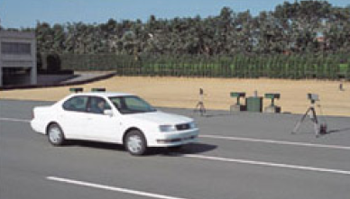
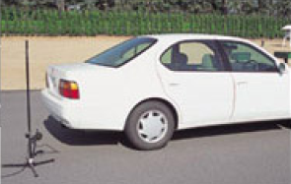
[Reference] Japan’s current regulations on motor vehicle noise
◆ Outline of motor vehicle noise regulations
Regulation method | Outline
Accelerating vehicle noise | Regulate the noise generated when a vehicle with the acceleration pedal fully depressed has passed to reduce noise from an accelerating vehicle.
Cruising vehicle noise | Regulate the noise generated when a vehicle has passed at a constant speed (50 km/h) to reduce noise from a cruising vehicle.
Proximity stationary noise | Measure the noise generated near the exhaust pipe outlet of a vehicle at a halt when the accelerator is quickly released after the engine speed has reached a certain level to clamp down on illegally modified vehicles on the street.
Accelerating/cruising noise tests (A test track is required.)
Proximity stationary noise test
(No test track is required.)
Ministry of the Environment
3

Slide 4
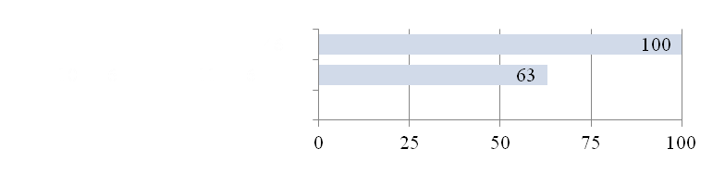
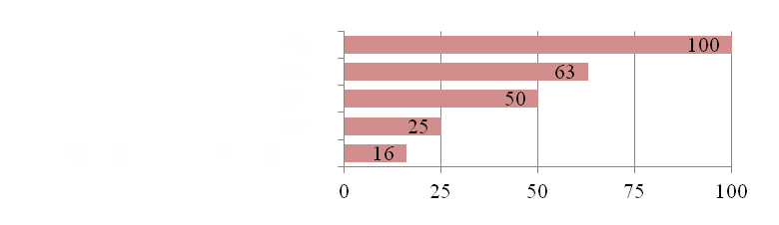
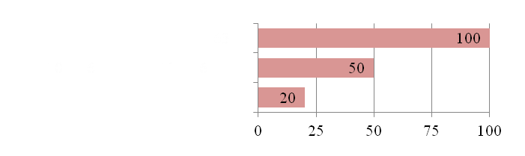
[Reference] Japan’s current regulations on motor vehicle noise
◆ History of noise regulations (passenger car)
 Accelerating vehicle noise
1971
(84 dB)
1977
(82 dB)
1979
(81 dB)
 Proximity stationary noise
1982
(78 dB)
1998 (6 seats or less), 1999 (over 6 seats)
(76 dB)
1988
(103 dB)
1998 (6 seats or less), 1999 (over 6 seats)
Rear-engined vehicle (100 dB)
 Cruising vehicle noise
Other than rear-engined vehicle (96 dB)
〃
1971
(74 dB)
1998 (6 seats or less), 1999 (over 6 seats)
(72 dB)
* The limit levels are converted to sound energy and the initial limit is set as 100%.
Ministry of the Environment
4

Slide 5
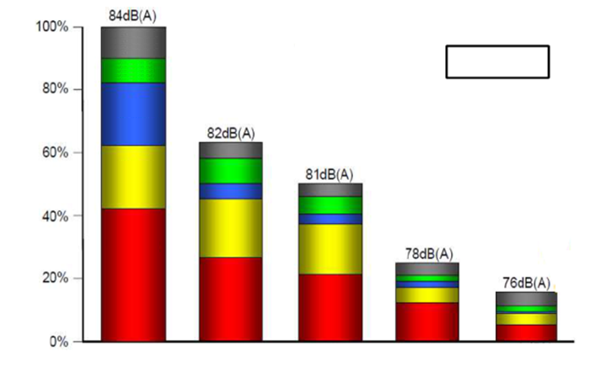
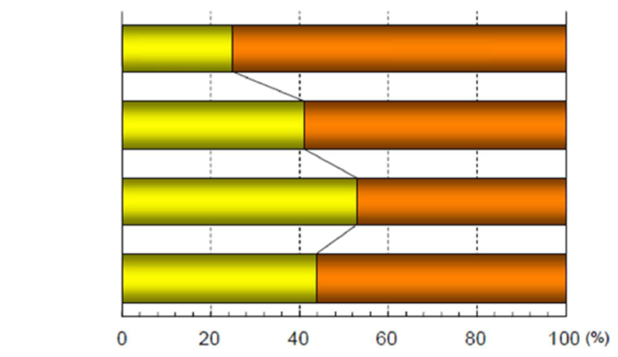
1. Introduction
[Reference] Ratio of accelerating vehicle noise sources by regulation year
 Necessity to review motor vehicle noise reduction measures
• Japan has tightened regulations, reducing both cruising vehicle noise and accelerating vehicle noise.
• As for four-wheelers, the performance of vehicles, uses and road traffic environment have changed. With the current driving noise test method, there is concern that beefing up of the regulations does not necessarily lead to reduction in motor vehicle noise.
• As the regulations on driving noise have been tightened repeatedly, tire noise, generated by the contact of a tire with road surface, accounts for a larger percentage of all the sources than before. (See the figure on the right.)
• Considering the situation above, the driving noise regulations need review as part of measures to further reduce constantly generated noise.
Tire
Passenger car
Intake system
Cooling system
Ratio of sources in loudness
Exhaust system
Engine
1971 regulations
1977 regulations
1979 regulations
1982 regulations
1993 regulations
[Reference] Cruising vehicle noise by source
Passenger car
Engine
Other
Tire
Small truck
Midsize truck
Large truck
Ministry of the Environment
5

Slide 6
1. Introduction (continued)
 Past reports
• In reply to the consultation of June 29, 2005, the interim report (2008) and the second report (2012) suggested that motor vehicle noise regulations be tightened. (See the table on the right.)
Report | Noise reduction measures
Interim (Dec. 18, 2008) | • Adopt a precertification program for mufflers used for vehicles in current usage to reduce noise from accelerating vehicles.
The second (Apr. 19, 2012) | • Adopt an international standard (UN Regulation No.41 04 Series (R41-04): Motorcycle Noise) as motorcycle driving noise regulations. • Adopt an international standard (UN Regulation No.117 02 Series (R117-02): Tire Rolling Sound Emissions, Adhesion on Wet Surfaces, and Rolling Resistance) as 4-wheeler tire noise test method. (Timing of application is to be discussed.)
 Point of the third report
Discussion of action items suggested by 2nd report
• Conformity to international regulations on 4-wheeler driving noise regulations
• Review of regulations on proximity stationary noise
• Timing of application of regulations on tire noise
Ministry of the Environment
6

Slide 7
2. Driving noise reduction measures of four-wheelers
 Background
• The United Nations, with Japan playing an active role, have reviewed the UN Regulation No.51 03 Series (R51-03): Vehicle Noise Emissions in order to adapt it to changes in vehicle performance and actual urban driving condition.
• Japan needs to consider adopting the R51-03, which has been improved, to improve the fulfillment of environmental standards and reduce complaints from the residents living near roads.
Ministry of the Environment
7

Slide 8
2. Driving noise reduction measures of four-wheelers (continued)
Points in the third report
 Adoption of a new test method for accelerating vehicle noise
• According to a survey on the urban driving condition of four-wheelers in Japan, passenger cars and small commercial vehicles hardly run at wide open throttle (WOT) acceleration, which is a condition of the current accelerating noise test method. Midsize and large commercial vehicles run at WOT acceleration but the engine speed during acceleration is far greater than that used for the test.
• It is confirmed that the new international standard is applicable to our country. Japan should adopt the accelerating noise test method of the R51-03 and conform to its target limits and timing of application.
 New target limits of accelerating vehicle noise and timing of application
• The R51-03 specifies limits tightened in three stages from Phase 1 to Phase 3. It is expected that vehicles are phased out from those with larger accelerating noise first. That will produce a definite effect on reduction of motor vehicle noise. However, the UN is to examine the limits in Phase 3 after application of the limits in Phase 2 begins. At the moment, even electric cars exceed the limits and technological possibility is unknown.
• For that reason, Japan should adopt the limits in Phase 1 and Phase 2 first.
• For conformity to international standards, the limits in Phase 1 should be applied from 2016 and those in Phase 2 should be applied from 2020 except that the limit for N2 should be applied from 2022.
[Reference] Comparison of limits in current and new regulations
(Example)
Regulations
(Unit: dB)
 | Current (WOT acceleration) | Phase 1 (urban acceleration) | Phase 2 (urban acceleration)
M1 (passenger cars) | 76 | 72 | 70
N1 (small trucks) | 76 | 72 | 71
N2 (midsize trucks) | 80 | 77 | 75
N3 (large trucks) | 81 | 81 | 79
Category
Ministry of the Environment
8

Slide 9
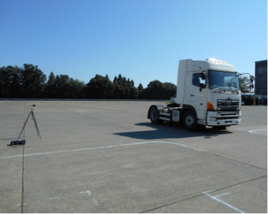
2. Driving noise reduction measures of four-wheelers (continued)
Points in the third report
 Adoption of the Additional Sound Emission Provisions
[Reference] Example of control of acceleration at the test condition of 50 km/h
• The category M1 and N1 vehicles, subject to partial throttle acceleration test, of which engines are now electronically controlled and thus it is possible to reduce the noise level only during the accelerating noise test to satisfy the limits. To prevent a noise level from soaring during actual driving, the R51-03 has the Additional Sound Emission Provisions.
• For M1 and N1 vehicles, Japan should also adopt the Additional Sound Emission Provisions when introducing the R51-03 in 2016 to prevent noise from soaring when a vehicle is driving under the conditions different from the test conditions.
 Adoption of compressed air sound regulations
Source: TNO VENOLIVA Report
• The R51-03 sets a limit on the compressed air sound generated by brake operation for vehicles having a maximum permissible mass exceeding 2.8 tons and equipped with an air brake. (The limit: 72 dB)
• In our country, noise from those vehicles should be reduced by setting a limit on the sound generated by brake operation. Therefore, Japan should adopt the compressed air sound regulations when introducing the R51-03 in 2016 and use the limit of the R51-03 (72 dB) as the target limit.
[Reference] Measurement of compressed air sound
Source: Japan Automobile Manufacturers Association, Inc.
Ministry of the Environment
9

Slide 10
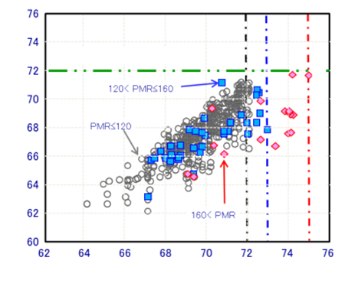
2. Driving noise reduction measures of four-wheelers (continued)
Points in the third report
 Abolition of cruising noise regulations
[Reference] Estimation of noise levels under the current cruising noise test method using the accelerating noise levels of vehicles compliant with the international standard (M1 category)
• The accelerating noise test method of the R51-03 based on the actual urban driving condition is considered to be effective for cruising noise regulation. We have tried to deduce the noise levels to be obtained by the current cruising noise test method from the accelerating noise levels of vehicles compliant with the R51-03. The result shows that vehicles compliant with the R51-03 accelerating noise regulations meet the current cruising noise limit.
• The cruising noise regulations can be safely abolished when the R51-03 is adopted in 2016, considering conformity to international regulations and adoption of the tire noise regulations below.
Current cruising noise limit
Estimated cruising noise level under the current test method dB(A)
R51-03 limit (Phase 1)
R51-03 noise level dB(A)
Source: Japan Automobile Manufacturers Association, Inc.
Ministry of the Environment
10

Slide 11
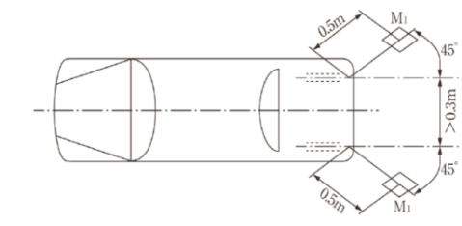
3. Review of regulations on 4-wheeler and motorcycle proximity stationary noise
 Background
• Proximity stationary noise is used as an alternative criterion to see whether the acceleration noise level is maintained even after a vehicle has been used for some time.
• Japan uses absolute value regulations for proximity stationary noise. They set the same limit for new vehicles and vehicles in current usage of the same vehicle type.
• European countries use relative value regulations. The proximity stationary noise of a new vehicle is measured but no limit is set. Vehicles in current usage are required to meet the proximity stationary noise levels equivalent to those measured when they were new. These regulations are effective in detecting an increase in proximity stationary noise.
• We have examined what to do with the proximity stationary noise regulations on the vehicles covered by the R51-03 and R41-04, for conformity to the international regulationss.
[Reference] Outline of proximity stationary noise test method
Direction of exhaust flow
Direction of exhaust flow
[Measuring method]
Measure the noise at the height of the exhaust pipe at a 45-degree angle to the exhaust flow from the exhaust pipe and 0.5 m away from the center of the opening of the pipe with a constant engine speed.
Ministry of the Environment
11

Slide 12
3. Review of regulations on 4-wheeler and motorcycle proximity stationary noise (continued)
Points in the third report
 Abolition of proximity stationary noise regulations of new vehicles
• The R51-03 and R41-04 do not require proximity stationary noise regulations of new vehicles as driving noise of a new vehicle is regulated by the accelerating noise test method based on actual urban driving condition. Therefore, the proximity stationary noise regulations of new vehicles can be safely abolished when the R51-03 is adopted in 2016, considering conformity to international regulations.
 Adoption of relative value regulations for vehicles in current usage
• Many of recent four-wheelers and motorcycles generate noise much lower than the limits of the proximity stationary noise regulations. Difference in noise level between model years is increasing. Japan should adopt relative value regulations. They will be effective in detecting an increase in proximity stationary noise due to improper maintenance or illegal modification.
• For the vehicles in current usage covered by the R51-03 and R41-04, relative value regulations should be adopted when the R51-03 is adopted in 2016. (See the table on the right.)
• For vehicles the absolute value regulations have been already applied, those regulations should be maintained. About vehicles in current usage having the genuine mufflers replaced with those verified by a performance certification program, adoption of relative value regulations should be discussed later. For the time being, the current regulations should be maintained.
[Reference] Comparison of current and new regulations (example)
(Unit: dB)
Regulations Vehicle type | Current (absolute value) | New (relative value)
Motorcycle | 94 | Equivalent to the proximity stationary noise levels measured when they are new
Passenger car | 96
Small truck | 97
Midsize truck | 98
Large truck | 99
Ministry of the Environment
12

Slide 13
4. Tire noise reduction measures of four-wheelers
 Background
• The second report suggests that Japan should adopt the R117-02 and adapt the target limits to those of the R117-02.
• We have discussed the timing of application of the target limits, which was an action item of the report.
Ministry of the Environment
13

Slide 14
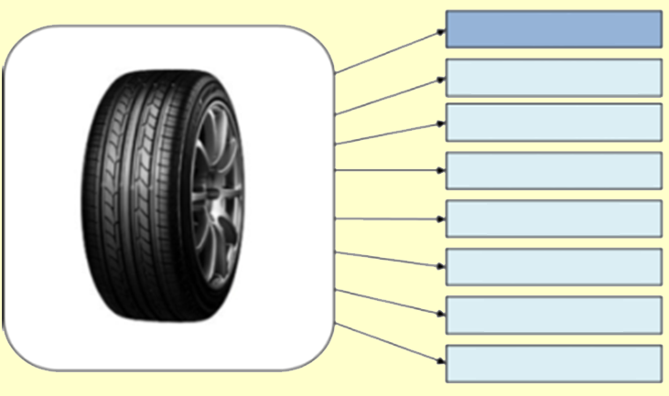
4. Tire noise reduction measures of four-wheelers (continued)
Points in the third report
[Reference] Capabilities required of tires
 Application of target limits for tire noise
• The tire noise regulations should be applied to new vehicles first, which are easier to adopt new regulations for.
• The R117-02 specifies three technical requirements: Tire rolling sound (noise), wet grip adhesion (safety), and rolling resistance (fuel efficiency). Considering time required for tire development including those capabilities, the limits should be applied as below.
Noise
Maneuverability
Wet grip
Rolling resistance
Durability
Ride
Abrasion resistance
Resistance to uneven wear
 Timing of application of target limits for tire noise
[Reference] Contradictory capabilities to tire noise reduction technology
Vehicle type | Application of tire noise target limits
Passenger car | 2018
Small commercial vehicle and 3.5-ton or lighter trailer | 2019
Midsize and large commercial vehicles and over 3.5-ton trailer | 2023
Classification |  | Noise reduction technology/method | Effects |  |  | Contradictory capabilities
 |  |  | Resonance | Vibration | Other
Tread pattern | Crosswise groove | Reduce groove volume: Make them short, shallow and narrow (especially short for lugs). |  | ❒ |  | Wet grip, abrasion, uneven wear, rolling resistance (fuel efficiency) and cost
 |  | Optimize the shape inside grooves: Control resonance and vibration. |  | ❒
 |  | Optimize the groove angle on front edge of contact area and right/left groove phase. | ❒ |  |  | Uneven wear
 | Circumfer-ential groove | Reduce groove volume: Reduce the number and make them shallow and narrow. |  |  |  | Wet grip, abrasion, uneven wear, rolling resistance (fuel efficiency) and cost
 |  | Narrow the width of groove zigzags. |  |  |  | Uneven wear
 |  | Optimize the shape inside grooves and the positions of grooves. | ❒ | ❒ |  | Straight line stability
 | Special groove | Special design inside grooves: Partition, dummy, etc. |  |  |  | Wet grip and uneven wear
 | Sipe | Reduce or remove them. |  |  |  | Wet grip and uneven wear
 | Pitch | Reduce the number of circumferential pitches. |  |  |  | Wet grip, uneven wear, rolling resistance (fuel efficiency) and cost
 |  | Pitch variation: Random arrangement |  | ❒ |  | Uneven wear
 The effect is great.  The effect is small. [Remark] The wet grip includes the capability on snow and ice.
• Midsize and large commercial vehicles and over 3.5-ton trailers should meet the R117-02 noise requirements in 2020 to take noise reduction measures early while considering the timing of their launch into the market.
Source: Taken from a report on tire road noise by the Japan Automobile Tyre Manufacturers Association, Inc.
Ministry of the Environment
14

Slide 15
5. Action items
 Review of 4-wheeler driving noise regulations
• The Phase 3 limits were included on condition that the UN would conduct research after the Phase 2 limit have been applied to review the limits if necessary. In Japan, it is difficult to say whether conformity to the Phase 3 limits is technically possible at the moment. The timing of application of the Phase 3 limits should be discussed upon research, including technological review, and research by the UN.
 Review of motorcycle driving noise regulations
• About the L3 category, as the 2nd report suggested conformity to the R41-04, a field survey should be conducted on motorcycles the R41-04 has applied to and, if necessary, the limits should be reviewed.
 Review of muffler performance certification program
• The interim report suggested adoption of the muffler precertification program (changed to the muffler performance certification program in 2011) for vehicles in current usage. About five years has passed since the program was adopted. Studies should be conducted on actual noise levels from mufflers and spread of the program. If necessary, the program should be reviewed, including adoption of relative value regulations.
 Remaining problems on tire noise regulations
• Adoption of regulations on vehicles in current usage (including handling of recycled tires) should be examined.
Ministry of the Environment
15

Slide 16
Thank you for your attention.
More information?
Environmental Control Technology Office,
Environmental Management Bureau,
Ministry of the Environment
Phone +81-3-5521-8296
FAX +81-3-3593-1049
E-mail ATSUSHI_KASAI@env.go.jp
Ministry of the Environment
16

