Slide 1
ECE REGULATION 48
Submitted by the expert from the International Automotive Lighting and Light Signalling Expert Group (GTB)
Informal document GRE-73-15
(73rd GRE, 14-17 April 2015
agenda item 6 (a))
Rear direction indicator lamp and stop lamp separation
Examples and explanations
In connection with
document ECE/TRANS/WP.29/GRE/2015/3

Slide 2
EXAMPLE 1
For this lamp the requirement on colour changes was not applied since the parts composing the two functions were considered not adjacent (being separated by a “neutral” area).
However this interpretation is ambiguous (“Adjacent” has slightly different meaning in different languages and whether considered as a mathematical term or not).
The text proposed for paragraph 5.7.1.3.1. clarifies the condition of application of the “colour changes” criteria, and limits the application of these criteria to lamps whose apparent surface is composed of two or more parts.
Based on the new text such a solution is acceptable as it is not detrimental for the correct perception of the signals.

Slide 3
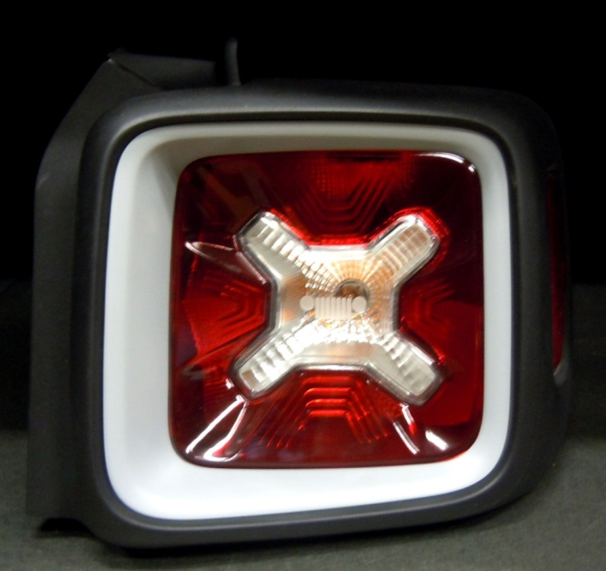
EXAMPLE 2
Based on the present requirements, this solution cannot be approved. Consequently it was modified to fulfil the requirements, even if it is clearly not detrimental for the correct perception of the signals, also in this original form.
Since the grouping of two “solid” (continuous) apparent surfaces like these gives no safety problems, the proposed text excludes the “solid” apparent surfaces from the application of paragraph 5.7.1.3.1. requiring in any case, in paragraph 5.7.1.3.2., that the apparent surfaces do not overlap.

Slide 4
EXAMPLE 3
All the red area is Rear Position/Stop function
All the amber area is Rear Direction Indicator function
In application of paragraph 5.9.2. of Regulation 48, position/stop functions can be “variable lamps” changing their area/intensity in relation to the activation of another function.
In this case, at the activation of the direction indicator, the left part of the lamp (that could cause confusion for the correct perception of the signals) is switched off while the remaining part still fulfils the applicable photometric/colorimetric requirements.
Even if this possibility is already included in the requirements of paragraph 5.9.2., a cross reference is introduced in paragraph 5.7.1.3.3. to avoid non-uniform interpretations.

Slide 5
THANK YOU FOR YOUR ATTENTION.
ANY QUESTION?

