Slide 1
A new EU Regulation for engines in non-road mobile machinery (NRMM)
Informal document GRPE-73-06
73rd GRPE, 6-10 June 2016,
agenda item 6(a)
GRPE session, June 2016
European Commission
Unit C.4 - Automotive and Mobility Industries
DG for Internal Market, Industry, Entrepreneurship and SMEs

Slide 2
DIRECTIVE 97/68/EC
OF THE EP AND OF THE COUNCIL of 16 December 1997 on the approximation of the laws of the Member States relating to measures against the emission of gaseous and particulate pollutants from internal combustion engines to be installed in non-road mobile machinery (NRMM)
Directive 97/68/EC
It´s about
  Engines – not vehicles or machinery!
  Pollutant emissions – gaseous (CO, NOx, HC) & particulate (PM)!
  Emission limits & type-approval procedures

Slide 3
Guiding principles for
revising EU legislation
Pathways for revision of
Directive 97/68/EC
Scope extension
Enhancing provisions
New emission limits
  Strive alignment with (higher) US EPA standards, where appropriate
  Address health-damaging evidence of ultrafine particulate matter
  Catch up with on-road technology trends
  Harmonise requirements across EU
  Simplification & closing loopholes in legislation

Slide 4
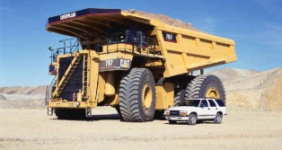





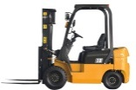
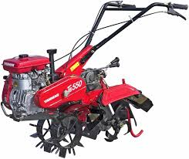
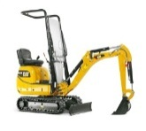
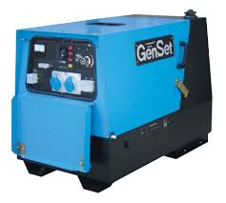
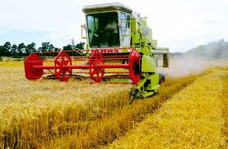
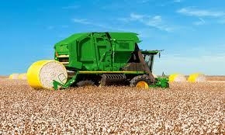
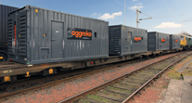
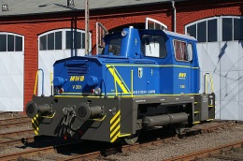
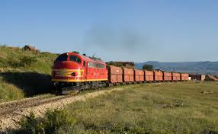

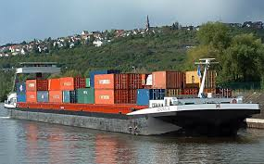


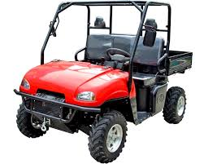
New NRMM Regulation
New scope of application
Land-based NRMM
SI – Spark-ignited (gasoline)
SI 0-19kW
SI 19-56kW
>560kW
56-130kW
130-560kW
Gen-Sets >560kW
CI 0-8kW
CI 8-19kW
CI 19-37kW
CI 37-56kW
CI – Compression-ignited (diesel)
Rail - Locomotives
>0kW
Rail - Railcars
>0kW
Inland Waterway Vessels (IWV)
37-75kW
75-130kW
130-300kW
300-1000kW
≥1000kW
Auxiliaries 560-1000kW
Auxiliaries ≥1000kW
Snowmobiles
>0kW
Scope of Directive 97/68/EC
All Terrain & Side-by-Side Vehicles
>0kW
Scope extensions new NRMM Regulation

Slide 5
Some key features
of the new Regulation
Regulation
Enhanced market-surveillance provisions
Simplification of administrative procedures
New transition scheme, with staggered introduction dates
Monitoring of emissions from in-service engines
Type-approval also for gas-fuelled engines (partial/mono)
Eliminating "greyzones" (field testing, sep. shipment, ATEX,…)
Early type-approval for Stage V

Slide 6
Adoption process
NRMM Regulation
Co-Decision Act (CDA)
Essential elements
Recitals
Chapters & Articles
Annexes
Supplementing Regulation
on NRMM
Delegated Act (DA)
Non-Essential elements
Recitals
Chapters & Articles
Annexes
Supplementing Regulation
on NRMM
Implementing Act (IA)
Non-Essential elements
(mostly of adminstrative nature)
(Recitals)
Chapters & Articles
(Annexes)
EP
Council
Commission
Sep
2014
Oct
-
Dec
2015
Jan
-
Dec
2016
TODAY
Jan
-
Dec
Adoption by Legislators
Entry into force of NRMM Regulation
2017
Adoption by Commission
Jan-
Mar
Application of NRMM Regulation
+
Repeal of Dir 97/68/EC

Slide 7
Timetable - Application of
New NRMM Regulation
Entry into force*
Date of application*
(DA & IA adopted)
Mandatory dates of application of Stage V – Placing on the market of engines
New NRMM Regulation
1.1.2016
1.1.2017
1.1.2018
1.1.2019
1.1.2020
1.1.2021
SI engines 19-56 kW
CI engines <19 kW
Engines >560 kW
SI engines for ATV & SBS
SI engines for snowmobiles
SI engines <19 kW
CI engines 19-56 kW
Engines 130-560 kW
Engines inland waterway vessels 19-300kW
YEAR 1
YEAR 2
YEAR 3
TA
Engines 56 -130 kW
Engines inland waterway vessels >300kW
YEAR 1
YEAR 2
YEAR 3
YEAR 4
TA
Engines for rail
YEAR 1
YEAR 2
YEAR 3
YEAR 4
YEAR 5
TA
Mandatory dates of application of Stage V – EU Type-Approval of engines
* Floating date!

Slide 8
Land-based NRMM
(CI <56kW & Engines >56kW)
>560kW
CI 0-8kW
CI 8-19kW
CI 19-37kW
CI 37-56kW
56-130kW
130-560kW
Gen-Sets >560kW
Scope of Directive 97/68/EC
Additional in new NRMM proposal

Slide 9
Land-based NRMM
(SI engines)
SI 0-19kW
SI 19-56kW
Snowmobiles
>0kW
All Terrain & Side-by-Side Vehicles
>0kW
Scope of Directive 97/68/EC
Additional in new NRMM proposal

Slide 10
UNECE Regulation 96 on
Uniform provisions concerning the approval of compression ignition (C.I.) engines to be installed in agricultural and forestry tractors and in non-road mobile machinery with regard to the emissions of pollutants by the engine
UNECE Reg 96
R 96 covers part of the scope of new EU Regulation on NRMM
Need to align R 96 with new EU Regulation on NRMM

Slide 11
Thank you
For further information
http://ec.europa.eu/growth/sectors/automotive/index_en.htm

