Slide 1
Informal document GRSG-109-20
(109th GRSG, 29 Sept.-2 October 2015,
agenda item 6)
Study of Pedestrian’s fatal accidents
(vs. motor vehicles at low speed) in Japan
109th GRSG
MLIT, Japan

Slide 2
Roadmap toward adoption of R46
 |  | 2015 |  | 2016 |  | 2017-
Devices, and their installation, for observing the vision area(s) immediately adjacent to the front and/or the passenger’s side of vehicles of category M1, M2, M3, N1 and N2 ≤8t
 | STEP1 To amend R46 to exclude the devices and their installation from is scope
 | STEP2 To introduce the requirements for the devices and their installation into R46
Reference Activity in Japan
 | Possible amendments to R46
 | Possible amendments to Japanese national regulations
Discussion at TF and GRSG
Submission of formal doc.
to WP29
Agreed
at GRSG
Voting
at WP29
Effective date of the revision
Submission of Inf.doc. to TF
Discussion at TF and GRSG
Submission of Inf.doc. to TF or GRSG
if needed
Discussion at GRSG
If needed
Discussion and preparation for amendments
Amending the national regulations
Adoption

Slide 3
Pedestrian’s fatal accidents (vs. motor vehicles at low speed)
Data (provided by Institute for Traffic Accident Research and Data Analysis)
Country: Japan
Type of accident： Pedestrian's fatal accidents (vs. motor vehicles)
Period： 2010 – 2014 (5 years)
Time: Daytime
Vehicle type：
1) Large vehicles designed for carriage of goods ≒ N3 and N2 (GVW>7.5)
2) Small vehicles designed for carriage of goods ≒ N2 (GVW≤7.5）and N1
3) Sedan (passenger vehicles of which capacity is 4-5 people other than SUVs and mini-vans.)
Vehicle speed: less than or equal to 10 km/h
Institute for Traffic Accident Research and Data Analysis
http://www.itarda.or.jp/english/
Notes:
3
3
2015/9/29
3

Slide 4
Points of analysis
Direction/Surface of collision
Behavior of the vehicle
 | Surface of collision | Behavior of the vehicle
Front of the vehicle | 1）front | 1) Start 2) forward 3) turn right 4)turn left
 | 2）right-front (driver’s side) | 1) Start 2) forward 3) turn right 4)turn left
 | 3）left-front (the other side of the driver) | 1) Start 2) forward 3) turn right 4)turn left
Side of the vehicle | 4）right-side (driver’s side) | turn right
 | 5）left-side (the other side of the driver) | turn left
Rear of the vehicle | 6）rear | Back
 | 7）rear-right (driver’s side) | 1) turn right 2) back
 | 8）rear-left (the other side of the driver) | 1) turn left 2) back
Notes:
4
4
2015/9/29
4

Slide 5
Pedestrians killed by the vehicles at low speed
Collision between pedestrians and vehicles at low speed
Could the driver be aware of the pedestrian?
One of the promising measures is improving the driver’s view
Notes:
5
5
2015/9/29
5

Slide 6
The number and rates of Pedestrian’s accidents killed by vehicles at low speed
Type of vehicles | The number of pedestrians killed by the vehicles (≤ 10km/h) (A) Total number of pedestrians killed by the vehicles (B) | Rates (A/B)
1) Large vehicles designed for carriage of goods (≒N3 and N2 (GVW>7.5) ) | 78 243 | 32.1%
2) Small vehicles designed for carriage of goods (≒N2 (GVW≤7.5）and N1） | 92 640 | 14.4%
3) Sedan (passenger vehicles of which capacity is 4-5 people) | 64 485 | 13.2%
Notes:
6
6
2015/9/29
6

Slide 7
Number and rates of pedestrians killed by vehicles
Vehicle type：
1) Large vehicles designed for carriage of goods ≒ N3 and N2 (GVW>7.5)
2) Small vehicles designed for carriage of goods ≒ N2 (GVW≤7.5）and N1
3) Sedan (passenger vehicles of which capacity is 4-5 people other than SUVs and mini-vans.)
Speed of the vehicles: All
Number (1)-(8) : surface of collision
Surface of collision | (1) | (2) | (3) | (4) | (5) | (6) | (7) | (8)
N (>7.5) | 105 | 54 | 60 | 7 | 7 | 2 | 5 | 3
N (≤7.5) | 351 | 116 | 134 | 4 | 2 | 24 | 5 | 4
Sedan | 274 | 82 | 101 | 3 | 2 | 15 | 2 | 6
Rates (%) (1)-(8) : surface of collision
Surface of collision | (1) | (2) | (3) | (4) | (5) | (6) | (7) | (8)
N (>7.5) | 43 | 22 | 25 | 3 | 3 | 1 | 2 | 1
N (≤7.5) | 55 | 18 | 21 | 1 | 0 | 4 | 1 | 1
Sedan | 56 | 17 | 21 | 1 | 0 | 3 | 0 | 1
\\Psfs01\予防歩行者\01【松】国交省受託(H27)\ITARDA\データ\①-3_各種構成比_歩行者_昼_死亡_1期3期比較分

Slide 8
Number and rates of pedestrians killed by vehicles
Vehicle type：
1) Large vehicles designed for carriage of goods ≒ N3 and N2 (GVW>7.5)
2) Small vehicles designed for carriage of goods ≒ N2 (GVW≤7.5）and N1
3) Sedan (passenger vehicles of which capacity is 4-5 people other than SUVs and mini-vans.)
Speed of the vehicles: less than or equal to 10km/h
Number (1)-(8) : surface of collision
Surface of collision | (1) | (2) | (3) | (4) | (5) | (6) | (7) | (8)
N (>7.5) | 26 | 14 | 22 | 3 | 6 | 2 | 4 | 1
N (≤7.5) | 27 | 17 | 15 | 3 | 1 | 21 | 4 | 4
Sedan | 17 | 15 | 8 | 2 | 0 | 14 | 2 | 6
Rates (%) (1)-(8) : surface of collision
Surface of collision | (1) | (2) | (3) | (4) | (5) | (6) | (7) | (8)
N (>7.5) | 33 | 18 | 28 | 4 | 8 | 3 | 5 | 1
N (≤7.5) | 29 | 18 | 16 | 3 | 1 | 23 | 4 | 4
Sedan | 27 | 23 | 13 | 3 | 0 | 22 | 3 | 9

Slide 9
Data of collision of surface
N (≤7.5) and Sedan:
Collision rate at side and rear is high
(Comparison with total data)
Total
10km/h≤
100%
100%
43
55
56
33
29
27
（1）
80%
80%
（2）
60%
60%
18
18
23
（3）
Fatalities of pedestrians
（4）
Fatalities of pedestrians
22
16
13
（5）
40%
18
17
40%
28
（6）
25
20%
23
22
（7）
20%
21
21
8
（8）
0%
5
9
9
0%
N(≤7.5)
（n=640）
Sedan
（n=485）
N(>7.5ｔ)
（n=78）
N(≤7.5)
（n=92）
Sedan（n=64）
N(>7.5ｔ)
（n=243）
Notes:
9
9
2015/9/29
9

Slide 10
Behavior of the vehicle killed pedestrians at low speed
Speed of the vehicles: less than or equal to 10km/h
Number
Behavior | Start | forward | turn right | turn left | Back
N (>7.5) | 39 | 1 | 13 | 18 | 7
N (≤7.5) | 16 | 2 | 39 | 6 | 29
Sedan | 8 | 4 | 28 | 3 | 21
Rates (%)
Behavior | Start | forward | turn right | turn left | Back
N (>7.5) | 50 | 1 | 17 | 23 | 9
N (≤7.5) | 17 | 2 | 42 | 7 | 32
Sedan | 13 | 6 | 44 | 5 | 33

Slide 11
Behavior of the vehicle killed pedestrians at low speed
Speed of the vehicles: less than or equal to 10km/h
start
100%
forward
17
13
6
80%
50
turn right
(driver side)
60%
42
44
Fatalities of pedestrians
turn left
(passenger side)
40%
17
7
5
back
20%
23
32
33
9
9
0%
N(>7.5ｔ)
（n=78）
N(≤7.5)
（n=92）
Sedan
（n=64）
N (>7.5) : Collision rate during start and turning left is high
N (≤7.5) and Sedan: Collision rate during turning right and back is high

Slide 12
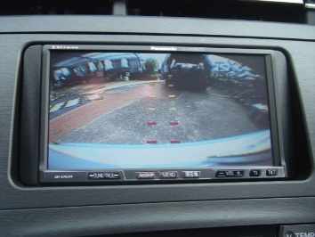
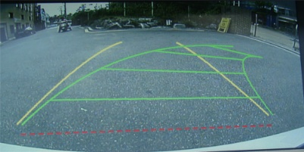
Summary
●Fatal accidents of pedestrians killed by the vehicles at low speed
The rate of fatal accidents of pedestrians killed by the vehicles at low speed is NOT low.
One of the promising measures is improving the driver’s view
●Surface of collision (pedestrian vs. vehicles at low speed)
Rate of side and rear collision is high (especially small N and Sedan)
* The possible reason why the number/rate of rear collisions of large N is not high in Japan is that voluntary fitting of camera monitoring systems (rear view monitor) are popular for these vehicles.
In Japan, about 70% of large N is fitted rear view
monitoring systems
●Behaviors of vehicles killed pedestrians at low speed
・large N: Rate of “Start” and “Turning left” (the other side of the driver) is high
⇒ Front and side vision (Class 5 and 6) is important
・Small N and Sedan: Rate of “Turning right” and “Back” is high
⇒ Turning right: Matter of direct vision (e.g. A pillar)
Back: Rear vision is also important.

Slide 13
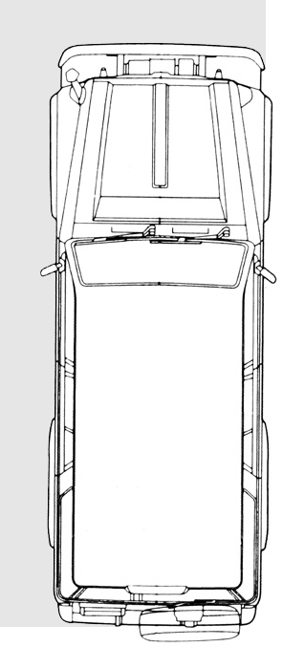
Requirement for proximity vision area
Japanese
Existing requirement
Example of a possible solution
Object
1m (φ0.3m)
Scope: M and N (<8t)
Scope: [M and N (<7.5t)]
The test object shall be seen directly or indirectly (mirrors or CMS) from the driver’s seat
The test object shall be seen directly or indirectly from the driver’s seat.
As alternative the object may be detected by devices such as sonar.

