Slide 1
SC.2 Meeting
Geneva, November 22nd, 2016
High Speed Railways
in TER Countries
Presentation
by
Mr. Helmut Adelsberger,
Consultant Engineer, Vienna, Aachen (Brussels)

Slide 2
High Speed Lines:
Definition acc. to TEN-T Regulation No. (EU) 1315/2013:
specially new-built high-speed lines equipped for speeds equal or greater than 250 km/h;
b. specially upgraded conventional lines equipped for speeds of the order of 200 km/h;
c. specially upgraded lines which have special features as a result of topographical, relief or town-planning constraints, on which the speed must be adapted to each case. This category includes connecting lines between the high-speed and conventional networks, lines through stations, access to terminals, depots etc. travelled at conventional speed by high-speed rolling stock.
(This criterion may lead to efficient improvements,
where high speed acc. to criteria a or b are not affordable.)

Slide 3
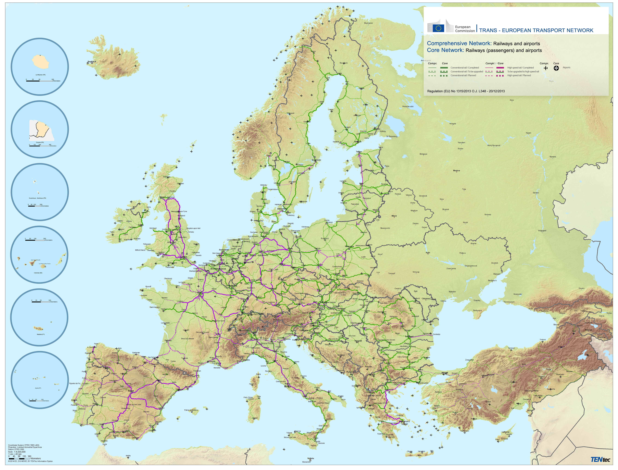
TEN-T Railways (Passengers)
Map acc. to
Reg. no. (EU)
1315/2013
conventional
lines
high speed
lines

Slide 4
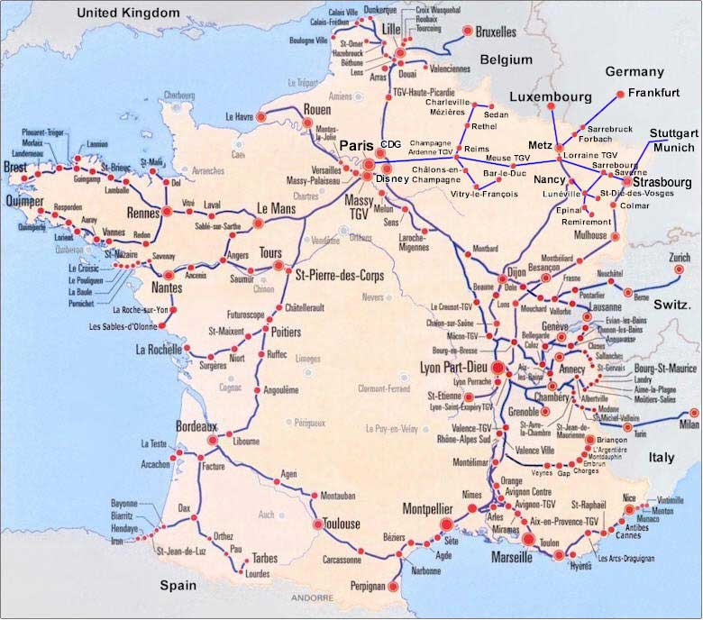
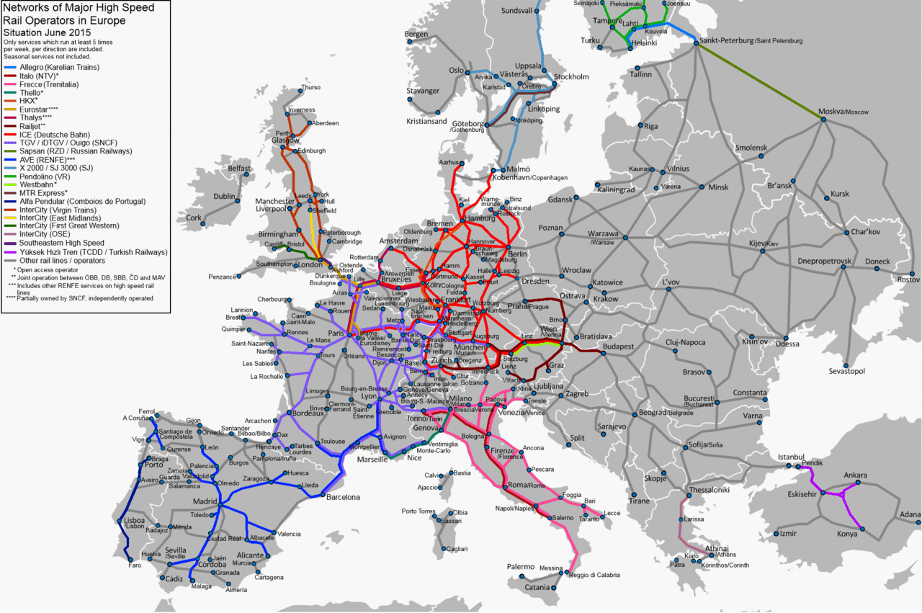
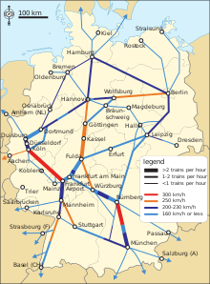
High Speed Networks in Europe
In Western Europe – despite high investments
into a high speed network across borders – travelling has not improved in every case,
due to higher fares, fewer connections,
lacking interoperability of tickets!

Slide 5
UNECE TER Masterplan („Backbone Network“; map no.3):

Slide 6
High Speed Rail: Properties, „Pros and Contras“:
The „golden mean“: half as fast as air, twice as fast as road,
can replace air transport within distances up to 3 – 4 hours
(sustainable alternative to both road and air!);
2. Conflict high speed passenger traffic – commuter and freight trains: priorities and trade-offs needed, if on same infrastructure
(as in many cases, new high-speed lines might not be affordable);
3. Need for particular technical infrastructure parameters:
radii (while gradients are lesser problem), track distance, axle load, catenary, signalling, noise walls, separate stations outside cities, etc.;
4. Expensive implementation and operation, therefore not appropriate unless between large cities at reasonable distance;
5. Tendency to reduce competing services at lower speeds
and fragmentation (in particular cross-border).

Slide 7
General description of high speed (HS) systems
General description of HS:
- definition of HS lines acc. to TEN-T Regulation (new lines, upgraded lines, exceptions),
- HS and spatial integration (monocentric – polycentric countries, …),
HS interconnections with airports (where this makes sense) ;
Operational aspects:
- HS only – mixed operation => impacts on capacity needs!
Technical aspects and interoperability:
- technical parameters of alignment (dynamic forces!),
- superstructure (stiffness and elasticity: rails, sleepers, ballast, …)
- turnouts (geometry, swing-nose, hydraulic switch setting, monitoring)
- electric power supply, catenary (oscillations of system catenary - pantographs!),
- in-cabin signalling (e.g. ERTMS: GSM-R + ETCS, level 1, 2 or 3),
TSI: next slide!
Maintenance:
impact of initial track quality on maintenance intervals and costs,
mechanised track maintenance,

Slide 8
EU: Technical standards (TSI):
INF TSI: infrastructure,
ENE TSI: energy supply,
CCS TSI: control, command, signalling,
SRT TSI: safety in railway tunnels,
RST TSI: rolling stock – locomotives and passenger rolling stock,
WAG TSI: rolling stock – freight wagons (not relevant for high-speed!),
NOI TSI: rolling stock – noise,
PRM TSI: persons with reduces mobility,
OPE TSI: operation and traffic management,
< 2012 separate for conventional and high-speed railways,
TAF TSI, TAP TSI: telematics applications for freight and passengers.
It is recommended to apply TSIs also outside EU:
- for cross-border interoperability (also beyond EU territory) and
- with view to possible future EU accession.
National standards to be used in a supplementary way
(e.g. to allow for national particularities).
10

Slide 9
Main Working Steps acc. to Terms of Reference (1):
Review of related work and initiatives, policies and studies …:
Characteristics of high speed railways in different countries
(technical parameters, operation, costs, benefits, challenges, …),
Collection and review of relevant studies and policy papers
with particular view to EU railway policy (desk-top research),
Elaboration and distribution of questionnaires (by May 31st, 2016):
- geographic, demographic and socio-economic data,
incl. national forecasts (preferably 2030, 2050);
- technical parameters of existing lines acc. to TER Masterplan (backbone network);
- information on possible or planned high speed lines;
traffic flow data in corresponding relation relations
(road, rail, air; passenger and freight; analysis and forecasts);
- information on studies and policies with respect to high speed;
- information and data on environment, etc.
12

Slide 10
Main Working Steps acc. to Terms of Reference (2):
Develop the methodology and main assumptions of the work …:
Analyse the returned (by June 30th!) questionnaires,
to „draw a picture“ of the individual countries
(economy, mobility, infrastructure, environment, …);
Update and harmonise national traffic forecasts
with each other and with global prognoses (e.g. OECD);
Elaborate a first selection of potential high speed connections
(upgrading of existing or construction of new infrastructure),
- based on Member States plans and policies,
- using the „gravity approach“ as a benchmark
(for further discussion),
- checking capacity needs with view to freight transport;
For EU MS:
- mainly to connect neighbouring non-EU TER Members,
- changes to TEN-T only long-term (TEN-T revision as from 2023).
13

Slide 11
Main Working Steps acc. to Terms of Reference (3):
3. Analyse and review the high speed rail status and needs …:
Continue and complete steps of Work Package 2:
- analysis of collected data and studies,
- elaboration of schematic maps;
Consider and propose high speed rolling stock;
Collect existing agreements on high speed links
between neighbouring TER Members;
Estimate investment needs, operation and maintenance costs;
Propose funding and financing.
Elaborate a cost-benefit analysis tool – model …:
Benefits: time savings, modal shift (environment, traffic safety, …),
better accessibilty enhances regional economy (hard to monetize!);
Costs: planning, construction, operation, maintenance (infrastructure, rolling stock).
14

Slide 12
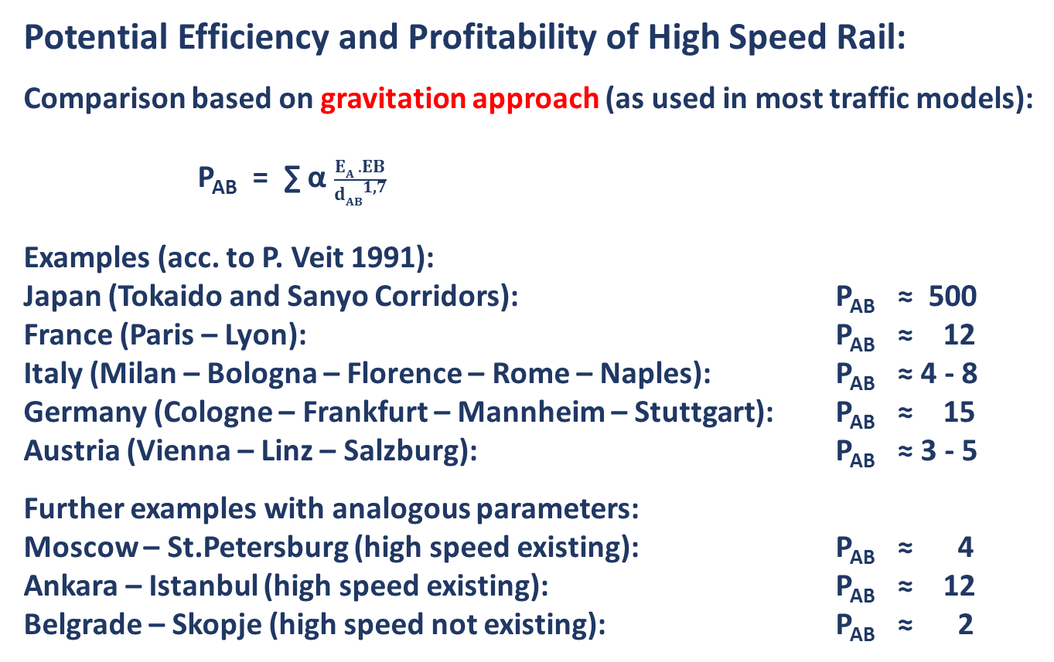
Potential Efficiency and Profitability of High Speed Rail:
Comparison based on gravitation approach (as used in most traffic models):
P_{AB} = ∑ α $\frac{EA . EB}{dAB\text{1,7}}$
Examples (acc. to P. Veit 1991):
Japan (Tokaido and Sanyo Corridors): P_{AB} ≈ 500
France (Paris – Lyon): P_{AB} ≈ 12
Italy (Milan – Bologna – Florence – Rome – Naples): P_{AB} ≈ 4 - 8
Germany (Cologne – Frankfurt – Mannheim – Stuttgart): P_{AB} ≈ 15
Austria (Vienna – Linz – Salzburg): P_{AB} ≈ 3 - 5
Further examples with analogous parameters:
Moscow – St.Petersburg (high speed existing): P_{AB} ≈ 4
Ankara – Istanbul (high speed existing): P_{AB} ≈ 12
Belgrade – Skopje (high speed not existing): P_{AB} ≈ 2
P_{AB} relative potential between A and B (Austria = 1)
α „gravitation constant“ depending on mobility etc.
E_{A} inhabitants of A
E_{B} inhabitants of B
d_{AB} distance between A and B

Slide 13
Cost-Benefit Analysis (CBA)
Scope depending on the context;
Principle, to be applied within defined area and time period:
identify all criteria of costs and benefits
to cover the range of effects completely, however not overlapping;
compare costs & benefits of measure
with cost & benefits without measure.
Railway undertakings and infrastructure owner:
assessment of internal profit (IIR) against investment cost.
National or transnational level:
3 pillars of socio-economic assessment (sustainability assessment):
- economic impacts
e.g. costs of operation, transport/travelling time reductions, …
- social impacts e.g. health
- environmental impacts, e.g. pollution, noise, climate, …

Slide 14
Non-monetisable effects
Most economic, social and environmental effects can be monetised,
at least within certain limits (provided agreement on unit costs).
This is not (or with important restrictions) possible
for macro-economic effects
such as impacts of changed accessibilty on location quality
(one of the most important effects of high speed
from a political point of view)
If these effects can be reflected in (non-monetised) indicators,
a multi-criteria analysis (MCA) can be applied,
Which is based on weighting individual criteria with pre-defined (agreed) perameters, which are applied to the indicators.
A MCA may be carried out either instead or in addition to a CBA.

Slide 15
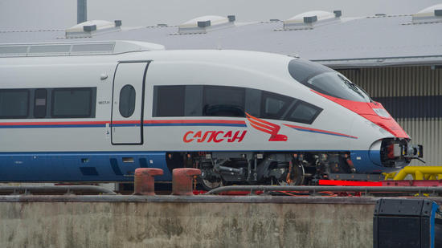
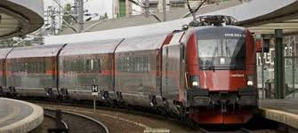
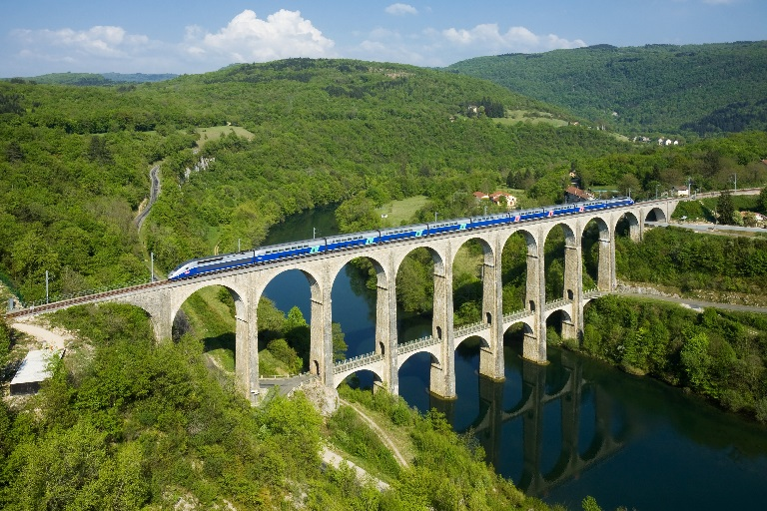
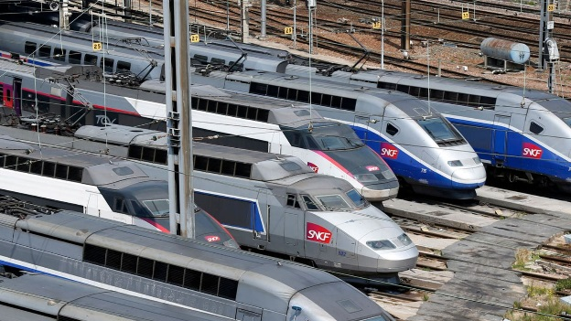
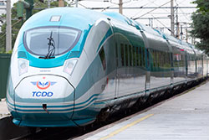
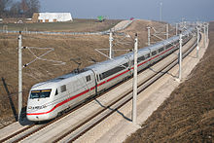
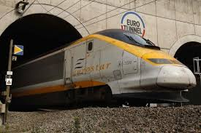

High Speed impressions:
WARNING:
What does technical interoperability help,
as we have lost interoperability of tickets,
due to market fragmentation!

Slide 16
THANKING YOU
FOR YOUR KIND ATTENTION!
Helmut Adelsberger
helmut.adelsberger@infraconcepta.at

