Slide 1
Transmitted by the expert from GTB | Informal Document No. GRE-76-24 Rev.1 (76th GRE, 25-28 October 2016) agenda item 4)
Simplification of Lighting and Light-Signalling Regulations
The GTB understanding of the application of the Unique Identifier (UI) and the UN secure internet database in accordance with Schedule 5 of the 1958 Agreement
G T B
The International Automotive Lighting and Light Signalling Expert Group
Groupe de Travail “Bruxelles 1952”
1

Slide 2
Existing Regulations
9 Groups of devices with various levels of amendment indicated in the approval markings
ONE new Regulation
Signalling Devices with various levels of amendment indicated in the electronic database
R4 - 00
9 Groups of devices with various levels of amendment within one simplified regulation
Existing approval marking system not feasible because each time the regulation is amended the markings on all devices shall be updated
Some general markings relating to paticular characteristics of the device will be retained
This simplified regulation contains :
all provisions and operate according to the existing structure of series of amendments, their transitional provisions and supplements.
transitional provisions associated with a new series of amendments of the regulations identified for each class of the device as applicable.
R6 - 01
R7 - 02
R23 - 00
R38 - 01
R50 - 02
R77 - 02
R87 - 00
R91 -00
G T B
The International Automotive Lighting and Light Signalling Expert Group
Groupe de Travail “Bruxelles 1952”
2

Slide 3
The Basic Approach to the Simplified Regulations
The simplified regulation will contain all provisions and operate according to the existing structure of series of amendments, their transitional provisions and supplements.
The transitional provisions associated with a new series of amendments of the regulations will be identified for each class of the device as applicable.
It is expected that all contracting parties to the 1958 agreement will adopt this regulation but they still have the freedom to choose to adopt, or not to adopt, particular devices. These decisions will be recorded in ECE/TRANS/WP.29/343 that lists the status of the annexed Regulations and of the amendments).
There is no requirement for the devices to carry the traditional type approval markings. These markings will be replaced by the UN secure internet database in accordance with Schedule 5 of the 1958 Agreement where all type approval documentation is held.
This approach is necessary because the principle of grouping a number of devices into a single regulation is incompatible with the use of detailed approval markings on the devices.
The use of the “Unique Identifier” giving access to the UN secure internet database will provide all information necessary to check conformity of the individual devices with their actual type approval documentation.
G T B
The International Automotive Lighting and Light Signalling Expert Group
Groupe de Travail “Bruxelles 1952”
3

Slide 4
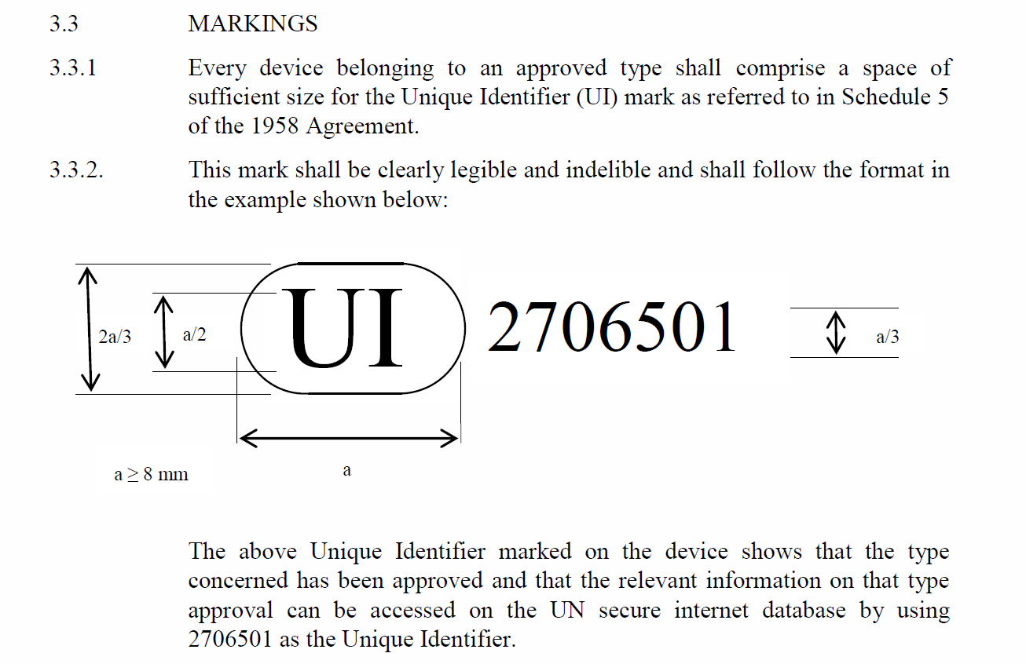
Text Proposed by the IWG-DETA for insertion into the section in the UN Regulations concerning markings
G T B
The International Automotive Lighting and Light Signalling Expert Group
Groupe de Travail “Bruxelles 1952”
4

Slide 5
Text of Revision 3 of the 1958 Agreement - Schedule 5
Circulation of approval documentation
Where an approval authority is required to or is requested to provide a copy of an approval and its attachments, it shall send the documents as paper copies, or by e-mail in electronic format, or by utilizing the secure internet database established by the United Nations Economic Commission for Europe.
GTB understands: The UN secure internet database will be in operation by January 2019 and in time for the entry into force of the simplified Regulations
Documents stored on the UN secure internet database shall consist of at least the documents specified in each UN Regulation. These shall include documentation communicating to Contracting Parties notice of approval, of extension, of refusal or withdrawal of approval or where production is definitely discontinued of a type of wheeled vehicles, equipment or parts pursuant to the UN Regulation.
GTB understands: All the documents specified in the new simplified regulations will be stored in the UN secure internet database. These will be the ”usual” documents that are currently required in the existing regulations.
G T B
The International Automotive Lighting and Light Signalling Expert Group
Groupe de Travail “Bruxelles 1952”
5

Slide 6
Text of Revision 3 of the 1958 Agreement - Schedule 5
Circulation of approval documentation
If the type approvals applicable to a wheeled vehicles, equipment or parts are stored on the secure internet database, then the approval markings required by UN Regulations may be replaced by a Unique Identifier (UI) preceded by the symbol UI, unless specified otherwise in the UN Regulations. Such unique identifier shall be generated by the database automatically.
GTB understands: a) GRE can decide that the Unique Identifier shall be used in place of the normal approval markings
b) The Unique Identifier will give access to the “usual” documents and it will only change for the same reasons that a new approval marking would be required, i.e. an extension to an approval would not trigger a change to the Unique Identifier.
All Contracting Parties applying a UN Regulation shall have access to the information for that UN Regulation contained in the database by using the Unique Identifier and this will provide access to the relevant information relating to the specific approval(s).
GTB understands: Access rights will be defined for certain other users of the UN secure internet database in addition to the Contracting Parties.
G T B
The International Automotive Lighting and Light Signalling Expert Group
Groupe de Travail “Bruxelles 1952”
6

Slide 7
Text of Revision 3 of the 1958 Agreement - Schedule 5
Circulation of approval documentation
UN Regulations annexed to the 1958 Agreement may require the circulation of type approvals by electronic copies utilizing the secure internet database, where necessary for the efficient operation of the approval process, subject to the access rights as defined by the Contracting Parties.
GTB understands: As the secure internet database will be necessary for the efficient operation of the Simplified Regulations GRE can decide that the Unique Identifier shall be used in place of the normal approval markings.
It is necessary to verify the GTB understanding of the operation of Schedule 5 in the context of the Regulations for which GRE is responsible.
G T B
The International Automotive Lighting and Light Signalling Expert Group
Groupe de Travail “Bruxelles 1952”
7

