Slide 1
Night demonstration:
H4 Halogen Reflector headlamp versus representative LED headlamp
Transmitted by the expert from GTB | Informal Document No. GRE-76-25 (76th GRE, 25-28 October 2016, agenda item 7 (f))
Geneva, 26.10.2016
Dr. Rainer Neumann
GTB Document No.CE-5360

Slide 2
LED Headlamps : Advantages
Low energy consumption
Reduced CO₂
Effective solutions also with small sized headlamps
Long life time
Flexibility in styling solutions keeping safe light output
Colour temperature leads to a well accepted light by consumers
GTB Document No.CE-5360

Slide 3
Proposal for Future Halogen & LED Headlamps
Intention: Target to demand a good light pattern on the road rather than requiring a certain number of lumens emitted by the light source
Introduction of a performance based requirement alternatively to the exisiting 1000 lm objective luminous flux for LED and halogen light sources
Take into account the given state of the art globally
GTB Document No.CE-5360

Slide 4
New Performance Proposal for LED Headlamps
+1 deg
Zone B >= 200lm
-3.5 deg
Zone A >= 400lm
-15 deg
-30 deg
+30 deg
GTB Document No.CE-5360

Slide 5
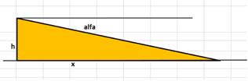
Mounting Height (h), Inclination (alfa), distance (x)
Alfa
h
x
GTB Document No.CE-5360

Slide 6
Headlamp mounting height [cm] | Ray inclination [deg] | Distance on the road [m]
85 | 0.57 | 85.4
 | 2.50 | 19.5
 | 3.50 | 13.9
 | 5.00 | 9.7
Headlamp mounting height [cm] | Ray inclination [deg] | Distance on the road [m]
65 | 0.57 | 65.3
 | 2.50 | 14.9
 | 3.50 | 10.6
 | 5.00 | 7.4
GTB Document No.CE-5360
Page 6

Slide 7
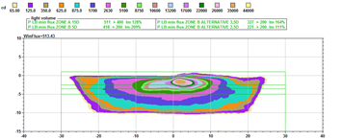
Representative LED Headlamp (out of 60) , 513 lm total luminous flux
GTB Document No.CE-5360

Slide 8
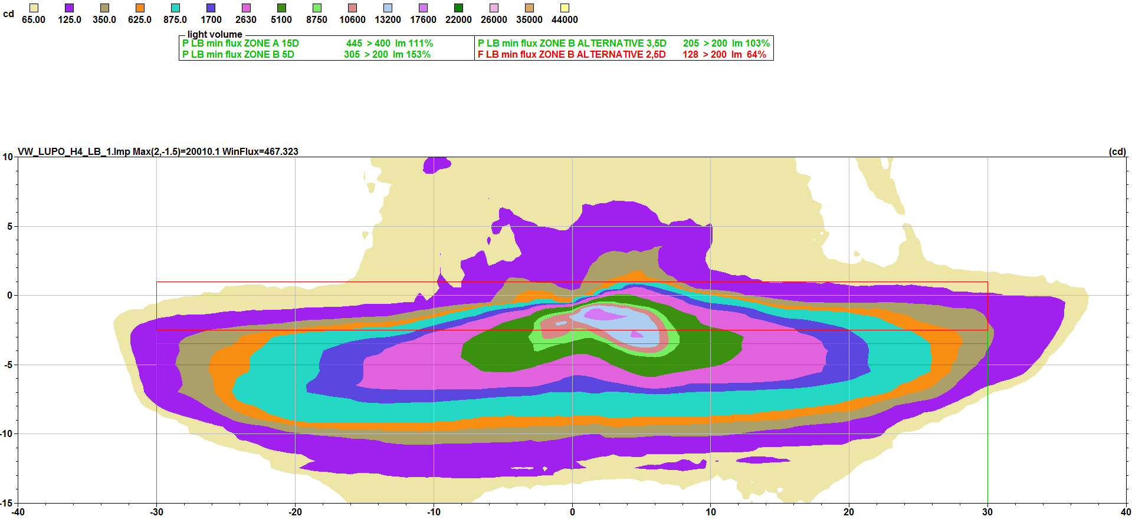
Reflector Headlamp H4 , 155mm diameter , 467 lm
GTB Document No.CE-5360

Slide 9
Photometric Results
Representative LED Headlamp :
total luminous flux : 513 lm
Zone A : 511 lm
Zone B : 327 lm
Reflector H4 Headlamp, 155mm diameter :
total luminous flux: 467 lm
Zone A : 445 lm
Zone B : 206 lm
GTB Document No.CE-5360

Slide 10
Reflector Headlamp H4 , 155mm diameter , 467 lm
GTB Document No.CE-5360

Slide 11
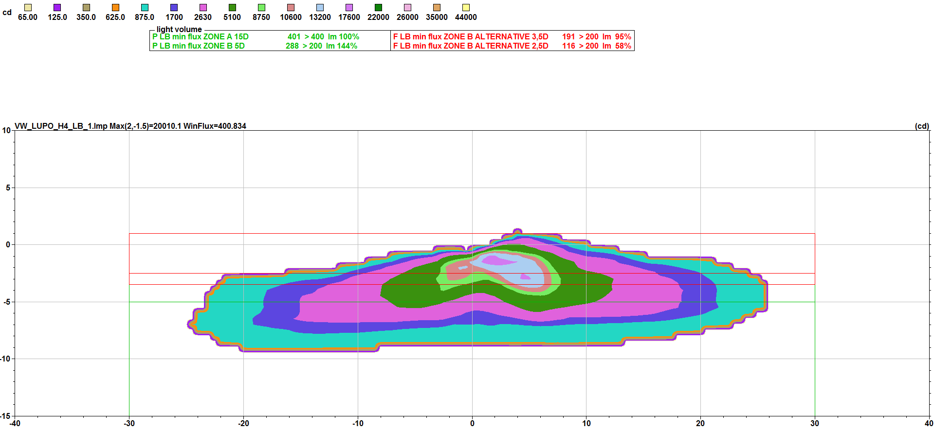
Reflector Headlamp H4 , 155mm diameter, 400 lm
GTB Document No.CE-5360

Slide 12
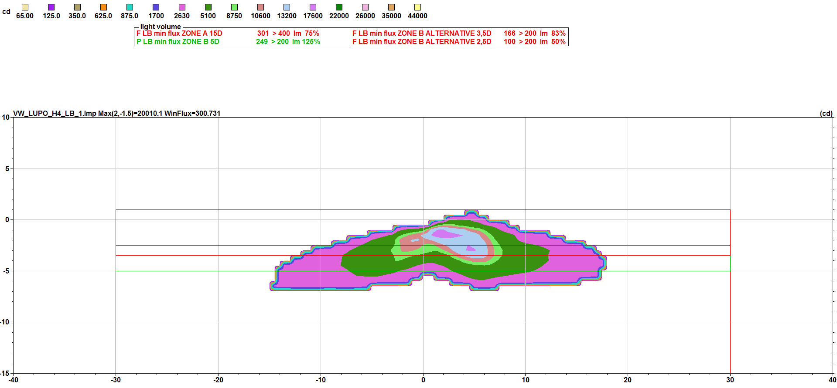
Reflector Headlamp H4 , 155mm diameter, 300 lm
GTB Document No.CE-5360

Slide 13
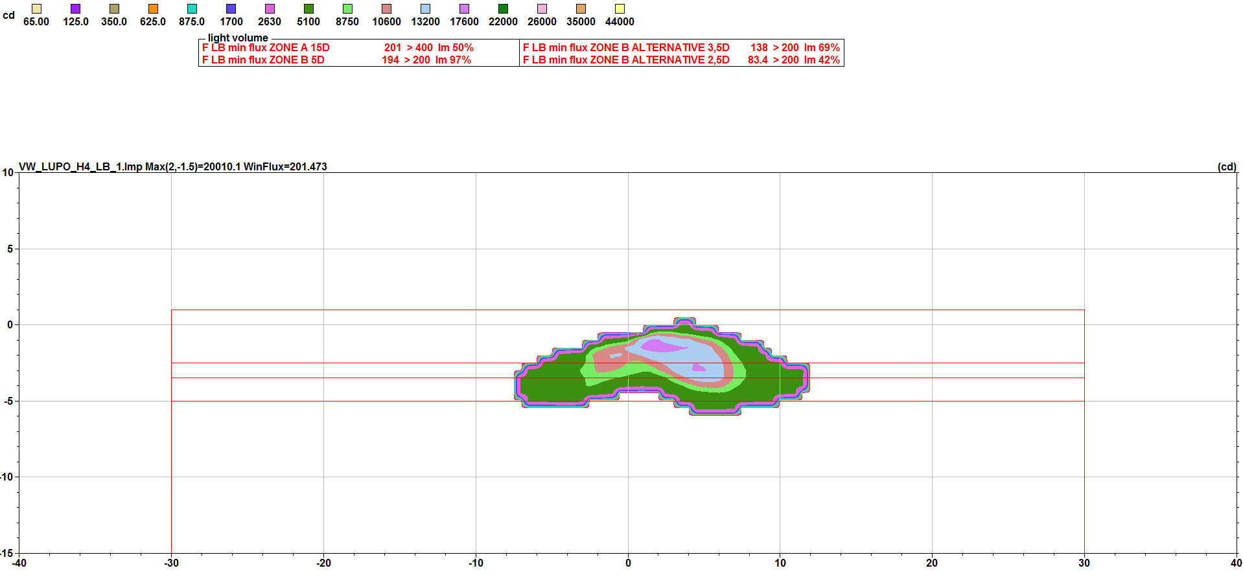
Reflector Headlamp H4 , 155mm diameter, 200lm
GTB Document No.CE-5360

Slide 14
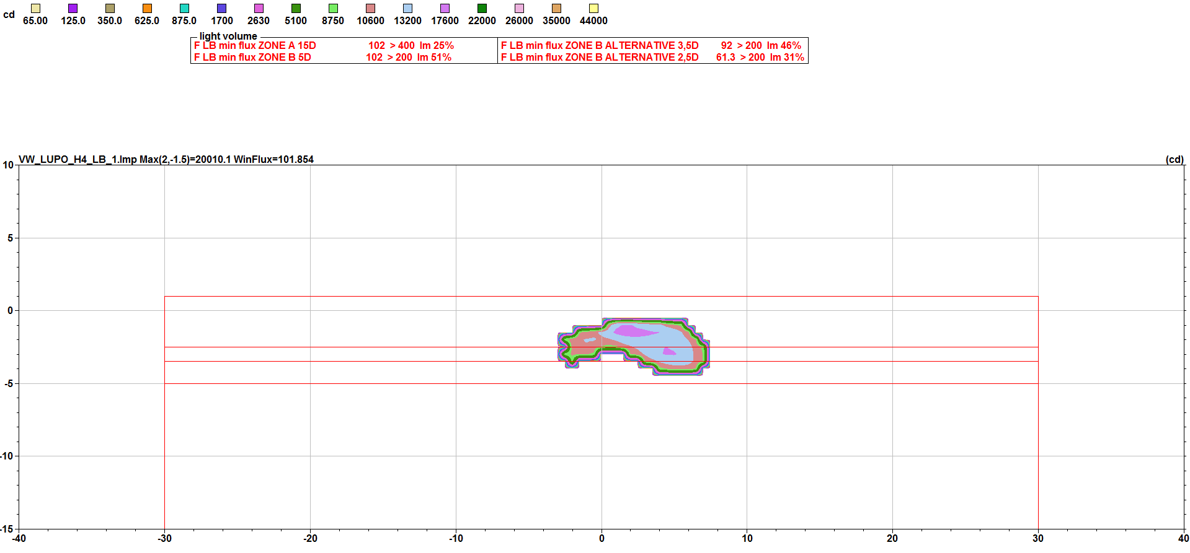
Reflector Headlamp H4 , 155mm diameter, 100lm
GTB Document No.CE-5360

Slide 15
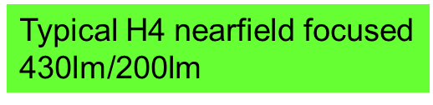
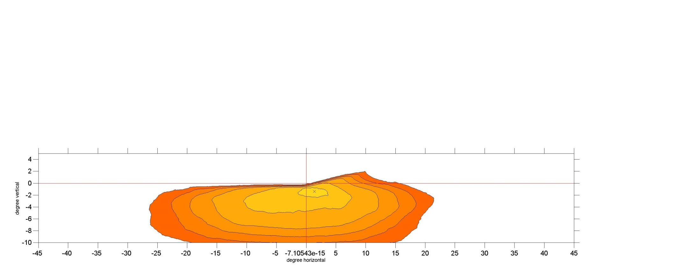
Comparison: different 400lm light distributions
GTB Document No.CE-5360

Slide 16

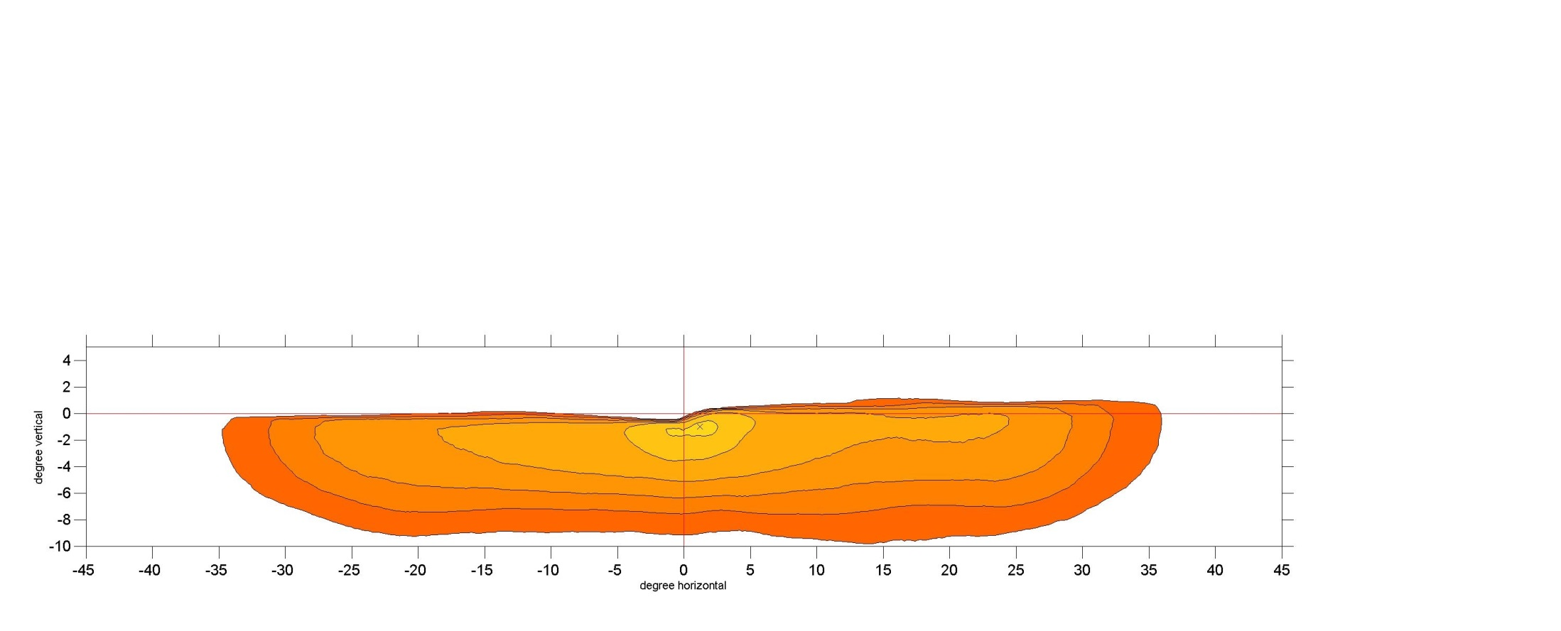
Comparison: different 400lm light distributions
GTB Document No.CE-5360

Slide 17
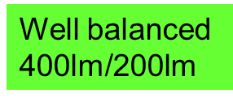
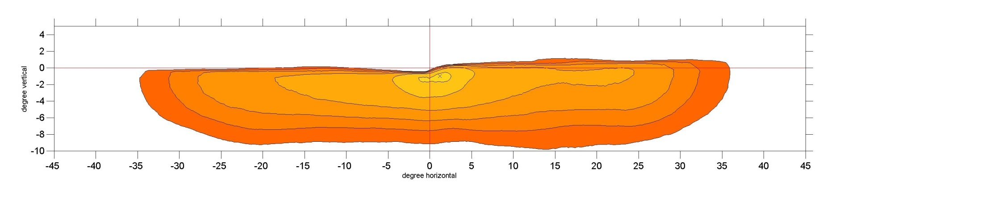
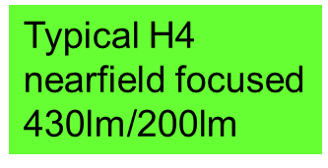
Comparison: different 400lm light distributions
GTB Document No.CE-5360

Slide 18
Comparison: different 400lm light distributions
GTB Document No.CE-5360

Slide 19

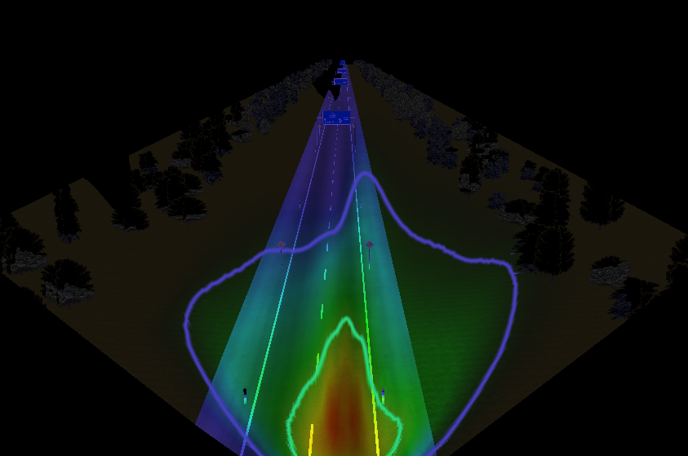
Comparison: H4 light distributions
GTB Document No.CE-5360

Slide 20
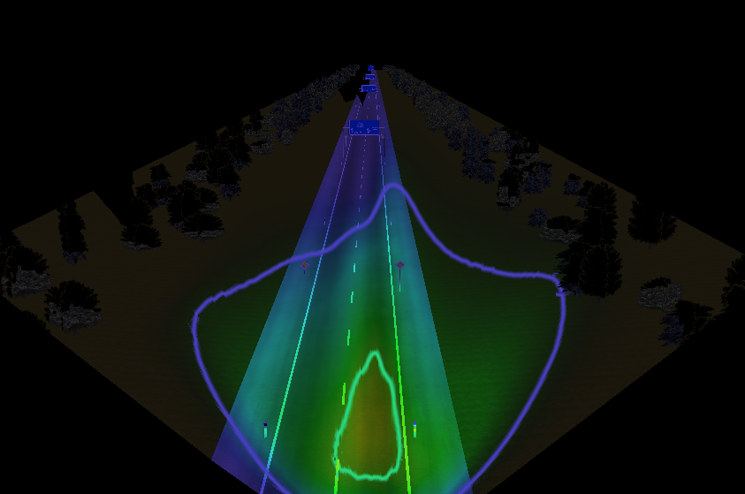
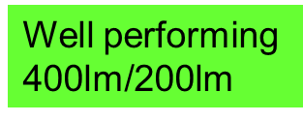
Comparison: balanced LED light distribution
GTB Document No.CE-5360

Slide 21
Comparison: H4 light distributions
GTB Document No.CE-5360

Slide 22
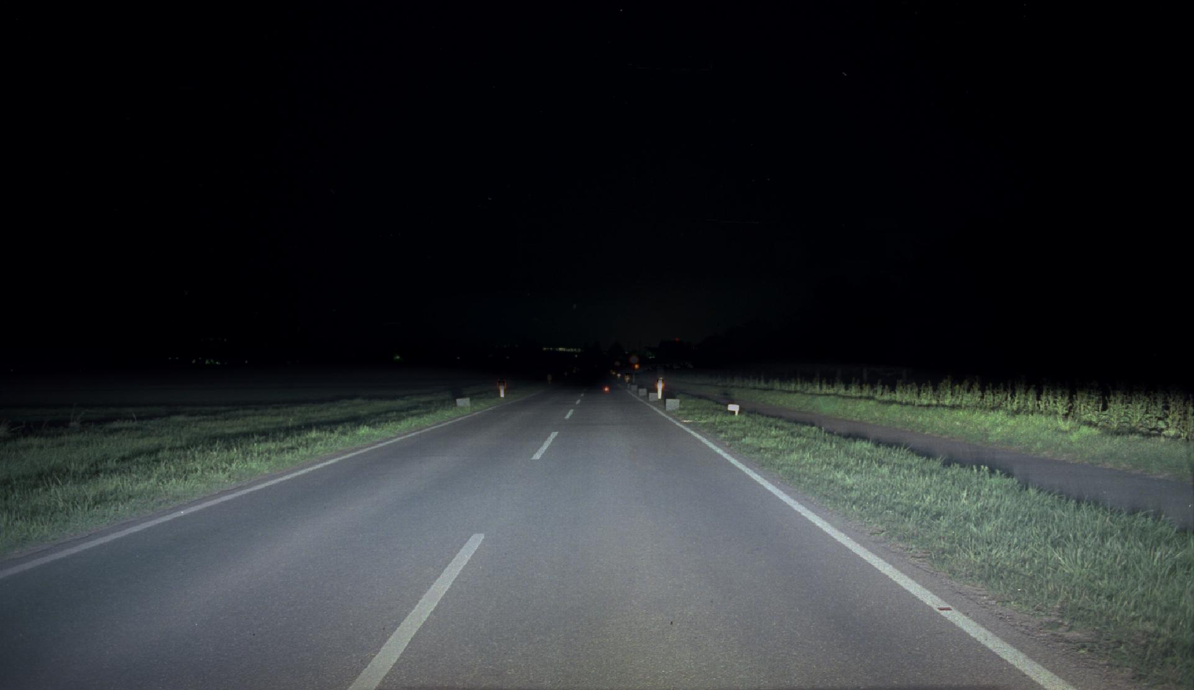

Comparison: balanced LED light distribution
GTB Document No.CE-5360

