Slide 1
Joint Research Centre
Informal document GRPE-73-20
73rd GRPE, 6-10 June 2016, agenda item 9(b)
UNECE IWG on EPPR for L-category vehicles
State of play
A.Perujo
The European Commission’s in-house science service
EPPR = Environmental and Propulsion Performance Requirements

Slide 2
Outline
Background
Past and next meetings
State of play
GTR on Evaporative and Crankcase emissions
GTR on OBD-I
GTR2
Roadmap

Slide 3
Background
ToR and mandate
Priority to work under 1998 Agreement but will also work under 1958 Agreement
Amend GTR No2 and develop new GTRs with respect to Environmental and Propulsion unit Performance Requirements
Create synergies with 58th Agreement and where possible develop common requirements in form of UN Reg(s)
Exchange information on current and future regulatory requirements for ‘light vehicles’
Adopted at WP29 Nov 2013
Extended at WP29 Jun 2015 (2016 to 2020) (ECE/TRANS/WP.29/AC.3/36/Rev.1)

Slide 4
Background
Topics to be covered by EPPR
Environmental performance:
Type I: Tailpipe emissions test after cold start (revision);
Type II: Tailpipe emissions test at (increased) idle / free acceleration;
Type III: Emission test of crankcase gases;
Type IV: Evaporative emissions test;
Type V: Durability testing of pollution control devices;
Type VII: Measurement of CO2 emissions, fuel consumption, electric energy consumption and electric range determination;
Type VIII: On-board diagnostics environmental verification tests.
Propulsion unit performance:
Unified rules and test procedures to measure power and torque for propulsion technologies fitted on L-category vehicles
unified measurement of maximum design vehicle speed and/or power for restricted L-category vehicles should be developed and agreed upon.
PRIORITY
PRIORITY
PRIORITY
PRIORITY

Slide 5
Meetings

Slide 6
Stay of Play
New GTR (informal document June 2015 & working document January 2016)
Evaporative emissions
Crankcase emissions
New GTR (working document in June 2016)
OBD
GTR 2 amended including (tentative informal document for January 2017)
Test type I (work have started)
Test type II (Idling)
Test type VII on Energy efficiency (CO2, FC& Range)
GTRs to be transposed into UN Regulations

Slide 7
Evaporative and Crankcase emissions
Adopted by the GRPE in its 72nd Session (Jan 2016)
Formal GTR proposal: ECE/TRANS/WP.29/GRPE/2016/2 - (Informal Working Group on Environmental and Propulsion Performance Requirements (EPPR)) Proposal for a new global technical regulation on the measurement procedure for two- or three-wheeled motor vehicles equipped with a combustion engine with regard to the crankcase and evaporative emissions
Combined with the
final draft Technical Report: GRPE-72-06
Several open points resolved and Informal Document GRPE-72-13
To be considered for vote by WP.29 and AC.3 in the June 2016 sessions

Slide 8
OBD-I
Submitted working document for the 73rd Session of the GRPE (June 2016)
ECE-TRANS-WP29-GRPE-2016-13
Some open issues resolved within the group:
Definition of warm-up cycle
Clarification of “freeze-frame” parameters to be stored
Template for the RMI (new Annex): Based upon some of the already existing templates in the parties.
Technical report submitted

Slide 9
GTR2
EPPR-11-15 Rev1 = proposal EC
IMMA started identification of differences with current GTR2 = EPPR-11-10
Extensive document. Split the work, during 2016

Slide 10
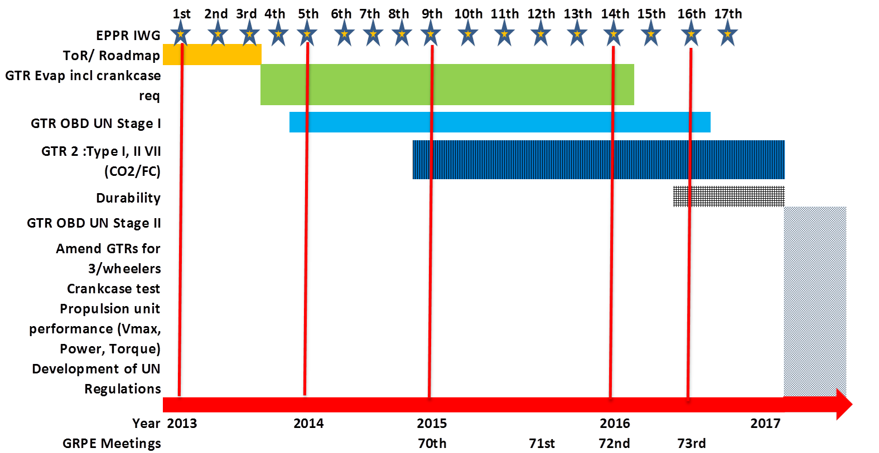
EPPR Roadmap

Slide 11
Contact information
Chair: Adolfo Perujo
adolfo.perujo@ec.europa.eu
Secretariat: Daniela Leveratto
d.leveratto@immamotorcycles.org
Hardik Makhija
hardik@siam.in
Web page for the EPPR IWG: https://www2.unece.org/wiki/pages/viewpage.action?pageId=5800520

