Slide 1
GRSG MEETING 2017 GENEVA
Informal document GRSG-112-06
(112th GRSG, 24-28 April 2017,
Agenda item 9.)
Tom Van Esbroeck
Kurt Vollmacher

Slide 2
ISO propulsion energy identification
Proposal made by CTIF and worked out together with various manufactures/regulators/CTIF on behalf of ISO
CTIF: organization of fire and rescue services, representing 40 member countries worldwide!
After first ISO CD ballot and review of the comments : ISO propulsion energy identification is approved by all main vehicle manufactures countries
Next stage: DIS ballot in progress for final approval
40 CTIF member countries

Slide 3
ISO propulsion energy identification
Important : the location or position of labels on the vehicle, on the rescue sheet, or in the emergency response guide is outside the scope of the ISO 17840-4 standard in development

Slide 4
Current Situation
Different kind of pictograms are used for the same type of fuel
No “global standardized color coding” determined by a RGB code

Slide 5
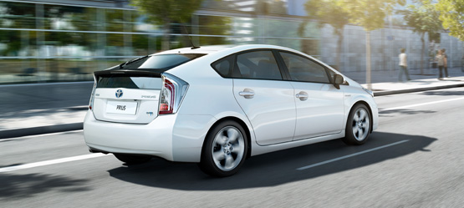
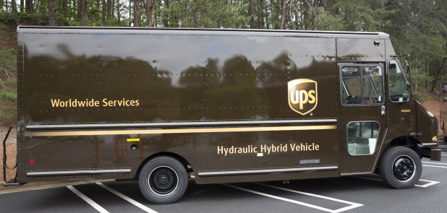
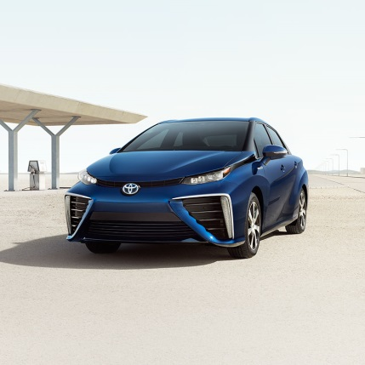
Current Situation
No update on the pictograms for already many years old ‘new’ technology…
We are facing a safety problem!
Hydraulic Hybrid-Vehicle
Hybrid-Vehicle
Fuel Cell Electric-Vehicle
Electric-Vehicle

Slide 6
Current Situation
Need for pictograms easy to understand by first and second responders (logical approach).
Not be able to know the type of fuel from a distance…
Important : the location or position of labels on the vehicle, on the rescue sheet, or in the emergency response guide is outside the scope of this standard.

Slide 7
Standardization: necessary for who?
First responder
Individual, that is authorized, trained and qualified to provide primary response to victims of a traffic accident, fire, submersion…
Note 1 to entry: included, but not limited to, fire departments, rescue squads, emergency medical personnel, law enforcement personnel, and in some instances military personnel if the personnel is trained in assessing and treating injuries.
Second responder
Individual, that is authorized, trained and qualified to take care of vehicles after they have been subject to a traffic accident, fire, submersion…
Note 1 to entry: Included, but not limited to, tow/recovery personnel, vehicle storage operators, repair/service technicians, dismantlers and auto salvage personnel.

Slide 8
How it works
The closer you come, the more information you get by reading the pictogram.

Slide 9
ISO propulsion energy identification
Used Colors
GREY | DIESEL
RED | GASOLINE
GREEN | GAS
WHITE | CRYOGEN LNG
BLUE | HYDROGEN
ORANGE | HIGH VOLTAGE

Slide 10
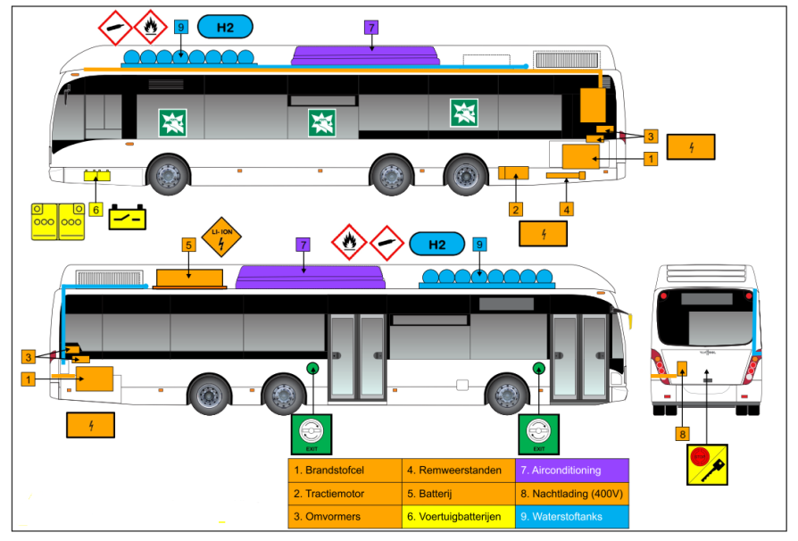
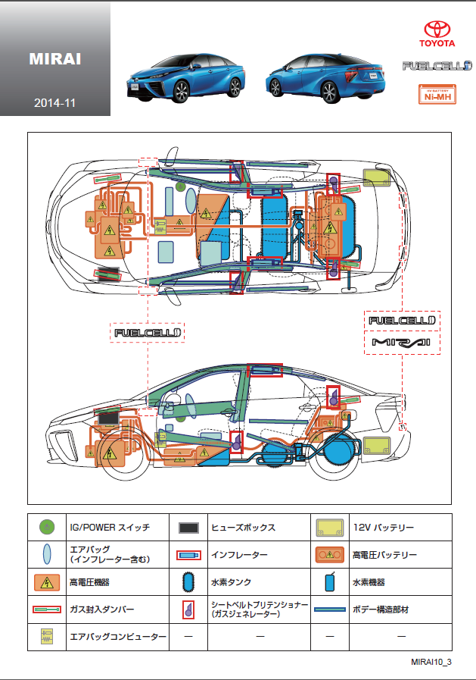
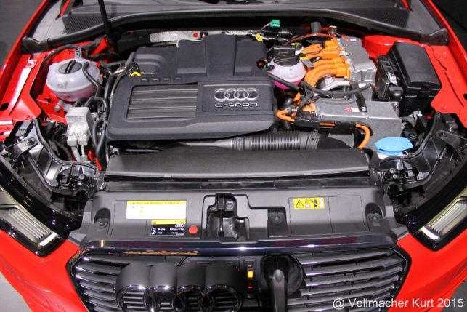
ISO propulsion energy identification
These colors can be used in rescue information or can be used to color vehicle components in the vehicle

Slide 11
ISO propulsion energy identification
2
3
1
4
1 | First energy source
2 | Second energy source
3 | Density towards air
4 | Stored state

Slide 12
ISO propulsion energy identification
SYMBOLS
1) FIRST ENERGY SOURCE
2) SECOND ENERGY SOURCE
3) DENSITY TOWARDS AIR
4) STORED STATE
CNG
LNG
LPG

Slide 13
ISO propulsion energy identification
Example:
First energy source:
CNG or LPG or LNG or H2
Diesel/Gasoline/Full Electric
Second energy source
Diesel/Gasoline/Full Electric/Hydraulic Hybrid

Slide 14
ISO propulsion energy identification
DIESEL

Slide 15
ISO propulsion energy identification
GASOLINE

Slide 16
ISO propulsion energy identification
CNG

Slide 17
ISO propulsion energy identification
LPG

Slide 18
ISO propulsion energy identification
LNG

Slide 19
ISO propulsion energy identification
FULL ELECTRIC (HIGH VOLTAGE)

Slide 20
ISO propulsion energy identification
HYBRID
HIGH VOLTAGE and GASOLINE

Slide 21
ISO propulsion energy identification
DUAL FUEL/BI FUEL:
CNG AND DIESEL

Slide 22
ISO propulsion energy identification
FUEL CELL: HYDROGEN AND ELECTRIC
(HIGH VOLTAGE)

Slide 23
ISO propulsion energy identification
HYBRID: DIESEL AND HYDRAULIC

Slide 24
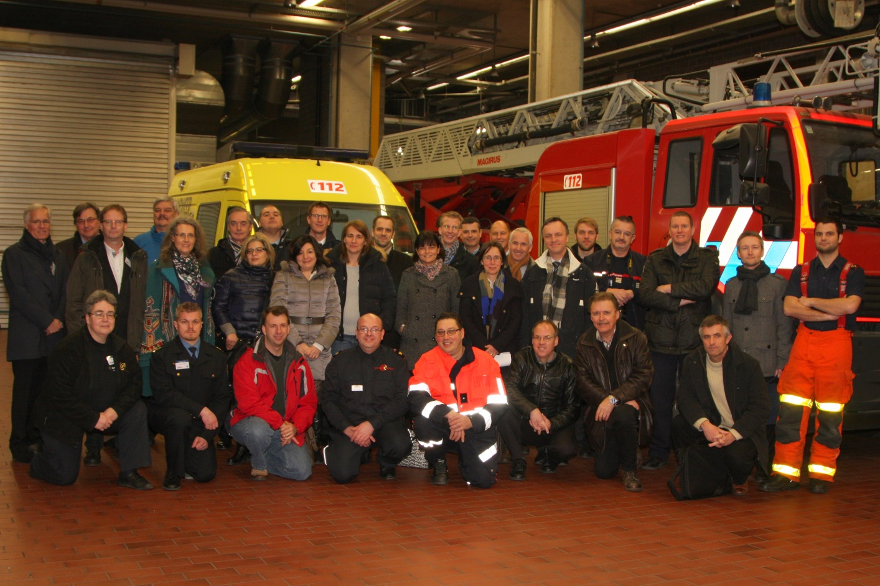
Questions ?
Participants Kick –off meeting ISO Project

Slide 25
More information?
Contact:
Chairman Commission Major Tom Van Esbroeck
tom.vanesbroeck@brandweerzonecentrum.be
Project Leader Commission Kurt Vollmacher
kurt.vollmacher@brandweerzonecentrum.be

