Slide 1


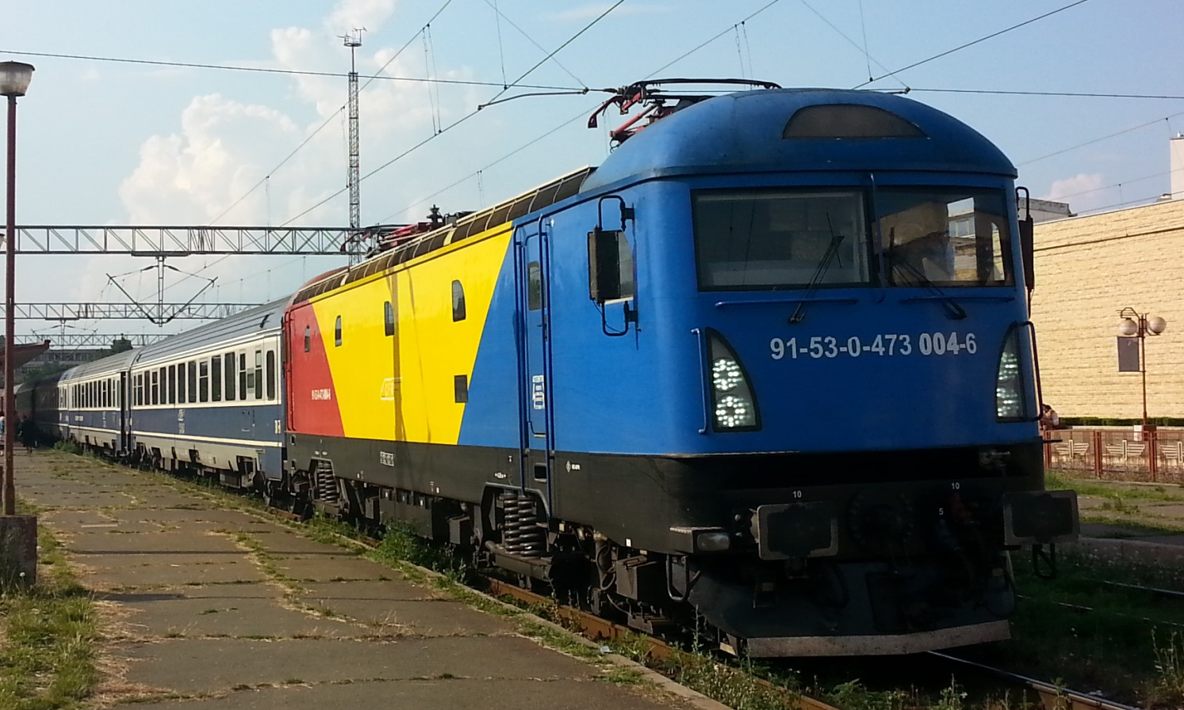
Romanian Railway Strategy

Slide 2
Romania understood this necessity therefore at the national level according to General Transport Master Plan has identified 46.48 billion euro financing needs of transport infrastructure projects, for all five modes of transport (road, rail, water, air and multimodal) of which:
- 15 billion euro for railway, naval and multimodal sectors
No. Crt. | Transport sector | Value (mld.euro) | Value (mld.euro including VAT)
1. | The road sector | 28,558 | 34,270
2. | The railway sector | 14,137 | 16,965
3. | The naval sector | 1,712 | 2,054
4. | The airline sector | 1,817 | 2,180
5. | The multimodal sector | 0,259 | 0,311
TOTAL |  | 46,48 | 55,783

Slide 3
For the program period 2014 – 2020 were identified transport infrastructure projects amounting 16.8 billion euro, of which over 6 billion euro only for transit projects.
Romania has already begun the accelerated implementation of these projects, based on their strategic importance.
No. Crt. | Transport sector | Value (mld.euro) | Value (mld.euro including VAT)
1. | The road sector | 10,454 | 12,545
2. | The railway sector | 5,179 | 6,215
3. | The naval sector | 0,949 | 1,139
4. | The airline sector | 0,081 | 0,098
5. | The multimodal sector | 0,159 | 0,191
TOTAL |  | 16,825 | 20,190

Slide 4

The National Model of Transport
(MNT)

Slide 5
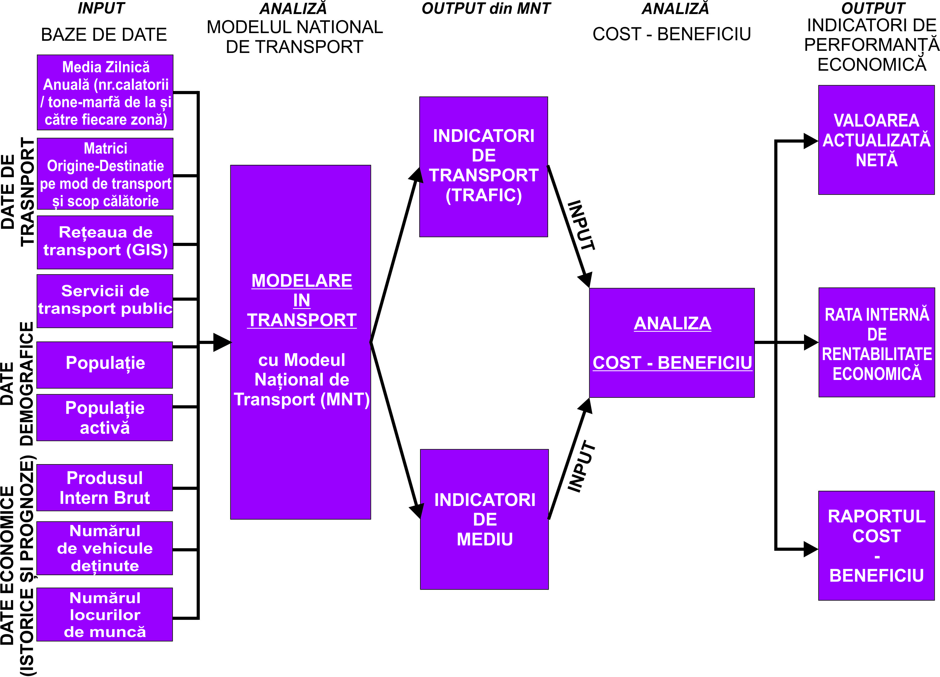
The National Model of Tranport– Structure
NPV
EIRR
CBR

Slide 6
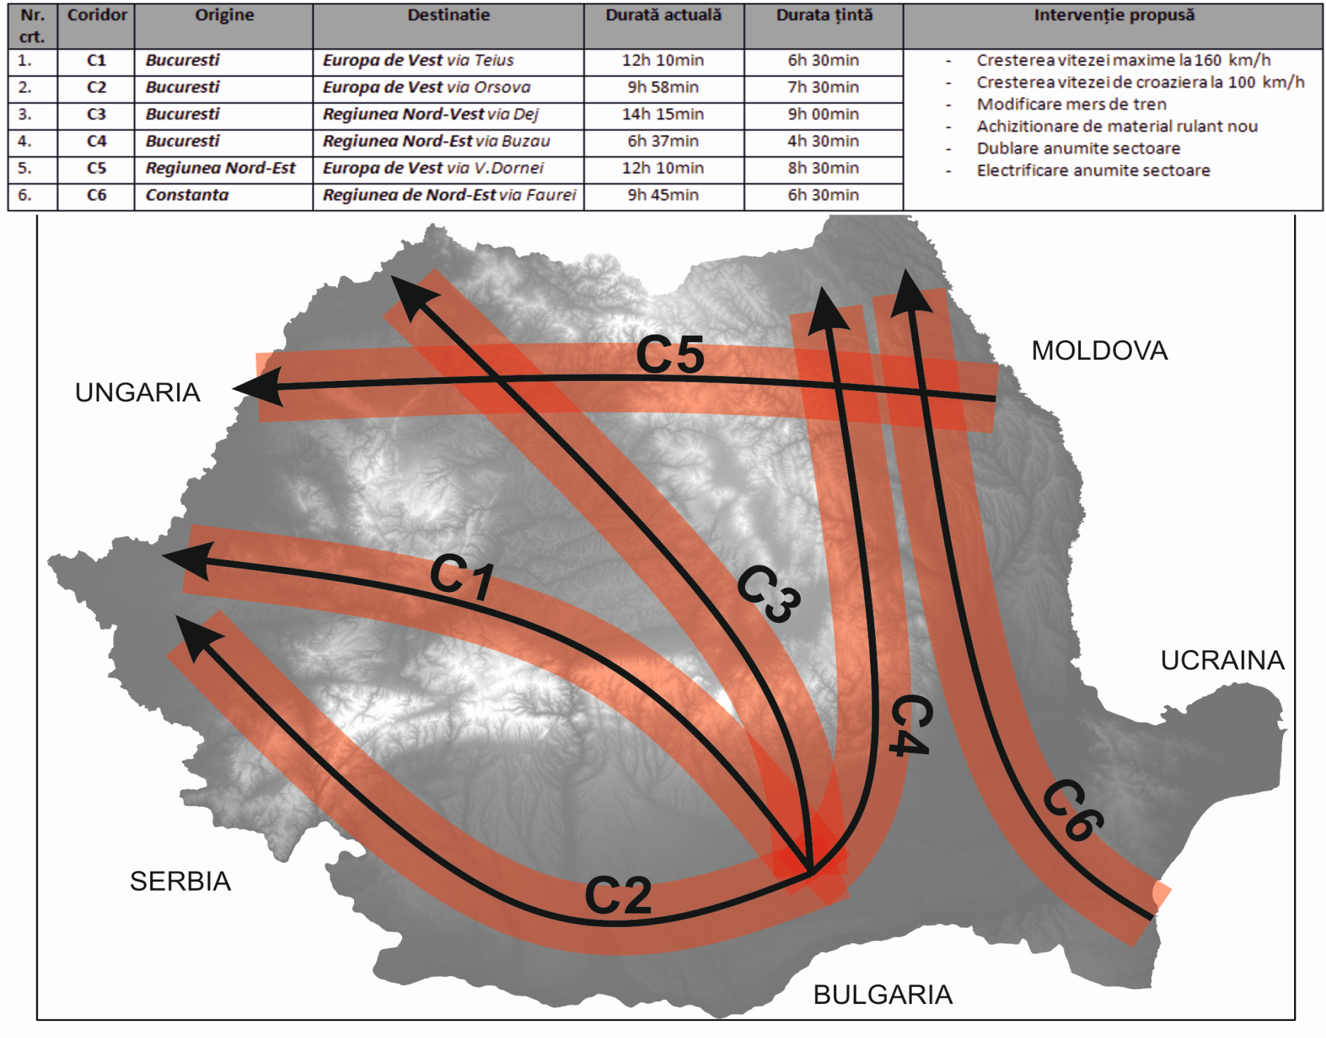
Sector feroviar – Coridoare de Conectivitate Nationala

Slide 7
The National Model of Tranport– Structure

Slide 8
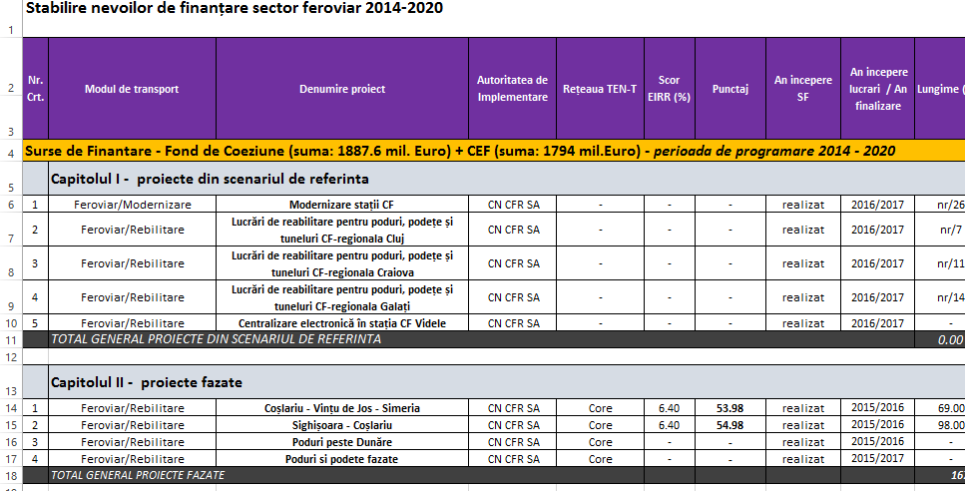
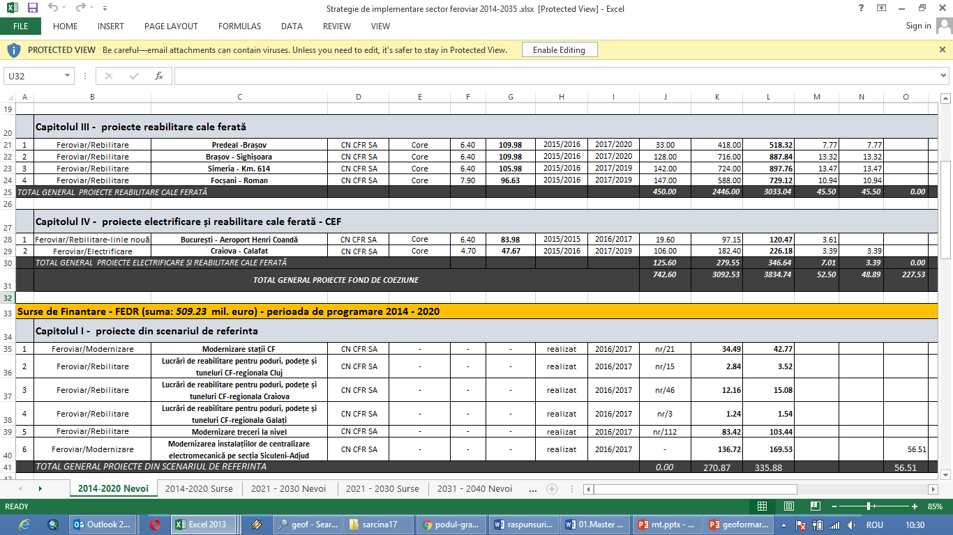

Slide 9
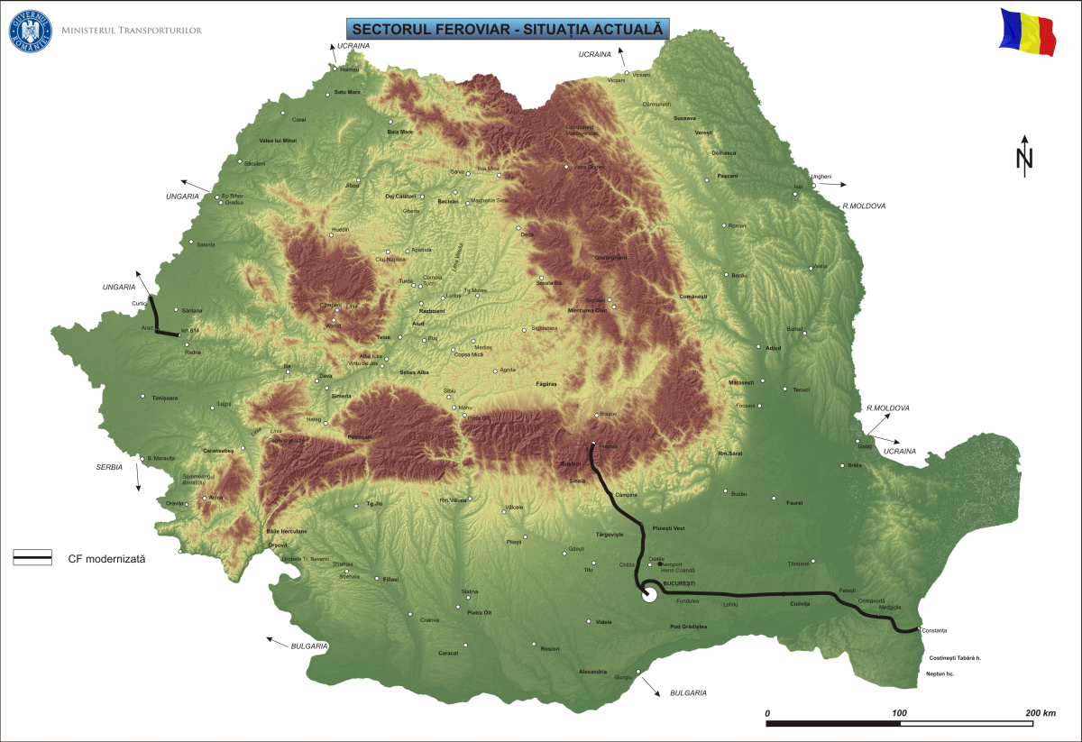
The railway sector – actual stage

Slide 10
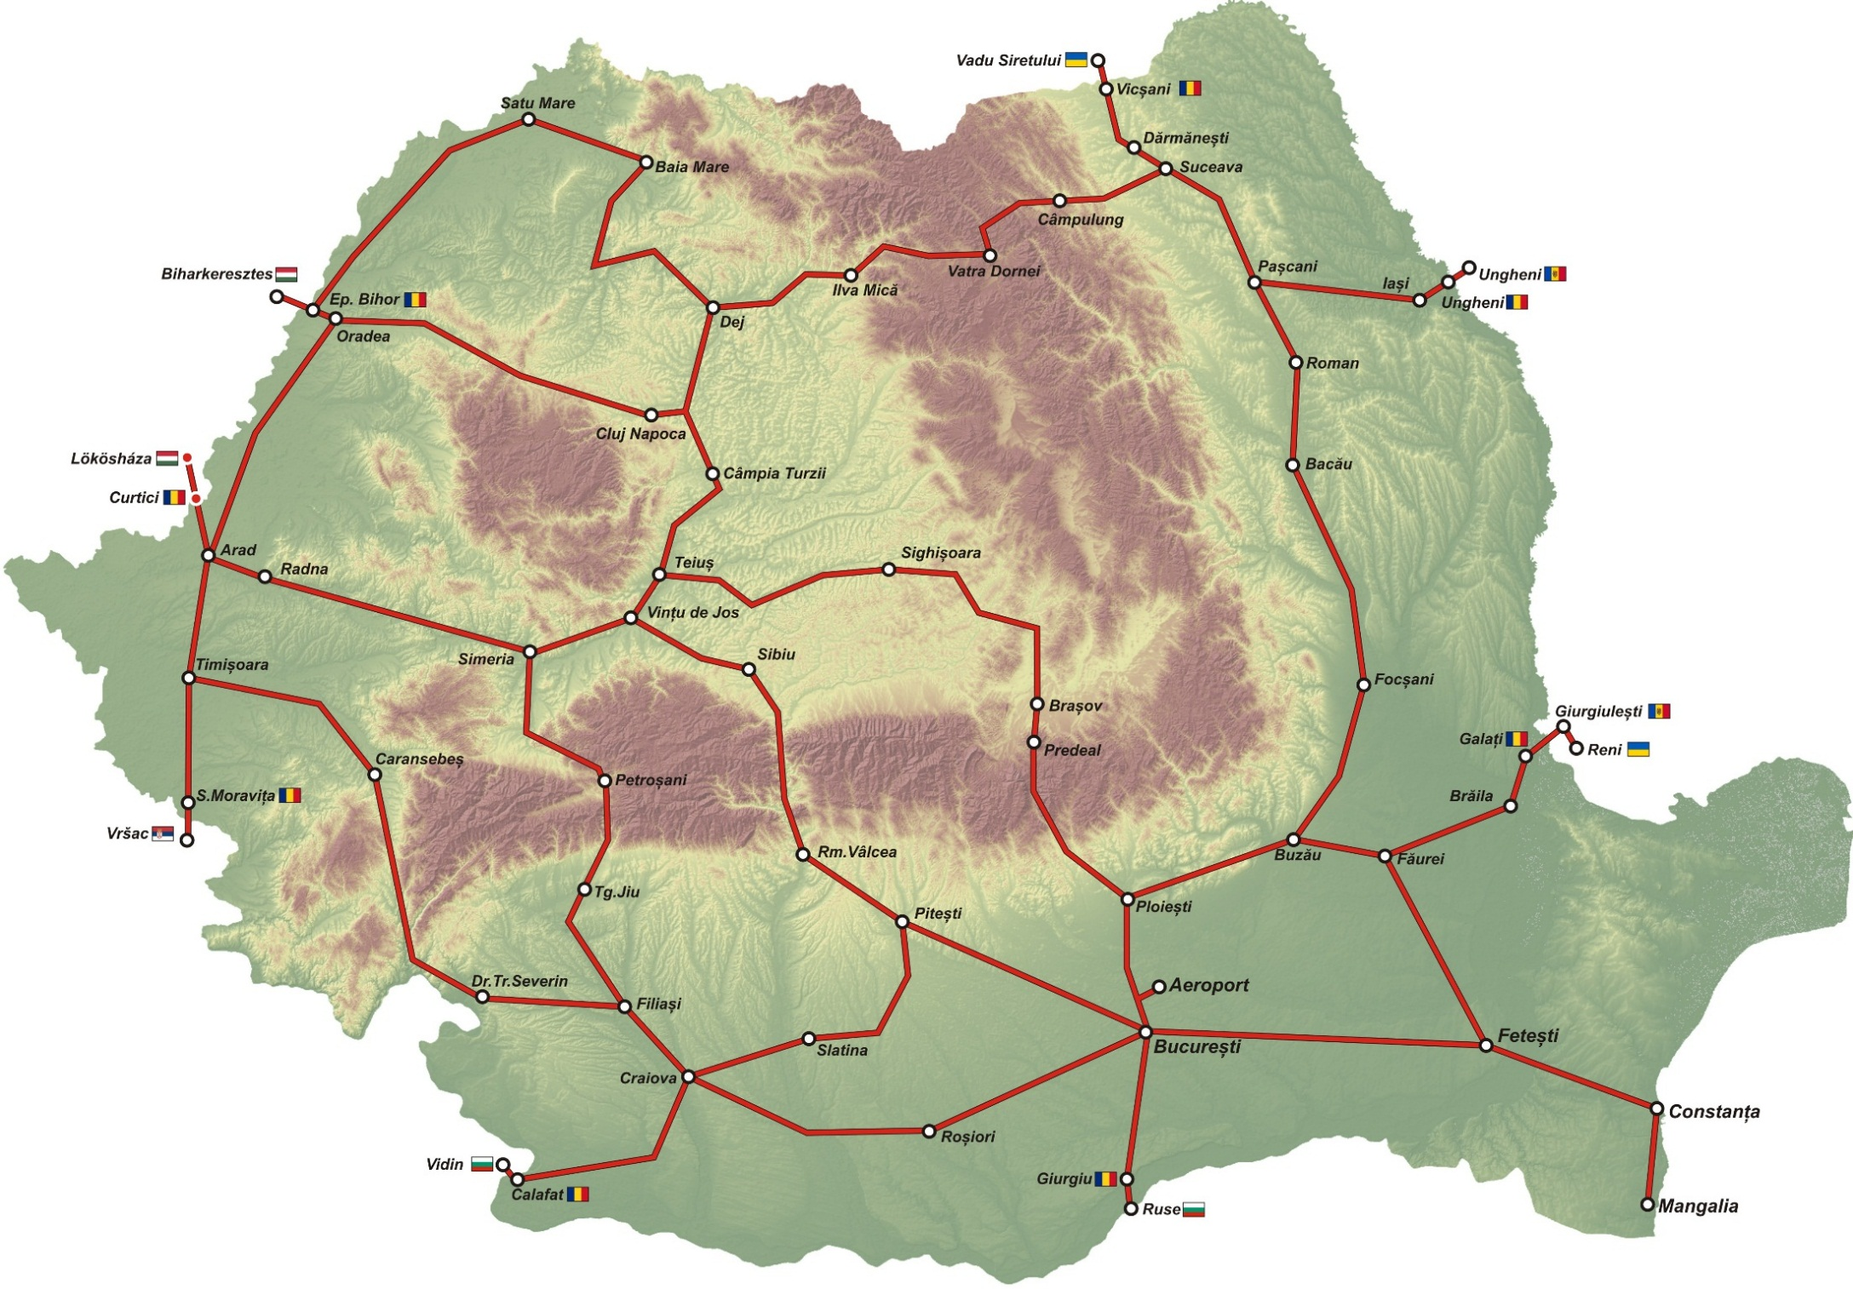
The railway sector – Projects Map 2030

Slide 12
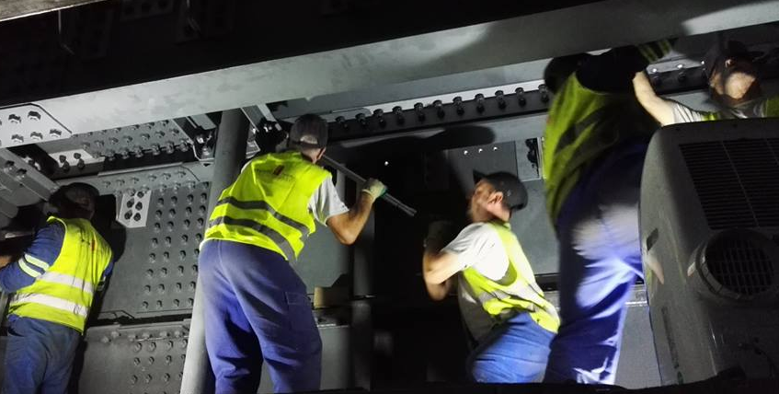
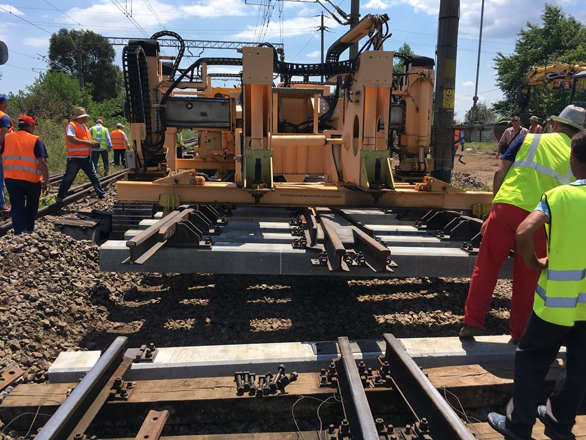
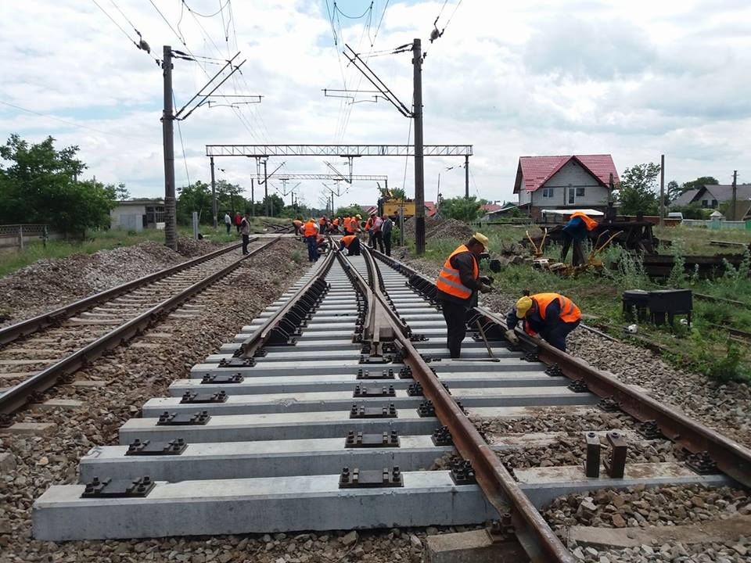
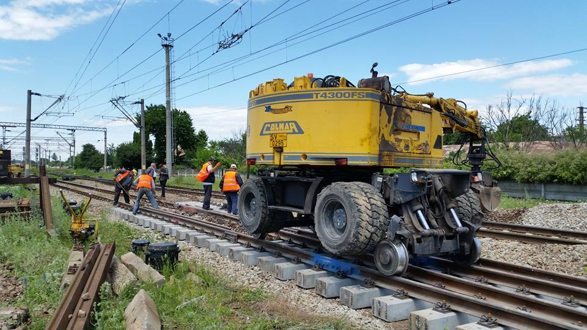
Level one:
Removing speed restrictions along railway transport corridors

Slide 13
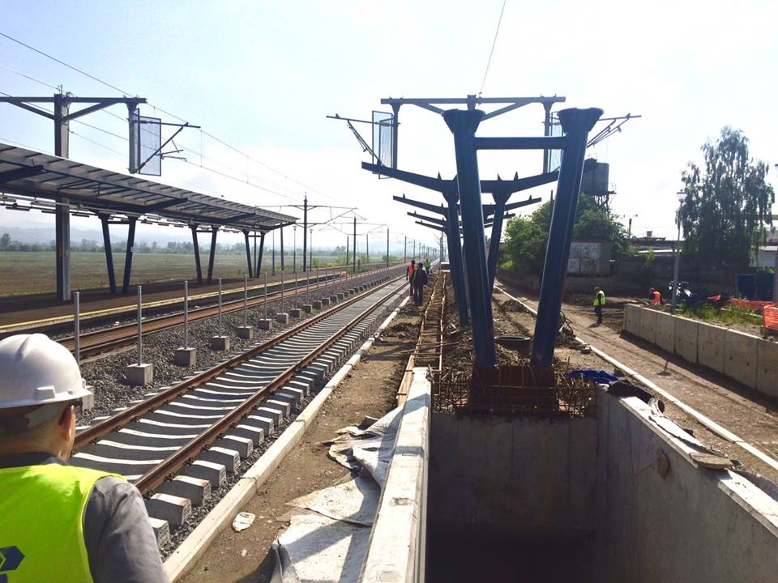
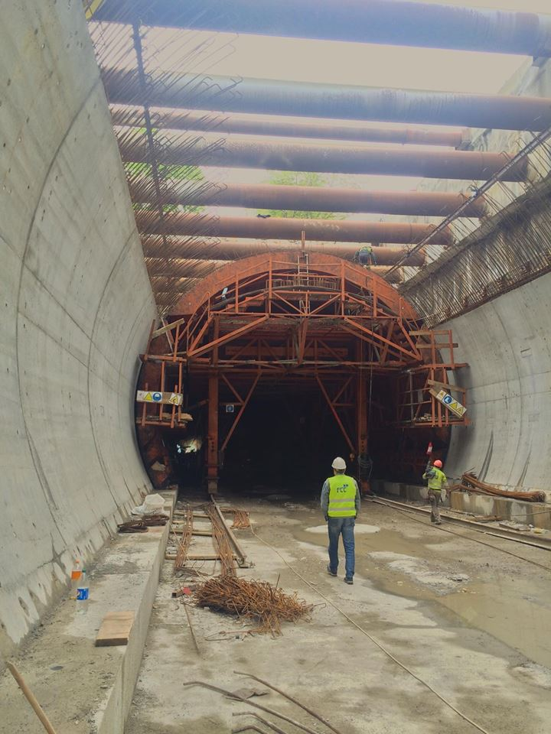
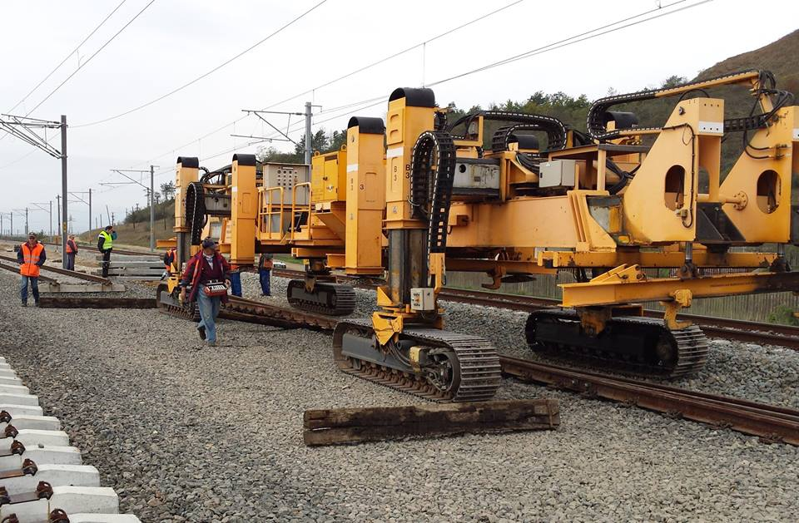
Level 2:
Massive investment in the development and modernization of infrastructure for the rail sector

Slide 14
Average speed (commercial speed) between Bucharest and the main cities of the Country
Km/h

Slide 15
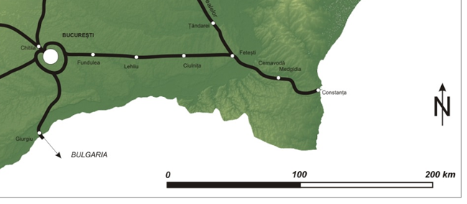
Black Sea

Slide 16
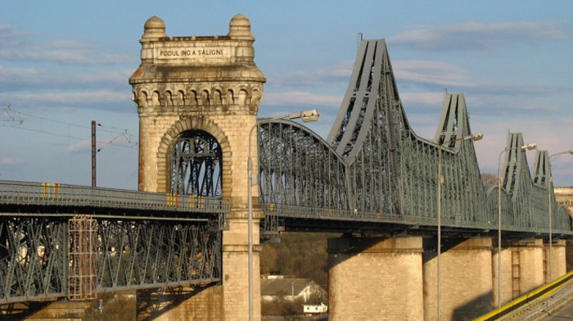

Slide 17
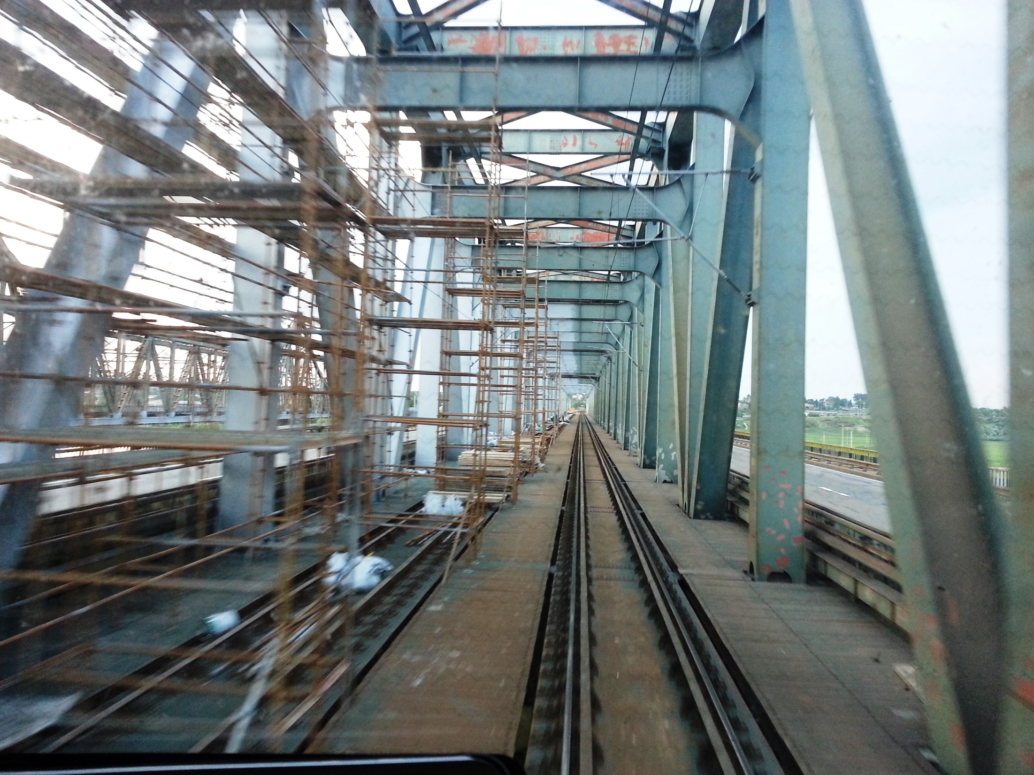

Slide 18
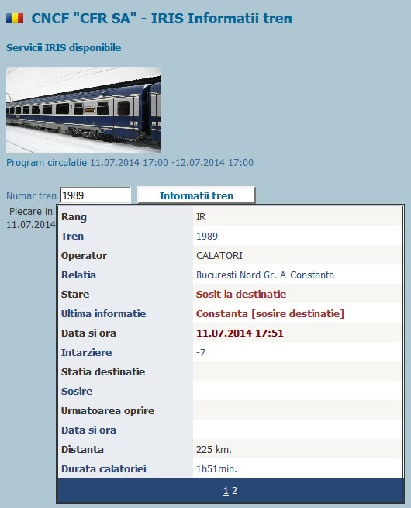

Slide 19
Bucuresti – Constanta: 225 km – 110 min, circulation speed 160 km/h

Slide 20
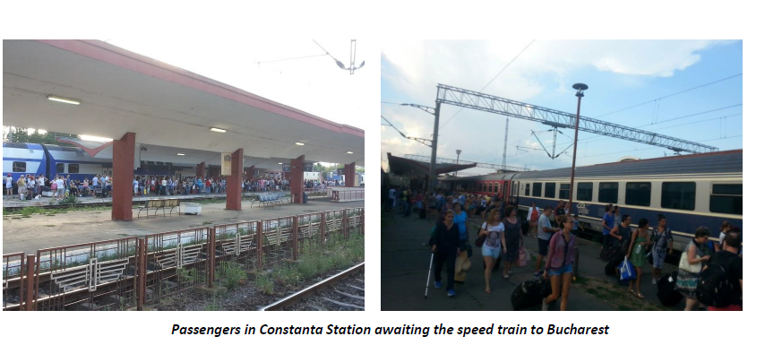
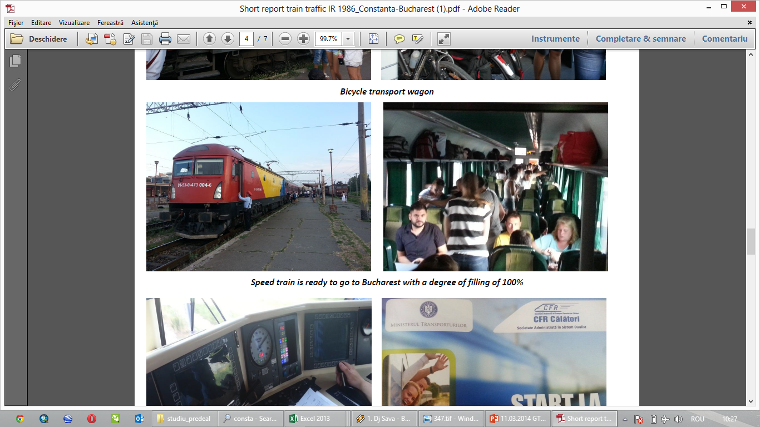

Slide 21
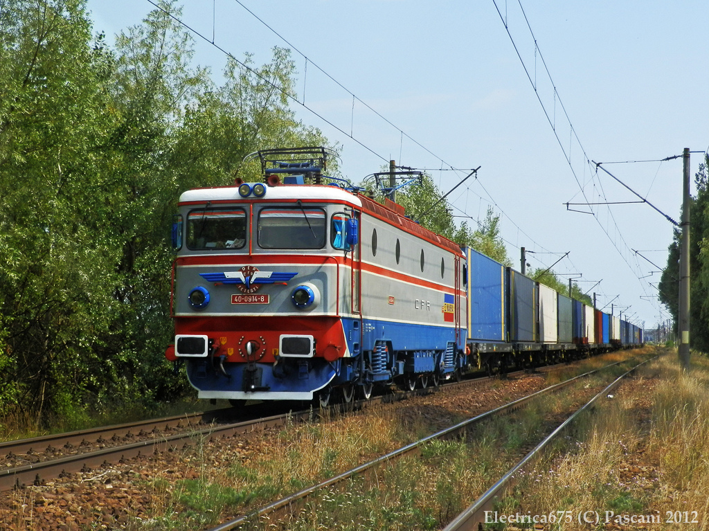
Level 3:
Crossborder railway projects
Cross-border railways in relation to Hungary, Serbia, Bulgaria and Moldova
- 390 km cross border railways
Over 700 million Euro allocated for these projects
ERTMS System
Interoperability System

Slide 22
Crossborder railway projects

Slide 23
ROMANIA - HUNGARY: EXAMPLE of interoperability SUCCESS
One locomotive pull a passenger train between Bucharest and Budapest (850 km) on the cross border modernized line Arad - Curtici - Lokoshaza
Locomotives belong both Romanian rail operator (CFR Passengers - type locomotive EA 060 series 47) and the Hungarian operator (MAV - Traxx locomotives type 040 EC)
In this way, more efficient use of the traction of rolling stock and saves time by eliminating border exchange locomotive
This is the approach for all cross-border links with Hungary, Serbia and Bulgaria, for a more efficient railway transport
-

Slide 24
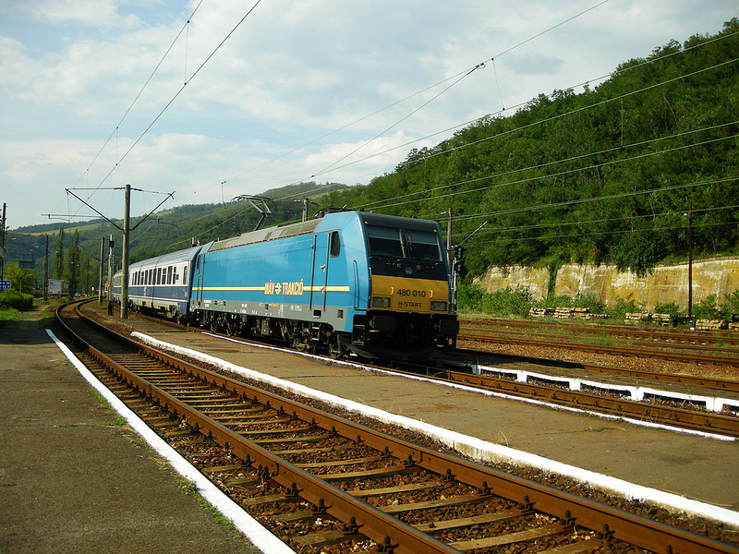
Eurocity 73 Traianus from Budapest to Bucuresti with hungarian MAV – Bombardier Traxx locomotive (in Orsova railway station) credit: artinescu.razvan

Slide 25
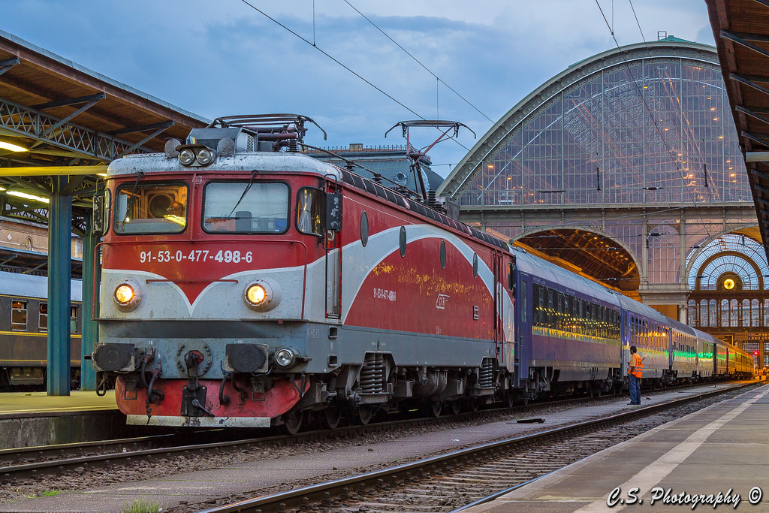
Euronight 472 Ister from Budapest to Bucuresti with romanian CFR – Electroputere serie 47 locomotive (in Budapest Keleti railway station) credit: Cosmin.Stefan

Slide 26
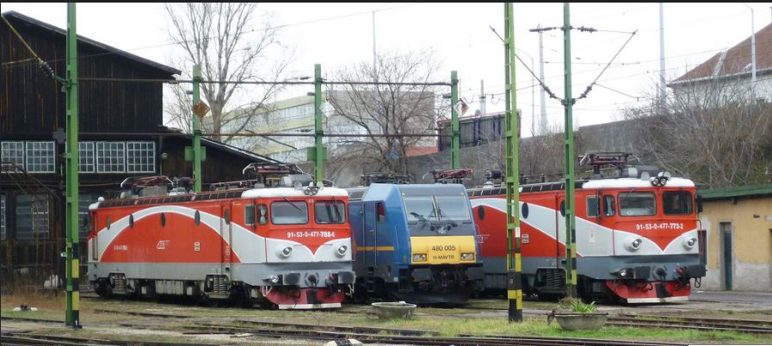
A picture from Budapest Keleti depot with locomotives wich pulling romanian – hungarian passenger trains credit: Rácz János

Slide 27
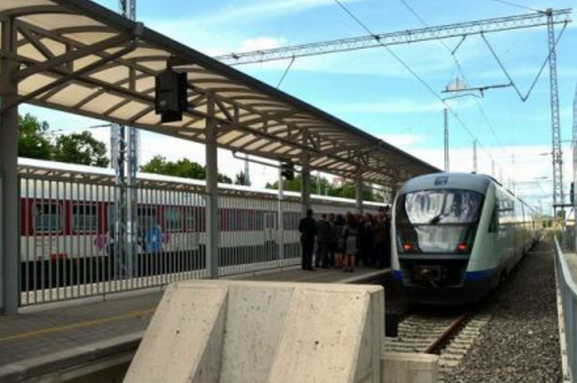
A picture from Vidin railway station with romanian CFR – Siemens Desiro tren wich links Craiova (RO) with Vidin (BG) credit: Agerpres

Slide 28





Level 4:
The Smart Transit concept we are proposing means a transport:
    CHEAP
    FAST
    SAFE
    INTEROPERABILITY

Slide 29
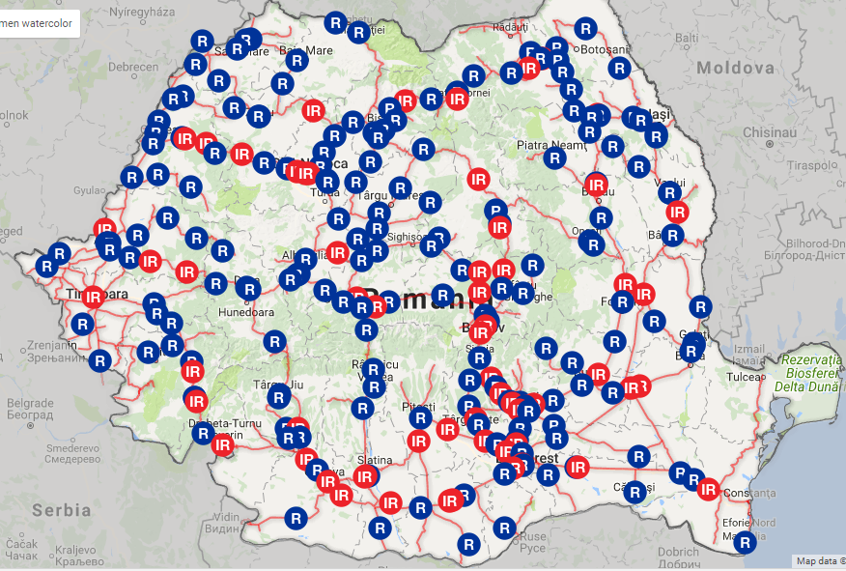
Romanian Smart Transit Concept
- IRIS (Intelligent IT Rail System) management system
It is structured in four IT modules:
Infrastructure management
Trains traffic monitoring
Rolling stock management
Management of freight transport operations

Slide 30
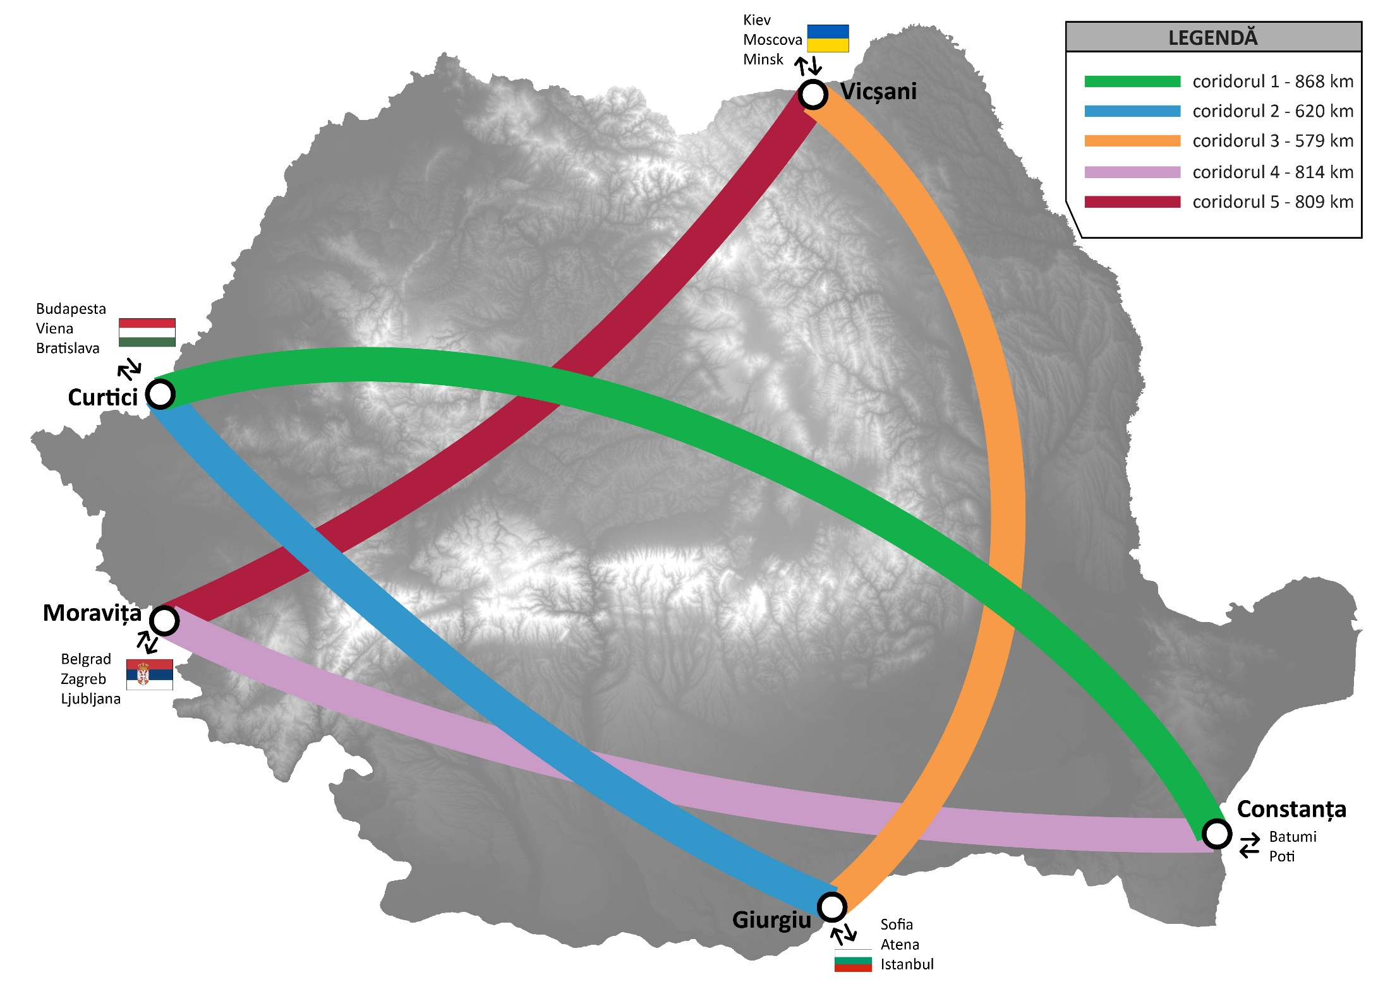
Main railway corridors in Romania – our vision
TOTAL 3690 km
BLACK
SEA

Slide 31
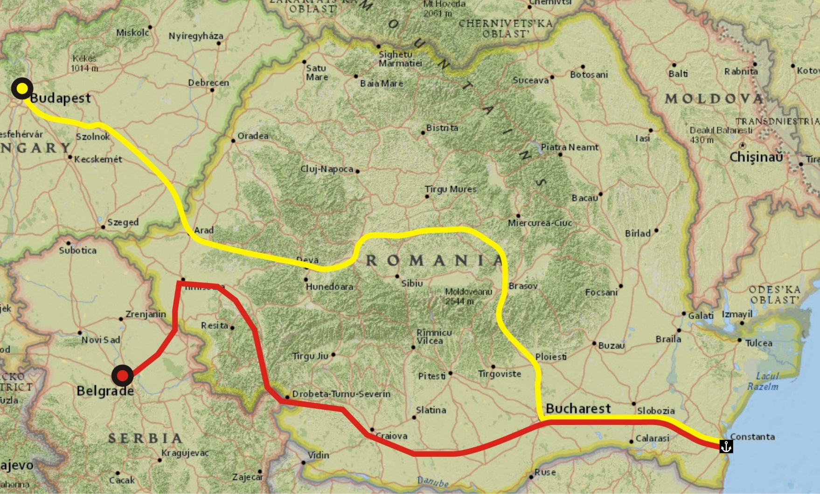
ROMANIA SMART RAILWAY TRANSIT CONCEPT
(BEOGRAD AND BUDAPEST ARE NOW BLACK SEA PORTS)
Budapest – București – Constanta 1000 km
Beograd – București – Constanta 925 km

Slide 32
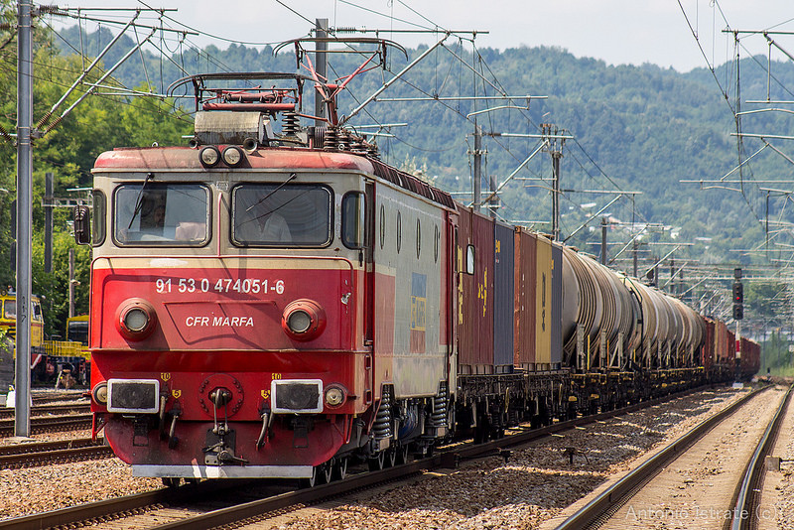
Thank you!

