Slide 1
JSC “UKRAINIAN RAILWAY” (UZ)
DEVELOPMENT STRATEGY FOR 2017-2021
JSC “Ukrainian Railway” 2017

Slide 2
UZ AMONG OTHER EUROPEAN RAILWAYS
2
Freight turnover
bn ton-km
Passengers
per km
Network size
ths, km
Ukraine
194
35,4
21,6
Germany
112
30,9
41,3
Poland
50
15,8
19,3
France
32
89,4
30,0
Italy
20
49,9
16,7
UZ is among the world’s biggest railways by freight and passenger turnovers

Slide 3
UZ ROLE IN UKRAINE’S ECONOMY
3
One of the biggest companies
Fostering the economic development
Significant for society
Produces 4% of Ukraine’s GDP
~USD 9,8 bn of assets (8,3 of witch is equity)
One of the biggest taxpayers – USD 0,57 bn payed in 2016
Key enterprise in many regions
58% of freight turnover
Realization of export potential of Ukraine
Strategic role for transit potential – 4 of 10 international transport corridors are going through Ukraine
Provides mobility for people – 29% of passenger turnover is done by UZ
The biggest employer in Ukraine – 272 000 workers (1,7% of all employed people in the country)

Slide 4
UZ CURRENT SITUATION
4
Infrastructure
Railways – the percentage of tracks with overdue capital repairs (including reconstruction) is 27%
Track equipment with an expired service life is 78%
Electricity supply - the traction substation's wear is 67%, contact network -65%
Locomotives
Mainline electric locomotives - depreciation of the park - 92%
Mainline diesel locomotives– depreciation of the park - 99%
Shunting locomotives – depreciation of the park - 80%
Cars
Freight cars - depreciation of the park is more than 90%
Passanger cars - depreciation of the park is more than 87%
EMUs and DMUs - depreciation of the park is more than 90%
JSC “Ukrainian Railway” 2017

Slide 5
UZ STRATEGIC GOALS
5
KEY GOALS
Improvement of corporate governance system
Improvement of economic efficiency on the company
Improvement of financial stability of the company
Providing high-quality satisfaction of demand for rail freight transportation in Ukraine
Increasing the attractiveness for employees and partners and implementing socially responsible approaches in personnel management
JSC “Ukrainian Railway” 2017

Slide 6
ОСНОВНІ ЗАХОДИ ДЛЯ РЕАЛІЗАЦІЇ КЛЮЧОВИХ ЦІЛЕЙ
6
KEY GOALS
MAIN ACTIONS
Building and developing an effective corporate governance system based on openness, transparency and accountability
Optimizing costs and ensuring sustainable growth, profitability and return on business through long-term tariff policies
Realization of investment policy aimed at updating rolling stock and infrastructure projects using public-private partnership
JSC “Ukrainian Railway” 2017

Slide 7
A KEY DIRECTORY OF CORPORATE GOVERNANCE REFORM IS A TRANSITION TO A VERTICALLY INTEGRATED STRUCTURE
7
1
Vertical integration of the activity of the company aimed at market segments, transition from the region-based structure
2
Principles of budgeting and economically justified mutual settlements between verticals
3
New system of tariff formation: separation between infrastructure and locomotive component of the tariff
4
New effective system of corporate governance: a clear separation of functions between structural divisions and verticals with the definition of financial and economic objectives for each vertical and control over their implementation.
JSC “Ukrainian Railway” 2017

Slide 8
TARGET BUSINESS MODEL WILL CONTAIN 5 BUSINESS VERTICALS
8
Corporate Center
Formation of strategic policies
Improved management efficiency
Providing
general corporate services
Freight and logistics
Passenger transportation
Infrastructure
Locomotion services
Production and service
Distinct separation according to market segments
1
2
3
4
5
Personal responsibility of managers for the business
Increase the flexibility and speed of decision-making
Corporate social responsibility
Reducing of operating costs

Slide 9
MODEL OF INTERACTION WITH LOADERS
9
CLIENTS
Load Holders with Rolling Stock
UZ
UZ Intermodal
Operator of intermodal services
UZ Forwarding
Forwarder
UZ International
Carrier outside of Ukraine
UZ Terminals
Terminal operator
UZ Sidings
Work on access railroads
UZ Cargo
Freight car operator
Other carriers
JSC “Ukrainian Railways”
Infrastructure service

Slide 10
STRUCTURE OF PASSENGER TRANSPORTATION BUSINESS-VERTICAL
10
PASSENGER TRANSPORTATION
Passenger company
Passenger service company
Ukrainian railway high-speed company
6 regional suburban companies
Station company
Exploitation of Passenger Rolling Stock
Organization of passenger transport process
Providing on board services
Maintenance functions :
Preparation of linen
Removable inventory
Catering
Providing equipment for trains
Exploitation of high-speed passenger rolling stock
Organization of passenger transport by train INTERCITY+ and INTERCITY
Regional and suburban passenger transport
Retention of station complexes
Organization of passenger services at railway stations
Maximizing profits of commercial space use
JSC “Ukrainian Railway” 2017

Slide 11
11
STRUCTURE OF INFRASTRUCTURE BUSINESS-VERTICAL
UZ UNFRASTRUCTURE
Вертикаль: ІНФРАСТРУКТУРА
УЗ ІНФРАСТРУКТУРА
UZ Rail tracks
UZ Automation and Communication
UZ Power Supply
UZ Traffic Control
UZ Diagnostics
Maintenance, repair and modernization of tracks
Maintenance, repair and modernization of structures
Maintenance, repair and modernization of communication equipment
Branch "Central communication station"
Maintenance, repair and modernization of the power supply industry
Supply of energy services - branch "Energosbyt"
Centralized traffic management process
Management of regional traffic management centers
Diagnostics and monitoring of the infrastructure, power supply and structures
JSC “Ukrainian Railway” 2017

Slide 12
12
STRUCTURE OF PRODUCTION AND SERVICE BUSINESS-VERTICAL
UZ PRODUCTION AND SERVICE
Вертикаль: ІНФРАСТРУКТУРА
УЗ ІНФРАСТРУКТУРА
Passenger car repairing company
Branch for repair of the locomotive rolling stock
Branch for repair of the freight cars rolling stock
execution of major types of repair of passenger rolling stock
service of passenger cars
execution of depot and capital types of repair of locomotive rolling stock
service of locomotives
carrying out depot and capital repairs of freight cars
manufacturing of freight wagons and spare parts
JSC “Ukrainian Railway” 2017

Slide 13
INVESTMENT PLAN FOR 2017-2021
13
5 864
USD Mio
Amount of funds for implementation of the investment plan
Main infrastructure Projects
Infrastructure | USD 1 875 Mio
Acquisition of rolling stock | USD 3 280 Mio
Modernization of rolling stock | USD 709 Mio
 | Total, USD Mio
Reconstruction of railway tracks on main routs | 601
Electrification of "Dolinska - Nikolaev - Kolosovka“ path | 278
Introduction of digital communication systems | 154
Finalization of construction of the Beskydy tunnel | 72
Electrification of the "Kovel-Izov - State border“ path | 53
Electrification of the "Kovel-Yagotyn - State border“ path | 40
Logistics warehouses construction | 30
Acquisition and modernization of rolling stock
 | Purchase, unit. | Modernization, unit. | Total USD Mio
Locomotives | 163 | 362 | 1330
Freight cars | 15 753 | 46 028 | 848
Passanger cars | 419 | 799 | 466
EMU (sections) | 120 | 326 | 516
DMU (trains) | 78 | 16 | 169
JSC “Ukrainian Railway” 2017

Slide 14
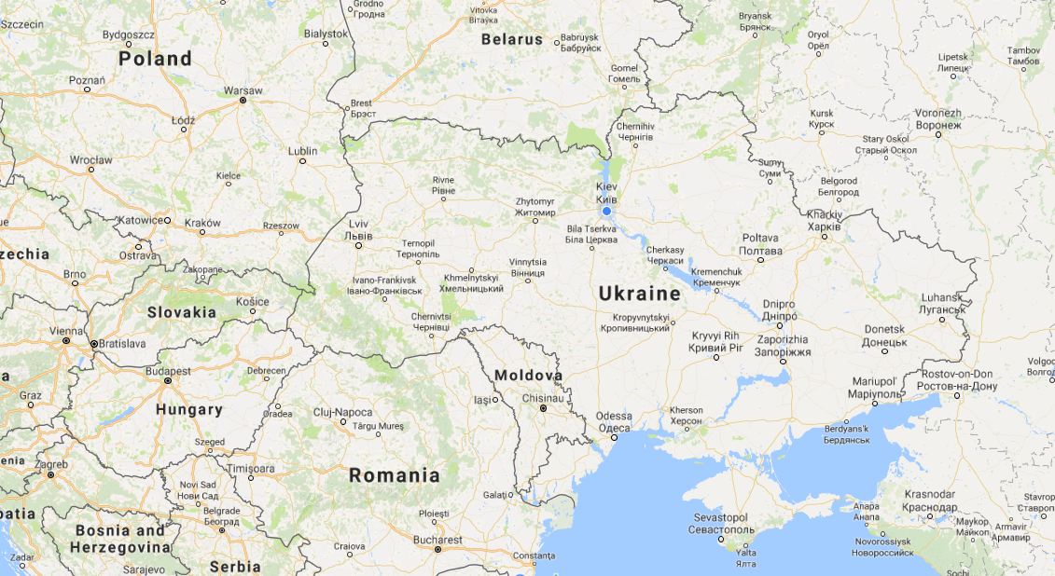
MAIN DIRECTIONS OF INFRASTRUCTURE DEVELOPMENT IN 2017-2021.
14
Kovel – Yagotyn – State border
USD 40 Mio
64 km
Berdychiv – State border
USD 153 Mio
215 km
Kovel – Izov – State border
USD 53 Mio
81 km
Dolynska – Kolosivka
USD 350 Mio
255 km
JSC “Ukrainian Railway” 2017

Slide 15
15
Thank you!
JSC “Ukrainian Railway” 2017

