Slide 1
Conceptualizing Road Safety Principles in the IoT era
Presented by the Chair of WP.1
Informal document GRRF-84-38
84th GRRF, 19-22 September 2017
Agenda item 8(b)
Joint meeting Global Forum for Road Traffic Safety ( WP1) – WP29/GRRF
20 September 2017
WP1 Chair Ms. Luciana Iorio

Slide 2
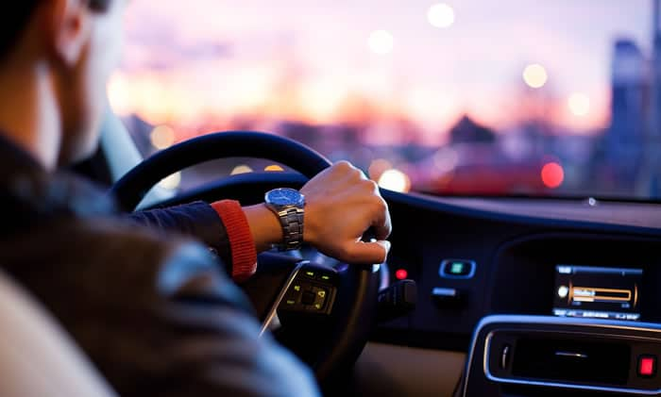
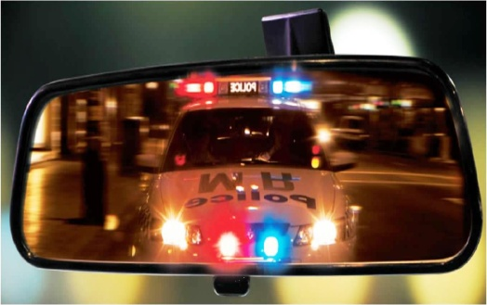
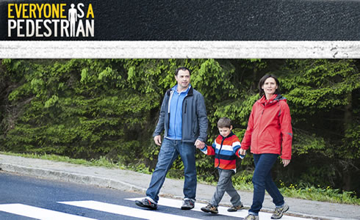
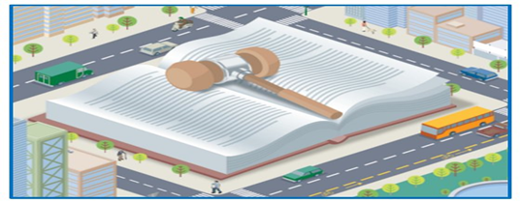
Road Traffic Safety
Driver
Users
VRU
Principles - Concepts : key stones for Conventions/ resolutions and Domestic regulations
BUT now…..

Slide 3
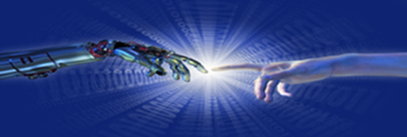
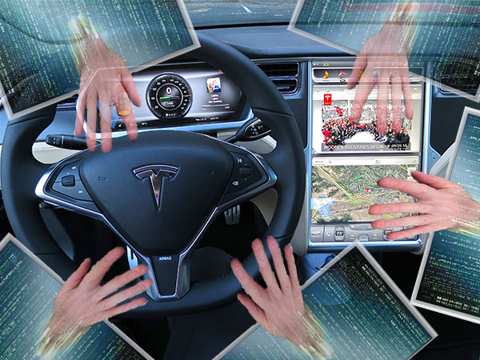
Car Sapiens re -calibrating parameters
Changing [ or zero-in] role of the driver
Co presence in the vehicle : the dawn and rise of A.I .
With A.I. , vehicle stays in IoT as a fragment in a galaxy
In this context , it seems that road traffic safety parameters will have to consider inputs relating to connected infrastructure operational frame, handling of big data, potentiality of augmented reality, latency, block-chain – all factors to weight in when rethinking safe mobility
And the unleash of the cybercrime within road traffic multi faceted environment ….

Slide 4
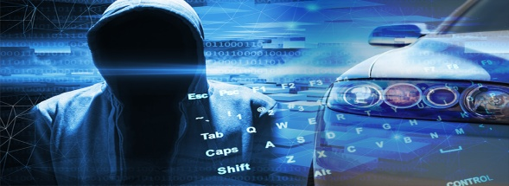
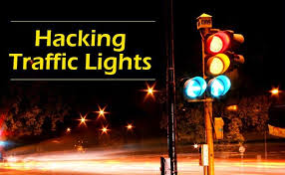
#Wannacry-#Wannacar ?
Harbingers of HAV Flaws :Charlie Miller & Chris Valasek
Their “ research –/ethical hacking“work helped manufacturers to create a security update to fix the flaw that gave them such easy remote access to the car. At Black Hat Security Conference they revealed how easy it would have been to break into several other driving systems
What if ,like
Wannacry…?

Slide 5
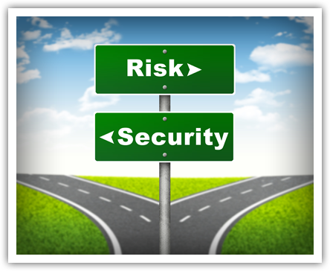
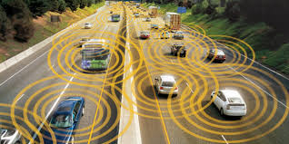
Call for policy makers and legislators
Exposure of Traffic , road users and vulnerable road users to a “weaponized” car or road junction
**When dealing with Road Traffic safety policies in the very next future Governments and International Fora should then take into account this new aspect of data theft / mishandling and systems misuse for unitented purposes
Trading liberty for security , would it be the societal price or an inevitable choice ?

Slide 6
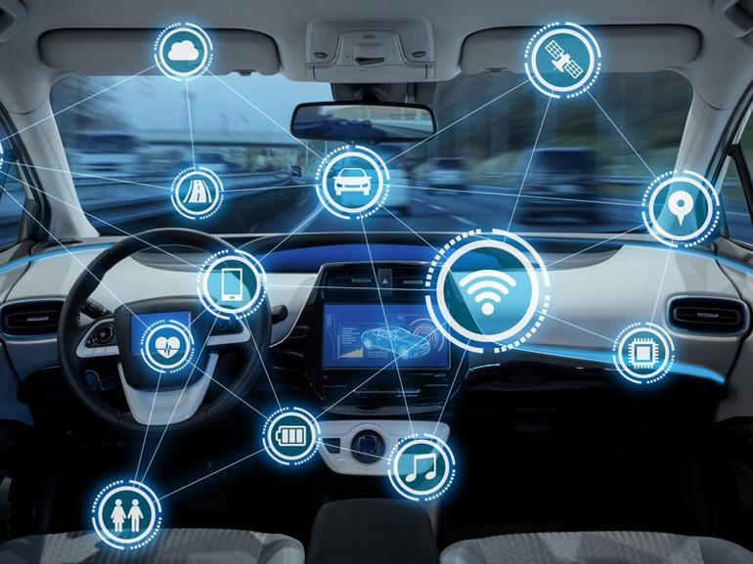
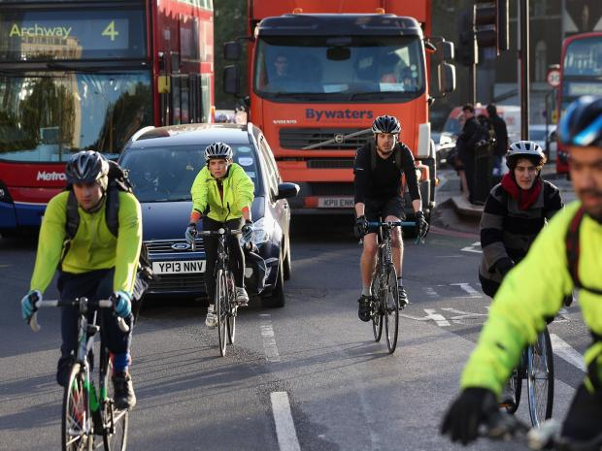
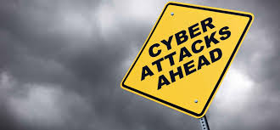
Time for adaptive and inclusive Road Safety policies
Global Forum for Road Traffic Safety as part of the motion in this challenge
Future views exchange, exploring eventual common concerns..Today, this could be seen as a first acknowledgement of the relevance of such cross-influential topic as cybersecurity certainly is.

Slide 7
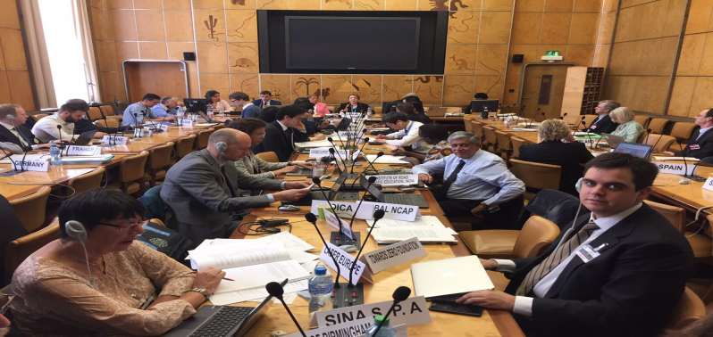
Global Forum for Road Traffic Safety
WE are all actors of the new mobility Evolution /Revolution
THANK YOU
Dott.ssa. Luciana Iorio
Chair- Global Forum for Road Traffic Safety ( WP1)

