Slide 1
Submitted by the expert from Republic of Korea
Informal document GRSP-61-24
(61st GRSP, 8-12 May 2017, agenda items 14 and 26(a))
Introduction plan for implementing
safety requirements of micro mobility
8 – 12 May 2017

Slide 2
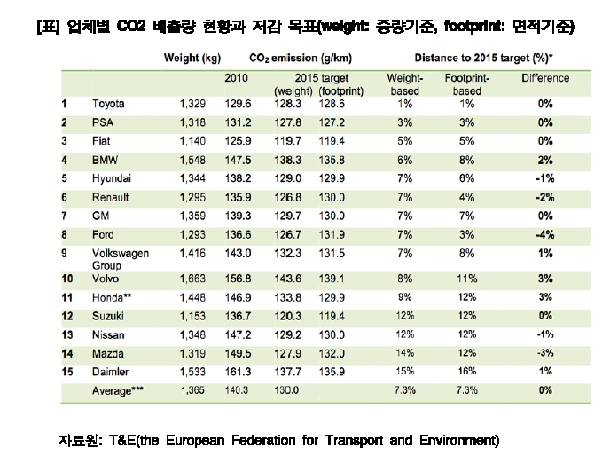
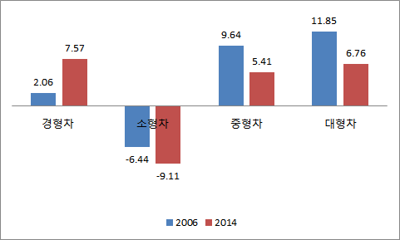
Background
Demand for micro mobility increased
due to changes in the social environment
Small vehicle
/ Large vehicle
Eco-friendly vehicle
Light and small vehicles accounted for 7.57%,
and large vehicles accounted for 6.76% in 2014.
Deepening polarization of preferred cars for small and large vehicles.
Strengthen CO2 emission requirements.
Continuing government policies such as tax reduction on eco-friendly vehicles.
Goals of CO2 emission reduction for each manufacturer
Role as City Car
Advanced vehicle
City car emerged as a means of short-distance transportation and complementary means of public transportation
Car sharing service was increased due to metropolitanization.
GM plans to develop a micro mobility with autonomous driving function
Efforts of Europe, Japan, etc. to strengthen safety of micro mobility.
- 2 -

Slide 3
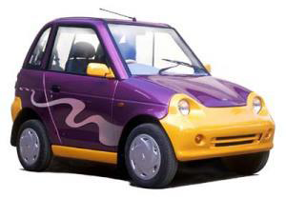
Research and safety requirement trend in other countries
Europe
Definition of L7 category
Micro mobility which is “car-like” was classified L7 category.
Vehicle regulations of L7 were strengthened to “Regulation (EU) No. 168/2013” from “Directive 2002/24/EC” in 2013.
In EU Regulation 168/2013, safety requirements on L7 category were added and strengthened.
For example, “vehicle occupant protection” requirement was newly established and “rearward visibility” requirement was improved.
In Dec. 2016, the WP29 addressed the need to improve the safety regulations of the L7 category.
Category | Definition
L7 Heavy Quadricycle | 4 wheels Mass ≤ 450kg(transport of passengers), 600kg(transport of goods) Seating positions ≤ 2 Vmax ≤ 90km/h Pmax ≤ 15kW
L7
Regulations of L7 category
Directive 2002/24/EC | EU Regulation 168/2013
47 items for type approval. In this directive, 25 items were mandatory. L6(Light quadricycle) category is the same as L2 category requirements. L7(Quadricycle) category is the same as L5 requirements. | This regulation was amended in Jan, 2013, effective from Jan, 2017. 36 items are mandatory. Safety requirements were added and strengthened.
- 3 -

Slide 4
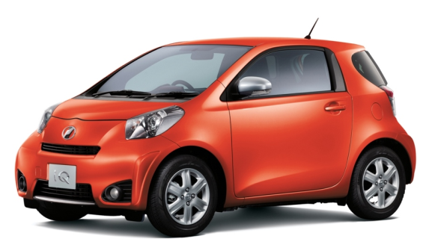
Research and safety requirement trend in other countries
Japan
Kei car | Ultra Small Mobility
Max. Power ≥ 15kW Provisions to gradually meet the regulations of category M1. Apply the 40km/h frontal impact requirement from 1994. Apply the 50km/h frontal impact and side impact requirements from 1998. Kei-car accounted for 32% of the entire auto market in 2012, therefore the number of Kei car traffic accidents increased. Need to strengthen the Kei-car safety requirements. | Included the Kei car sub-category. Carrying out the pilot projects to evaluate the usability and safety. No safety provisions for Ultra small mobility. Ultra small mobility definition Length, width, height < Kei car Seating positions ≤ 2 Max. Power ≤ 8kW Max. Velocity ≤ 90km/h No roads dedicated exclusively for Ultra small mobility Compulsory system: Pedestrian alert system, Seat belt, Rear view mirror, Steering wheel
Ultra small mobility
Micro mobility was called as “Ultra small mobility”.
In several local governments, pilot projects are under progress.
Through the pilot projects, the usability and safety of ultra small mobility will be evaluated .
Toyota iQ
- 4 -

Slide 5
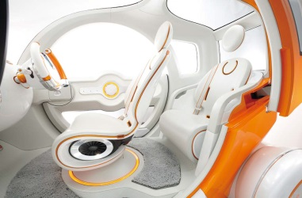
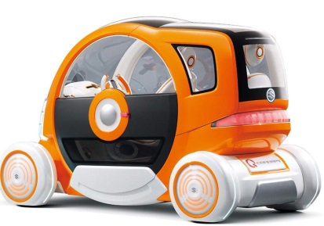
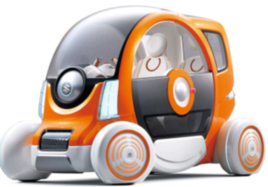
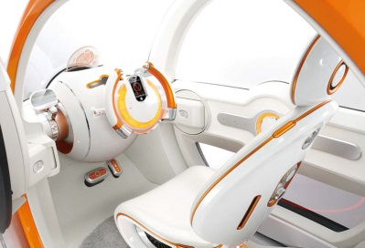
Research outline
Passive safety test
Test Vehicle
Selecting test vehicle
General safety test
Selection of test vehicle that are available in Korea
Seat, Safety-belt,
Occupant protection,
Frontal impact, etc.
Protective structure,
Load platform, etc.
Regulations
Researching regulations
Review of overseas regulations that are applicable in Korea
Active safety test
Braking, Lamps,
Steerability , etc.
편의성
Testing as following regulations
Test
Tested according to the reviewed regulations
Performance test
Safety regulations
편의성
Implementing regulations
Battery, EMC,
Fuel consumption, etc.
Safety regulations by sectors of general safety, passive safety, active safety and performance.
Implementing Plan
Establish micro mobility regulations in Korea
- 5 -

Slide 6
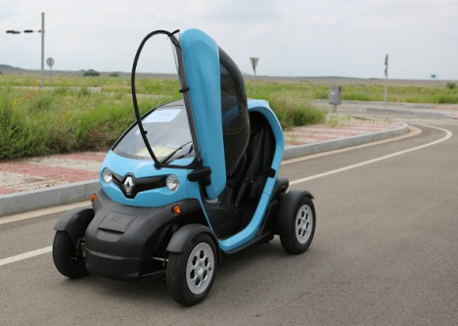
Selection of test vehicle
Investigation of development and sales status
Development plan of domestic and foreign manufacturers
5 OEMs : No plan except for Renault-Samsung(Twizy).
6 medium-sized companies : 2 manufacturers undergoing development,
4 manufactures considering development plan.
Foreign manufacturers(from KAIDA) : No sales plan in Korea.
Foreign manufacturers’ development and sales plan (from Literature search) : 15 vehicles.
Selection of test vehicle
Renault “Twizy”.
Only Twizy is available in Korea.
Domestic brand vehicle will not be available within our research period.
Renault, Twizy

Slide 7
Regulations
Review of EU regulations that are applicable in Korea
Test item for establishing micro mobility safety regulation in Korea based on EU Reg. 168/2013
Applying M1 category regulations
Directive 2002/24/EC
Sector | Number of item | Added item for strengthening safety
General Safety | 6 items Mass and dimension, Protective structure, Fuel storage, Load platform, Devices to prevent unauthorized use, Coupling device | -
Active Safety | 2 items Braking, Steerability | Speedometer
Passive Safety | 4 items Rollover, Safety belt, Occupant Protection, Seats | Frontal Impact, Pedestrian, Steering wheel impact, Door lock, Electrical safety
Performance | 9 items Audible warning device, Glazing, Lamp, Rearward visibility, Tire, EMC, Fuel consumption, Engine power, Wipers | REESS safety, QRTV
Total | 21 items | 8 items
47 items for type approval.
In this Directive, 25 items were mandatory.
L6(Light quadricycle) category is the same as L2 category requirements.
L7(Quadricycle) category is the same as L5 requirements.
EU Reg. 168/2013
This regulation was amended in Jan, 2013, effective from Jan, 2017.
36 items are mandatory.
Safety requirements were added and strengthened.
Application of EU Regulation 168/2013
- 7 -

Slide 8
Tests
Tested according to the reviewed EU regulation 168/2013
Sector | Test items | Test results and remarks
General Safety | 6 items Mass and dimension, Protective structure, Fuel storage, Load platform, Devices to prevent unauthorized use, Coupling device | Mass and dimension - In case of the dimension, considering the application of light passenger vehicle regulation in KMVSS. - For mass, gross vehicle weight 550kg including battery. Other items: Be able to apply of passenger vehicle(M1) regulations.
Active Safety | 3 items Braking, Steerability, Speedometer | Braking - Applying a form derived from two-wheeled motor vehicle braking system. - Need to apply of secondary braking system like a M1 category braking system. - Need to develop exclusively Micro mobility ABS. Steerability: Equivalent to M1 category regulations. Speedometer: Be able to apply passenger vehicle regulations.
Passive Safety | 9 items Rollover, Safety belt, Occupant Protection, Seats, Frontal impact, Pedestrian, Steering wheel impact, Door lock, Electrical safety | Rollover: Apply roof crush requirement of KMVSS. Safety belt: Need to strengthen the applying forces. Occupant protection - Similar to the requirement for checking radius of curvature. - For other vehicles, no requirement of curvature radius in KMVSS. Steering wheel impact: Considering this requirement in case of not applying frontal impact regulations. Pedestrian - Expecting the high frequency of exposure to pedestrian. Door lock, Frontal impact and Electrical safety are not assessed yet.
- 8 -

Slide 9
Tests
Tested according to the reviewed EU regulation 168/2013
Sector | Test items | Test results and remarks
Performance | 9 items Audible warning device, Glazing, Lamp, Rearward visibility, Tire, EMC, Fuel consumption, Engine power, Wipers, REESS safety, QRTV | Lamp - Mandatory: Head lamps, Direction indicators, Position lamps, Stop lamps, Reversing lamps, Rear registrations plate lamps. Fuel consumption - Need a additional research for the test cycle. - FTP Mode(Passenger vehicle) or WMTC mode(Two-wheeled motor cycle) Wiper - Need the mandatory installation requirements of wiper system when compulsory side door and window pane installation requirements are applied. REESS safety - the tests carried out according to UN R.136. QRTV: Be able to apply passenger vehicle(M1) regulations.
- 9 -

Slide 10
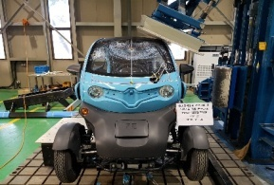
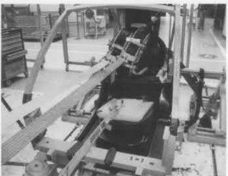
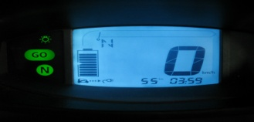
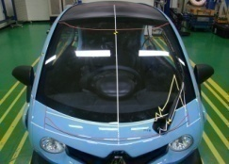
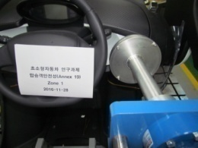
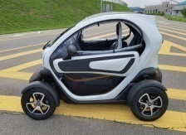
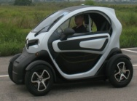
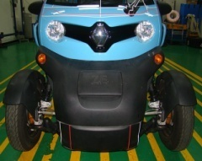
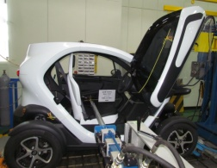
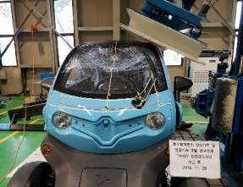
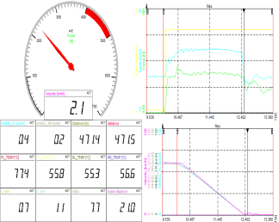
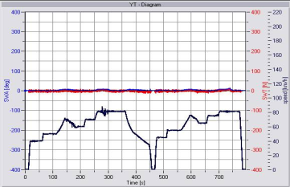
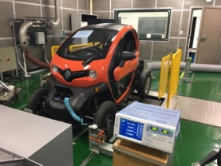
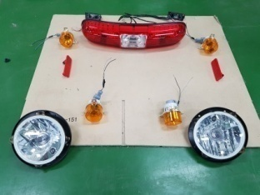
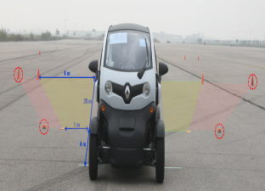
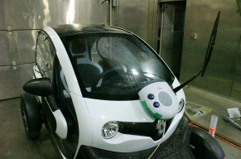
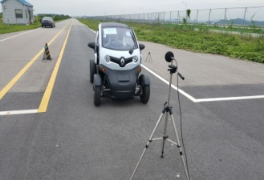
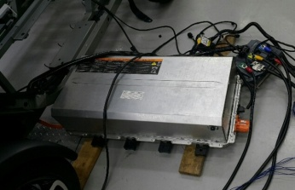
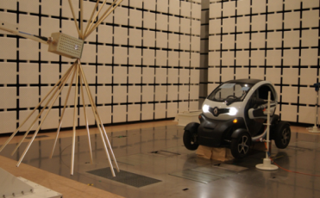
Examples of performed test
Passive safety tests
Active safety tests
Pedestrian
Occupant Protection
Rollover
Seat belt
Braking
Steerability
Speedometer
Head form Impact
Leg form Impact
Head form impact
Door lock
Before test
After test
Belt anchorage
Test equipment
Test result
Test equipment
Test result
Performance tests
Fuel consumption
Lamp
Rearview visibility
Wiper
Audible warning
REESS
EMC
- 10 -

Slide 11
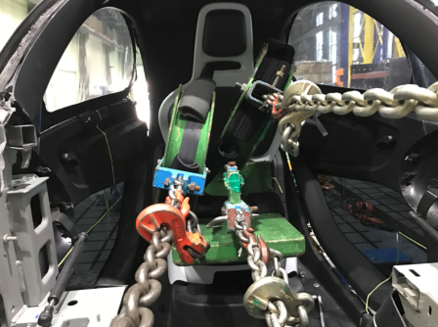
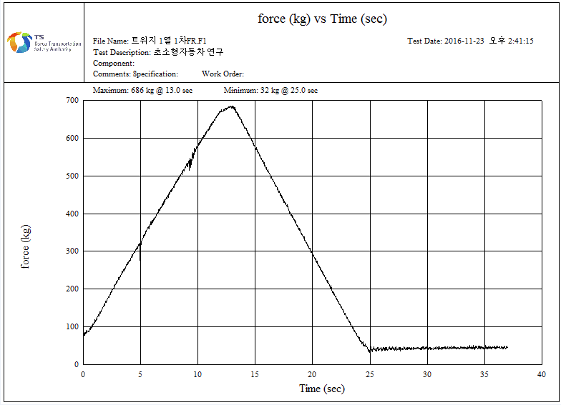
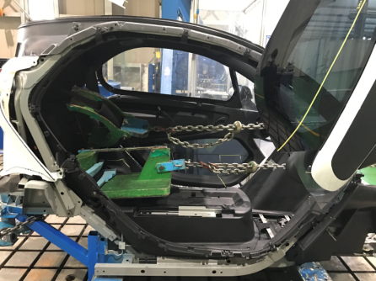
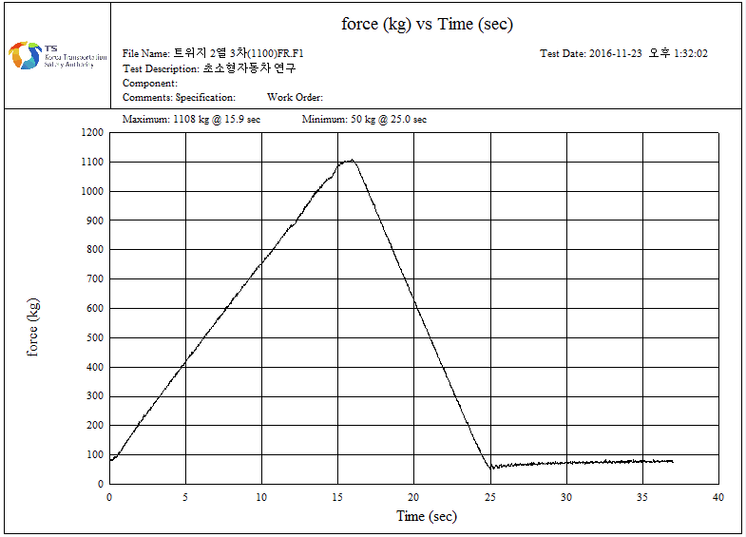
Issues related to crash worthiness
Seat and Safety belt anchorage requirement
Applied regulations
Performed test
Test results
Based on EU R.168/2013 and KMVSS 97 and 103.
The loaded force on the safety belt anchorage is stronger(about twice times) in KMVSS than EU Regulation.
Tractive force in EU R: 675 daN
Tractive force in KMVSS: 1,078 daN
First test results subject to application of the EU R. are met the requirement.
In second test according to KMVSS, safety belt anchorages withstood.
Issue 1.
Strengthened the loaded force.
In full frontal crash test result,
the loaded force value on safety
belt was about 800~900 daN.
We need to strengthen the applied
load on the safety belt anchorage.
According to test results, there is
no problem that the test vehicle
meets the strengthened
requirements from now.
.
① First Row
① 675 daN(EU R.)
Implementing regulations
② Second Row
Considering the implementation of strengthened regulations in Korea.
② 1,078 daN(KMVSS)
- 11 -

Slide 12
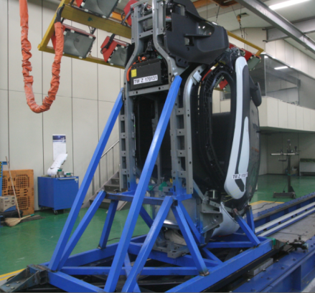
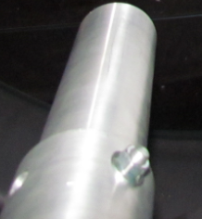
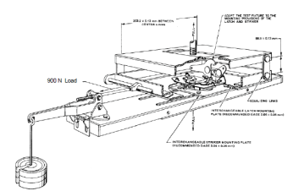
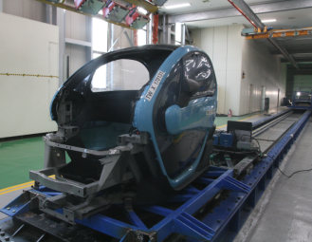
Issues related to crash worthiness
Door Lock system requirement
Applied regulations
Performed test
Test results
Based on EU R.168/2013 and KMVSS 104(equivalent to GTR 1).
For evaluating the safety of door lock systems the test procedures of KMVSS is different from those of EU R.
Static load test in EU R.
push force of 200 daN, delivered by a flat-ended ram.
Load test and Inertial test in KMVSS
First test results met the requirements of EU R..
In second test according to KMVSS, the door lock systems withstood the load and inertial test.
Issue 1.
Strengthened the regulation.
Door lock systems are very important in vehicle accidents because the door locks will prevent passengers from being ejected in the car accident.
According to test results, there is
no problem that the test vehicle
meets the strengthened
requirements from now.
Test procedures of EU R.
Implementing regulations
Inertial test
in vertical direction
Considering the implementation of strengthened regulations in Korea.
Test procedures of KMVSS
- 12 -

Slide 13
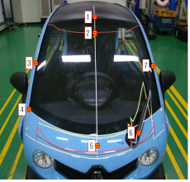
Issues related to crash worthiness
Pedestrian safety
Applied regulations
Performed test
Test results
Based on KMVSS 102-2 (equivalent to GTR No.9) Pedestrian Protection
Head Test Condition - Impactor (Impact angle) : Adult Headform(65°), : Child Headform(50°) - Impact Speed: 35 km/h - Injury Criteria: ≦ HIC 1000/1700 - Location: Worst / Typical area
Leg Test Condition - Impactor: Flex-PLI - Impact Speed: 40 km/h - Injury Criteria 1. ACL/PCL: ≦ 13 mm 2. MCL: ≦ 22 mm 3. T Bending Moment: ≦ 340 Nm - Location: CTR, Corner
Head Test Result
Issue 1 : Head form Test : Not adequate Test Area , or Extremely Narrow Test Area - Due to the short front - Not effective assessment (by the current regulation)
Issue 2 : identification of Bumper
/Hood : Hard to distinguish bumper/hood - Due to the distinctive design (exposed tire, small front cover) - Not effective test area (if exemption zone is considered)
No | Location | HIC | A
1 | WAD1900(CTR) | 591.60 | ○
2 | WAD1670(CTR) | 340.98 | ○
3 | A-plr RH | 1712.78 | X
4 | Hood Corner | 1990.99 | X
5 | WAD 1000(CTR) | 1307.07 | Δ
6 | Wiper | 1365.93 | Δ
7 | A-plr LH | 2007.53 | X
Leg Test Result
Implementing regulations
Location | Injury | Result | A
Corner | Tibia Moment | 284.05 Nm | ○
 | MCL/ACL/PCL | 6.95/4.19/3.67 | ○
CTR | Tibia Moment | 378.15 N/m | Δ
 | MCL/ACL/PCL | 9.02/4.86/2.83 | ○
Need to consider the new regulations of micro vehicles for pedestrian protection, if necessary.
- 13 -

Slide 14
Issues related to crash worthiness
Crash safety
Applied regulations
Performed test and results
Based on KMVSS 102, UN R.94 and UN R.95
(KMVSS 102 similar to UN R.137)
KMVSS 102(Full frontal) - Test speed: 48 km/h
- Rigid barrier impact test
- Dummy: Hybrid III 50%ile
- Injury measurement:
Head, Neck, Chest, Leg
UN R.94(Offset) - Test speed: 56 km/h
- 40% Offset
- Honeycomb block impact test
- Dummy: Hybrid III 50%ile
- Injury measurement:
Head, Neck, Chest, Leg
UN R.95(Side)
- Test speed: 50 km/h
- Movable barrier impact test
- Dummy: EuroSID II
- Injury measurement:
Head, Chest, Pelvis
Sector | Injury | Requirement | Measurement
 |  |  | Full frontal | Offset | Side
Head | HIC36 | 1000 | 860 | 893 | 2452
 | Acceleration | 80 |  | 76.6 | -
Neck | Shear force | 3.1 | 0.37 | 0.67 | -
 | Tension force | 3.3 | 1.56 | 1.49 | -
 | Moment | 57 | 48.2 | 23.7 | -
Chest | Deflection | 50 / 42 | 19.0 | 19.4 | 6 / 19.9 / 25.2
 | VC | 1.0 | 0.17 | 0.09 | 0.23
 | Acceleration | 60 | 71.2 |  | -
T12 | Compression force | 2.0 | - | - | 3.49
 | Moment | 200 | - | - | 175.4
Abdomen | Abdominal peak force | 2.5 | - | - | 2.13
Pelvis | Pubic symphysis force | 6 | - | - | 2.89
Femur | Compression force | 9.07 | L: 3.12 / R: 4.83 | L: 3.25 / R: 3.14 | -
Tibia | Compression force | 8.0 | L: 4.5 / R: 6.4 | L: 2.05 / R: 2.66 | -

Slide 15
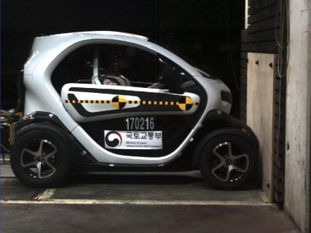
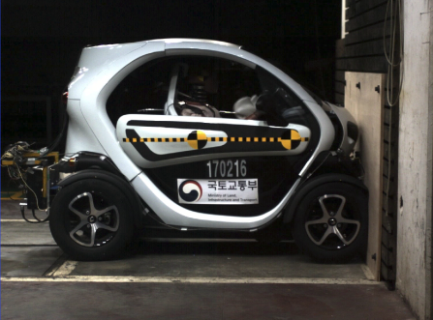
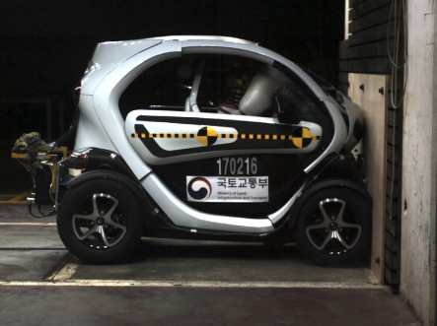
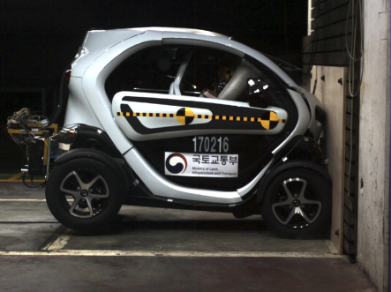
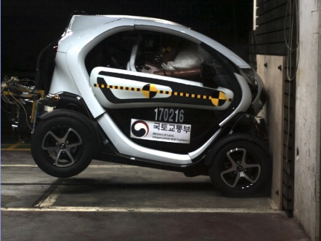
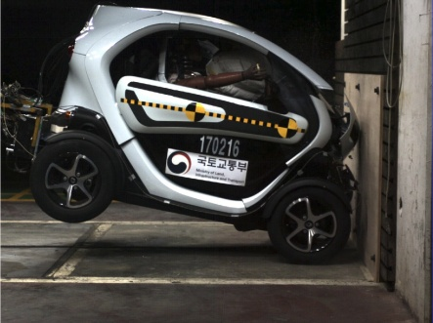
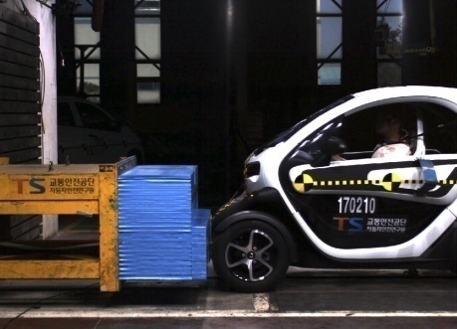
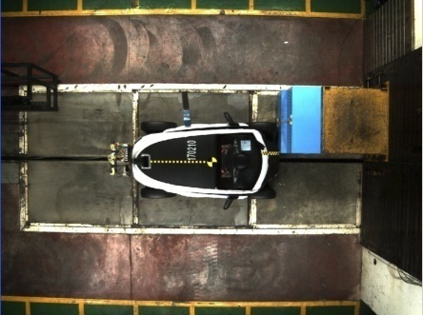
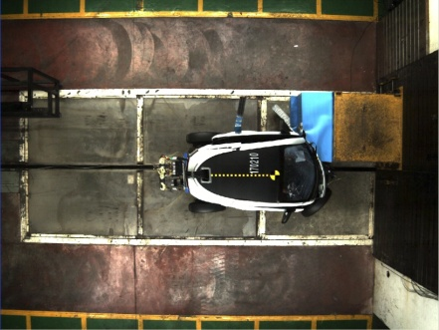
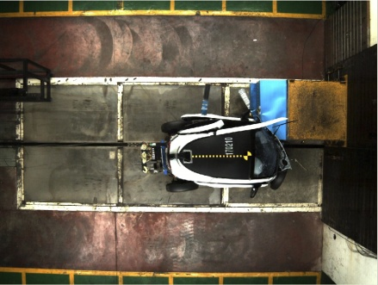
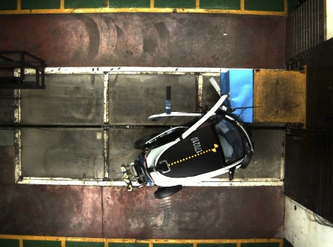
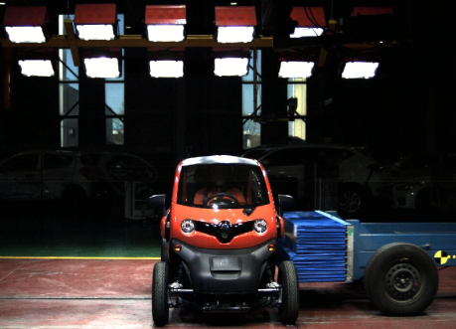
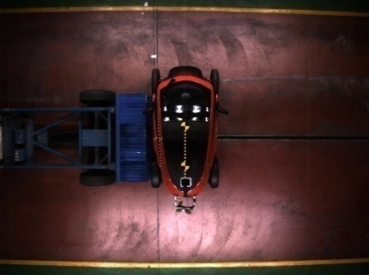
Issues related to crash worthiness
Full frontal impact
0ms
20ms
40ms
60ms
100ms
150ms
Offset impact
0ms
56ms
86ms
150ms
200ms
Side impact
80ms: Head contact to the roof in vehicle
0ms
50ms
100ms

Slide 16
Comparing KATRI crash test results with 2014 EuroNCAP test results
Frontal impact test results
Side impact test results
Remarks and issues
Head and neck injuries of 2014 EuroNCAP are similar to 2017 KATRI test.
In the case of chest injuries, the result of chest deflection in KATRI test improved significantly compared with those in 2014 EuroNCAP.
Femur force value improved.
In 2017 research, dummy head contacted the roof of vehicle and HIC value exceeded 1000.
Lower chest deflections improved significantly in 2017 KATRI research.
But, chest acceleration results was worse.
T1 and T12 injuries of spine in 2014 EuroNCAP were similar to those in 2017 KATRI research.
The comparison of crash tests showed that some areas of the test vehicle in 2017 KATRI research improved over 2014 EuroNCAP.
Based on KATRI test results
Korea is considering the strengthening of crashworthiness requirements.
57% improvement in chest deflection
98% improvement in in lower chest deflection
64% improvement in right femur force
71% deterioration in lower chest Accel. Y
- 16 -

Slide 17
Implementing regulations in Korea
Phase-in application of micro mobility regulations
 | Application
Phase 1 | 43 items amendment in KMVSS General safety: 20 items including mass and dimension, control and tell-tale signs, fuel storage, etc, Active safety: 3 items including braking, steerability, speedometer. Passive safety: 4 items including safety-belt, Door lock, etc. Performance: 16 items including tire, glasses, fuel consumption, lamps, etc.
Phase 2 | 4 items Frontal impact Side impact Pedestrian safety Braking(ABS)
- 17 -

Slide 18
Thank you for your attention.

