Slide 1
Rail Security Observatory
Francesco Dionori
Chief, Transport Networks & Logistics
23rd May 2018
Notes:
This is a sample Title Slide with Picture ideal for including a dark picture with a brief title and subtitle.

Slide 2
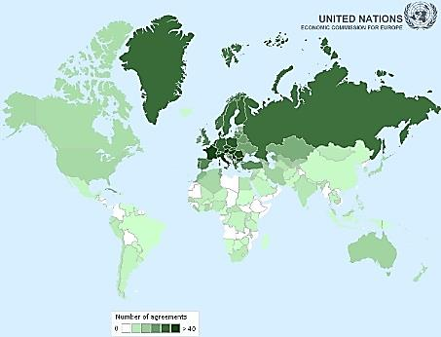
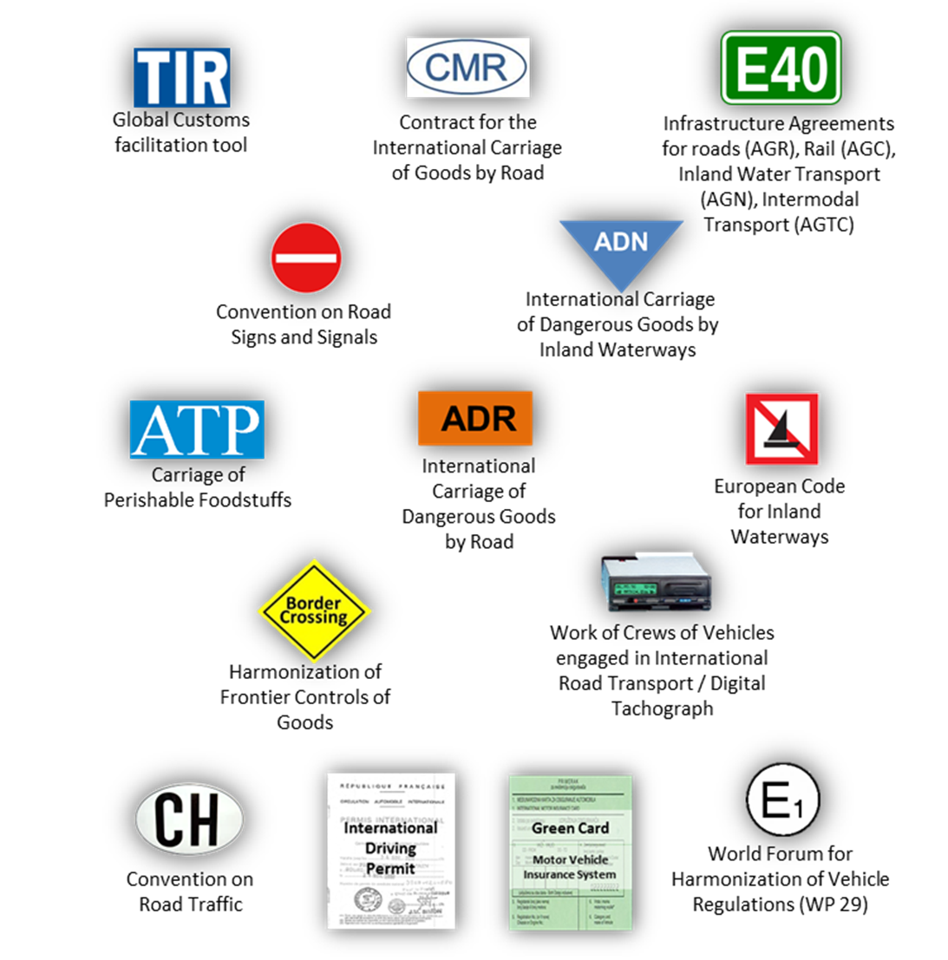
Sustainable Transport Division
Strengths of the Committee in the delivery of tangible results
58 conventions, 1742 Contracting Parties
Goal: a universally harmonized inland transport system

Slide 3
UNECE Rail Security
Mandate and history
Rail security on the agenda of SC.2 for many years
Following a workshop in 2013 it was agreed to create an electronic space on rail security to:
Disseminate ad hoc knowledge and best/good practices
Exchange information about projects and other initiatives/proposals
Seek cooperation on specific rail security projects/tasks/studies and research agreed upon during SC.2 sessions and other events, and focus on developing definitions
Over the years the Observatory has been developed and updated in structure
It was relaunched at SC.2 in November 2017

Slide 4
UNECE Rail Security Observatory
How it works: a repository of files on rail security, with access restricted only to authorized users
Organized by themes, countries, document categories and Working Party documents

Slide 5
UNECE Rail Security Observatory
Different ways to find information: search engine / pages menu / links to pages

Slide 6
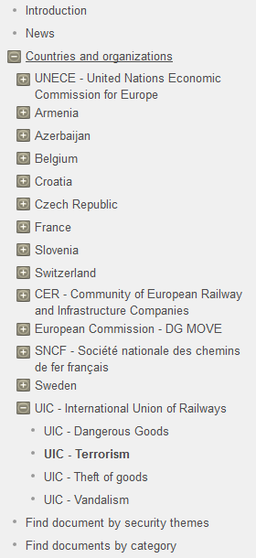
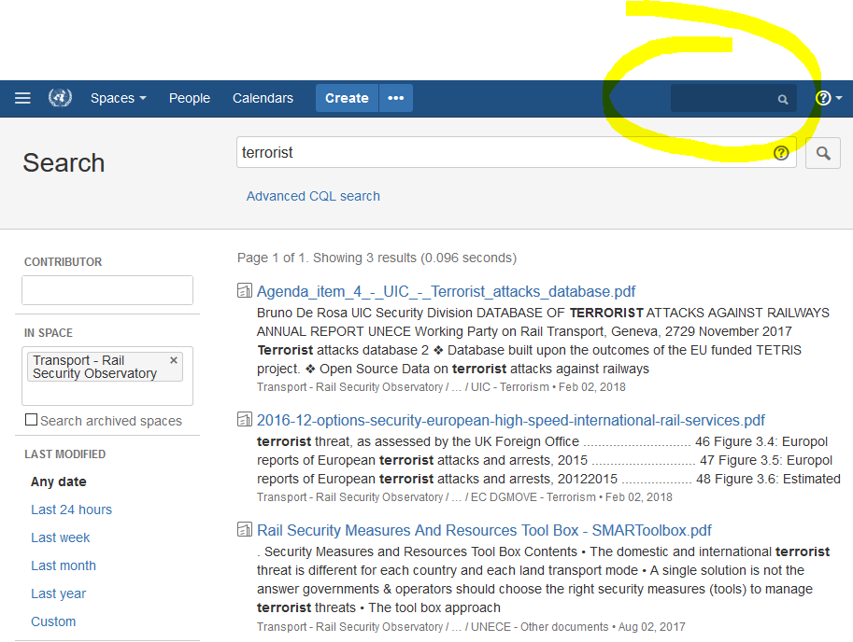
UNECE Rail Security Observatory
Browse documents using the pages menu
Use the search engine to find pages or documents
Use the menu to directly access a page from a specific country or organization, on a specific theme
-
Or use the menu links to find document by security themes (dangerous goods, terrorism, theft of goods, vandalism) or by category (projects, publications)

Slide 7
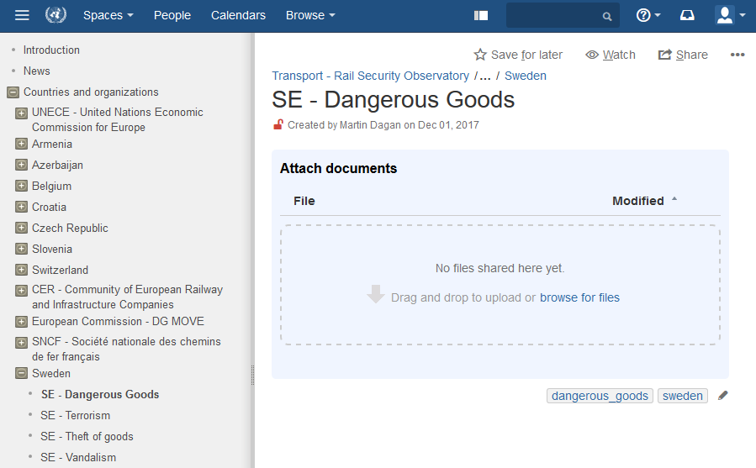
UNECE Rail Security Observatory
Uploading documents
The users can upload or delete documents under their respective area (country / organization)
Relevant labels are automatically attached to the uploaded documents
User-friendly interface
Video tutorial https://www.youtube.com/watch?v=gW9mXxPc7ps&feature=youtu.be

Slide 8
To register please contact the secretariat Thank you
Francesco Dionori
Notes:
This is a sample Title Slide with Picture ideal for including a dark picture with a brief title and subtitle.

