Slide 1
CYbersecurity in the RAILway sector : lessons learnt from EU SECRET project and EU CYRAIL Project
ITF/UIC/UNECE Workshop on Rail Security, 23 May 2018, Leipzig
Bruno De Rosa
UIC Security Division

Slide 2
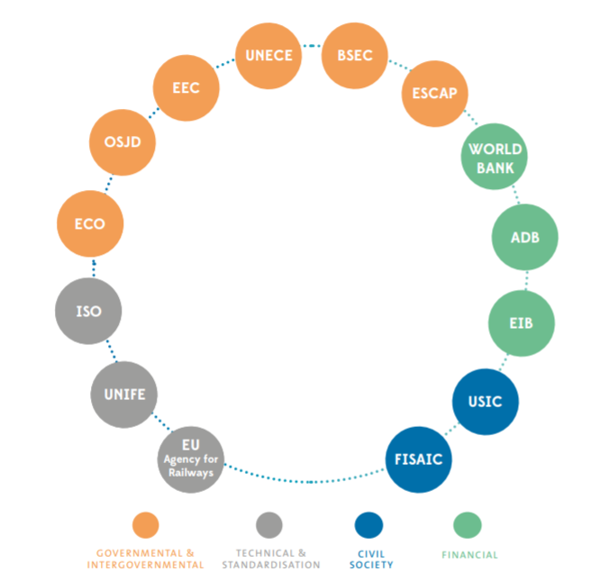
What is the UIC?
INTERNATIONAL UNION OF RAILWAYS
THE MISSION NOWDAYS
Promote rail transport at world level in order to meet both current and future challenges of mobility and sustainable development.
Promote interoperability.
Develop and facilitate all forms of international cooperation among Members (e.g. sharing of best practices).
Support Members in their efforts to develop new businesses and new areas of activity.
Propose new ways to improve technical and environmental performance of rail transport.

Slide 3
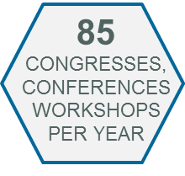
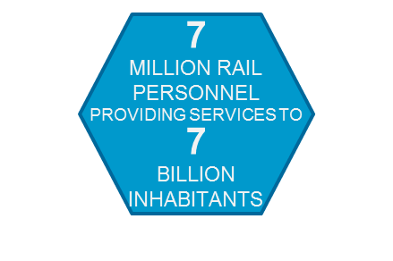
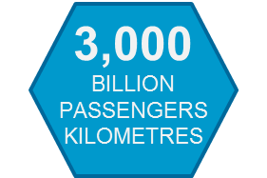
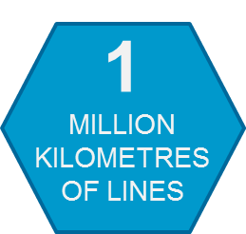
…some numbers about UIC

Slide 4
Rail Security at UIC
SECURITY PLATFORM : GLOBAL LEVEL
Current chair : DB AG (Germany), Gerd Neubeck.
Current Vice chair : VIA Rail (Canada), Marc Beaulieu.
SECURITY WORKING GROUPS
ANNUAL CONGRESS and SECURITY WEEK
2018 World Security Congress will be held in Slovenia, with a focus on “Crisis Management & resilience”
2018 Security Week will be held in UIC HQ in Paris, 18-21 June.
HUMAN FACTORS
Chaired by RZD (RUSSIA)
SABOTAGE INTRUSIONS ATTACKS
Chaired by DB (GERMANY)
TECHNOLOGY
Chaired by CZK (CZECH REPUBLIC)
3 PERMANENT WORKING GROUPS
2 THEMATIC WORKING GROUPS
(UPON MEMBERS’ REQUEST)
STEERING COMMITTEE (Quarterly)
UIC Activities:
UIC Regions:
UIC Partners:
BORDERS CROSSING, INTERNATIONAL CORRIDORS
Chaired by PKP PLK (POLAND)
STRATEGY, PROCEDURES AND REGULATIONS
Chaired by SNCB (BELGIUM)
Rail system, Freight, Passenger, Fundamental Values.
including Colpofer (Europe), Coordinating Council on Transiberian Transportation.
UITP, RAILPOL, CER, EIM…
Notes:
ANNUAL CONGRESS, to capitalize on the activities carried out during the year and to propose new priorities.

Slide 5
Railways have been so far generally considered as a ‘safe domain’ with regard to cybersecurity issues
The shift towards inter-modal transports will require management systems capable of connecting previously separated layers and entities, but also of preventing malicious attacks directed to new potential weak spots in the chain.
The need for a smarter mobility will call for a new generation of intelligent transportation services.
Customers are constantly seeking for reliable and seamless internet connectivity not only to plan, book and manage their journeys, but also to entertain themselves or work inside the stations and on the trains.
Notes:
Railways have been so far generally considered as a ‘safe domain’ with regard to cybersecurity issues mainly because they usually rely on proprietary, segregated networks, with specific protocols for management, communication and signalling…

Slide 6
Cybersecurity on rail : the challenges
INCREASE OF THE POTENTIAL ATTACK SURFACE
INCREASE OF THE NUMBER OF ATTACK VECTORS
MANY LAYERS OF THE SYSTEM COULD BE EXPOSED TO BOTH CYBER AND CYBER-PHYSICAL ATTACKS.

Slide 7
UIC IS TACLKING DIFFERENT ASPECTS OF THESE CHALLENGES WITH THREE DIFFERENT ACTIONS:
Rail EM (Electro Magnetic) ATTACKS EU SECRET Project
Rail CYBER ATTACKS EU CYRAIL Project
Exchange of experiences among railway companies and other third-party stakeholders, through:
Working Groups, publications, initiatives (e.g. Workshop on Cybersecurity held during the UIC Security Week, 19 June 2018, Paris)

Slide 8
EU Project SECRET
Duration: 01 August 2012 for 36 Months
Budget : 4,268 M€ (3,059 M€ funding by EU)
Coordinator : IFSTTAR (France)
Partners : 10 Partners from 5 countries
This project has received funding from the European Union’s Seventh Framework Programme for research, technological development and demonstration under grant agreement n° 285136
Protection of railway infrastructure against EM attacks through:
Assessing the risks and consequences of EM attacks on the rail infrastructure
Identifying preventive and recovery measures
Developing protection solutions for EM attacks
Producing technical recommendations to reinforce the railway infrastructure

Slide 9
Rail networks: attractive targets for EM attacks
Railways are a mass transport system, easy to access, open, potentially high economic and security impacts
Many vulnerable components in the railway system : Sensors (balises), antennas, communication systems
Multiplication of emission devices, antennas and amplifiers accessible to the general public
Easy to design emissions devices able to disrupt rail technologies
ERTMS homogenizes the technologies in Europe and so the vulnerabilities
Facilitates the implementation of organized and simultaneous attacks.
CASE 1: THE TARGET IS AN ELECTRONIC DEVICE
Permanent or Temporary Default on electronic devices with HIGH FREQUENCY EM emission
= damaging or disrupting, confusing
ELECTRONIC DEVICE
Electro-Magnetic SIGNAL
ANTENNA
ELECTRONIC DEVICE
CASE 2: THE TARGET IS TO AVOID THE DATA TRANSMISSION
Jamming the data transmission between the devices with LOW FREQUENCY EM emission
= disrupting or confusing the system
ELECTRONIC DEVICE
DATA
TRANSMISSION
Electro-Magnetic SIGNAL
ANTENNA
ELECTRONIC DEVICE
EU SECRET PROJECT scope

Slide 10
Scope of the SECRET Project
SECRET considers any system of emission, authorized or not, available on the public domain market producing low-frequecy electro-magnetic emissions, such as jammers, remote controls, etc.
but does not consider High Power Intentional Electromagnetic Sources.
WHY?
Because low power intentional interferences can be sufficient to break the communication links;
Their effects would be diagnosed as a technical failure
Bad impact on operator/railways image
Notes:
Explain that the train stop in emergency

Slide 11
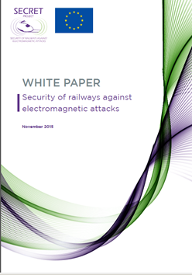
Public Results : WHITE PAPER
This project has received funding from the European Union’s Seventh Framework Programme for research, technological development and demonstration under grant agreement n° 285136
CONTENTS:
3 categories of recommendations covering:
Prevention from EM jamming effects
Detection of EM attacks
Mitigation of EM jamming effect
About 40 recommendations on:
- Organisation
- Standardization
- Technical aspects
Document available online at: http://www.secret-project.eu
Notes:
PREVENTION from EM jamming effects
Methodology recommendations
Planning security risk assessment study to define wether existing risks are tolerable and that risk control measures are adequate (incorporates risk analysis and risk evaluation phases)
Ensuring its interoperability with Risk Analysis Methods
Operational recommendations
Minimizing the emergency brake impact
Engineering Recommendations
DETECTION OF EM JAMMING
Jammer detection techniques
Detection based on Error Vector Magnitude monitoring
on monitoring the frequency spectrum occupation
on monitoring QoS
Jammer Detection Application
ON-board vehicle fixed detector
On board portable detector
Trackside BTS proximity detector
Trackside mobile detector
Train station detector
Methodology Recommendations
Harmonized indicators and reference conditions
Inputs to be considered when designing a dedicated EM attack detection solution
MITIGATION OF EM JAMMING EFFECTS ON TRAIN TO GROUND COMMUNICATIONS
Operational Recommendations
Ground BTS ---- Increase temporarily the ground BT output
Train Antenna ---- SPACE DIVERSITY (Switching from train front cab radio equipment to the rear equipment when a jamming situation is detected)
Radio Network
Decision Criteria for Mitigation Activation

Slide 12
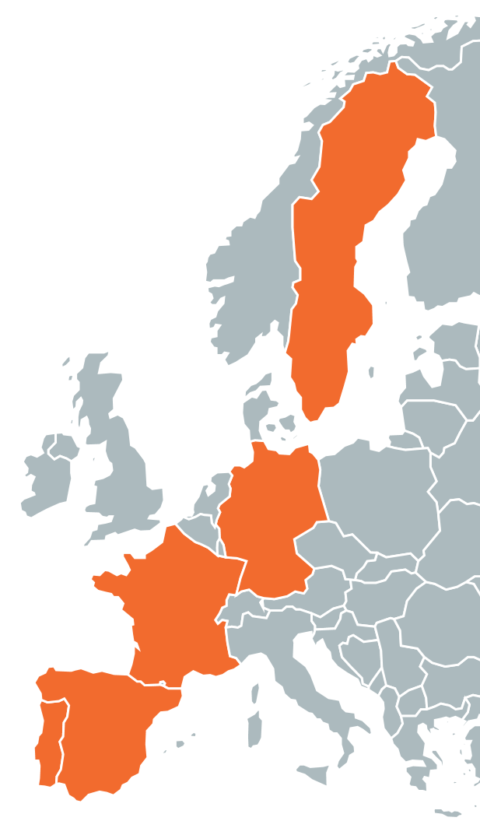
CYbersecurity in the RAILway sector
Duration: 1 Oct. 2016 - 30 Sept. 2018
Budget : 1,5 M
Coordinator : Evoleo Technologies
Consortium : 6 Partners from 5 countries
Notes:
Small but multidisciplinary consortium: members from different domains bring benefits from other domains (IT, aerospace, Stakeholders, Academia)
They use the solutions in their domain, and the project will assess the existing solutions and find which are the most adapted for the rail sector

Slide 13
Cybersecurity on rail : the challenges
Rail Networks are Critical Infrastructures. Their nature is heterogeneous and geographically-distributed.
Older technologies are slowing down the evolutionary process (e.g. circuit-switching, GSM-R)
Rail Systems are more and more (inter-)connected and open.
Rail Technologies are becoming increasingly interoperable and harmonized.
Threats (human- and technology-based) - are adapting quicker than traditional security detection methods.
Notes:
Rail Networks are Critical Infrastructures. National, international and thus direct and/or indirect interdependancies are in place. Escalating or Cascading transnational effects can be foreseen in certain cases.
Old technologies are slowing down the evolutionary process. (such as Circuit-switching and GSM-R) but new technologies often bring new vulnerabilities.
Rail Systems are more and more connected and open. On the other hand the potential attack surface increases dramatically.
Rail Technologies are becoming more and more interoperable and harmonized.
Threats (human and technology based) - are adapting quicker that traditional security detection methods. Attackers are a multitude smart, motivated (various motivations) , agile (they adapt quicker their attack methods because they are flexible, they don’t have policies and procedures and regulations to respect).
These could expose many layers of the system to both cyber and cyber-physical attacks (explain), potentially involving or triggering domino effects within the same or different domains

Slide 14
Project Goals
Perform a cyber security assessment of the Railway systems;
Deliver a taxonomy of threats targeting rail management and control systems;
Assess and select innovative rail management systems attack detection techniques;
Specify Countermeasures and Mitigation strategies for improved quality levels;
Achieve Security by Design, by selecting a development framework and specifying Protection Profiles with Evaluation of Assurance Levels.
Notes:
What are the most critical railway services, zones and communications?
What are the threats? WP4 threat taxonomy (ACTOR, TARGET, CONTEXT, ATTACK, IMPACT), anaysis of past attacks against rail and against other sectors, comparative study, future cyber threat scenarios.
How to detect attacks targeting rail management systems? The challenge here is to ….
To specify adapted techniques to detect attacks as early as possible, with the least impact on operation and at an acceptable cost
TO DO SO: assess the existing CYBER ATTACK detection techniques, ANOMALY detection techniques, PHYSICAL INTRUSION detection techniques ------) combining these techniques to be able to detect complex/multi-steps cyber attacks on rail infrastructures.
Assessment of 30+ existing solutions (both railway and non railway focused)
How to prevent attacks and how to make the system resilient? WP 5 countermeasures to prevent threats from impacting the systems, definition of mitigation strategies to minimize the impact, definition of resilience mechanisms to ensure system availability in presence of a security breach
Pprofiles: A Protection Profile (PP) is a document used as part of the certification process according to ISO/IEC 15408 and the Common Criteria (CC). As the generic form of a Security Target (ST), it is typically created by a user or user community and provides an implementation independent specification of information assurance security requirements. A PP is a combination of threats, security objectives, assumptions, security functional requirements (SFRs), security assurance requirements (SARs) and rationales.

Slide 15
Further information on
CYRAIL Final Conference well be held
on
September 18, 2018 at UIC HQ in Paris.
Website : www.cyrail.eu
Coordinator of the project : magno.santos@evoleotech.com

Slide 16
THANKS FOR YOUR KIND ATTENTION
SAVE THE DATE OF NEXT EVENT: CYBERSECURITY WORKSHOP will be held on 19 June, during the UIC SECURITY WEEK in Paris, UIC HQ.
SECRET Project : www.secret-project.eu
CYRAIL Project : www.cyrail.eu
UIC Security Division : www.uic.org/security
Contact point : security@uic.org

