Slide 1
Informal Document GRB-68-14
Agenda item 19
ETRTO proposal for UN R30 & 64 amendments
Extended Mobility Tyres
Sept 2018 GRBP Supporting material

Slide 2
WHY TO REGULATE EMT ?
REGULATORY PICTURE
REAL WORLD APPLICATION
“RF” TYRES regulated focusing essentially on flat running mode performance (zero inflation pressure)
“NOISE/WET GRIP/RR” have been regulated afterwards together with other tyre characteristics.
“RF” TYRES rarely adopted, not constituting a representative use case.
Millions of tyres providing flat running mode capability (at least 80 km @ 80 km/h) are on the market and not regulated regarding their flat running mode performance.
WHY TO REGULATE EMT?
To specify a minimum deflated performance requirement that tyres declared as EMT have to meet
to consider EMT as a safety asset for current vehicles and forthcoming autonomous ones.

Slide 3
WHY NOT JUST TO AMEND RF?
RATIONALE TO INTRODUCE A NEW DEFINITION:
Because RF and EMT have two different structure identification: RF vs. R;
To prevent market confusion, while ensuring a clear regulatory framework.
REQUIREMENT
At least 80 km @ 80 km/h
PRODUCT
RF
EMT
STRUCTURE
205/55RF16
RUN FLAT
RADIAL
205/55R16
MARKING
“SNAIL”
“SWIRL”
TEST
ANNEX 7 §3
ANNEX 7 §4

Slide 4
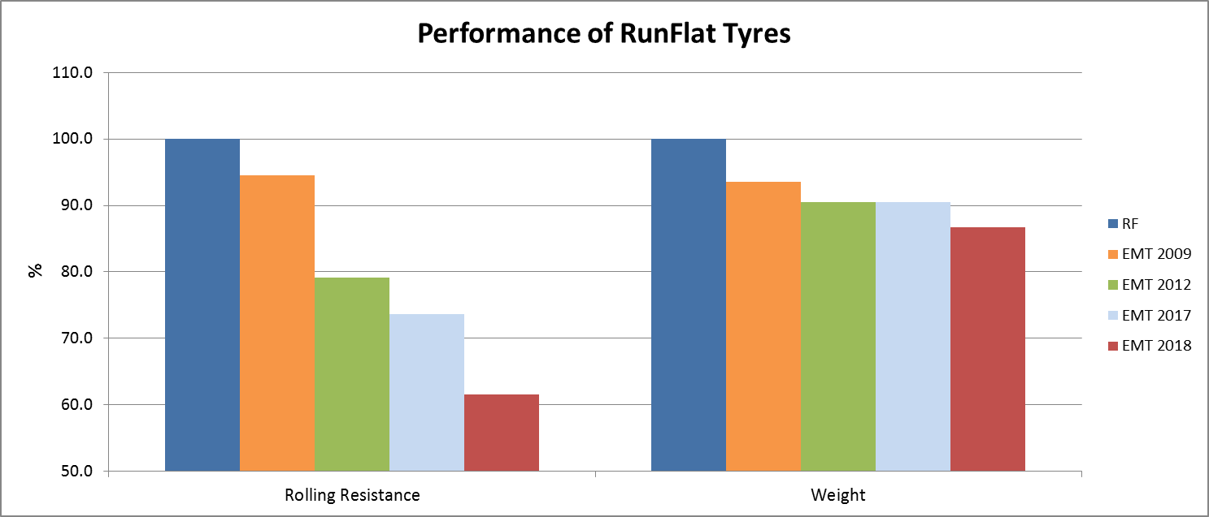
RF vs. EMT: REAL WORLD TARGETS & PERFORMANCES EVOLUTION
2005-2006
2006 → TODAY
ISO 16992:2005 & UN R30 requirement set on limited real world experience
Initial target on vehicle above 200 km
RF tyres focusing more on flat performance than e.g. comfort and rolling resistance
Actual target on vehicle in line with 80 km @ 80 km/h
ISO 16992:2018 with the addition of a more realistic test (reduced load and temperature) following real world experience and better understanding of indoor failure mode compared to the road test.
vs.
EMT additional capabilities
Rolling resistance improvement Fuel consumption / CO₂ reduction.
Weight and stiffness improvement better NVH (comfort, acoustics).
Chassis loads reduction safety enabler (reduced inertia for impact & braking)
Performance evolution RF vs. EMT
80 km on vehicle kept
-38% RR
-13% Weight
Customers Feedback: Since 2009 more than 7 million vehicles had been sold worldwide fitting EMT, without reported issue on flat running mode performance.

Slide 5
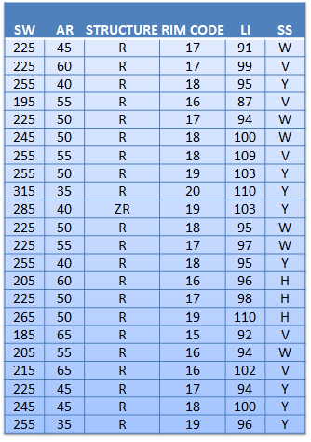
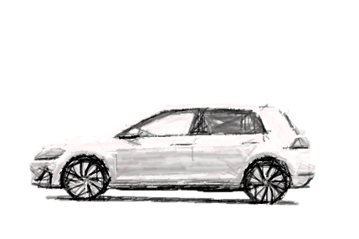
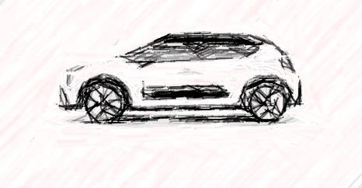
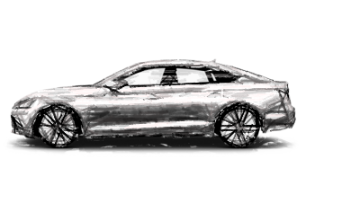
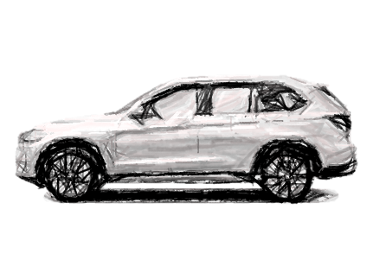
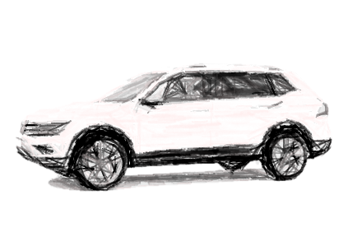
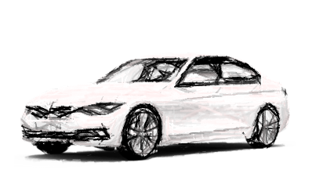
EMT PERFORMANCE EVIDENCE ON VEHICLE
ACTUAL EMT ON M1 SEGMENTS = 80 x 80 ON VEHICLE
C: medium cars
D: large cars
E: executive cars
F: luxury cars
J: sport utility cars
M: Multi purpose cars
S: Sports cars
WIDE RANGE OF TYRE SIZES AND VEHICLE TYPES COVERED TO DEVELOP THE NEW EMT TEST METHOD

Slide 6
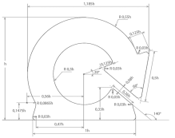
HOW TO REGULATE EMT?
UN R30
3-PILLARS FOR CONSISTENCY IN THE REGULATION & CLEAR REQUIREMENTS SETTING
DEFINITION
2.9. "Extended Mobility Tyre (EMT)" describes a tyre with a radial structure allowing the tyre, […] to provide the vehicle with the basic tyre functions at a speed of 80 km/h and a distance of 80 km when operating in flat tyre running mode.
MARKING
3.1.15 The symbol below for EMT
ANNEX 7 - TEST
4. Procedure to assess the "flat tyre running mode" of "extended mobility tyres“
High quality procedure, including test at zero pressure with clear and detailed requirements
UN R64
Amendments to implement EMT beside RF

Slide 7
BIG PICTURE OVERVIEW: EMT BESIDE RF
Solution
SOLUTION
Spare Tyre
Temporary spare
Tyre repair Kit
„RF“ tyre
EMT
Search the spare tyre
Search the emergency wheel
Search the tyre repair kit
(non regulated)
SIDE ROAD RISK
Lift the vehicle
Lift the vehicle
Connect the repair kit
Dismount the damaged/deflated tyre
Dismount the damaged/deflated tyre
Able to use the tyre repair kit???
Mount the spare tyre
Mount the emergency wheel
Remove the tyre repair kit
Put the damaged tyre back in the car
Put the damaged tyre back in the car
Put the tyre repair kit back in the car
DOES IT WORK?
restart driving
If spare not underinflated
restart driving @ limited speed
If not underinflated
Restart driving with limited speed if able to use the kit
Keep driving with max 80 km/h speed for at least 80 km
Keep driving with max 80 km/h speed for at least 80 km
RF TO BE KEPT BESIDE EMT

Slide 8
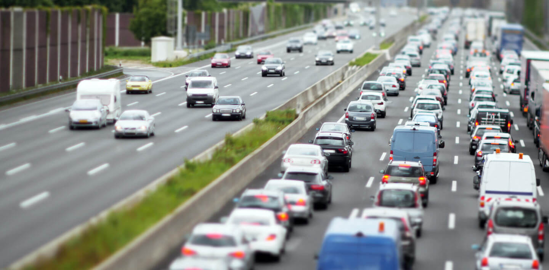
VISION
It is raining and an L5 full automated vehicle is on the highway fast lane
One tyre has got a puncture,
the Tyre Pressure Monitoring System detects underinflation
The ECU is notified by the TPMS
The ECU is aware the tyre is an EMT
The vehicle safely reduce the speed, safely moves to the exit line and reaches a maintenance area where the tyre is checked and/or repaired
EMT will be an additional asset for Automated Vehicles

Slide 9
CONCLUSION and RECOMMENDATIONS
EMT is a safety asset and needs to be regulated to ensure a minimum flat running mode performance.
The proposal while addressing this need is aligned with harmonized regulations regarding road safety and environmental protection (RR, Weight)
The millions of tyres meeting the proposed EMT requirements perform satisfactorily on the market
ETRTO recommends the GRBP to consider for adoption the working documents ECE/TRANS/WP.29/GRVA/2018/6 and ECE/TRANS/WP.29/GRVA/2018/7

Slide 10
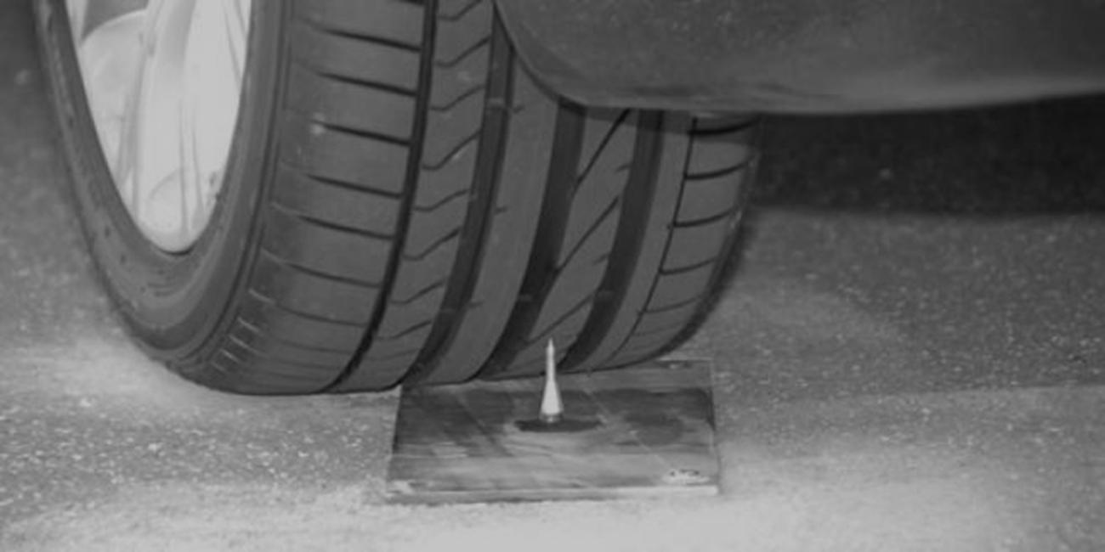
Thank you!

