Slide 1
Transmitted by the expert from the Netherlands
Informal document GRB-68-28
(68th GRB, 12-14 September 2018,
agenda item 10)
Information on the 2018 update of “PIEK”
the national regulation in the Netherlands on delivery noise of trucks
Presentation for GRBP September 2018
Introducing informal document GRB-68-10
Under Agenda item 10. “Exchange of information on national and international requirements on noise levels”
Remco Tekstra (PIEK-Keur)
Erik de Graaff (M+P)

Slide 2
Why do we share this information with GRB?
Some parties in GRB are using the PIEK measurement method as a test institute
Some parties (truck manufacturers) are applying for a PIEK certificate
Delivery noise is on the long list of GRB and GRB may wish to take note what is going on in the Netherlands

Slide 3
What is PIEK?
A national regulation in the Netherlands on maximum allowable Peak noise immission levels during loading and unloading of delivery trucks
Day: no limit
Evening: limit 65 dB(A)
Night: limit 60 dB(A)
Problem-owner is the shop/supermarket:
delivery is forbidden during evening/night, unless noise limits are satisfied
Immision: Evaluation point is closest home around the shop

Slide 4
What is PIEK?
Huge interest of the branch and widely supported:
Most supermarkets set requirements towards their transport companies
Evening/night delivery has major benefits with respect to
Cost (time, fuel consumption),
CO2/tail pipe emission,
Safety
Liveability of urban centres
In force since 1998, certification-scheme introduced in 2004

Slide 5
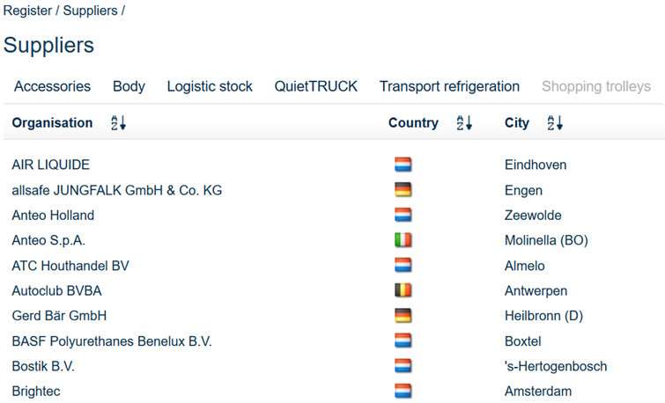
How does PIEK certification work?
Immission levels are translated to 60/65 dB(A) emission levels on 7,5 m
Driveline noise for truck is exempted: Limit for “Quiet Truck” = 72 dB(A)
Measurement methods agreed for a variety of products (trucks, body/coachwork, truck refrigeration units, pallet trucks, dolly’s etc.)
Stichting PIEK-Keur grants certificates; approved products are entered in online register
Approved products are granted night time delivery status
Individual products receive stickers
http://www.piek-international.com/english/

Slide 6
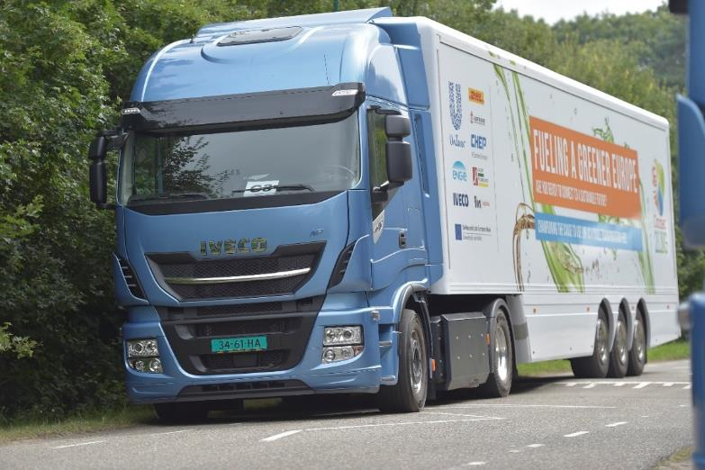
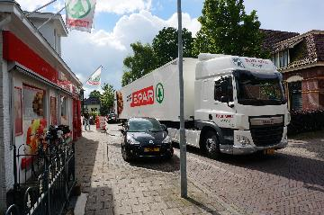
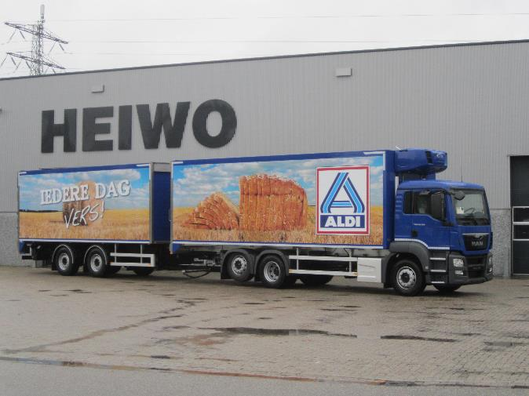
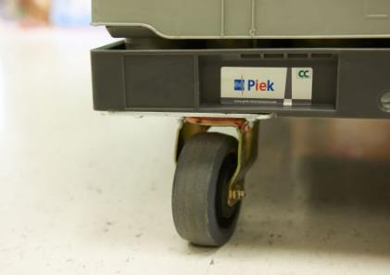
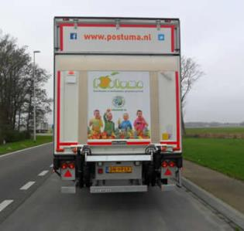
PIEK products
Stille componenten

Slide 7
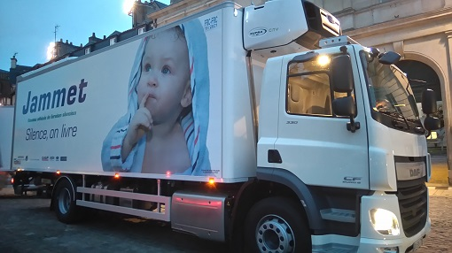
National versus international
PIEK system adopted in Belgium (Flemish law)
Preparations going on in Denmark
Various EU cities have adopted PIEK system on a voluntary base
Recognized and adopted by various international parties
http://piek.cemafroid.fr
http://noiseabatementsociety.com/campaigns/nas-piek/
etc
Many international companies have applied products
Including most EU truck manufacturers

Slide 8
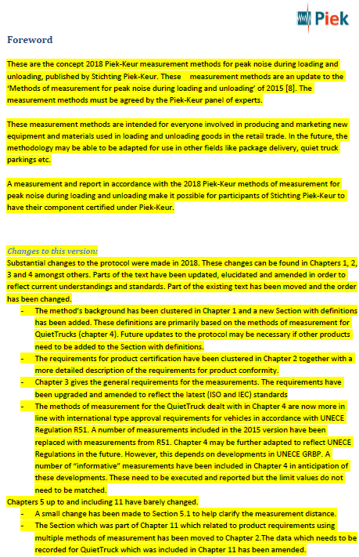
What is going to change in the 2018 version?
See text proposal in GRB-68-10
Changes are marked in yellow
Procedure update for the whole document
Clarification of general requirements, like applicable test methods, product family, COP etcetera’s
Clarification of general requirements on measuring conditions and equipment
Test method update for Quiet Truck
Clarify and repair ambiguities in the old text
Update to satisfy the latest stage of technology
Remove superfluous test methods (e.g. double tested noise sources)
and keep only the most representative and most demanding method
Use where possible the ECE R51 systematics and/or test methods

Slide 9
What is going to change in the 2018 version? Measurement methods for Quiet Truck
Still in place:
acceleration 0-20 km/h; but procedure slightly changed
Compressed air noise; but adopted to ECE R51 procedure
Reversing alarm and blind spot warning (awaiting progress in GRB IG)
Withdrawn:
Backwards driving 3 km/h
Cruise by 20 km/h
Braking 20-0 km/h
Added:
Pass by noise conform ECE R51
@35 km/h, but PIEK mode engaged
Obliged, but only informative, not normative
Closing doors
Obliged, but only informative, not normative

Slide 10
Procedure and Planning
Current proposal 2018 still to be confirmed by PIEK-Keur board
After consultation of the committee of experts
Expected: end of September 2018
New procedures applicable as from January 2019
It remains a national Netherlands procedure and document
But feedback from any expert or body is always welcome
Future developments in GRBP will be followed closely
And, if applicable, incorporated in following version of the PIEK protocol

Slide 11
Questions to GRBP experts (especially truck manufacturers)
Short term:
If you have any feedback on this 2018 proposal for update, please hand them over to your Netherlands representative in the PIEK-keur expert group
Deadline: 30 September
Long term:
Consider introducing delivery noise standards in GRB
Consider PIEK-keur system as an example or starting point

Slide 12
Thank you for your attention

