Slide 1
HD FE Harmonization OICA HD-FE TF Y. Takenaka
Submitted by the expert from OICA | Informal document GRPE-77-08 77th GRPE, 6-8 June 2018 Agenda item 13,
Notes:
1

Slide 2
HD FE regulatory schedule in each area
Year | '13 | '14 | '15 | '16 | '17 | '18 | '19 | '20 | '21 | ‘22 | ‘23 | ‘24 | ‘25 | '26 | ‘27 | ‘28 | ‘29 | ‘30
JPN
US
EU
CHNA
India
2015 HD FE standard
2025 HD FE standard
GHG Phase I
Phase II
FE Phase I
Labeling of FE value
2025 target
2030
1st stage
2nd stage
3rd stage
4th stage
2nd Stage of constant speed test
Phase 1 (EuroIV)
Phase 2(BSIV)
Phase1 (EuroVI)
Phase1 (BSVI)
Legislation
Under consideration

Slide 3
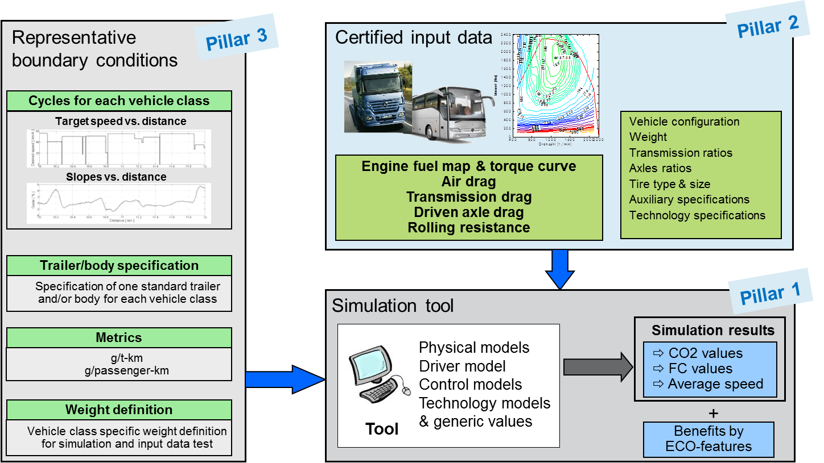
Example of FE Measurement
There are 3 major pillars of a simulation based CO2 declaration method:
Simulation tool, certified input data and representative boundary conditions.

Slide 4
Elements FE regulation including measurement method
Elements | Sub-Elements | Issues | Examples
FE Unit | - | Transport efficiency or easily understand able unit | - km/L - ton.km/L
Others | Criteria | Limit of FE value or average value | - Averaged by number of sales (CAFE)
Vehicle classification | - | Simpler category is desired, but needs to reflect to real world complexity | - Vehicle type (Tractor, bus….etc) - GVW, type of cabin
Items of FE effect | - | Accuracy vs. cost of measurement Contribution for FE | - Engine, T/M - Aero dynamic and rolling resistance
Driving Mode | - | Vehicle speed base or road data base less complexity vs real world reflection | - Combination of two cycles - Unique mode for each vehicle type
Measurement Method | Chassis dynamometer | Chassis dynamometer measurement requires real vehicle
 | Simulation | Driver model is required for simulation | - Common calculation logic - Difference of steady and transient
 | Engine measurement | Number of measurement points Transient operation effect | - CO2 measurement by engine - Engine FE map and simulation
 | Aero dynamic measurement | Measurement methods Selection of vehicle type, rear body | - Coast down, steady speed drive - CFD - Wind tunnel
 | Tyre rolling resistance | Measurement method, labeling | - Common tyre measurement method - How to handle a number of axis
 | Others | Measurement method | - Driveline drag, Auxiliary drag, etc

Slide 5
FE Elements in each Area
Item |  | Sub-item | Status of each region
 |  |  | EU | US （PhaseⅡ） | China | Japan (Next FES)
Categorize |  |  | Axles, Configurations, Weight | Weight Cab type | Vehicle type Weight | Vehicle type Weight
FE Unit |  |  | CO₂ g/ton-km g/passenger-km | gal/1000ton-mile CO₂ g/ton-mile | L/100km | km/L
FE Criteria |  |  | Consider after labeling | Becomes strict every 3 years | Becoming strict in 2019 | FES value around 2025 is decided this year
Mode |  |  | 10type | ARB tangents 55,65 mph | C-WHVC | JE05, Inter city
Measurement method | Engine | Steady state Engine Map | 100 points | 70points for 55,65 mph | 81 points | 51 points
 |  | Transient Engine Map | NA | Cycle average map | NA (Include chassis dyno) | NA
 |  | Transient coefficient | WHTC correction factor tool | Include Cycle average map | NA (Include chassis dyno) | Table value 3%
 | Powertrain | FE map with powertrain | For Hybrid, AT, AMT by simulation | For Hybrid, AT, AMT by powertrain test | NA | For Hybrid and AMT by simulation
 | Gear | T/M efficiency | Table value or Measurement | Table value or Measurement | NA (Include chassis dyno) | Table value
 |  | AT parts efficiency | Table value or Measurement | Include powertrain test method | NA (Include chassis dyno) | Table value or Measurement
 |  | Axle efficiency | Table value or Measurement | Table value or Measurement | NA (Include chassis dyno) | Table value
 | Aero Drag | Aero Drag measurement | Constant speed Simulation | Coast down Wind tunnel CFD | Table value (Opt. Wind tunnel or coast down) | Coast down or Constant speed
 |  | Vehicle select method | Family Concept | ? | ? | Family Concept
 | Tire | Resistance measurement | (EC) 1222/2009 = ISO28580 | ISO28580 | Table value | Ranking by ISO28580
 |  | Resistance select Method | Direct input of tire RRC for each vehicle | Direct input of tire RRC for each vehicle | - | Averaging tire RRC to be used
 | auxiliary parts |  | Generic or OEM-specific | ? | NA | Only installed when measuring engine
Determine FE value | Simulation | Input data & Logic | Input data and driver model is different based on item above
 | Chassis dyno |  | NA | NA | Must family-representative vehicle | NA

Slide 6
HD FE regulatory schedule in each area
Year | '13 | '14 | '15 | '16 | '17 | '18 | '19 | '20 | '21 | ‘22 | ‘23 | ‘24 | ‘25 | '26 | ‘27 | ‘28 | ‘29 | ‘30
JPN
US
EU
CHNA
India
2015 HD FE standard
2025 HD FE standard
GHG Phase I
Phase II
FE Phase I
Labeling of FE value
2025 target
2030
1st stage
2nd stage
3rd stage
4th stage
2nd Stage of constant speed test
Phase 1 (EuroIV)
Phase 2(BSIV)
Phase1 (EuroVI)
Phase1 (BSVI)
Legislation
Under consideration
Possibility of Rule making

Slide 7
Steps for Harmonization
Elements | Sub-Elements | Issues | Examples
FE Unit | - | Transport efficiency or Easy to understand for everybody | - km/L - ton.km/L
Others | Criteria | Limit of FE value or average value | - Averaged by number of sales - CAFÉ
Vehicle classification | - | Simpler category is desired, but needs to reflect to real world compexity | - Vehicle type (Tractor, bus….etc) - GVW, type of cabin
Items of FE effect | - | Accuracy vs. cost of measurement Contribution for FE | - Engine, T/M - Aero dynamic and rolling resistance
Driving Mode | - | Vehicle speed base or road data base less complexity vs real world reflection | - Combination of two cycles - Unique mode for each vehicle type
Measurement Method | Chassis dynamometer | Should Chassis dynamometer measurement be used
 | Simulation | Should simulation be used Driver model contents | - Common calculation logic - Difference of steady and transient
 | Engine measurement | Number of measurement points Transient operation effect | - CO2 measurement by engine - Engine FE map and simulation
 | Aero dynamic measurement | Measurement methods Selection of vehicle type, rear body | - Coast down, steady speed drive - CFD - Wind tunnel
 | Tyre rolling resistance | Measurement method, labeling | - Common tyre measurement method - How to handle a number of axis
 | Others | Measurement method | - Driveline drag, Auxiliary drag, etc
Second step
First step

Slide 8
Summary
FE legislation is increased in these 10 years and will increase more in future. This is big burden for manufactures.
Several rules are updated but not harmonized, rather sometimes unique rules are introduced based on each governmental policy.
Simulation is adopted in each rule and exist 4 different software. It may increase in future.
It seems each rule will be updated in near future. Several countries is planning to introduce FE legislation near future. Harmonize rule should be prepared as soon as possible not to miss the chance of harmonization.
It is recommended to separate two steps for HD FE harmonization to be effective in short time. FE measurement GTR is recommended as 1st step.
It is strongly recommended by OICA/GEPE that the WS to share the information on this matter and consider about suitable action in future will be organized in next GRPE.

Slide 9
Technical Information

Slide 10
Major Elements of FE Measurement
Driving cycle
Simulation
Engine measurement
Driving Resistnace

Slide 11
Key Elements of FE Measurement
Driving Cycle
Driving cycle defines the driving conditions to evaluate the fuel consumption.
Two types of driving cycle are adopted in.
A: Time and vehicle speed
B: Distance and target speed
Item | Status of each region |  |  |  | Remarks
 | EU | US （PhaseⅡ） | China | Japan (FES 2025)
Type | B Distance and target speed | A Time and speed | A Time and speed | A Time and speed | B requires more realistic driver model
Number of cycle types | 10 | 4 | 3 | 2 | Although there are few types of cycles other than EU, weighting factor is changed for each vehicle category.
Details of cycle | Trucks:5 City Bus:3 Bus:2 | ARB tangents 55 mph 65 mph Idle Above four kinds of weighting factor depending on the category of the vehicle. | C-WHVC Urban Suburban Highway Above three kinds of weighting factor depending on the category of the vehicle. | JE05 Inter city (80km/h) Above two kinds of weighting factor depending on the category of the vehicle.

Slide 12
Key Elements of FE Measurement
Simulation
Simulation is introduced to evaluate HDV with fuel efficiency.
Mathematical method of simulation seems similar for each software.
Input data differs because of the difference of concept or FE items.
Classification | Item | Status of each region |  |  |  | Remarks
 |  | EU /VECTO | US/GEM （PhaseⅡ） | China | Japan (FES2025)
Vehicle Parameters | Vehicle Category | ✔ | ✔ | ✔ | ✔
 | Curb Weight | ✔ | ✔ | ✔ | ✔
 | Gross Vehicle Weight | ✔ | ✔ | ✔ | ✔
 | Maximum Payload | ✔ | ✔ | ✔ | ✔
 | Gross Combination Weight | ✔ | ✔ | ✔ | ✔
 | Rated Passenger Capacity | ✔ | ✔ | ✔ | ✔
 | Axle Configuration | ✔ | － | ✔ | －
 | Axle Number | ✔ | － | ✔ | －
 | Aero drag (Cd) | ✔ | ✔ | ✔ | ✔
 | Auxiliary | （✔）* | － | － | － | * By spec. of technology
Engine Parameters | Engine Fuel Map | ✔ | ✔ | ✔ | ✔
 | Full Load Engine Torque | ✔ | ✔ | ✔ | ✔
 | Motored Engine Torque | ✔ | ✔ | ✔ | ✔
 | Idling Speed | ✔ | ✔ | ✔ | ✔
 | Rated Engine Speed | ✔ | ✔ | ✔ | ✔
 | Maximum Engine Speed | ✔ | ✔ | ✔ | －
 | Transient Engine Map | － | ✔ | － | －
Drive train | Transmission type | ✔ | ✔ | － | ✔ | MT,AT,AMT
 | Number of gear | ✔ | ✔ | ✔ | ✔
 | Transmission gear ratio | ✔ | ✔ | ✔ | ✔
 | Transmission drag | ✔ | ✔ | － | ✔
 | Final reduction gear ratio | ✔ | ✔ | ✔ | ✔
 | Drive axle drag | ✔ | ✔ | － | ✔
Tire | Rolling radius | ✔ | ✔ | ✔ | ✔
 | Rolling resistance | ✔ | ✔ | ✔ | ✔

Slide 13
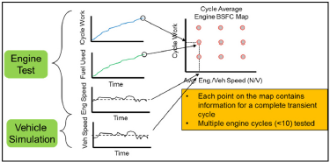
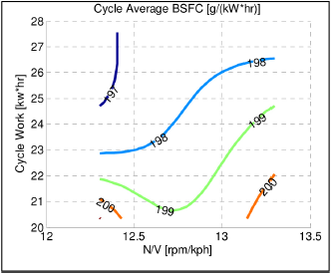
Key Elements of FE Measurement
Engine measurement
FE map measured by steady state operation is commonly used to take account engine performance.
However, US Phase II introduced new method called “Cycle averaging map”.
Item | Status of each region |  |  |  | Remarks
 | EU | US （PhaseⅡ） | China | Japan (FES2025)
Steady state Engine Map | 100 points | 70points for 55,65 mph | 81 points | 51 points | Difference in concept
Transient Engine Map | NA | Cycle averaging map | NA | NA
Transient coefficient | WHTC correction factor tool | Include Cycle averaging map | NA | Table value 3%
Steady state Engine measurement
Cycle averaging map
fuel
-
800
consumption map
700
600
500
400
300
200
100
0
-
100
-
200
500
1000
1500
2000
2500
3000
Engine speed [rpm]

Slide 14
Key Elements of FE Measurement
Driving Resistance
There are two types of methods for measuring Aero Drag, “Coast down test” and “Constant speed test”. One of these or both is adopted in each area.
Tire RRC measurement uses ISO 28580 which is a tire bench test method common to each region.
Item | Sub-item | Status of each region |  |  |  | Remarks
 |  | EU | US （PhaseⅡ） | China | Japan (FES2025)
Aero Drag | Aero Drag measurement | ・Constant speed ・Simulation | ・Coast down ・Wind tunnel ・CFD | ・Table value (Opt. Wind tunnel or coast down) | ・Coast down ・Constant speed | Similar method is used, but no common method
Tire RRC | Resistance measurement | (EC) 1222/2009 = ISO28580 | ISO28580 | Table value | ISO28580 | Method of measuring tire RRC is common in individual areas in the unit test by ISO method.
 | Resistance select Method | Direct input of tire RRC for each vehicle | Direct input of tire RRC for each vehicle | - | Averaging RRC to be used

