Slide 1

Informal document GRSG-115-42
(115th GRSG, 09-12 October 2018,
agenda item 18)
        ITC-related matters
        ITC Strategy 2030
        UN Management Reform: Update
  115th session of Working Party on General Safety Provisions (GRSG)
  Geneva, 9-12 October 2018

Slide 2
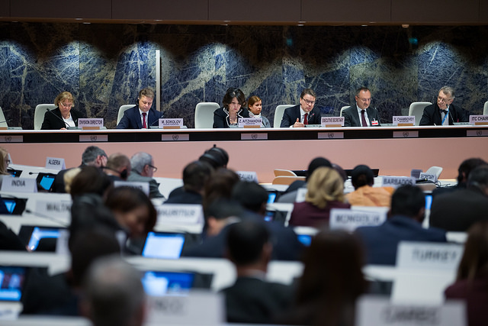
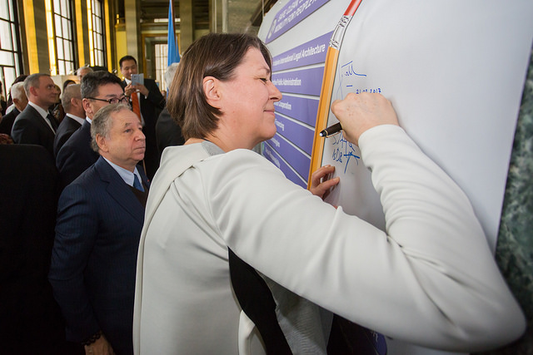
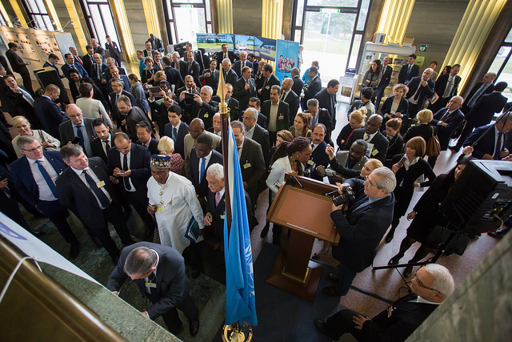
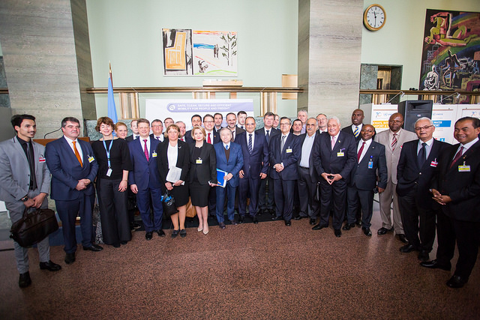
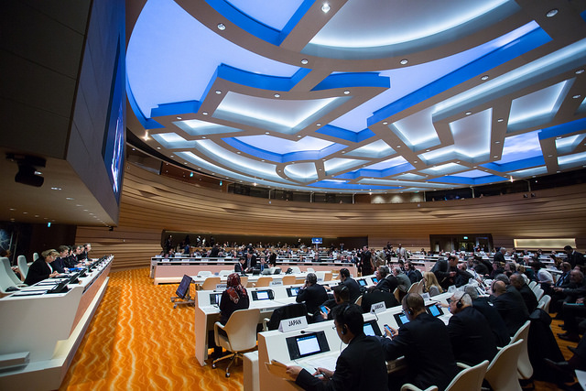
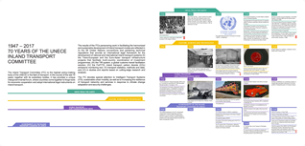
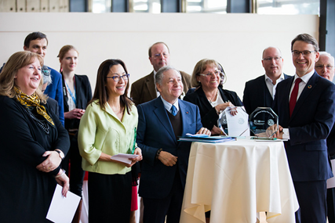
70th Anniversary of the Inland Transport Committee
Exhibition and brochure on the 70-year history of the ITC
ITC 70th Anniversary
Ministerial Resolution & ITC Strategy
2016 Results per area of work
500 participants from 90 countries
2016 Policy dialogue
2016 Results analytical work
Global Road Safety Film Festival
UNEP-UNECE conference on used cars
IWT High Level Conference
IsDB-UNECE workshop
2016 Results Performance indicators
High-profile side events
Decisions
Commission /EXCOM

Slide 3
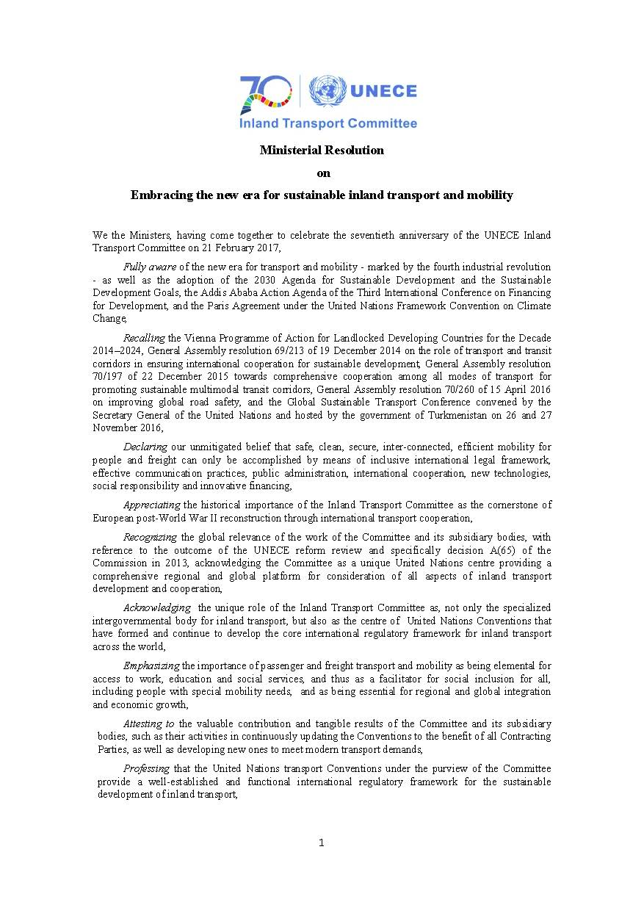
Ministerial Resolution and ITC Strategy
Ministerial Resolution:
Strong political support“Recognizing the global relevance of the work of the Committee and its subsidiary bodies…”
59 signatures on the Ministerial Resolution
12 decisions promoting sustainable transport and mobility and strengthening global governance of Inland Transport
ITC Strategy:
ITC for sustainable mobility by 2030
Consultations throughout 2017
Discussion paper on ITC Strategy considered by ITC in 2018
ITC 70th Anniversary
Ministerial Resolution & ITC Strategy
2016 Results per area of work
2016 Policy dialogue
2016 Results analytical work
2016 Results Performance indicators
Decisions
Commission /EXCOM
Notes:
The Anniversary session showed how big the expectation is towards the Committee. To live up to it, we need to further strengthen its capacity to deliver. The development of its strategy “ITC for sustainable mobility by 2030” will be a highly relevant exercise throughout the year to come.
During the session, consultations started on the future strategy that is expected to be endorsed in February 2018. Our approach is to build on the results of the past 70 years, while the point of departure is based on the global political commitments, i.e. how the Committee can support the implementation of the 2030 Sustainable Development Agenda, the Paris Climate Change Agreement and the New Urban Agenda. We have also agreed on the critical importance of the technological changes, especially digitalization and automation. And in this respect, we considered the need for an agile policy and regulatory framework at multi-country level.

Slide 4
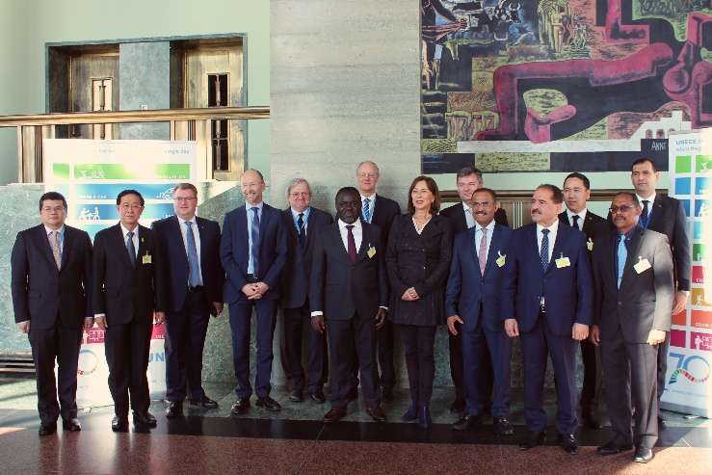
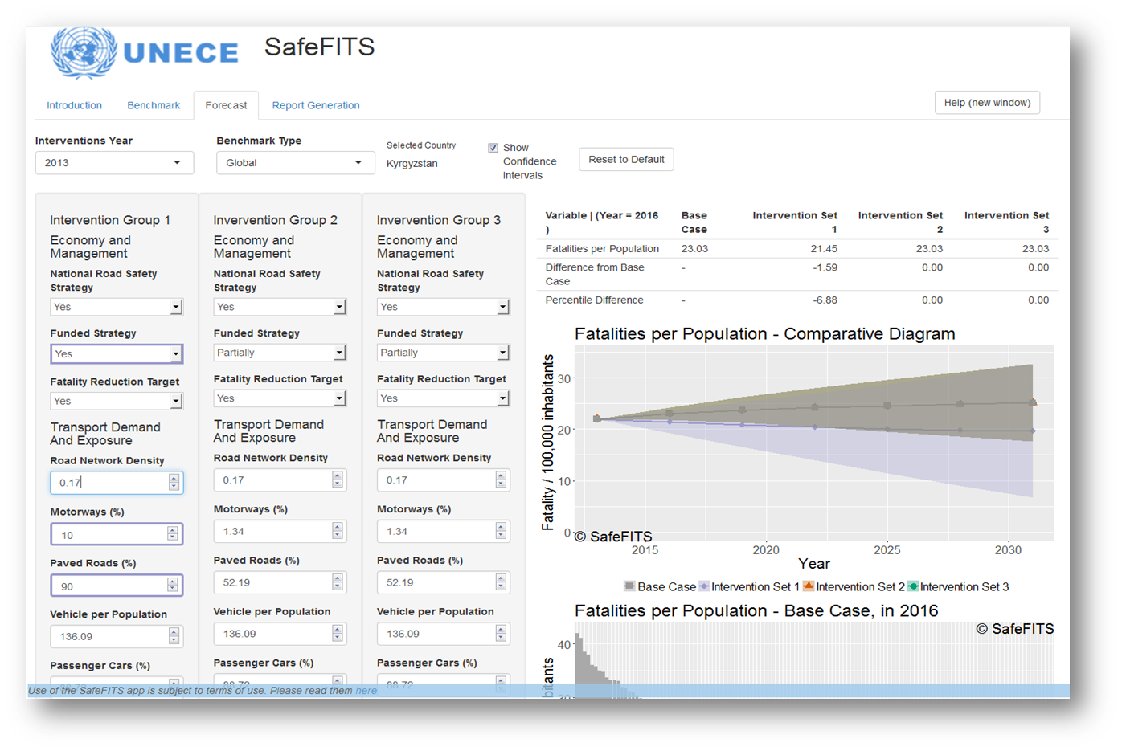
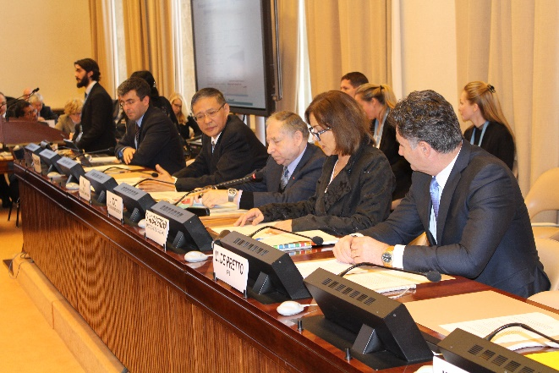
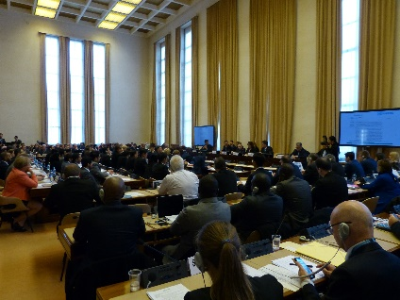
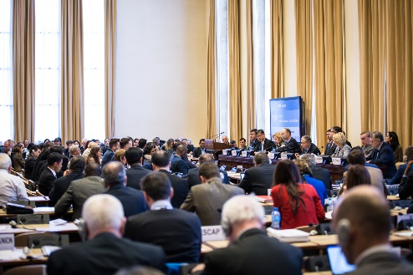
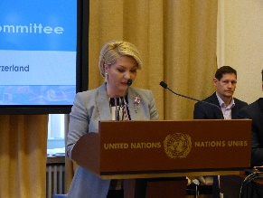
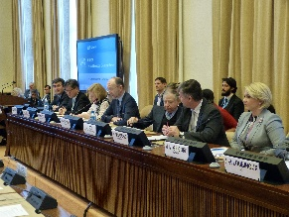
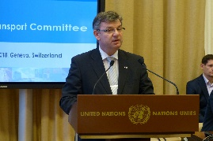
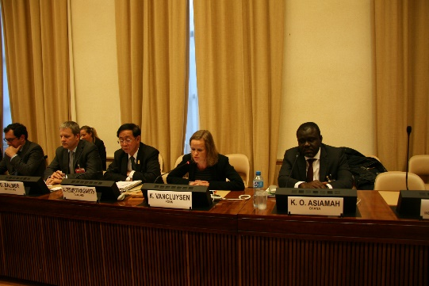
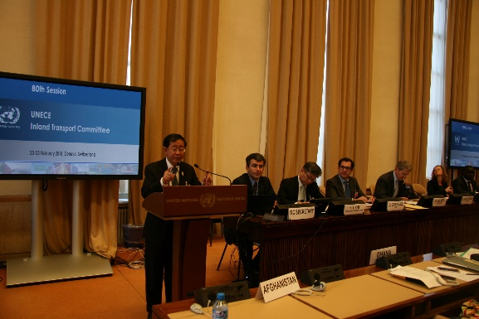
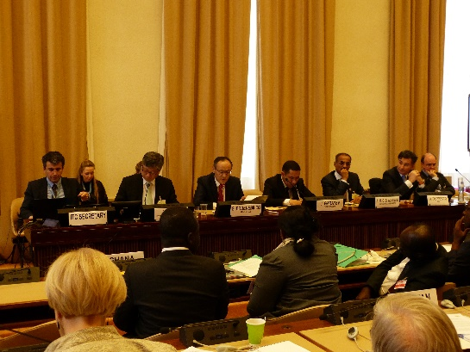
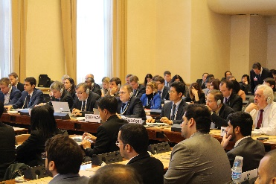
80th Annual session of the Inland Transport Committee – A year of Transformation
Ministers from Africa, Asia, Europe and the Middle East
High-profile speakers
ITC 80th Annual Session
250 participants from 63 countries
2017 Results per area of work
Launch of the SafeFITS tool - Safe Inland Transport Systems
2017 Policy dialogue
2017 Results analytical work
2017 Results Performance indicators
Decisions
Commission /EXCOM

Slide 5
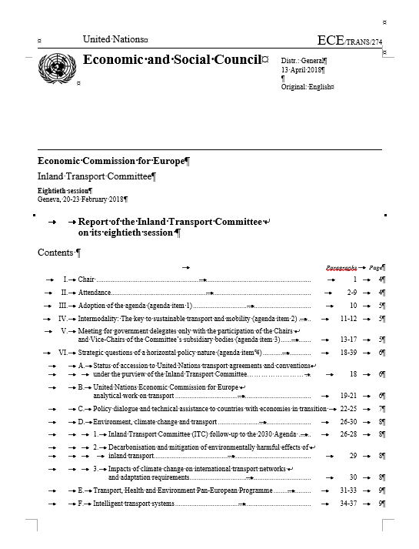
80th Annual session of the Inland Transport Committee – ITC strategy
ITC Decisions:
ITC 80th Annual Session
2017 Results per area of work
2017 Policy dialogue
2017 Results analytical work
2017 Results Performance indicators
Decisions
Commission /EXCOM

Slide 6
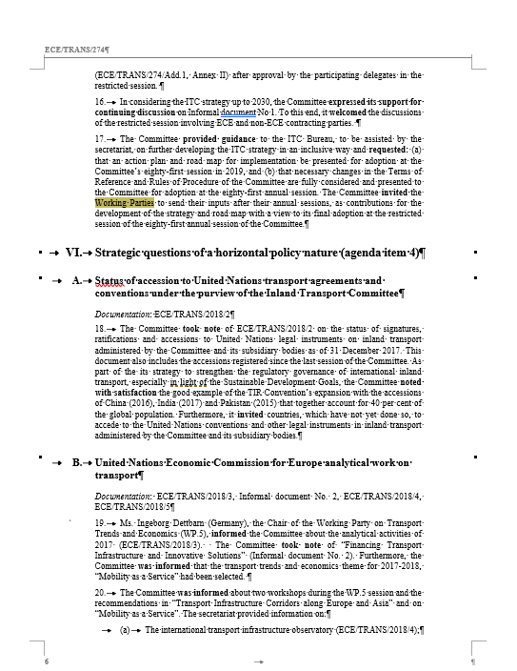
80th Annual session of the Inland Transport Committee – ITC strategy
ITC Decisions:
ITC 80th Annual Session
17. (…)
The Committee invited the Working Parties to send their inputs after their annual sessions, as contributions for the development of the strategy and road map with a view to its final adoption at the restricted session of the eighty-first annual session of the Committee.
2017 Results per area of work
2017 Policy dialogue
2017 Results analytical work
2017 Results Performance indicators
Decisions
Commission /EXCOM

Slide 7
80th Annual session of the Inland Transport Committee – ITC strategy
ITC Strategy:
ITC for sustainable transport & mobility by 2030
Consultations throughout 2018
For adoption in 2019
2017
79th Annual session:
- Resolution
- ECE/TRANS/2017/R.1
2018
80th Annual session
- Discussion paper on ITC Strategy
- Background report
2019
81st Annual session
Adoption of ITC Strategy 2030
2019
68th Commission session of UNECE for follow-up decisions (e.g. on TORs)
ITC 80th Annual Session
2017 Results per area of work
2017 Policy dialogue
2017 Results analytical work
2017 Results Performance indicators
Decisions
Commission /EXCOM

Slide 8
        UN Management Reform: Update

Slide 9
80th Annual session of the Inland Transport Committee – UN Management Reform
ITC Decisions:
ITC 80th Annual Session
2017 Results per area of work
2017 Policy dialogue
2017 Results analytical work
2017 Results Performance indicators
Decisions
Commission /EXCOM

Slide 10
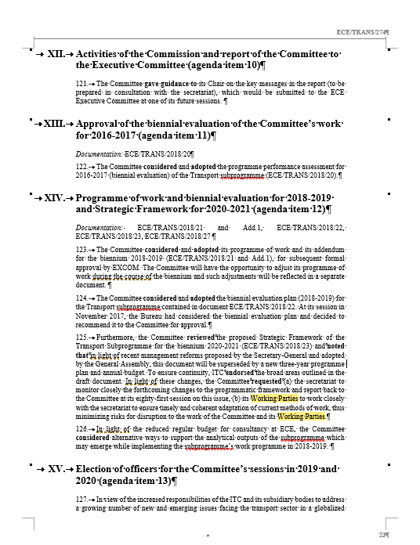
80th Annual session of the Inland Transport Committee – UN Management Reform
ITC Decisions:
ITC 80th Annual Session
2017 Results per area of work
2017 Policy dialogue
2017 Results analytical work
125. (…)
. In light of these changes, the Committee requested (a) the secretariat to monitor closely the forthcoming changes to the programmatic framework and report back to the Committee at its eighty-first session on this issue, (b) its Working Parties to work closely with the secretariat to ensure timely and coherent adaptation of current methods of work, thus minimizing risks for disruption to the work of the Committee and its Working Parties.
2017 Results Performance indicators
Decisions
Commission /EXCOM

Slide 11
UN Management Reform: UN Budget 2020 – Structure and Process
Part I
Committee for Programme & Coordination
Part II
Programme Plan & Performance
Prepared by ECE
Part III
Post & Non-post requirements
General Assembly
Plan outline
Prepared by UN HQ
General Assembly
Advisory Committee on Administrative and Budgetary Questions & 5th Committee
Prepared by ECE
Committee for Programme & Coordination
General Assembly

Slide 12
UN Management Reform: UN Budget 2020 – Structure and Process
The UN Budget 2020 will consist of the following three parts:
Part I: Plan outline (long-term priorities and objectives);
Part II: Programme plan for programmes/subprogrammes and programme performance; and
Part III: Post and non-post resource requirements for programmes and subprogrammes.
Part I will be prepared by the secretariat at the UN Headquarters, and submitted to the General Assembly through the Committee for Programme and Coordination (CPC).
Parts II and III will be prepared by Secretariat Departments, including ECE, on an annual basis. The Budget will be submitted to the GA through the Committee for Programme and Coordination (Part II) and the Advisory Committee on Administrative and Budgetary Questions and Fifth Committee (Part III).

Slide 13
UN Management Reform: New programme/budget processes
Discontinued: Old Results-Based framework | New Results-based framework
Discontinued: Strategic Framework/Biennial Programme of Work | Annual Budgets: Plan Outline; 1-year Programme Plan /1-year Post and non-post requirements
Discontinued: Expected Accomplishments and Indicators | Focus on deliverables
Discontinued: “series” of documents | Actual deliverables
To be discontinued: IMDIS | Monitoring of implementation integrated in Umoja
Memo items:
Misalignment of budget cycle with ITC sessions | Better alignment of budget cycle with ITC sessions
Possible discontinuation of programmatic docs | Advise Working Parties
Management of steep increase in outputs: Forecasted deliverables for transport: 1,419 (out of 3,084 for UNECE, i.e. 46 per cent) | New fascicle: 3,883 (+2,464); monitoring

Slide 14
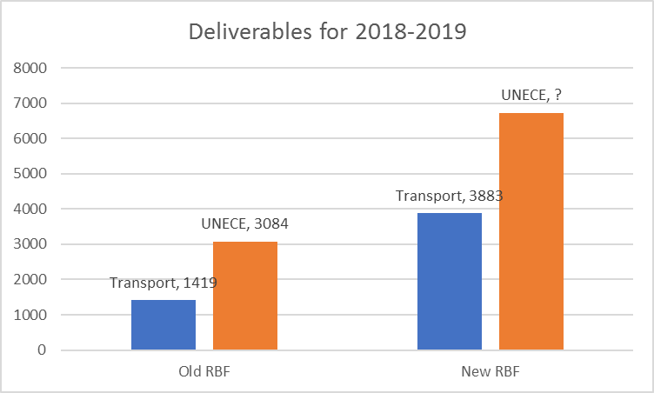
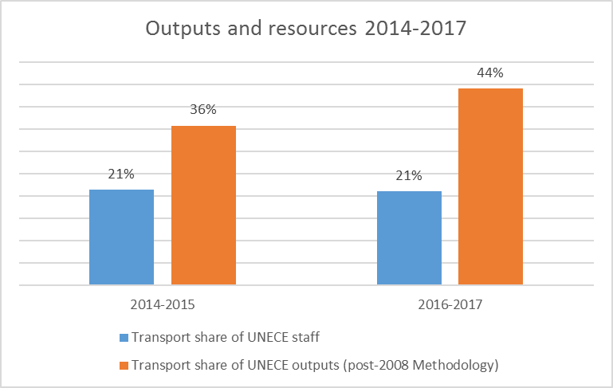
UN Management Reform: New programme/budget processes

Slide 15
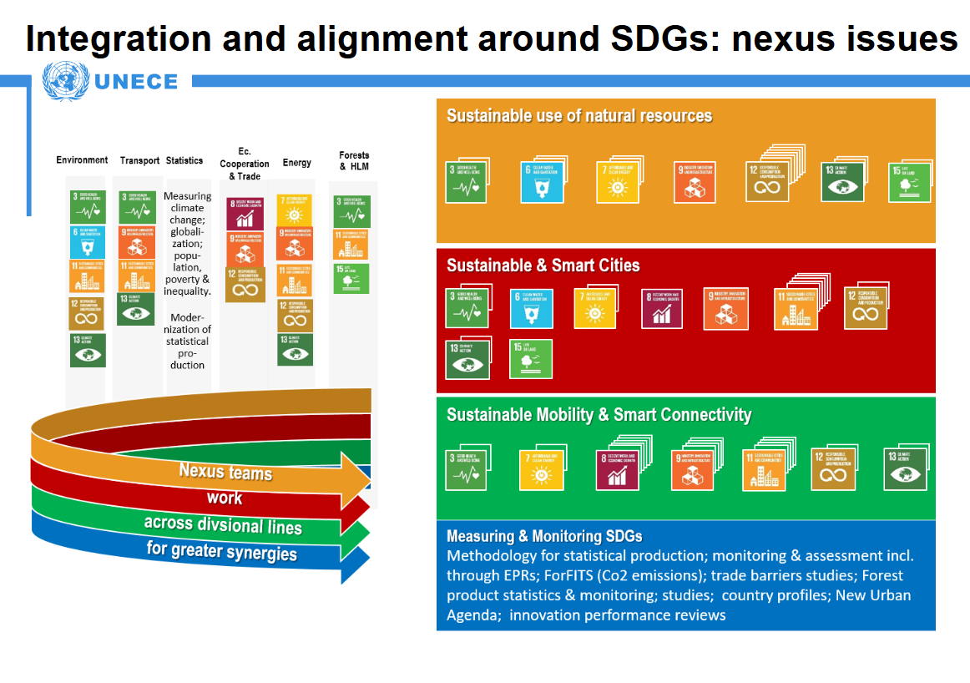
UNECE SDG alignment: Nexus areas

Slide 16

Notes:
16

