Slide 1
Informal document GRSP-63-28
(63rd GRSP, 14-18 May 2018
Agenda item 19)
Respose to .../GRSP/2018/17-18 submitted by Spain on behalf of the TSG
Approval categories and stature limits for booster seats
63rd session of UN Working Party on Passive Safety (GRSP)
Geneva, 14-18 May 2018

Slide 2
There are two booster seat type-approval categories in R129 – i-Size or specific-vehicle
CRS category | External dimensions | Dynamic test
i-Size booster seat | Fits in ISO/B2 envelope | Test bench
Specific vehicle booster seat (‘Option 1’) | Fits in no envelope; only in vehicles specified in a list (submitted at type-approval) | Vehicle body shell or complete vehicle
Specific vehicle booster seat (‘Option 2’) | Fits in ISO/B3 envelope (list not mandatory) | Test bench or vehicle body shell
Replicates R44 semi-universal philosophy (without a separate category)
A minimum stature is (100 cm) set for boosters, but no maximum – for either category

Slide 3
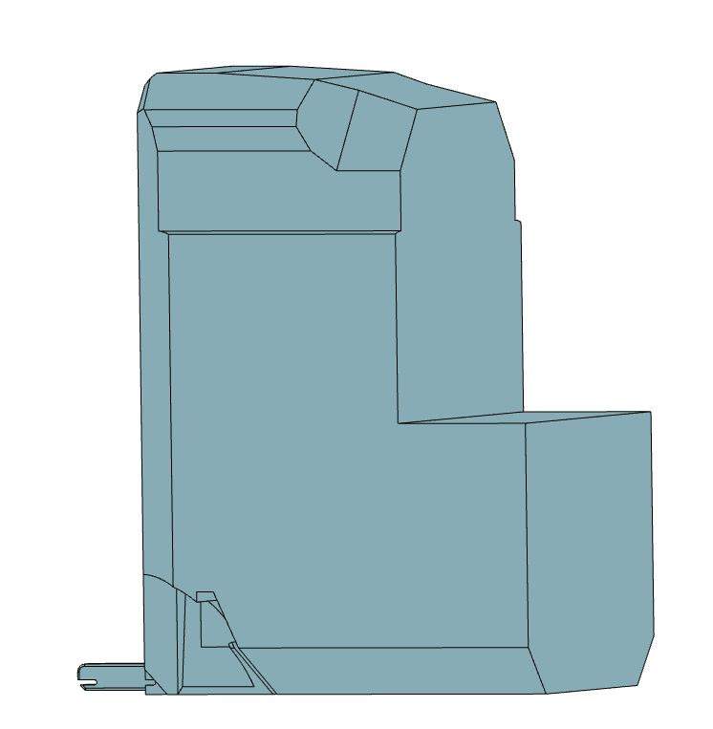
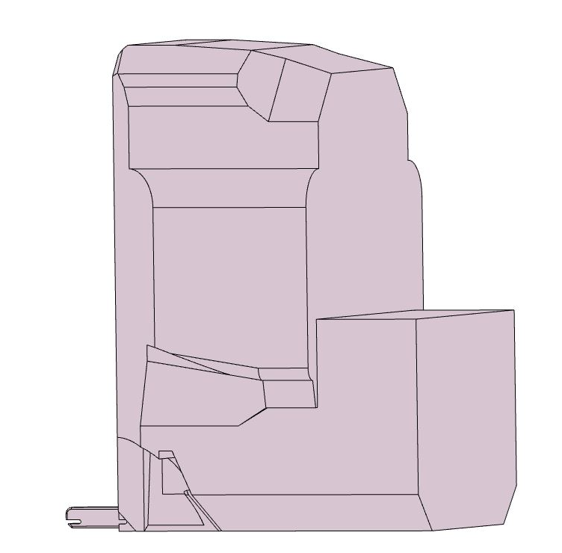
Both booster seat envelopes are designed to accommodate children up to 135 cm (95th percentile)
ISO/B2 (i-Size)
ISO/B3 (Spec. vehicle #2)
Booster seats need to be approved to 150 cm (as per EU belt-wearing laws)
No 150 cm envelope
How are 150 cm boosters treated?
760 mm
760 mm
440 mm
520 mm
Note: A booster for a taller stature might still fit in the B2 or B3 envelope – limiting their use to 135 cm might exclude some children unnecessarily

Slide 4
External dimensions test carried out to 135 cm – user manual statement for greater statures
Consistent with approach for backrest angle
Taller adjustment is a ‘comfort feature’
Implies i-Size or specific-vehicle (Option 2) booster can be approved to 150 cm without further categorisation
But: it seems a matter of interpretation

Slide 5
External dimensions test carried out to 135 cm – user manual statement for greater statures

Slide 6
External dimensions test carried out to 135 cm – user manual statement for greater statures
Consistent with approach for backrest angle
Taller adjustment is a ‘comfort feature’
Implies i-Size or specific-vehicle (Option 2) booster can be approved to 150 cm without further categorisation
But: it seems a matter of interpretation

Slide 7
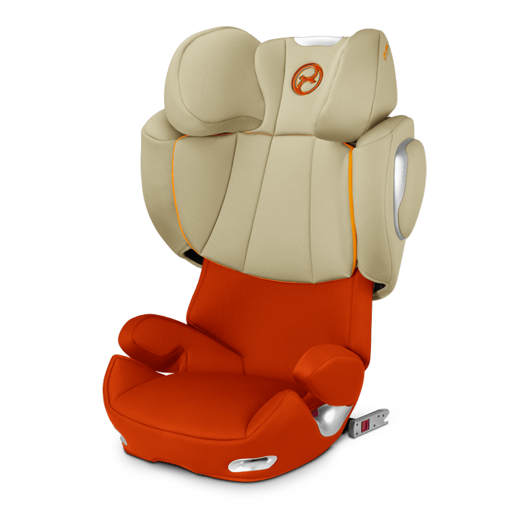
Example 1 – Literal interpretation of R129
i-Size booster seat or specific-vehicle booster seat (Option 2)
i-Size booster seat
100 cm – 150 cm
E¹
Complies with ISO/B2
002585
Easy for Tech. Services
Easy for users
UN-Regulation No. 129/02
or
Specific vehicle booster seat
100 cm – 150 cm
Complies with ISO/B3
E¹
002593
UN-Regulation No. 129/02
User manual states CRS may not fit in all vehicles when adjusted for children above 135 cm

Slide 8
Example 2a – Alternative interpretation of R129
i-Size booster seat
i-Size booster seat
100 cm – 135 cm
Complies with ISO/B2
(until 135 cm)
E¹
Specific vehicle booster seat
135 cm – 150 cm
002585
UN-Regulation No. 129/02
No envelope for 135 cm to 150 cm = Specific vehicle (Option 1) & fitting list submitted at type-approval
Fitting list is required for final 15 cm of stature range only
List would need to be seen by Technical Service and Extension issued when added to

Slide 9
Example 2b – Alternative interpretation of R129
Specific-vehicle booster seat (Option 2)
Specific vehicle booster seat
100 cm – 135 cm
E¹
Complies with ISO/B3
(until 135 cm)
[Specific vehicle booster seat
135 cm – 150 cm]
002585
UN-Regulation No. 129/02
No envelope for 135 cm to 150 cm = Specific vehicle (Option 1) & fitting list submitted at type-approval
Fitting list is required for final 15 cm of stature range only
List would need to be seen by Technical Service and Extension issued when added to

Slide 10
Thank you for your attention!
www.clepa.eu

