Slide 1
Informal Document GRSP-64-06
(64th GRSP, 11-14 December 2018,
agenda item 19)
D-E Plane Assessment
Explanatory notes related to formal documents GRSP/2018/ 19 through 22 submitted by Spain @ GRSP 63rd Session supersided by Inf. Docs. GRSP-64-02 to GRSP-64-05

Slide 2
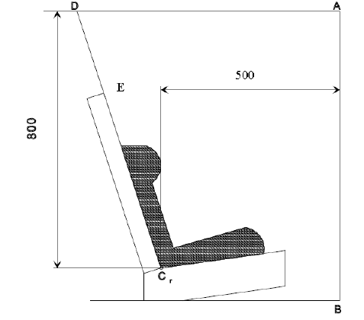
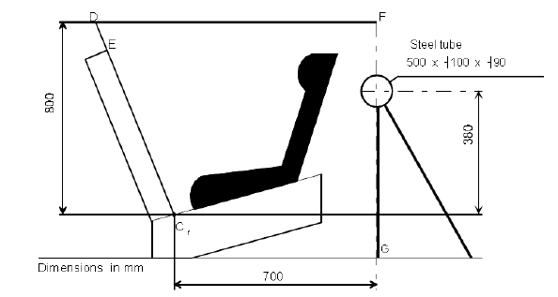
R129 Head Excursion Requirements
6.6.4.4.1.1.
Forward facing ECRS
Head excursion: No part of the head of the dummy shall pass beyond the planes BA, DA and DE.
Except for booster seats when testing using Q10 dummy where:
(a) The value in relation to the DA plane is 840 mm; and
(b) The value in relation to the BA plane is 550 mm; and
(c)The rebound phase is not considered for the assessment of the plane DA and DE.
6.6.4.4.1.2.
Rearward-facing ECRS and carrycots:
6.6.4.4.1.2.1.
Head excursion: no part of the head of the dummy shall pass beyond the planes FD, FG and DE.

Slide 3
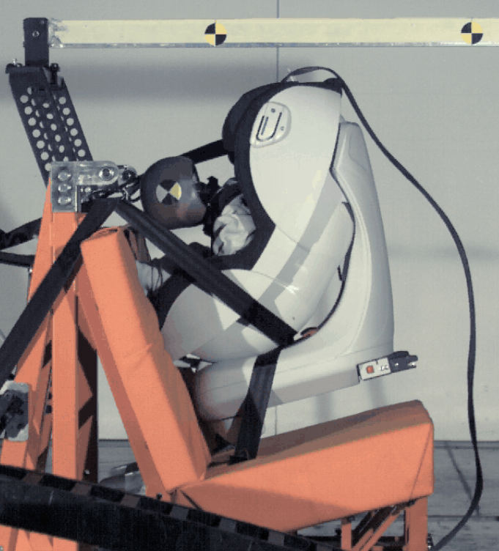
R129 Rearward Facing
D-E plane assessment existed in R44 for RF CRS
If dummy’s head crosses D-E plane it would have no protection from CRS
Understand reason for this D-E plane assessment to apply to RF CRS

Slide 4
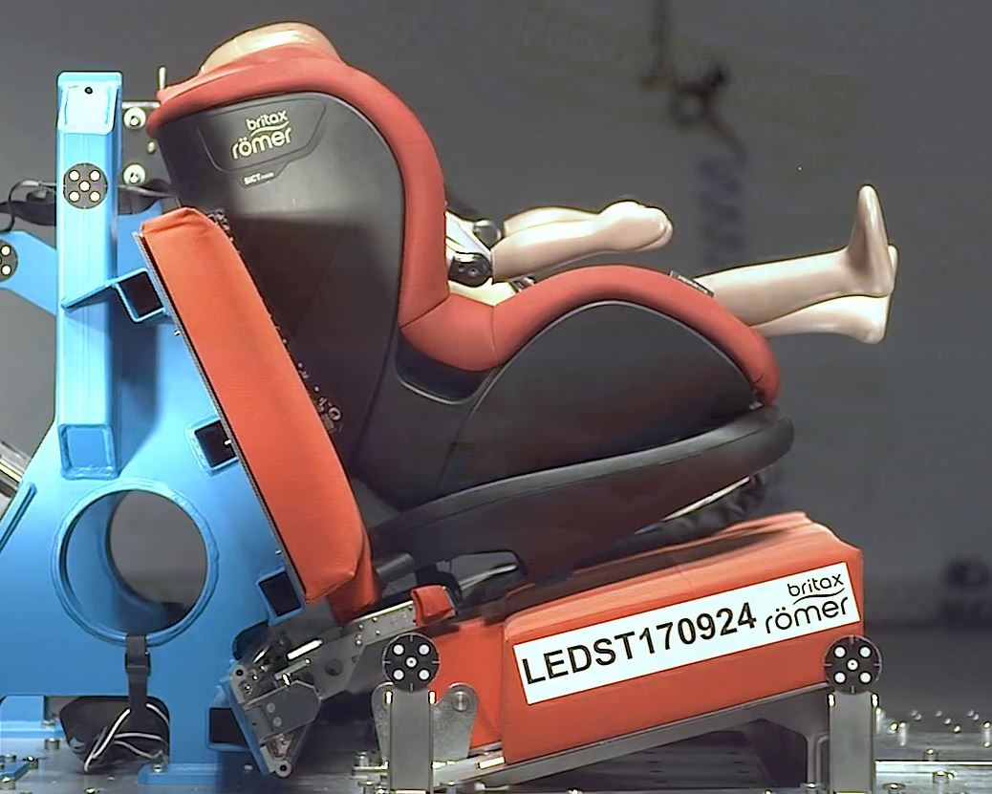
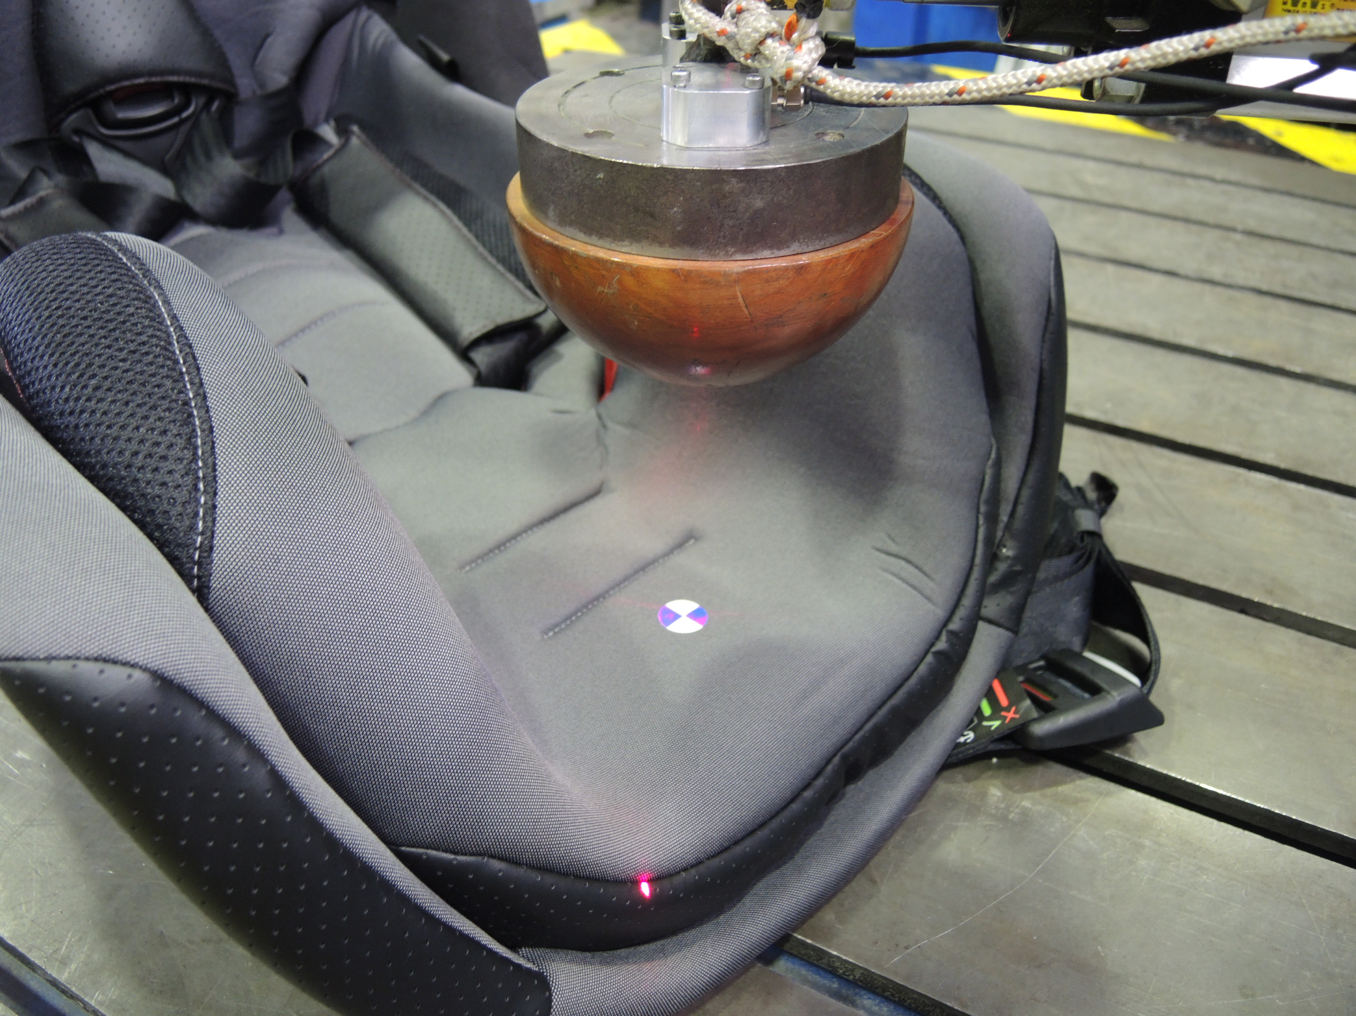
R129 Forward facing
R129 applies D-E plane assessment to Forward Facing ECRS
For integral & non-integral CRS dummy’s head often crosses D-E plane - but usually CRS structure (head res) behind headt
CRS headrest material drop tested for energy absorption properties
Forward Facing CRS will usually have a headrest to protect the child’s head from contact with the vehicle
TSG proposal
Only check D-E plane for rearward facing CRS tests (as per R44)
D
E

Slide 5
R129 PROPOSAL
Proposal for the 00 and 01 series of amendments
Paragraph 6.6.4.4.1.1., amend to read:
"6.6.4.4.1.1. Forward facing Enhanced Child Restraint Systems
Head excursion: No part of the head of the dummy shall pass beyond the planes BA, DA and DE as defined in Figure 1 below.
This shall be judged up to 300 ms or the moment that the dummy has come to a definitive standstill whatever occurs first.
For all forward facing Enhanced Child Restraint Systems, the head of the dummy may pass beyond the DE plane, if there is part of the child restraint structure, i.e. head pad or backrest, behind the head of the dummy, at the point the head passes the DE plane."
Only check D-E plane for rearward facing CRS tests
(as per R44)

Slide 6
R129 PROPOSAL
Proposal for the 02 and 03series of amendments
Paragraph 6.6.4.4.1.1., amend to read:
6.6.4.4.1.1. Forward facing Enhanced Child Restraint Systems
Head excursion: No part of the head of the dummy shall pass beyond the planes BA DA DE as defined in Figure 1 below.
This shall be judged up to 300 ms or the moment that the dummy has come to a definitive standstill whatever occurs first.
Except for booster seats when testing using Q10 dummy where:
(a) The value in relation to the DA plane is 840 mm; and
(b) The value in relation to the BA plane is 550 mm; and
(c) The rebound phase is not considered for the assessment of the plane DA and DE.
For all forward facing Enhanced Child Restraint Systems, the head of the dummy may pass beyond the DE plane, if there is part of the child restraint structure, i.e. head pad or backrest, behind the head of the dummy, at the point the head passes the DE plane.
Only check D-E plane for rearward facing CRS tests
(as per R44)

Slide 7
R129 PROPOSAL
Justification
1. The assessment of the DE plane only applies to rearward facing Child Restraint Systems (CRS) in UN Regulation No. 44. The DE plane assessment remains relevant for rearward facing child restraints in UN Regulation No. 129.
2. For forward facing child restraints, there is often structure of the child restraint, (either head pad or backrest) behind the head of the dummy at the point the DE plane is passed. The energy absorption properties of this structure will have been tested using the test method described in UN Regulation No. 129. Therefore this structure would provide protection to the child’s head.
3. It is therefore not necessary to assess the DE plane for forward facing child restraints that maintain structure of the child restraint behind the head of the dummy.
Only check D-E plane for rearward facing CRS tests
(as per R44)

