Slide 1
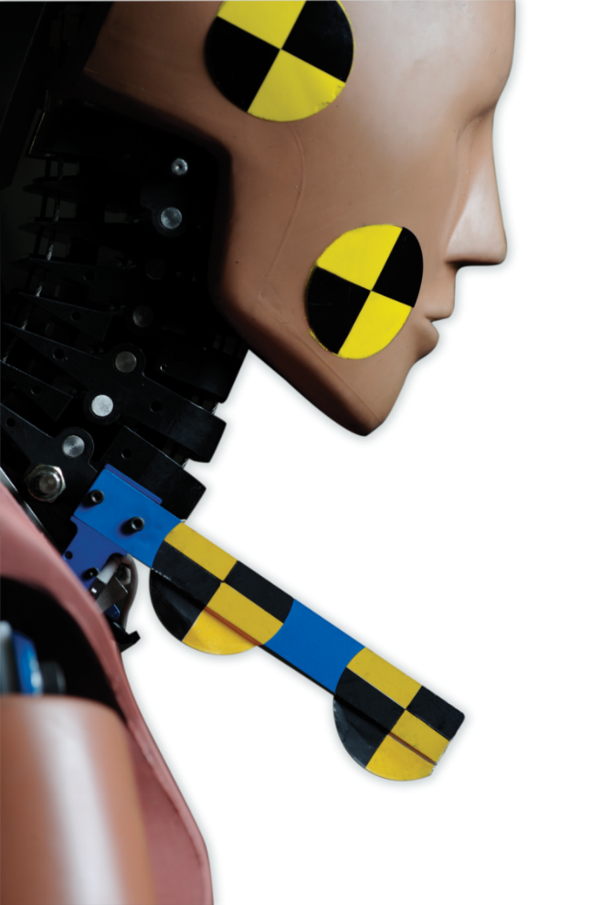
Informal document: GRSP-64-38
(64th GRSP, 11 - 14 December 2018,
agenda item 2)
Introduction to Revision of GTR 7
Formal Document
ECE/TRANS/WP.29/GRSP/2018/27
(superseding GRSP/2015/34)
December 2018

Slide 2
Background
At its 143rd session in November 2007, based upon a proposal from Japan, the World Forum for Harmonization of Vehicle Regulations (WP.29) agreed to provide guidance to GRSP for the development of an amendment to GTR number 7 – Head Restraints.
They directed that GRSP should consider the following issues:
The head restraint height of 850 mm;
The appropriate dynamic test, including the test procedure, injury criteria and the associated corridors for the biofidelic rear impact dummy II (BioRID II).

Slide 3
Background
Further advice was given at the 148th session, in June 2009, based upon proposals from the representative of the United Kingdom of Great Britain and Northern Ireland and of the United States of America.
It was agreed that GRSP should address injuries occurring in low speed rear impact crashes with consideration of injuries in higher speed rear impact crashes being considered in a later step.

Slide 4
Background
On this basis GRSP established an Informal Working Group (IWG). In developing this work the informal group considered that the changes were so substantial that a revision of the GTR would be most appropriate.

Slide 5
Background
November 2009: WP.29/AC.3 agreed a joint proposal from Japan, the United Kingdom and the United States of America to develop an amendment to GTR7 – Head Restraints.
The Terms of Reference were to consider:
The head restraint height of 850 mm;
The appropriate dynamic test, including the test procedure, injury criteria and associated corridors for the Biofidelic Rear Impact Dummy II (BioRID II).
(low speed rear impact crashes only - injuries in higher speed rear impact crashes to be considered as a further step.)

Slide 6
Draft GTR 7 Phase 2
At the 58th GRSP formal document GRSP/2015/34 was introduced (GRSP-58-18) representing the progress at that time
At the 58th GRSP agreement was reached on the head restraint height of 830 ^{*)} mm and 720 ^{*)} mm respectively.
Formal Document number GRSP/2018/27 represents now the progress to date
^{*)} A contracting party may opt for a lower value in its domestic legislation if it decides that such value is appropriate.

Slide 7
Draft GTR 7 Phase 2
Document 2018/27 still contains a number of square brackets.
A small drafting group with representatives from J/NL/D went through the document and agreed on the removal of the square brackets.
Informal document 64-xx is a consolidated version.

Slide 8
Draft GTR 7 Phase 2
In principle 5 parts of the GTR have been mainly affected:
the main text of the GTR and the content of
Annex 1 (Height measurement test procedure)
Annex 4 deleted (Backset measurement test procedure using the HRMD method)
Annex 5 (Backset measurement test procedure using the R-point method)
Annex 9 (Dynamic performance test procedure)

Slide 9
Draft GTR 7 Phase 2
Head Restraint Height
Changes to the procedure for establishing the height of the head restraint are proposed. These changes ensure that the height is measured at a position where the restraint can be effective upon head contact rather than at its absolute height.
The procedure is detailed in Annex 1 but, significantly, it removes the requirement to use the H-point machine and the HRMD.

Slide 10
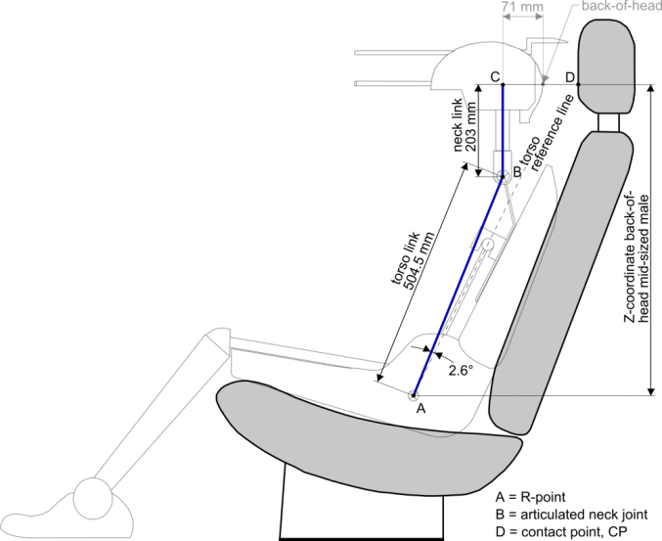
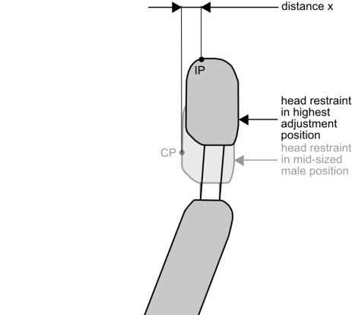
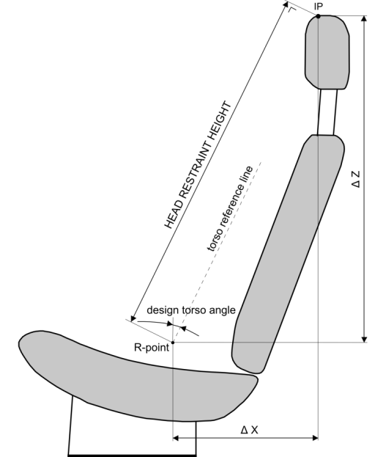
Draft GTR 7 Phase 2
Concept of measuring effective HR height (Annex 1)
CP: contact point
IP: intersection point
Distance x: function of design torso angle

Slide 11
Draft GTR 7 Phase 2
Annex 9 (Dynamic performance test procedure)
Annex 9 contains the proposal for the introduction of BioRID UN. It has been introduced in parallel with the current Hybrid III device but could easily be shown as a single tool of choice if Contracting Parties agree.
There has been significant effort to address initial concerns about reproducibility of the BioRID tool.
Both NHTSA and the European Commission funded extensive testing by VRTC in the US and by TRL/BASt in Germany. The manufacturer has also invested heavily to ensure that the tool is suitable for regulatory tests.

Slide 12
Draft GTR 7 Phase 2
Annex 9 (Dynamic performance test procedure)
The IWG is now content that the tool is as good as or better than the Hybrid III.

Slide 13
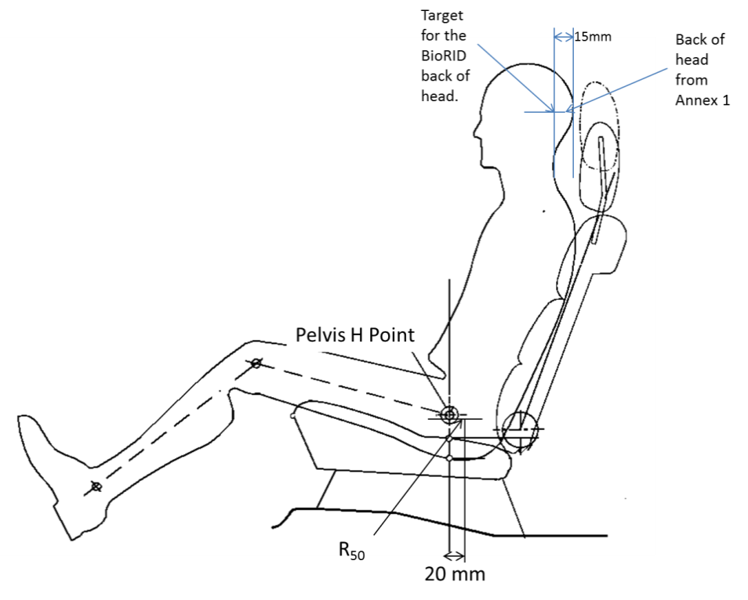
Draft GTR 7 Phase 2
Annex 9 (Dynamic performance test procedure)
Introduction of the „R₅₀ point“
Introduction of a new “designated H-point” for mid-size male seating position “R₅₀”.
This data is provided by the manufacturer, allowing the seat to be adjusted to this point.
Note: static measurement is made in a different seat set-up than for the dynamic test.
“R₅₀“tolerance is checked by the H-point machine. If it lies within the 50 mm box it is this is the designated design point.

Slide 14
Draft GTR 7 Phase 2
Annex 9 (Dynamic performance test procedure)
The IWG recognises limitations in BioRID’s use and recommends that it is only used for seats having a torso angle not less than 20° and not greater than 30°.
The IWG recognises that the design of BioRID is such that its spine can be set to represent a more upright seating position but notes that before it could recommend its use in this setting more evaluation would be required.
This could be considered for a further amendment to the GTR but, in the meantime, the IWG recommends that, at the manufacturer’s request, seats with a torso angle between 15° and 20° may be tested as if the torso angle is 20°.

Slide 15
Draft GTR 7 Phase 2
Injury / Seat Performance Criteria
The IWG recognised the absence of an absolute medical definition for whiplash associated disorder and had the ambition to develop this understanding as part of its work.
Innovative cadaver based studies were undertaken by VRTC guided by an extensive work of simulation studies by Japan and this programme of work has been significant in the timeline for the delivery of a proposal.
However, while the work has helped to evaluate the repeatability and reproducibility of the tool it has not been successful in producing correlation between the tool and the cadaver performance. It has become clear that more cadaver studies are required in order to deliver a sufficiently large statistical sample.

Slide 16
Draft GTR 7 Phase 2
Injury / Seat Performance Criteria
The IWG believes that it is necessary to proceed with a more empirical approach and to recommend that the cadaver work be reported in a later amendment.
The BioRID tool is already used extensively in consumer information programmes where empirical criteria are in use.
Document 64-xx therefore proposes a set of seat performance criteria based on an empirical approach.

Slide 17
Draft GTR 7 Phase 2
Outlook / Recommendation
The IWG would welcome comments on the content of document ECE/TRANS/WP.29/GRSP/2018/27 and 64-xx so that it may consider them while preparing the final proposal for the May 2019 session.
The final proposal shall be accompanied by a proposal for an entry in Mutual Resolution 1 that will detail the BioRID UN test tool.
A parallel proposal to amend UN ECE Regulation 17 to reflect the new content of GTR7 was prepared by Japan GRSP/2018/34

Slide 18
Thank you for your attention!
Bernd Lorenz
Bundesanstalt für Straßenwesen (BASt)
Brüderstraße 53
D-51427 Bergisch Gladbach
lorenz@bast.de

