Slide 1
Submitted by the expert From Spain | Informal document GRSP-65-11 (65th GRSP, 13-17 May 2019, agenda item 26)
Securing of children in buses and coaches
May 2019

Slide 2
Securing of children in buses and coaches
Background
Safety of children in buses and coaches has been discussed at GRSP in several occasions.
Before UN Regulation 129 (2008 GRSP-44-29 submitted by Spain)
GRSP acknowledged the importance of this issue. However, GRSP expressed the wish that the informal group on child restraints addresses this subject once its work on CRS has been completed. (Report on the 44 session of the GRSP)
After UN Regulation 129
Germany proposed to come back with this topic once the UN Regulation has been finished.
Last GRSP
Russia: The expert suggested the possibility of establishing a group of interested experts on this subject to speed up solutions.
USA: The Chair of GRSP stated that NHTSA had conducted research and testing on this topic and offered to share the results of the research at the May 2019 session of GRSP.
The expert from the Russian Federation and Sweden also announced testing experience and statistics on this subject and their intention to also share results at the next session.

Slide 3
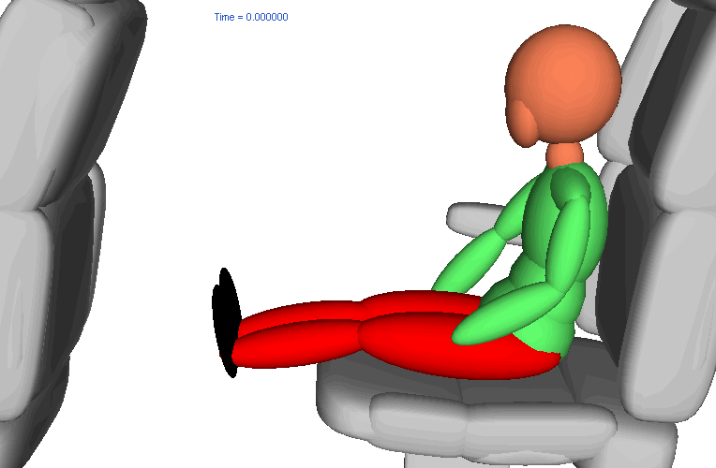
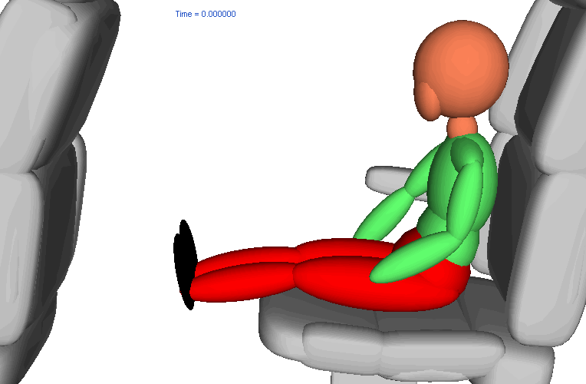
Securing of children in buses and coaches
Potential Behavior of children in accidents in buses and coaches
Children traveling without adult seat belt.
Frontal impact Rollover
Possible consequence :
Complete ejection of the occupant from the seat. Real world accidents show ejection within the passenger compartment, or outside !

Slide 4
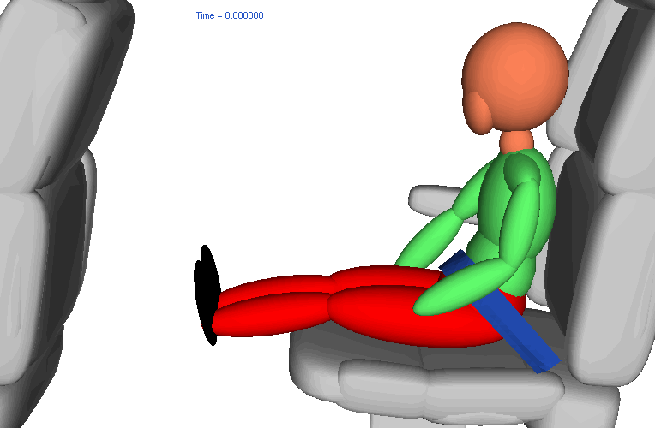
Securing of children in buses and coaches
Behavior of children in accidents in buses and coaches
Children traveling with 2 point adult seat belt.
Frontal impact Rollover
Possible consequence :
Serious or fatal injuries!

Slide 5
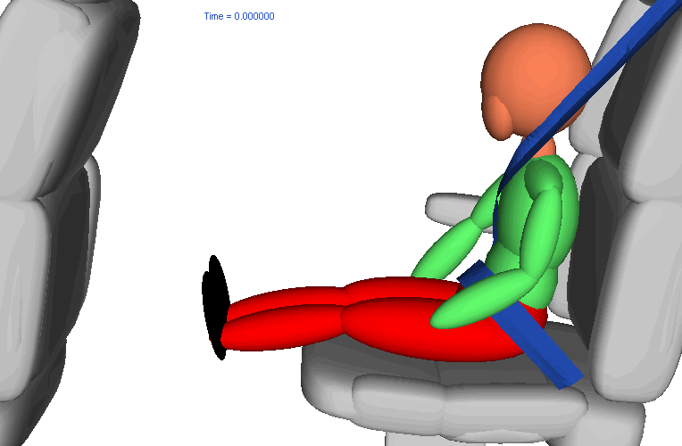
Securing of children in buses and coaches
Behavior of children in accidents in buses and coaches
Children traveling with 3 point adult seat belt.
Frontal impact Rollover
Possible consequence :
Serious or fatal injuries including abdominal injuries.

Slide 6
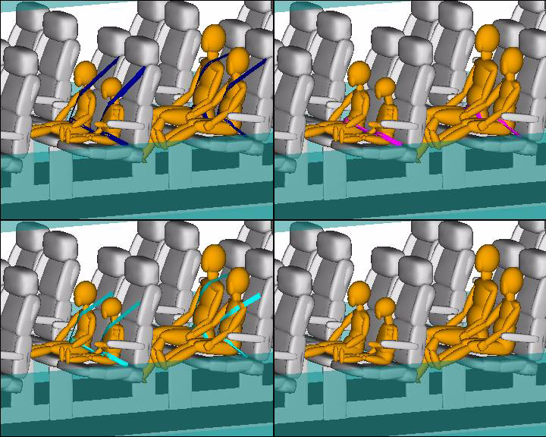
Securing of children in buses and coaches
Behavior of children in accidents in buses and coaches
Frontal Impact Simulation (R-80)

Slide 7
Securing of children in buses and coaches
Conclusions
Regulation 44 and 129 are defined in order to secure children in passenger vehicles when traveling. The specifications of the Regulations are done on the basis of vehicles of category M1
There are no specific requirements for children traveling in buses and coaches.
It’s time for GRSP to establish requirements for securing the children in M2 and M3 vehicles based on real accidents in those type of vehicles.
Top priority should be to avoid ejection of the occupant

Slide 8
Securing of children in buses and coaches
Proposal
We ask GRSP to support the development of a new Regulation for securing children in buses and coaches.
An informal Working Group should be established to perform the work.

Slide 9
Thank you for your attention

