Slide 1
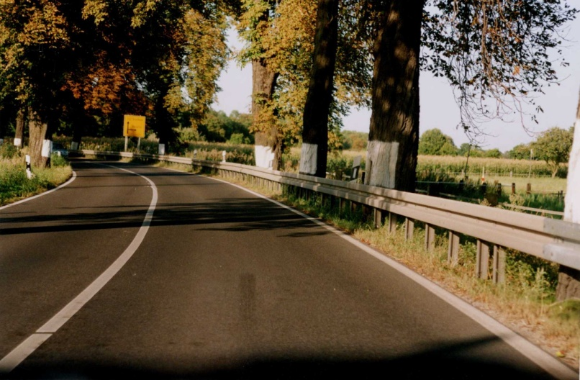
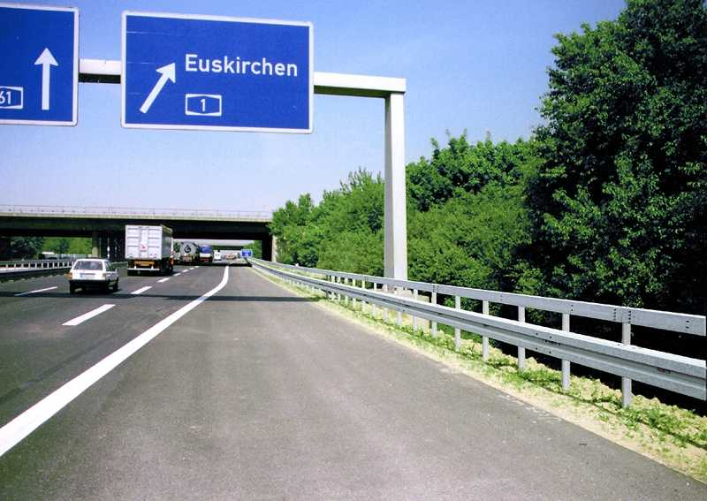
Impact Attenuating Devices to Protect Motorcyclists from Guardrail Posts
Informal document GRSP-65-35 (65th GRSP, 13-17 May 2019, agenda item 28(a))
Picture: BASt
Picture: BASt
Federal Highway Research Institute (BASt)

Slide 2
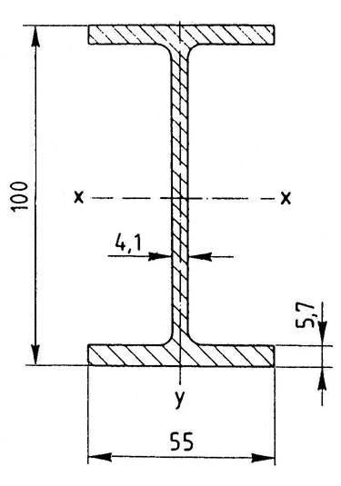
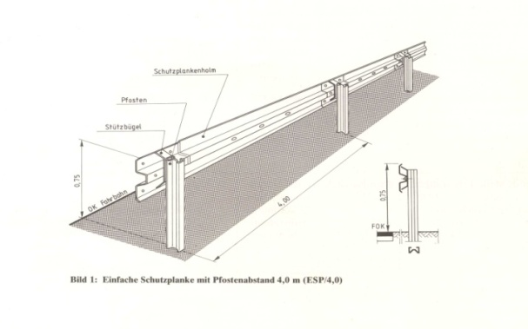
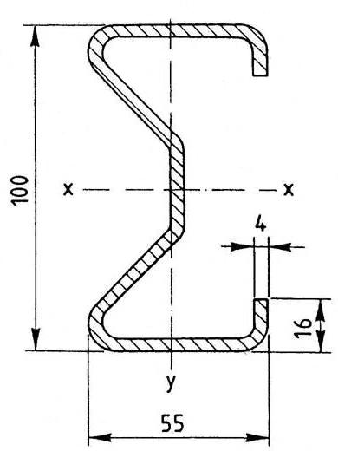
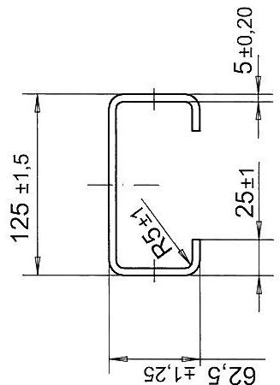
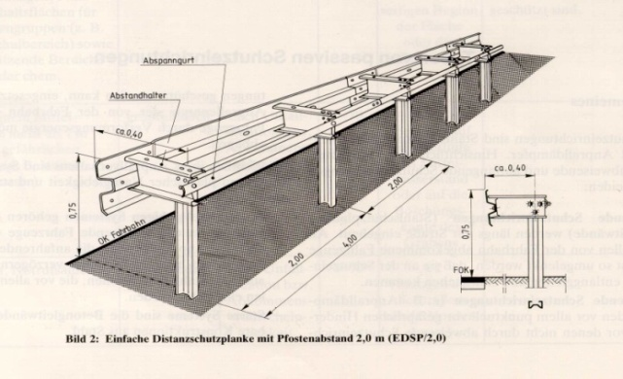
Post of Steel Guard Rail (Cross Section)
Pictures: FGSV

Slide 3
What Can Happen to Motorcylists?

Slide 4
What Can Happen to Motorcylists?

Slide 5
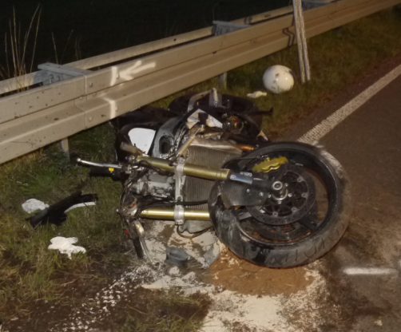
Basics – Accident Data
In Germany we have about 26.000 accidents with injured motorcyclists per year.
568 motorcylists lose their lives each year.
In 1200 cases of all accidents with an injured motorcyclist a vehicle restraint system (VRS) was involved.
Only 2.2% of all accidents of injured motorcyclists ends up in a fatality; but if VRS are involved the number increases to 14%.
Picture: GIDAS

Slide 6
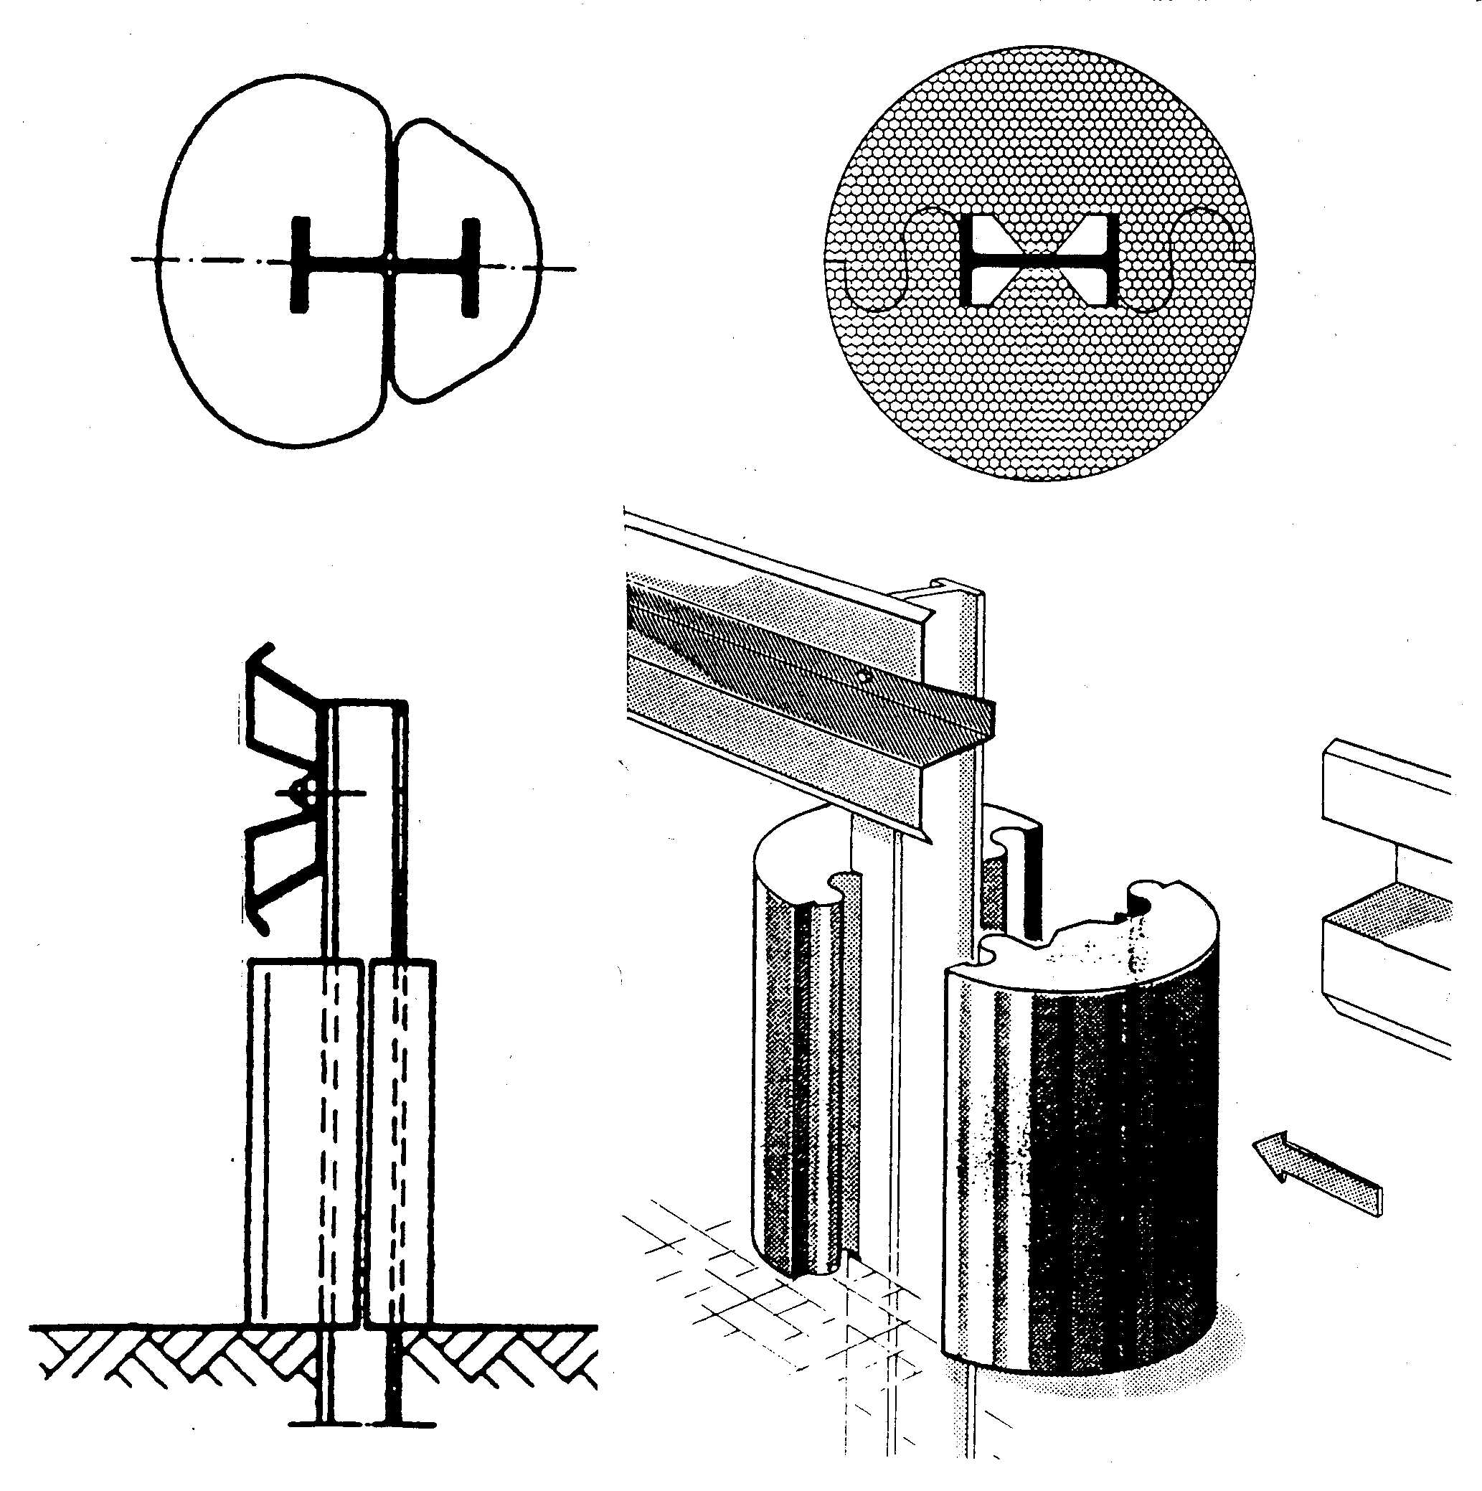
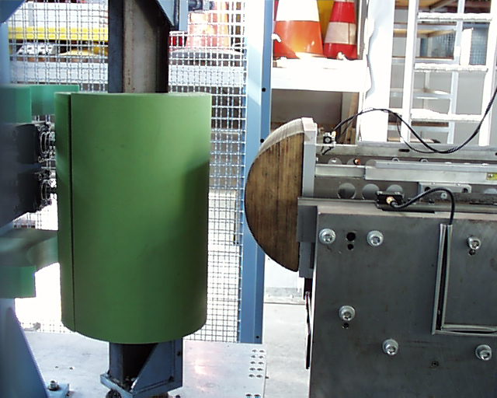
Motorcyclist Protection Systems (MPS) in use
Picture: BASt
Picture: BASt

Slide 7
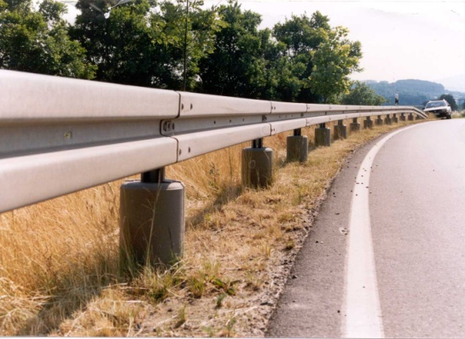
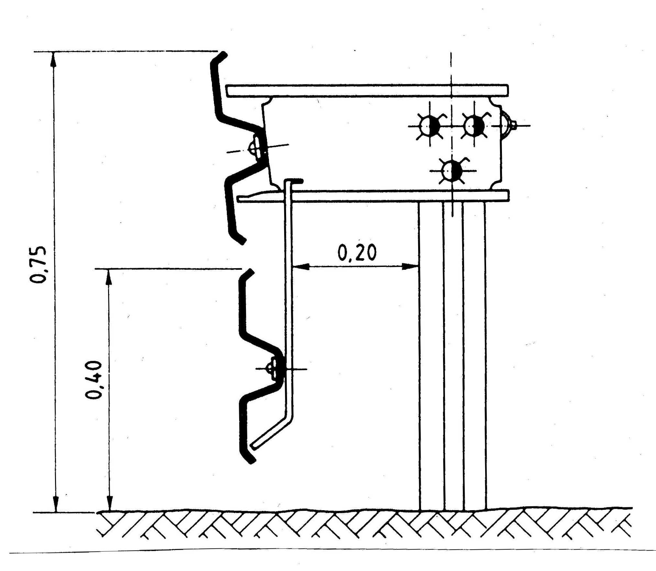
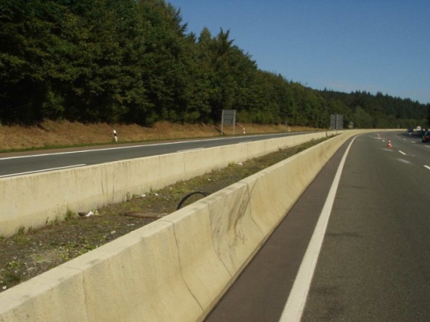
Motorcyclist Protection Systems (MPS) in use
Post Protection (SPU)
ESP or EDSP with extra beam for underride protection
Concrete Barrier
Pictures: BASt

Slide 8
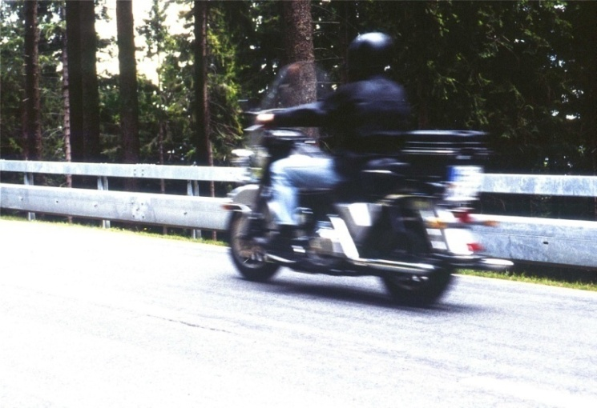
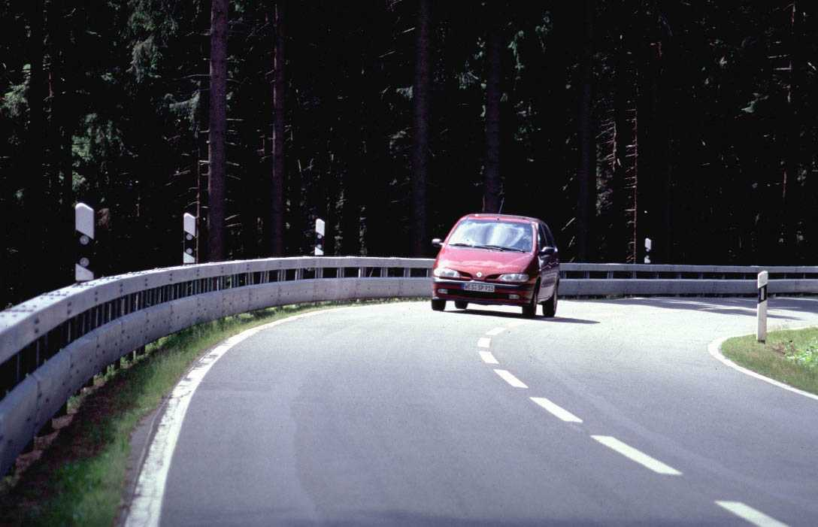
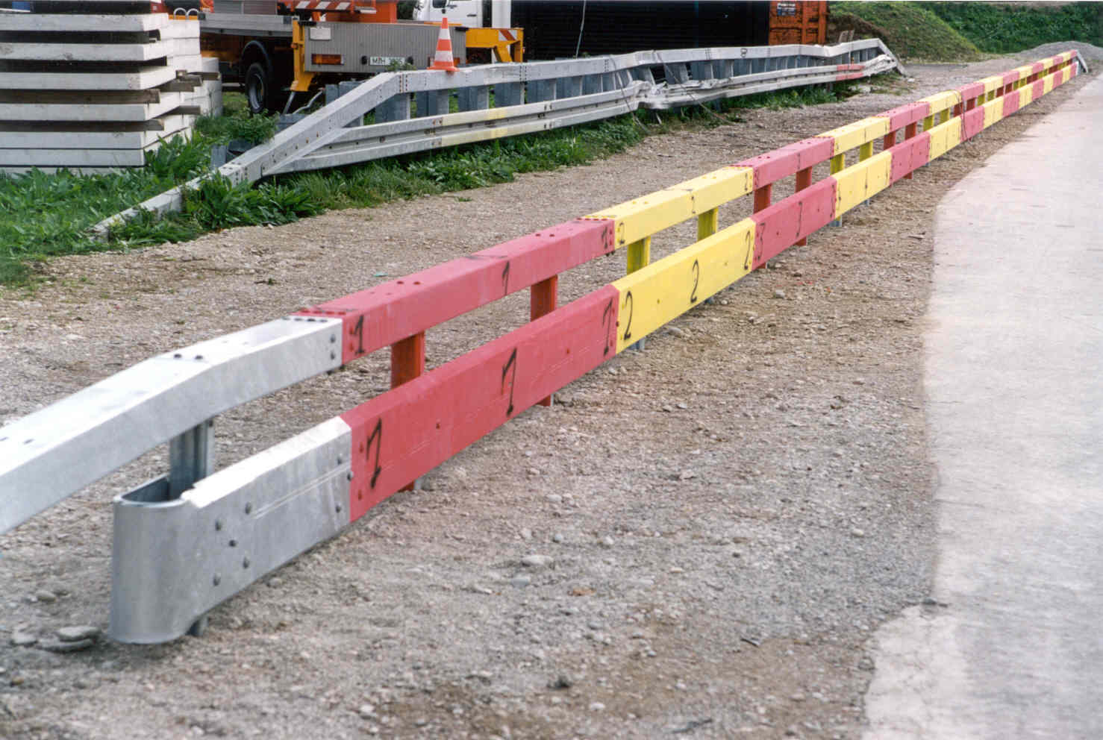
Motorcyclist Protection Systems (MPS) in use
Box beam with extra beam for underride protection
Pictures: BASt

Slide 9
Former Research
BASt started a research project to improve the situation.
The aim was the development of a system which is more „friendly“, e.g. less severe, for motorcyclists.
Pictures: DEKRA

Slide 10
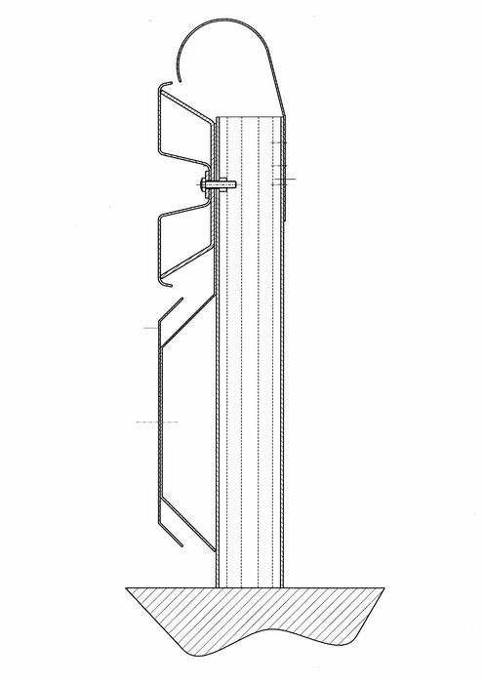
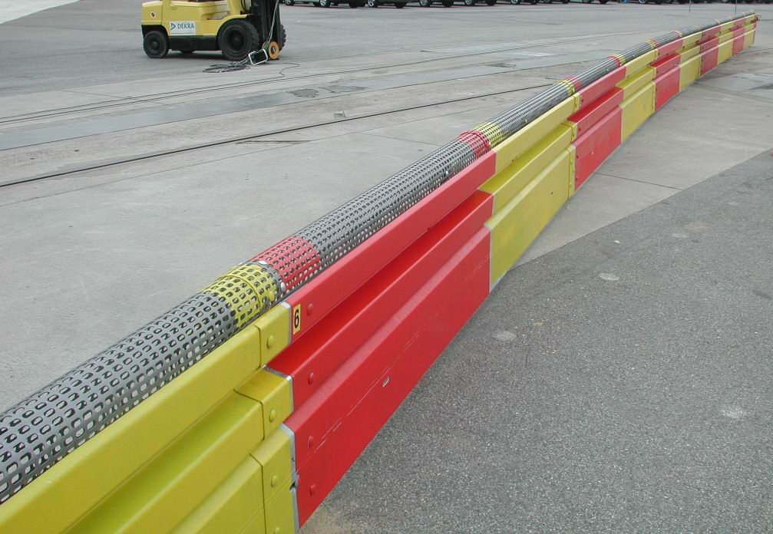
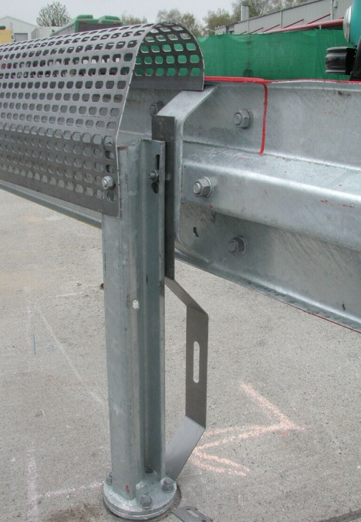
System Euskirchen Plus (ESP)
Pictures: BASt

Slide 11
System Euskirchen Plus (ESP)

Slide 12
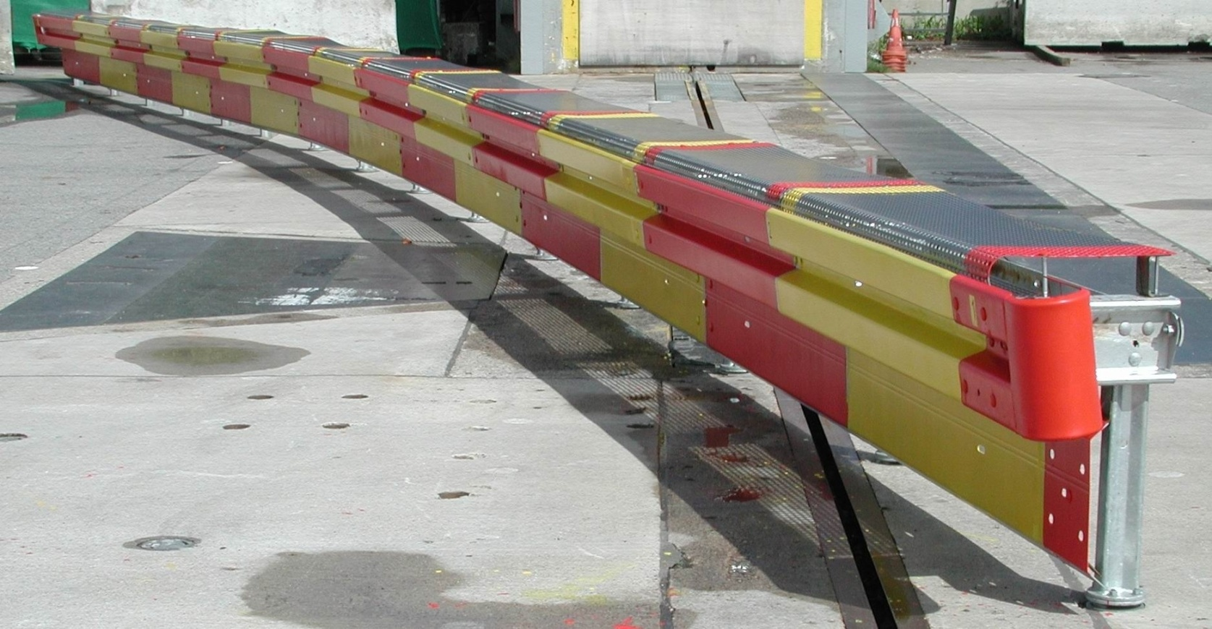
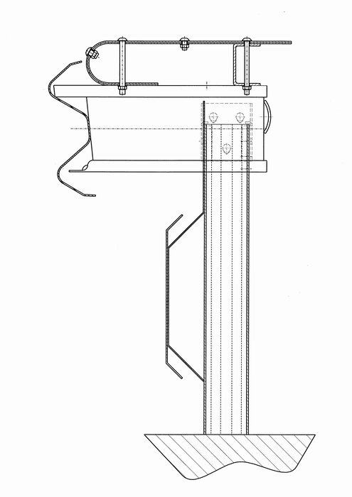
System Euskirchen Plus (EDSP)
Pictures: BASt

Slide 13
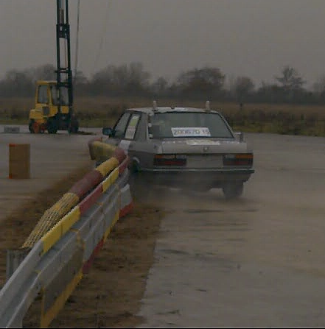
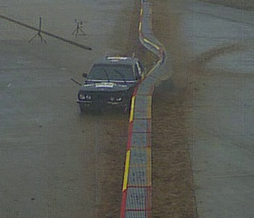
Additional Tests according to standard EN 1317
Containment | Level | Type | Velocity | Angel | Mass
Normal | N2 | TB 32 | 110 km/h | 20 ° | 1500 kg
 |  | TB 11 | 100 km/h |  | 900 kg
Pictures: BASt

Slide 14
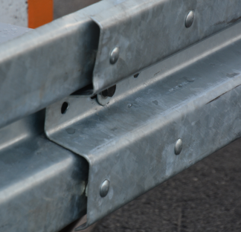
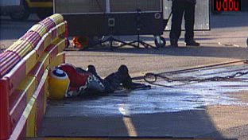
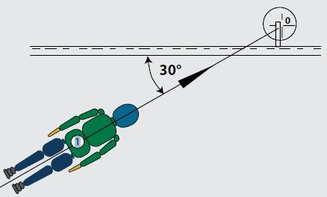
Current Research
Identification of sharp elements of VRS
Improving systems according to new standard EN 1317-8
Pictures: BASt

Slide 15
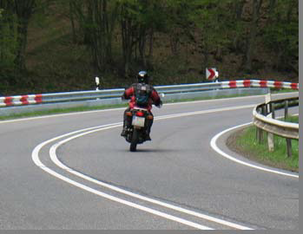
Summary
VRS need to be improved for motorcyclists!
Protection for sliding and sitting impact
Thank You for Your Attention!
Picture: Menge, RP

