Slide 1

C-EDR
Informal document WP.29-178-27
(178th WP.29, agenda items 2.3)
Introduction of
Chinese Mandatory National Standard
GB “Automobile Event Data Recorder "

Slide 2
contents
1
BACKGROUND
2
DEVELOPMENT PROCESS & STANDARD
FRAMEWORK
3
STANDARD CONTENT
4
STANDARD IMPLEMENTATION

Slide 3
CONTENTS
BACKGROUND

Slide 4
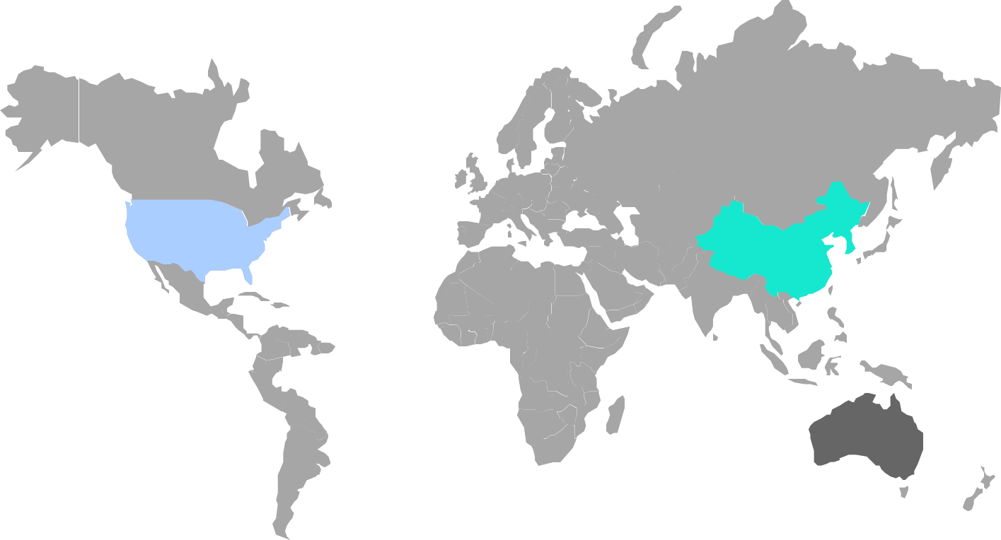
BACKGROUND
Current EDR Regulations & Standards Around the World
Main Concern
1.There are many traffic accidents and complicated situations in China.
2.With the rapid development of intelligent connected vehicles and new energy vehicles, higher requirements are put forward for vehicle safety protection measures. We want to propose requirements for EDR systems that are in line with China’s current and future developments.
3.Support an implementation independent of the airbag system.
4.EDR system should be suitable for the status quo of domestic enterprises.
5.Unified data reading scheme is required.
CFR 563
Chinese Mandatory Standard
(in the process of approval)

Slide 5
CONTENTS
DEVELOPMENT PROCESS & STANDARD FRAMEWORK

Slide 6
DEVELOPMENT PROCESS
2017.09
2019.03
Project approval
Submit for review
2016.09
2018.06
2016.03
2019.06
Draft
Solicit comment
Begin
Submit for approval

Slide 7
FRAMEWORK OF EDR STANDARD
INPUT
OUTPUT
Acceleration
Consistency check
Trigger
Threshold
Locking
Condition
Beginning of Event
End Of Event
Delta-V
Public Needs
Braking Status
EDR
Data Retrieval
Accident Analysis
……
Defects Recall
Data Record
Storage Coverage Mechanism
Power-off Storage
Electronic
Protection
Airbag Status
Insurance Claims

Slide 8
CONTENTS
STANDARD CONTENT

Slide 9
STRUCTURE OF EDR STANDARD
Step 2
Step 5
Technical Requirements
Test Methods and Requirements
Step 1
Step 6
Appearance and Identification
C-EDR
Type Inspection
Step 4
Step 7
Manual
Standard Implementation(TBD)
Step 3
Step 8
9

Slide 10
TECHNICAL RERUIREMENTS
Technical Requirements
EDR功能要求
EDR Functional Requirements
Data Function Requirements
Data Retrieval Requirements
Impact Event Requirements
Data Record Requirements

Slide 11
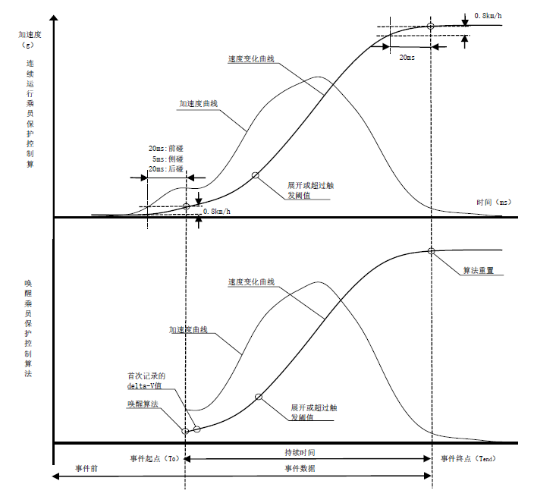
IMPACT EVENT REQUIREMENTS
Trigger Threshold
Locking Condition
Beginning of Event
End of Impact Event

Slide 12
DATA RECORD REQUIREMENTS
Maximum Recorded
Lateral delta-V
Lateral delta-V
Maximum Recorded
Lateral delta-V
Time to Maximum
Recorded delta-V
Level A (17)
A
A
Data that shall be recorded when vehicles are equipped with EDR system.
Clipping Flag
Vehicle Velocity
Service brake
，on or off
Acceleration pedal position%
Revolution per minute
Driver seatbelt status
5
HIGH
10
VERY HIGH
15
EXTREME
20
EXTREME
25
Level B (43)
Level A Data
Element
Power-on cycle at retrieving
B
Power-on cycle
at event
Complete status of event data record
Relevant data that should be recorded when vehicles with EDR system are equipped with relevant devices or have relevant functions.
MEDIUM
4
MEDIUM
8
HIGH
12
VERY HIGH
16
EXTREME
20
Time interval from this
event to the last event
VIN
LOW
3
MEDIUM
6
MEDIUM
9
HIGH
12
VERY HIGH
15
ECU hardware number that records EDR data
ECU software number that records EDR data
ECU serial number that records EDR data
VERY LOW
2
LOW
4
MEDIUM
6
MEDIUM
8
HIGH
10
VERY LOW
1
2
LOW
3
MEDIUM
4
MEDIUM
5

Slide 13
DATA RECORD REQUIREMENTS
Longitudinal
acceleration
Lateral
acceleration
Lateral
delta-V
Maximum Recorded
Lateral delta-V
Square of Maximum
Recorded Resultant
delta-V
Time to Maximum
Recorded delta-V
lateral
B
Time to Maximum Recorded delta-V，Resultant
Pre-event
synchronization
timing time
Yaw Angle
Velocity
Steering
Angle
Steering Lamp
Status
Working status and event status
Tend
Gear
Position
Engine Throttle Position
Brake Pedal
Position
Parking System
Status
Occupant Protection
System Warning Status
Tire Pressure Monitoring System
Warning Status
Braking System Warning
Status
Level B Data
Element
Driver’s front airbag
Deployment time （phase I）
Driver’s front airbag
Deployment time
（phase II）
Driver’s seat belt pretensioner
Deployment time
Driver’s side air curtain
Deployment time
Driver’s side airbag
Deployment time
Front-row passenger
seat belt Status
Restraint system
Front-row passenger seat belt pretensioner
Deployment time
Front-row passenger ‘s front airbag suppression status
Front-row passenger ‘s front airbag
Deployment time(phase I)
Front-row passenger ‘s front airbag
Deployment time（phase II）
Front-row passenger’s side airbag
Deployment time
Front-row passenger’s side air curtain
Deployment time
Active system
Cruise Control
system status
Adaptive Cruise
Control system status
Anti-brake system
status
AEB status
Electronic stability
control system status
Traction control
system status
Time
Year
Month
Day
Hour
Minute
Second
13

Slide 14

DATA RECORD FUNCTION REQUIREMENTS
Storage media and storage frequency requirements
Storage coverage mechanism requirements
Power-off storage requirements
Unlocked event data should be overwritten by subsequent un-locked event data, in chronological order.
Locked event data should not be overwritten by data from subsequent events.
For unlocked events, the manufacturer is allowed to set other storage coverage mechanisms.
Non-volatile storage medium
At least 3 times of impact event
data.
data before T₀ and after T₀ to (150±10) ms should be recorded.
14

Slide 15


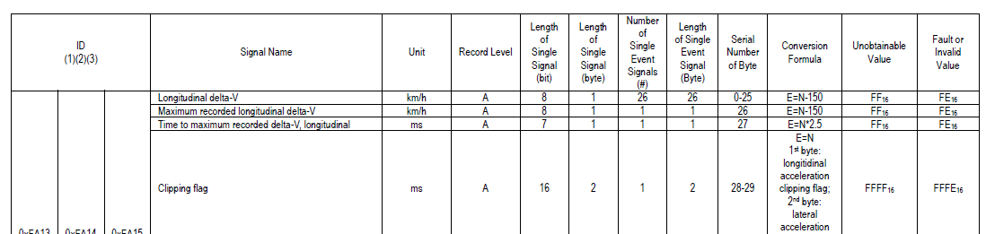
DATA RETRIEVAL REQUIREMENTS
Unified data retrieval protocol
2
1
Unified data retrieval connector
GB/T 34589-2017“Road Vehicles diagnostic connector”
√ Use diagnostic service 0x22“ReadDatabyIdentifier“ in ISO 14229 “Road Vehicles unified diagnostic service " to retrieve EDR data.
√ compatible with CAN bus and k-line.
√ Compatible with functional addressing and physical addressing
√ Compatible with 11-bit and 29-bit CANID
3
Unified data retrieval ID
0xFA13, 0xFA14 and 0xFA15
Where,
0xFA13 for the most recent event,
0xFA14 for the second event from the bottom,
0xFA15 for the third event from the bottom.
Unified data arrangement
4
Unified data range, accuracy, resolution and data arrangement order
15

Slide 16
TEST METHODS
Test Methods
MEASURE
DRIVER OPERATION DATA TEST
IMPROVE
IMPACT TEST
BENCH TEST
16

Slide 17
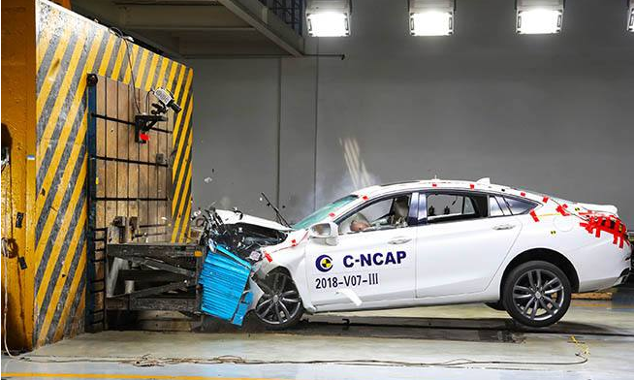
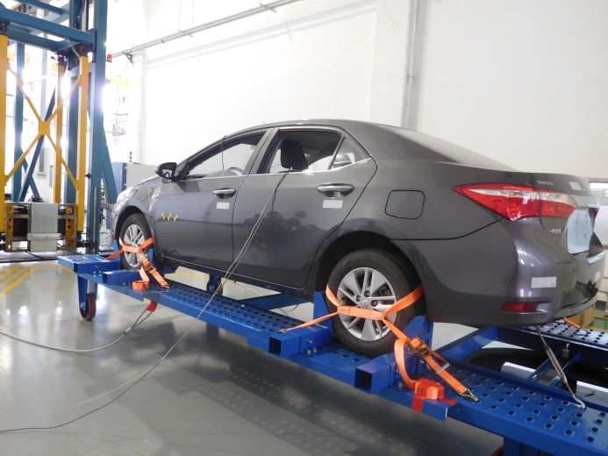
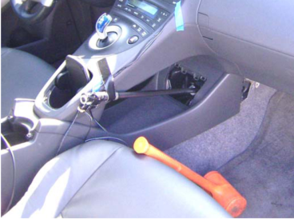
TEST METHODS
Impact Test
Add acceleration and airbag deployment time measurement to the existing mandatory impact test, and compare the results measured in the laboratory and recorded by to verify the accuracy of dynamic data after collision.
Driving Operation Data Test
Enable the vehicle to reach the trigger in any way:
-- hit the vehicle
-- fix the vehicle with the pallet, and hit the pallet
-- physically trigger the EDR
-- input trigger signal to the EDR。
17

Slide 18
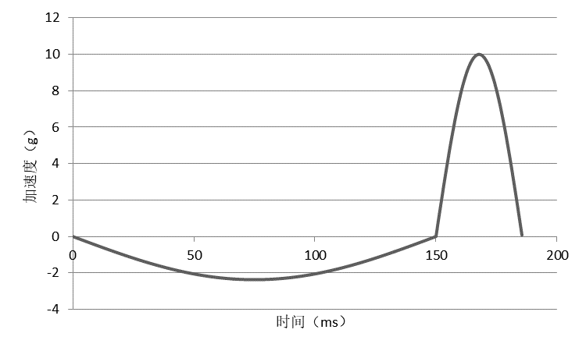
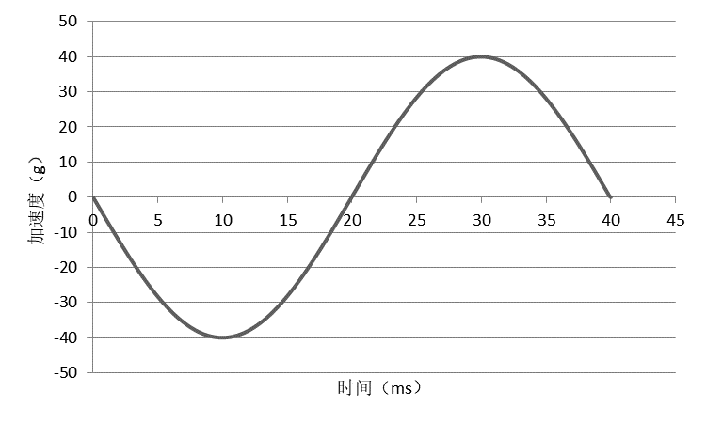
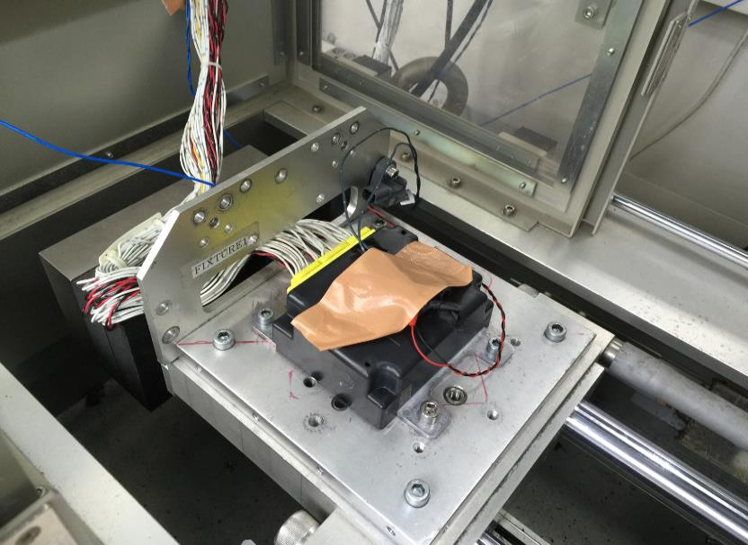
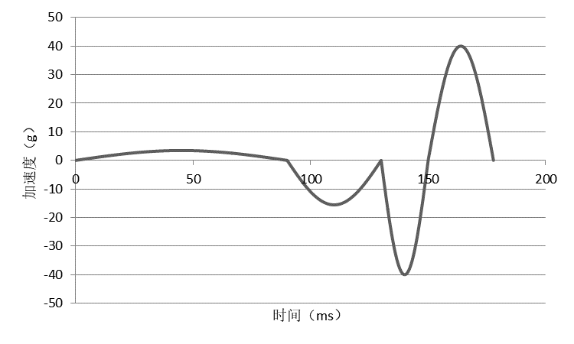
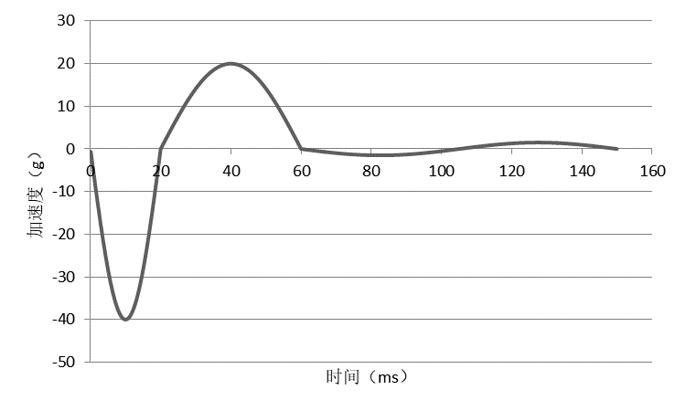
TEST METHODS
Bench Test
The impulse waveform of acceleration is applied to the EDR controller by the shock testing machine to verify the EDR trigger, storage times, coverage mechanism and power off storage requirements.
18

Slide 19
Summary
1.This standard is expected to enter into force gradually in China.
2.China would like to contribute our EDR standard development experience to the WP.29 for future development of EDR regulation if it will be developed under 1958 agreement.
3.And China also suggests to adopt this standard into the Compendium of Candidate GTR, if a GTR for EDR is going to be developed by WP.29.
4.China is looking forward to participating the working group for EDR issues. And Chinese delegates would like to further elaborate the details in the IWG level.
For specific discussion please contact Ms. Wu Hanbing by email: wuhanbing@catarc.ac.cn
19

Slide 20
C-EDR
THANK YOU！

