Slide 1


Note by the secretariat
Informal document GRBP-70-27
(70th GRBP, 11-13 September 2019, agenda item 14)
Inland Transport Committee (ITC) -related matters
ITC Strategy 2030 - Special focus: Draft ITC Recommendations for enhancing National Road Safety Systems
Working Party on Noise and Tyres (GRBP) 70th session, Geneva, 11 - 13 September 2019
INLAND TRANSPORT COMMITTEE

Slide 2
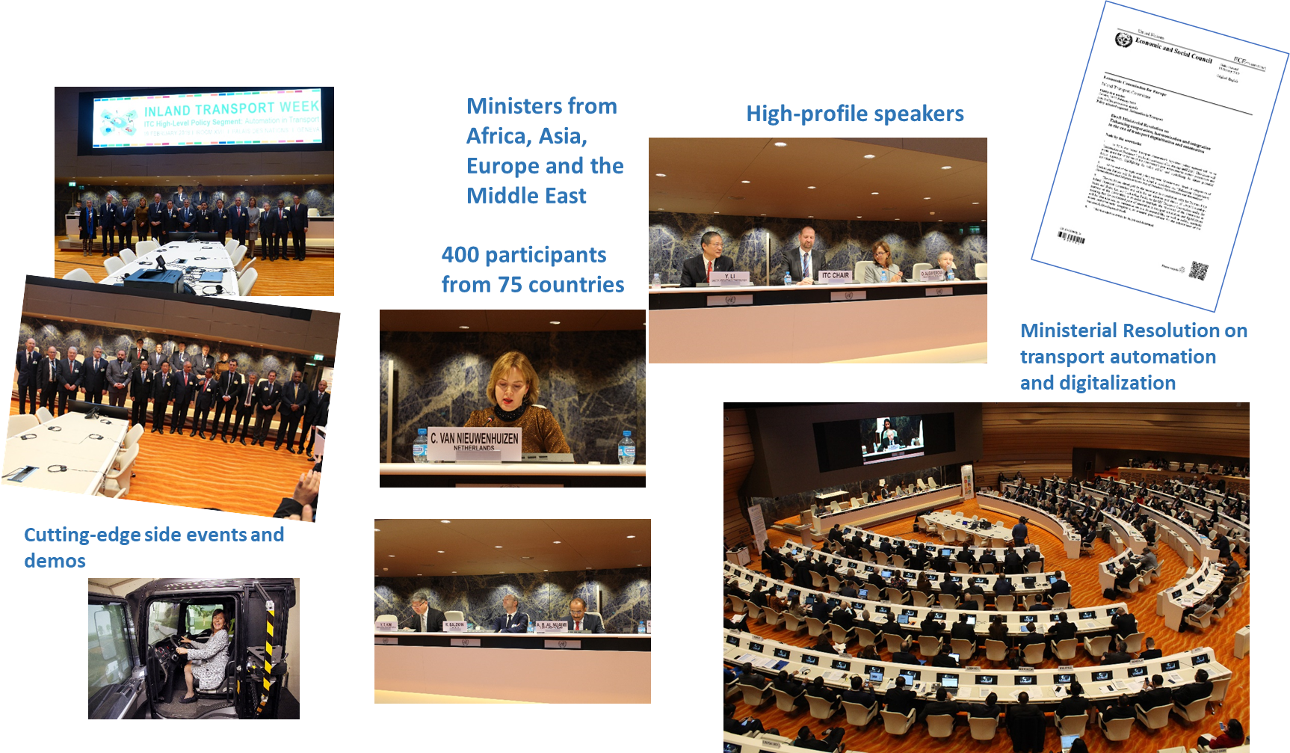

81st ITC Plenary: A turning point –
Adoption of ITC Strategy 2030
INLAND TRANSPORT COMMITTEE

Slide 3
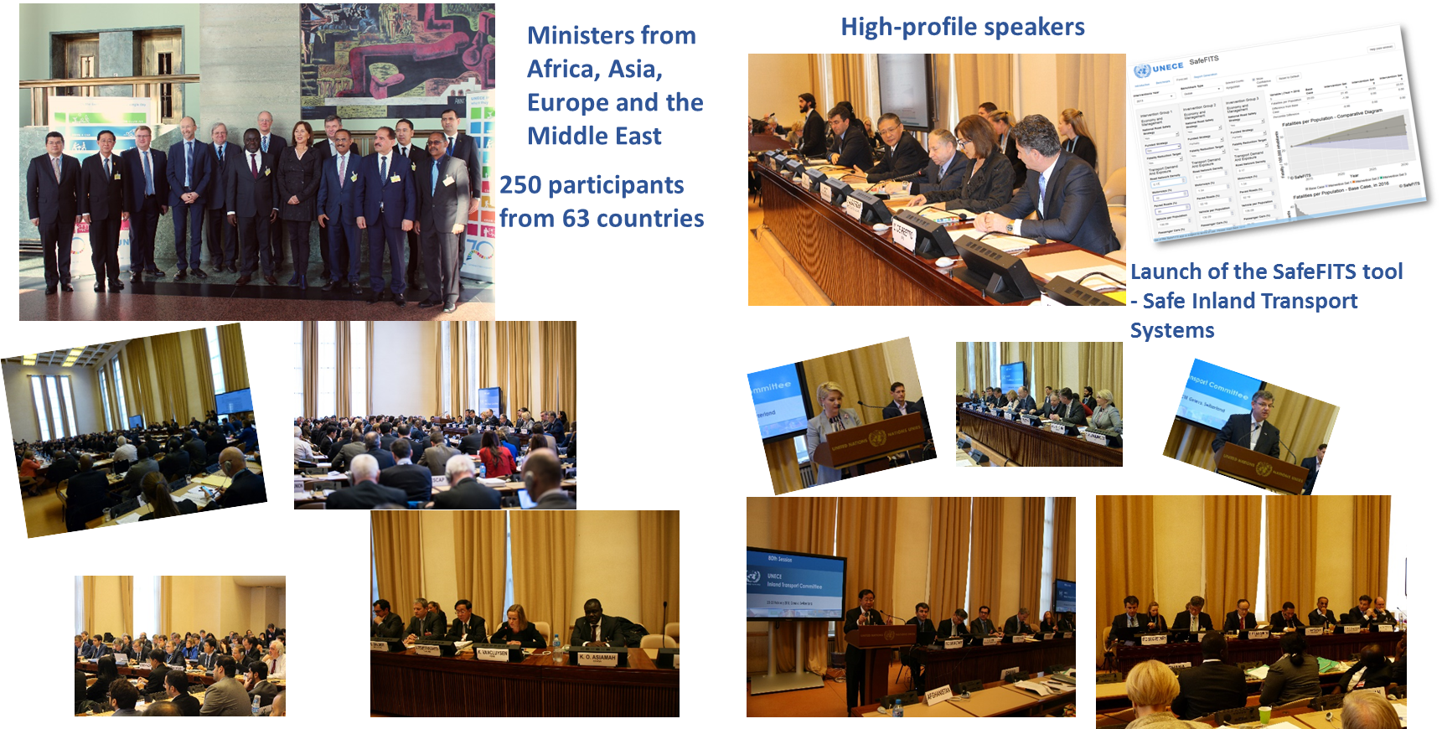
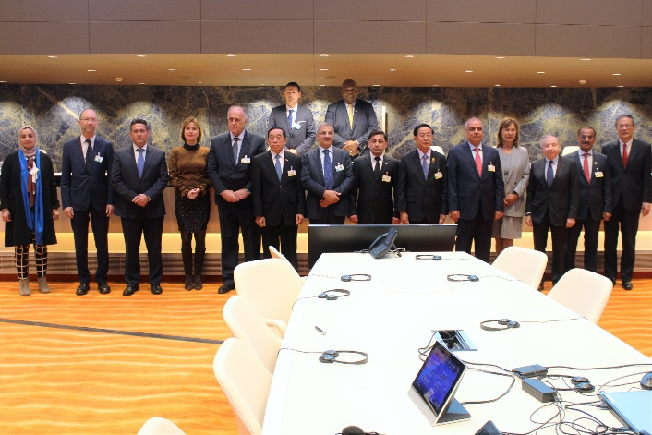

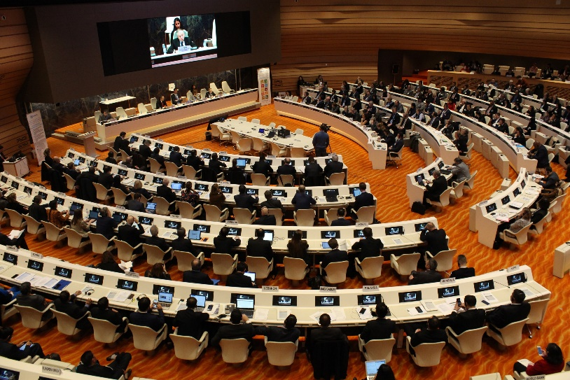
81st ITC Plenary: A turning point – II
Adoption of the ITC Strategy
INLAND TRANSPORT COMMITTEE
2017
79th Annual session:
- Resolution
- ECE/TRANS/2017/R.1
2018
80th Annual session
- Discussion paper on ITC Strategy
- Background report
2019
81st Annual session
Adoption of ITC Strategy 2030

Slide 4
ITC Strategy 2030:
Vision and Mission
INLAND TRANSPORT COMMITTEE
Vision 2030: Vision: The Inland Transport Committee is the United Nations platform for inland transport to help efficiently address global and regional needs in inland transport
The ITC as the UN platform for inland transport will continue to provide a comprehensive regulatory framework for inland transport including road, rail, inland waterway and intermodal transport, comparable to the role of the International Maritime Organization (IMO) and International Civil Aviation Organization (ICAO).
To perform the following key functions:
  (a) Leading change in inland transport
  (b) Developing and administering transport legal instruments
  (c) Increasing accessions and equitable participation, including by non-ECE Member States.

Slide 5
UNECE ITC Strategy 2030:
Means to an end in the era of the SDGs
INLAND TRANSPORT COMMITTEE
Aviation
ICAO
Maritime
IMO
Inland Transport
UNECE (ITC)
Sustainable Transport and Mobility

Slide 6
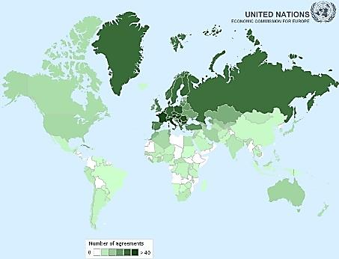
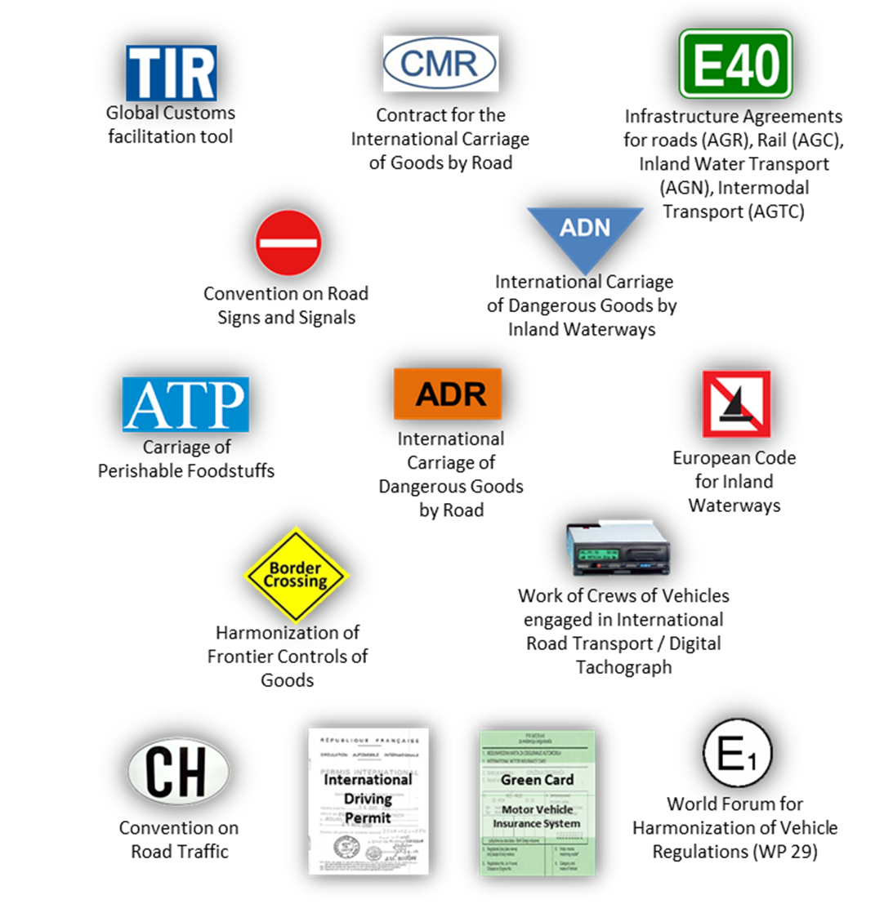
ITC - The UN Platform for Inland Transport
INLAND TRANSPORT COMMITTEE
59 conventions
148 UN Member States/Contracting Parties
Including all 56 ECE member States
Goal: a universally harmonized inland transport system

Slide 7
ITC Strategy 2030:
Vision and Mission
INLAND TRANSPORT COMMITTEE
The mission for ITC is that it contributes to sustainable inland transport and mobility for achieving the sustainable development goals in the ECE and UN member States through policy dialogue, harmonizing regulatory frameworks, as appropriate, promoting new technologies, assisting in enhancing connectivity and supporting the implementation of legal instruments.
In performing its mission, the Committee will enhance its role as:
  (a) The UN Platform for regional and global inland transport conventions
  (b) The UN Platform for supporting new technologies and innovations in inland transport
  (c) The UN Platform for regional, interregional and global inland transport policy dialogues
  (d) The UN Platform for promoting sustainable regional and interregional inland transport connectivity and mobility

Slide 8
ITC Strategy 2030:
Objectives
INLAND TRANSPORT COMMITTEE
Strategic Objective: Increased governance
  ITC is truly the UN platform with equal participation of all contracting parties to UN legal instruments under its purview to lead the future development of inland transport
  UN transport conventions under its purview are universally accepted and implemented, open for accession/ratification by all UN Member States if feasible, and inclusive of regional good practices
  ITC keeps pace with technological developments in a timely manner
  ITC’s work enhances regional and inter-regional connectivity

Slide 9
ITC Strategy 2030:
Objectives
INLAND TRANSPORT COMMITTEE
Horizontal objective: Increased support to all SDGs, in particular:
improved traffic safety and urban mobility (SDGs 3 and 11)
reduced pollutant and GHG emissions (SDGs 3 and 13)
improved industry innovation and infrastructure efficiency and connectivity (SDG 9)
affordable and clean energy (SDG 7)
decent work and economic growth (SDG 8)
gender equality (SDG 5)
contributions to global monitoring of progress towards sustainable transport as much as feasible

Slide 10
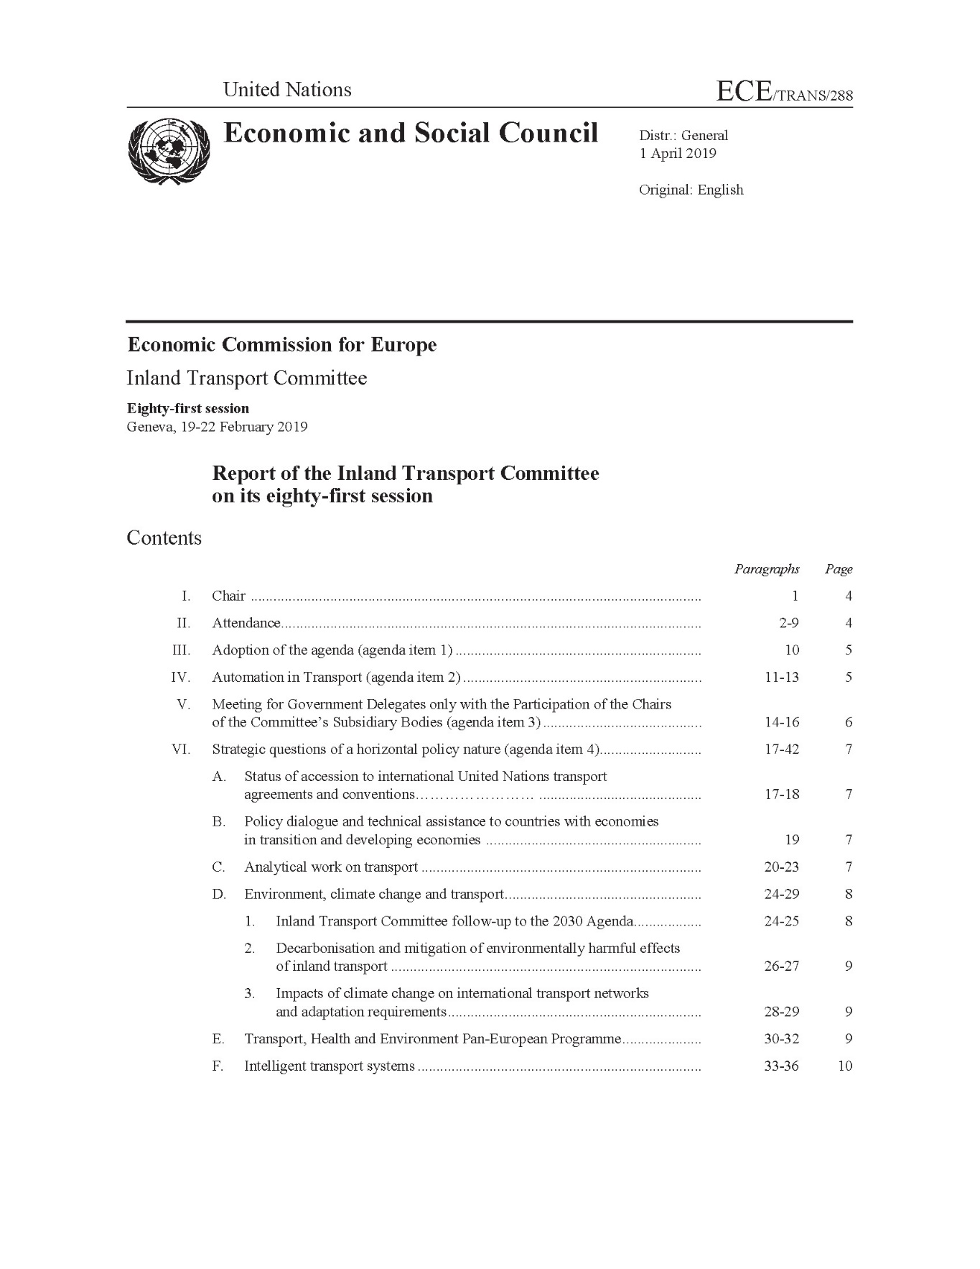
ITC Strategy 2030:
81st ITC Plenary Session: Decisions
INLAND TRANSPORT COMMITTEE

Slide 11
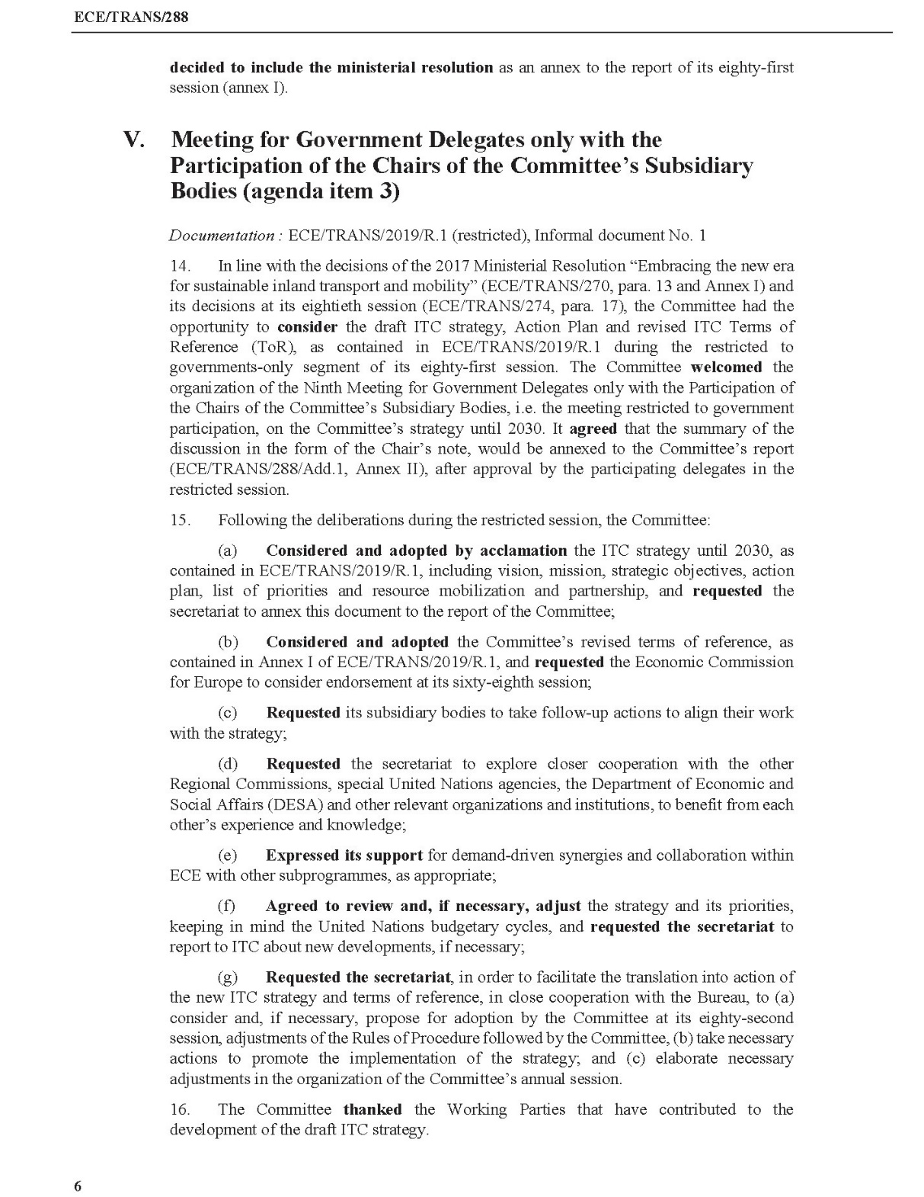
ITC Strategy 2030:
81st ITC Plenary Session: Decisions
INLAND TRANSPORT COMMITTEE
15. (c) Requested its subsidiary bodies to take follow-up actions to align their work with the strategy;
15. (g) (…) Requested the secretariat, in order to facilitate the translation into action of the new ITC strategy and terms of reference, in close cooperation with the Bureau, to (…) (b) take necessary actions to promote the implementation of the strategy; (…)
16. The Committee thanked the Working Parties that have contributed to the development of the draft ITC strategy.

Slide 12
ITC Strategy 2030:
Special priority of global interest: Road Safety
INLAND TRANSPORT COMMITTEE
The ITC and its subsidiary bodies will strengthen their activities related to the United Nations legal instruments on road safety under the purview of the ITC:
to support contracting parties in developing, improving and sustaining their national road safety systems;
to further promote the accession and effective implementation of the United Nations legal instruments;
to support the efforts of the United Nations Secretary General’s Special Envoy for Road Safety in promoting global accession to the United Nations legal instruments; and
to play an effective role as the international regulatory support provided in the United Nations Road Safety Trust Fund Global Framework Plan of Action for Road Safety

Slide 13
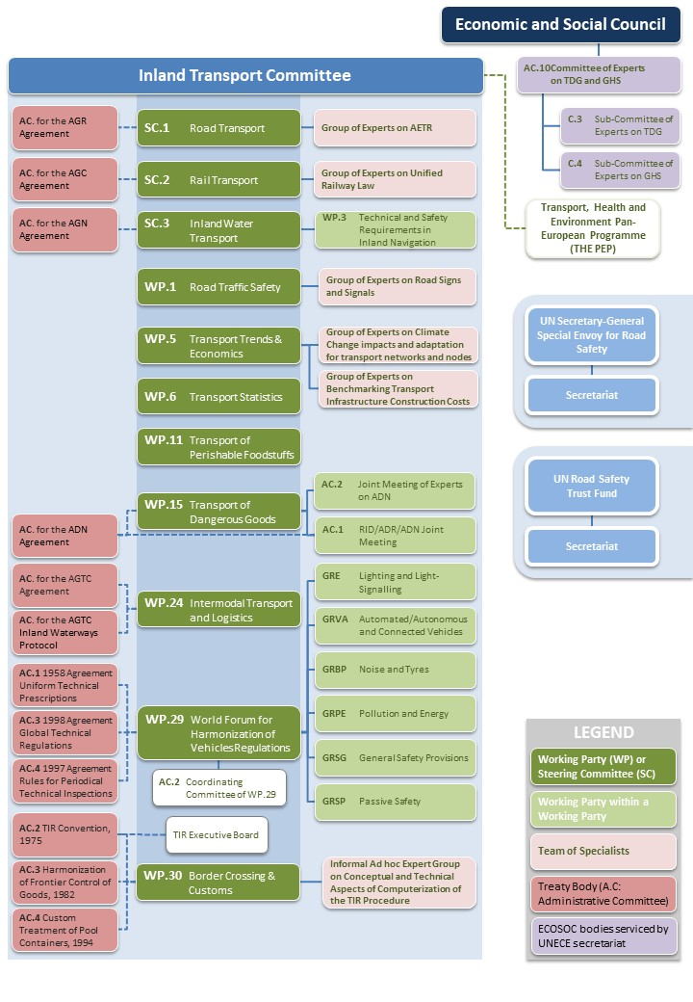


Our structure – How we work
INLAND TRANSPORT COMMITTEE

Slide 14
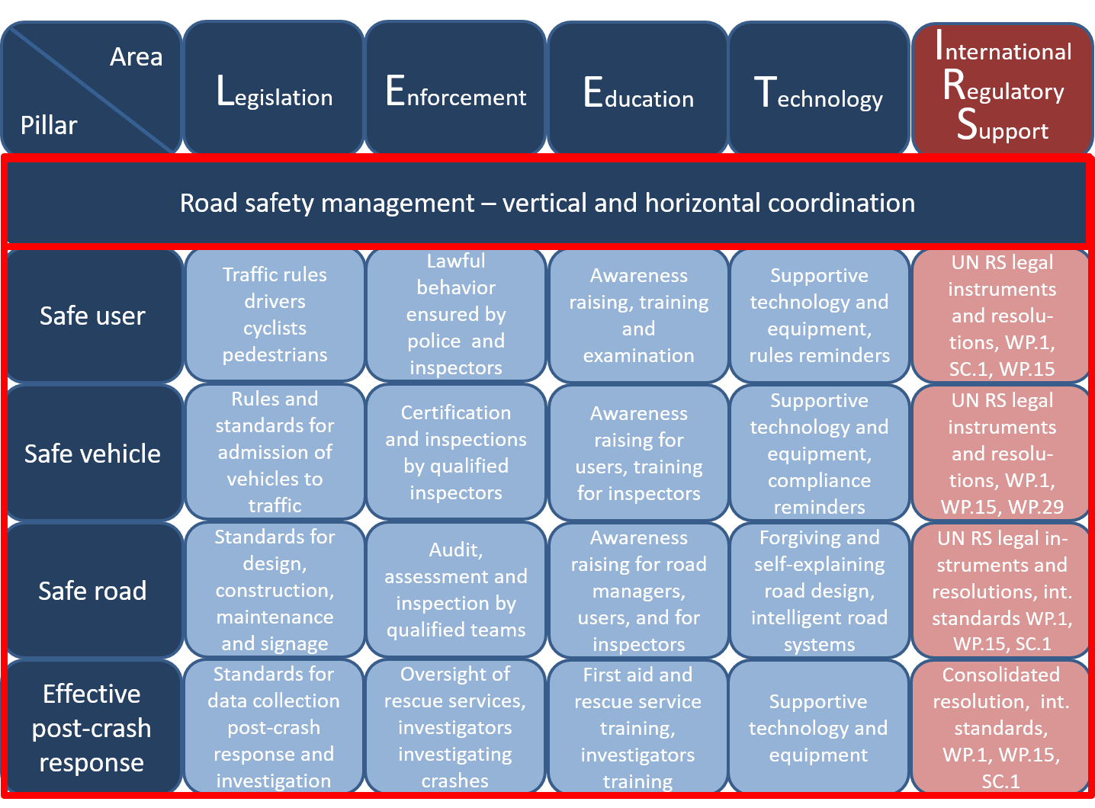
Draft ITC Recommendations for enhancing National Road Safety Systems
INLAND TRANSPORT COMMITTEE
Overview of a national road safety system
Evolves from:
The Global Framework Plan of Action for Road Safety
The Global Plan for the Decade of Action for Road Safety
Contains: five pillars for road safety as the essential blocks
for creating sound national road safety systems
Foundation: safe system approach
Is specific on (interconnected) actions across areas to be
taken by different actors
Covers any action necessary for attaining the 12 road
safety performance targets
Sustainable Transport and Mobility

Slide 15

Draft ITC Recommendations for enhancing National Road Safety Systems
INLAND TRANSPORT COMMITTEE
Overview of a national road safety system
Evolves from:
The Global Framework Plan of Action for Road Safety
The Global Plan for the Decade of Action for Road Safety
Contains: five pillars for road safety as the essential blocks
for creating sound national road safety systems
Foundation: safe system approach
Is specific on (interconnected) actions across areas to be
taken by different actors
Covers any action necessary for attaining the 12 road
safety performance targets
Sustainable Transport and Mobility

Slide 16
Draft ITC Recommendations for enhancing National Road Safety Systems
INLAND TRANSPORT COMMITTEE
Area
Pillar
Legislation
Actions - Legislation
Safe vehicle
Rules and stan-dards for ad-mission of vehi-cles to traffic
Sustainable Transport and Mobility

Slide 17
Draft ITC Recommendations for enhancing National Road Safety Systems
INLAND TRANSPORT COMMITTEE
Actions - Enforcement
Area
Pillar
Enforcement
Safe vehicle
Certification and inspections by qualified inspectors
Sustainable Transport and Mobility

Slide 18
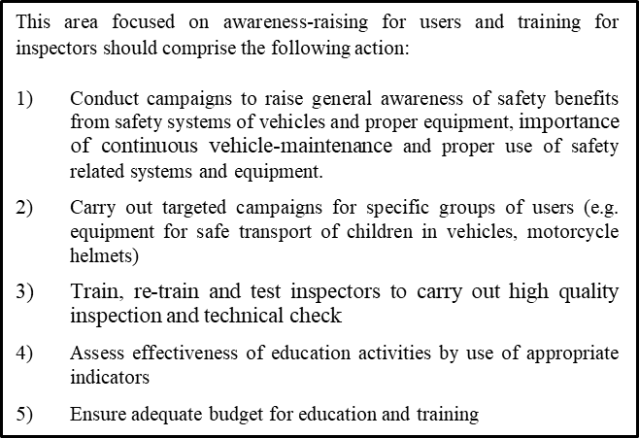
Draft ITC Recommendations for enhancing National Road Safety Systems
INLAND TRANSPORT COMMITTEE
Actions - Education
Area
Pillar
Education
Safe vehicle
Awareness-raising for users, training for inspectors
Sustainable Transport and Mobility

Slide 19
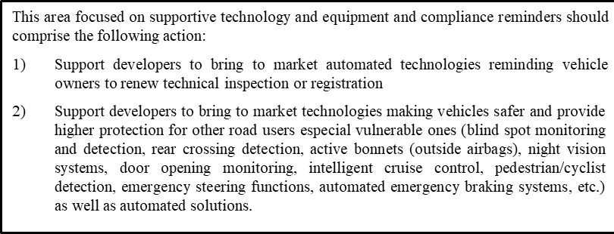
Draft ITC Recommendations for enhancing National Road Safety Systems
INLAND TRANSPORT COMMITTEE
Actions - Technology
Area
Pillar
Technology
Safe vehicle
Supportive tech-nology and equ-ipment, compli-ance reminders

Slide 20
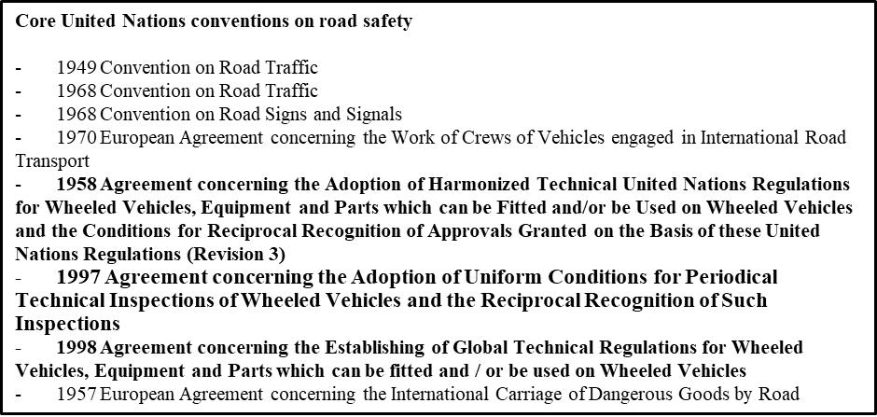
Draft ITC Recommendations for enhancing National Road Safety Systems
INLAND TRANSPORT COMMITTEE
Actions - International regulatory support
Area
Pillar
International Regulatory Support
Safe vehicle
UN RS legal instruments and resolutions, WP.1, WP.29
Sustainable Transport and Mobility

Slide 21
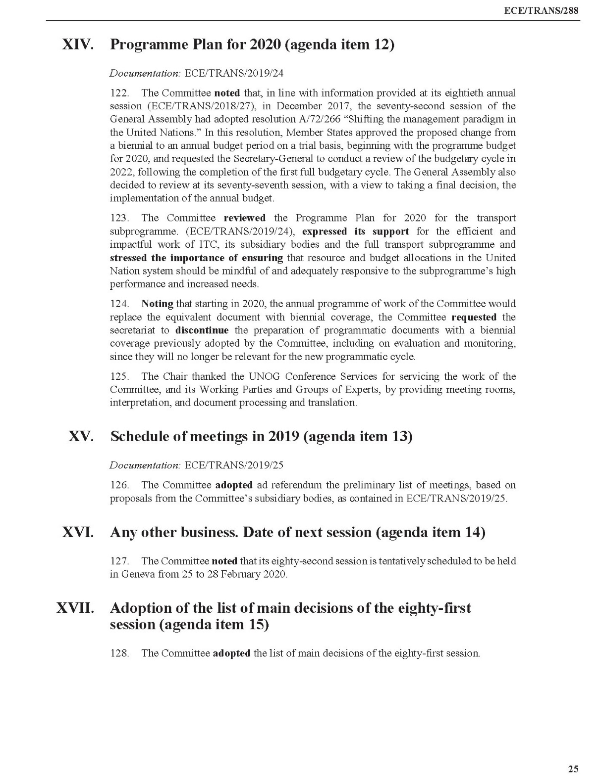
ITC Strategy 2030:
81st ITC Plenary Session: Decisions
INLAND TRANSPORT COMMITTEE
124. Noting that starting in 2020, the annual programme of work of the Committee would replace the equivalent document with biennial coverage, the Committee requested the secretariat to discontinue the preparation of programmatic documents with a biennial coverage previously adopted by the Committee, including on evaluation and monitoring, since they will no longer be relevant for the new programmatic cycle.

Slide 22

INLAND TRANSPORT COMMITTEE
Thank you!

