Slide 1
Submitted by the expert from Poland
Informal document GRE-81-16
(81st GRE, 15–18 April 2019,
agenda item 4)
BOX JUSTIFICATION
for GRE-81-13
Poland
15 April 2019

Slide 2
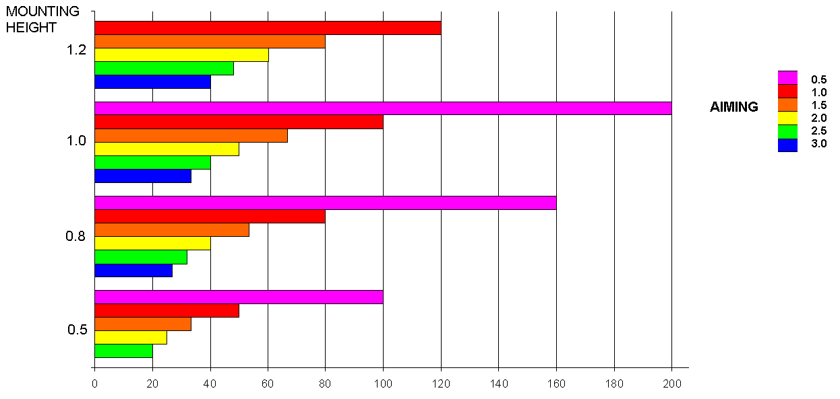
Road illumination distance in present Reg. 48
GRE-65-30

Slide 3
Road illumination distance proposed in
ECE/TRANS/WP.29/ GRE/2019/3
>250m
(restricted by intensity to 75...150 m)
GRE/2019/3
28m

Slide 4
Detection distance for different kind of headlamps
(20m – 100 m)
GTB
Glare and Visibility Forum, Geneva,
22 October 2018
J. Kobbert, K. Kosmas, T. Khanh

Slide 5
PEDESTRIAN FATALITIES IN RELATION TO
MONTH AND DAY HOUR
GTB
Glare and Visibility Forum, Geneva,
22 October 2018
M. J. Flannagan
UMTRI

Slide 6
DARKNESS HAS VERY DIFFERENT EFFECTS
BY CRASH TYPE
For fatal crashes, darkness increases risk by factors of:
- Two-vehicle 1.33
Road departure 0.99
Pedestrian 4.14
Animal 4.60
GTB
Glare and Visibility Forum, Geneva,
22 October 2018
M. J. Flannagan
UMTRI

Slide 7
ACCIDENTS WITH PEDESTRIAN WITHIN ONE HOUR BEFORE AND AFTER SUNSET OUTSIDE BUILT-UP AREAS
NEARLY THE SAME CLOCK HOURS (16:00-17:30 DEPENDING ON GEOGRAPHIC CO-ORDINATES)
Poland
2013
-
2017
7 DAYS BEFORE AND AFTER CHANGING TIME FROM SUMMER TO WINTER
8% ACCIDENTS „BEFORE”
92% ACCIDENTS „AFTER”
FOR PEDESTRIAN ACCIDENTS IN DARK RISK INCREASED BY FACTOR OF 12

Slide 8
NO RESPONSE FROM MANUFACTURERS SIDE FOR QUESTION REGARDING REQUEST FOR 1,6% AIMING RANGE (VGL-10-06)
(STATIC) AUTOMATIC LEVELLING DEVICES FOR MANY USED SYSTEMS CAN CONTROL LEVELLING BETTER THAN POSSIBLE TO MEASURE
STILL POSSIBLE TO USE MANUAL LEVELLING DEVICE

Slide 9
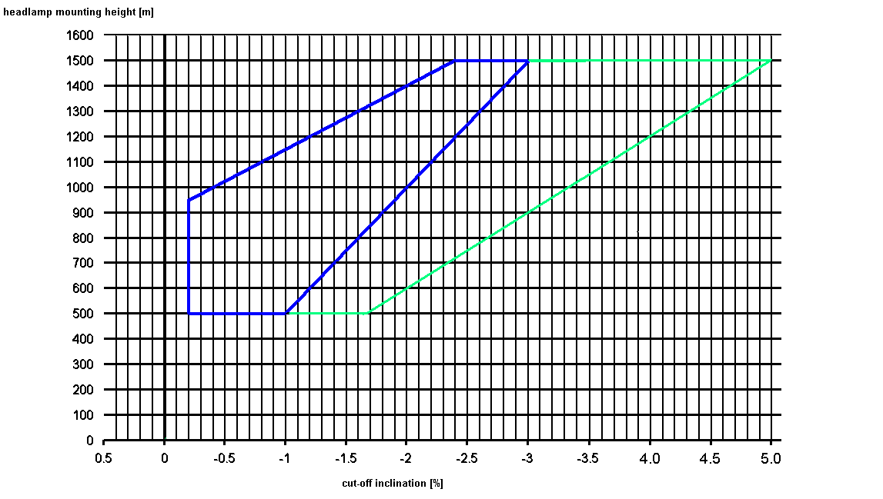
PROPOSAL
The same glare
restriction
beyond
25 m
[ Min 30 m for special
(restricted speed) vehicle ]
Min 50m road illumination distance for normal vehicle

Slide 10
Thank you for attention

