Slide 1
Transmitted by Poland
Informal document GRE-81-22
(81st GRE, 15-18 April 2019,
agenda item 4)
Simplification of the UN Lighting and Light-signalling Regulations
Poland - response to request SLR for advice

Slide 2
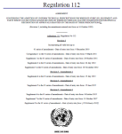
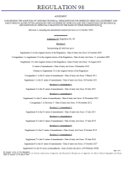
WP.29/2018/158/Rev.1
YESTERDAY
TODAY (RID “Stage 1”)
TOMORROW (RID “Stage 2”)
R112 Class A
Class B
Class AR
Class BR
R98 Class DC
Class DR
R123 Class C
Class E
Class V
Class W
Class XR
ADB
R113 Class AS
Class BS
Class CS
Class DS
Class ES
Class R-BS
Class R-CS
Class R- DS
Class R- ES
R19 Class B- F3
R119 Class K
Class A
Class B
Class AR
Class BR
Class DC
Class DR
Class C
Class E
Class V
Class W
Class XR
ADB
Class AS
Class BS
Class CS
Class DS
Class ES
Class R-BS
Class R-CS
Class R- DS
Class R- ES
Class F3
Class K
Basic /”C” Passing beam
Low speed /”V” Passing beam
Motorway/”E” Passing beam
Adverse weather passing beam
Basic Driving beam
Low speed Driving beam
ADB
AS, BS for mopeds
CS DS for motorbikes (>< 11 kW /125 cm³)
Secondary driving beams (>< 11 kW /125 cm³)
Auxiliary driving beam
Fog beam
Cornering beam
…
6 Regulations
24 Beam patterns
1 Regulation
16 Beam patterns
TC4-45 SAE J2829
Expertise of Optical engineers
1 Regulation
23 Beam patterns

Slide 3
Poland advice RID
Clear justification needed why it is still needed 16 beam patterns ?
Basic (passing beam) – what does „Basic” mean? What is max. speed for basic?
Low speed - which speed? Why?
Motorway – is Basic sufficient for motorway or not?
Should be Basic forbidden for motorway driving?

Slide 4
Poland advice RID
Adverse weather passing beam – is the Basic passing beam sufficient during adverse weather?
If yes – anything more than Basic is not needed
(up to manufacturer – no need to regulate).
If not - will be Adverse weather mandatory for performance based RID ?
Is Fog lamp = Adverse weather?
If not who and how will decide regarding use of Adverse weather?

Slide 5
Poland advice RID
Basic Driving beam
What is the difference for safety between Basic passing beam and Driving beam?
(Is Basic passing beam sufficient for safety?
If not the other performance based solution is needed)
Is the need to regulate driving beam?
(Cancel glare restriction only ?)
Low speed Driving beam – is Basic or Low speed passing beam insufficient ?

Slide 6
Poland advice RID
ADB - if Basic passing beam is sufficient than is no need to define ADB – it can be industry standard and have to meet Basic passing beam only. If not the new attempt to safety/performance headlighting needed
AS, BS for mopeds? - Why low speed Passing is insufficient?

Slide 7
Poland advice RID
Secondary driving beams (>< 11 kW /125 cm3) – What is the purpose?
Is the Basic passing beam (or Basic driving beam???) insufficient?
Auxiliary driving beam – as above.
Cornering beam - OK

Slide 8
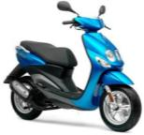
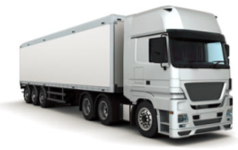
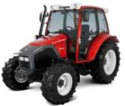
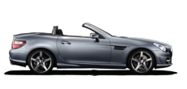
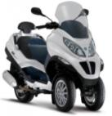
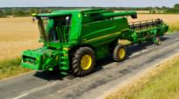
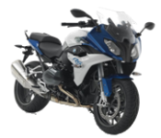
Installation requirements after SLR step 1 Regulation RID
AS
BS, R-BS
CS, R-CS
DS, R-DS
ES, R-ES
A, AR
B, BR
CS, R-CS
DS, R-DS
ES, R-ES
Class B, BR
Class DC, DR
F3
R74
Class B, BR
Class DC, DR
Class C
Class E
Class V
Class W
Class XR
ADB
Class F3
Class K
Class A, AR
Class B, BR
Class DC, DR
Class AS
Class BS, R-BS
Class CS, R-CS
Class DS, R-DS
Class ES, R-ES
Class F3
Class K
< 50 Km / h
R53
R48
R86
<125 cm³
2 x CS, 2 x R-CS
DS, R-DS
ES, R-ES
A, AR
B, BR
DC, DR
F3
GREEN colour means «optional»
BLACK colour means «mandatory»
Should the beam requirements be based on the category of the vehicle?
>125 cm³

Slide 9
Poland advice RID
We don’t see the need to generate design based special beams for two-wheelers, tractors, machinery, etc.
The performance oriented is visibility distance and width directly connected with speed and stopping distance + effective protection against glare

Slide 10
Poland advice RID
There are needed:
1. Basic beam
1A. Low (which?) speed – preferred max. speed assigned to Basic type approval
2. Adverse weather or fog ?? – if Basic is not sufficient.
3. Cornering as supporting comfort
The rest RID should meet Basic or Low speed.
If not sufficient more safety details needed.

Slide 11
GRE advice needed (1/3)
Is it OK to continue having the headlamp provisions expressed on the basis of luminous intensities equivalent to illuminance measured on screen at a distance of 25m?

Slide 12
Poland advice (1/3)
Is it is incorrectly stated question (OK or NOT OK).
Provisions should be adequate to performance for road illumination and glare exposed eyes area – not for the screen.
For testing it is possible to use equivalent co-ordinate system – e.g. goniometer angular and intensities. There is no problem to recalculate.

Slide 13
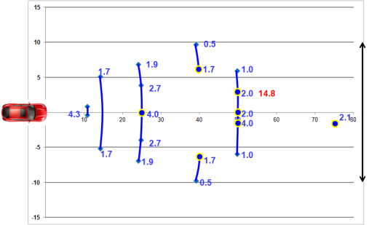
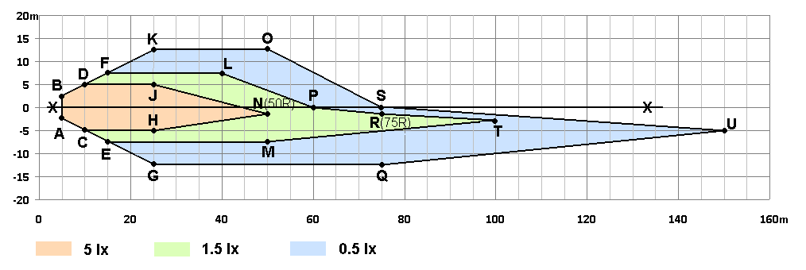
Poland questions to SLR (or GTB?)
idea for RID
(expressed in SLR 28-02)

Slide 14
Poland questions to SLR (or GTB?)
idea for RID
Clear and detailed justification to each proposed value is expected
Regarding performance, what does 1.7 lx mean and why it differs from 1.9 lx or 2.0 lx or 1.0 lx or 0.5 lx or 4.0 lx etc?
Doubt about the distances and widths chosen e.g. why only outside for 40 m etc.
Why is the required value in point 75R is increased by 20%?
What does this mean for performance (increase distance or other values in relation to safety)?

Slide 15
Poland questions to SLR (or GTB?)
idea for RID
Doubt regarding holes in illumination requirements.
Are holes in light distribution alowed?

Slide 16
Poland questions to SLR idea of RID
Should the true performance requirements with higher expectations than today be met by all present technologies?
Does the proposal restrict any existing headlamp design which are today legal ?

Slide 17
Poland advice to SLR idea of RID
New attempt for glare suggested. Allow to vertical non-uniform intensity instead of fixed value for glare zone.
Intensity may decrease with increasing vertical angle (higher above cut-off than today)
No reasons for preserving screen points and segments philosophy directly taken from the historical requirements based on parabolic design.

Slide 18
THANK YOU FOR ATTENTION

