Slide 1
Transmitted by the experts from The International Automotive Lighting and Light Signalling Expert Group (GTB)
Informal document GRE-81-23
(81st GRE, 15-18 April 2019,
agenda item 10)
GTB activity report
for the 81st GRE session
G T B
The International Automotive Lighting
and Light Signalling Expert Group
Groupe de Travail “Bruxelles 1952”

Slide 2
Main working areas
  Stage 2 Simplification:
  - Support SLR and harmonisation with Chinese simplification of GB Standards.
  AV Signalling:
  - Support the GRE TF on Autonomous Vehicle Signalling Requirements (AVSR)
  - Consideration of the next steps in signalling and communication
  New Lighting functions:
  - Development of provisions for light projections on the road
  - Research Studies on New Functionalities in Automotive Lighting
  LEDs retrofit:
  - Support the GRE TF on Substitutes/Retrofits (TF S/R)
  - Consideration to have general requirements for new innovative Light Sources
  Various:
  - Consideration of sensors related to lighting and visibility functions (e.g. camera, LIDAR, radar, etc.), their integration in Headlamp/Rear Lamps and cleaning
  - Support SAE for NHTSA ADB NPRM requirements
G T B
The International Automotive Lighting
and Light Signalling Expert Group
Groupe de Travail “Bruxelles 1952”

Slide 3
Focus on Research Studies on
New Functionalities in Automotive Lighting
New Functionalities :
Parking / Deparking indication
Driving through Construction Zones
Projection of symbols as information for driver
Identifier for vehicles running in autonomous mode
Cultural aspects in understanding of symbols used in Car to Pedestrian Communication
G T B
The International Automotive Lighting
and Light Signalling Expert Group
Groupe de Travail “Bruxelles 1952”

Slide 4
Target and Motivation to initiate
and support research studies by GTB
Independent research studies by universities and institutes should investigate if a new function provides safety benefits, is a comfort feature and provides important information to the driver and to other road users.
Such studies shall also investigate whether a new function is disturbing or confusing other road users.
G T B
The International Automotive Lighting
and Light Signalling Expert Group
Groupe de Travail “Bruxelles 1952”

Slide 5
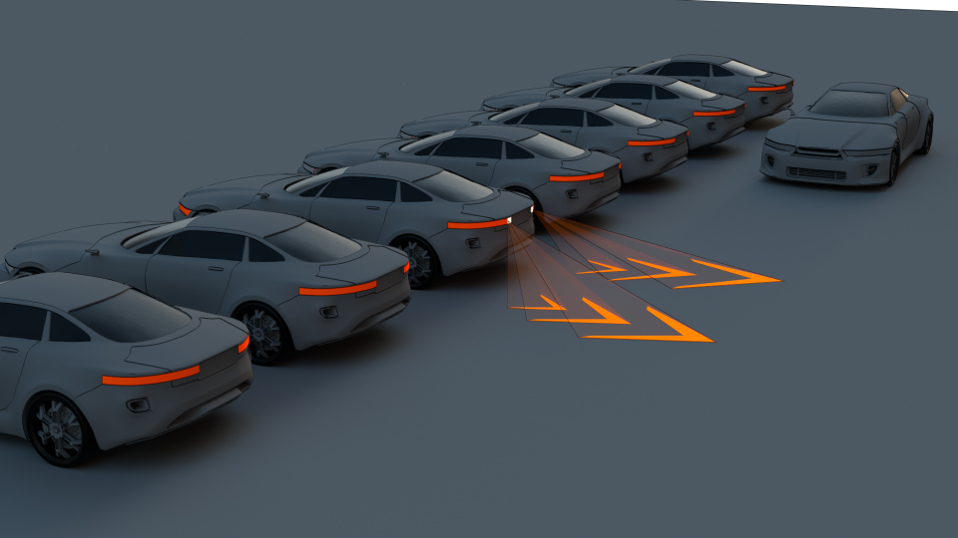
Deparking Rear Light | Indication of the vehicle’s movement direction
G T B
The International Automotive Lighting
and Light Signalling Expert Group
Groupe de Travail “Bruxelles 1952”

Slide 6
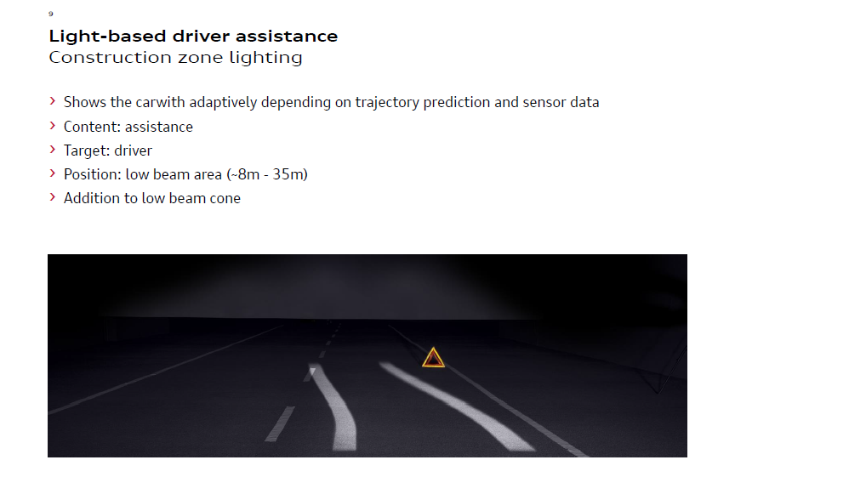
Light-based driver assistance
Construction zone lighting
Projects a trajectory prediction of the car width on the basis of sensor data
Purpose: assistance
Target: driver
Position: passing beam area (8-35 m)
Addition to passing beam
G T B
The International Automotive Lighting
and Light Signalling Expert Group
Groupe de Travail “Bruxelles 1952”

Slide 7
Guidelines in Construction Zone Areas
G T B
The International Automotive Lighting
and Light Signalling Expert Group
Groupe de Travail “Bruxelles 1952”

Slide 8
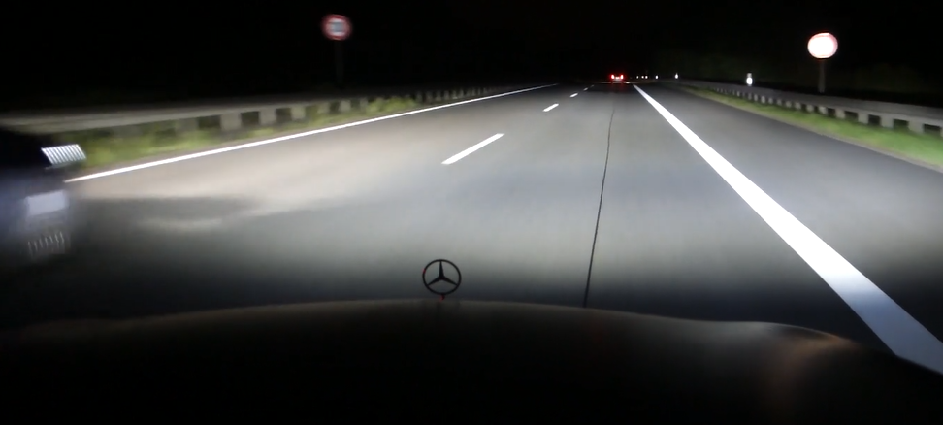

New Functionalities: Snow Flake Projection
Case : Vehicle with high resolution headlights projects a symbol
while overtaking other vehicles
G T B
The International Automotive Lighting
and Light Signalling Expert Group
Groupe de Travail “Bruxelles 1952”

Slide 9
HR (High Resolution) vehicle projecting a snowflake
x
x
HR
x
x
x
x
x
ROI
TP
40 m
H
HR vehicle
Overtaking @ 100 km/h
Random order
    Snowflake
    Guiding lines
    Construction site
    Low beam
TP(Test Person) vehicle
  Subject driving
  Following H
  Gaze behavior
  Fixations in ROI
  Test instructor
H (Hare) vehicle
  Preceding
  Constant speed 80 km/h
G T B
The International Automotive Lighting
and Light Signalling Expert Group
Groupe de Travail “Bruxelles 1952”

Slide 10
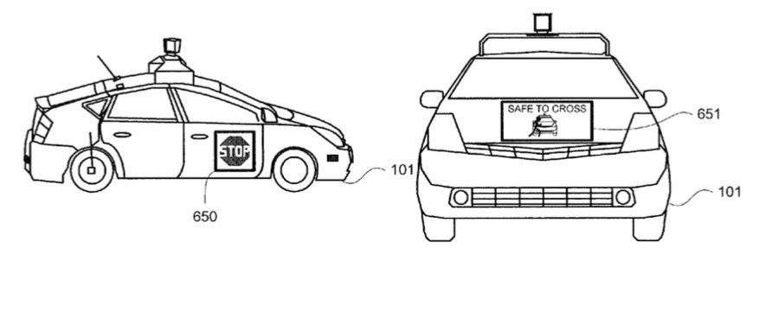
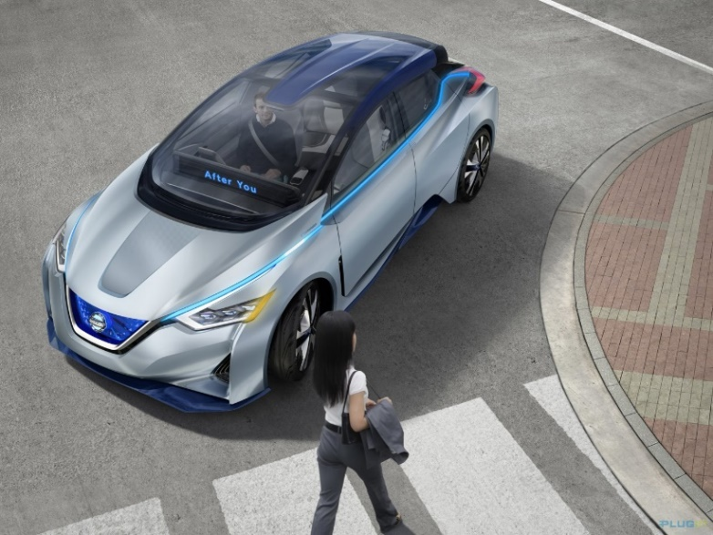
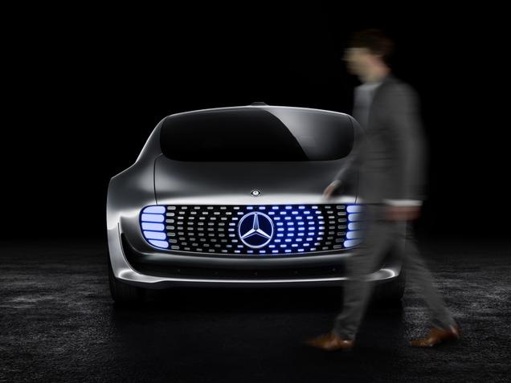
How to identify and inform the other traffic participants on the autonomous driving mode?
The technology of autonomous driving cars is rapidly developing.
The first cars will soon be on the road.
A visual communication using light signalling between the vehicle in autonomous mode and the other road users has to be defined
G T B
The International Automotive Lighting
and Light Signalling Expert Group
Groupe de Travail “Bruxelles 1952”
10

Slide 11
Cultural Aspects in Communication
Car to Pedestrian using Symbols
Research Tests in Europe, Japan, China, South Korea, USA
G T B
The International Automotive Lighting
and Light Signalling Expert Group
Groupe de Travail “Bruxelles 1952”

Slide 12
Timing and Outlook
Research Studies will be completed in July 2019
Results will be published
Further studies are in preparation
G T B
The International Automotive Lighting
and Light Signalling Expert Group
Groupe de Travail “Bruxelles 1952”

