Slide 1
H11 Substitute – interlock solution Fit & function / Fit & non-function by the “Electrical key-system”
Transmitted by the experts from IEC
Informal document GRE-82-12
(82nd GRE, 22-25 October 2019, agenda Item 5)
(Based on TFSR-06-03)
Cor Versluijs, Walter Schlager, Philipp Plathner
20 September 2019
This document visualizes the interlock solution for the category H11/LED proposed in the document GRE/2019/21

Slide 2
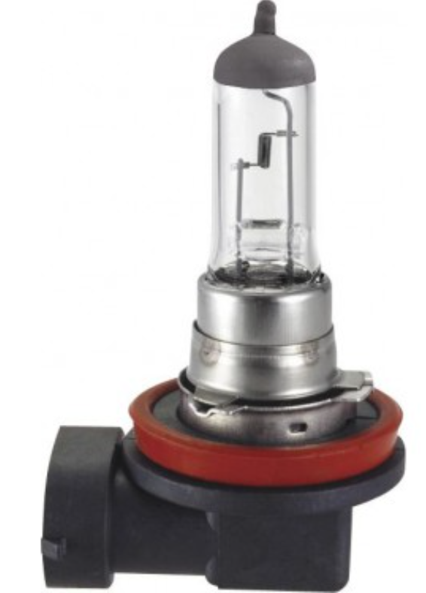
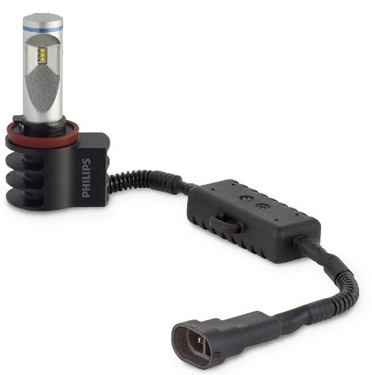
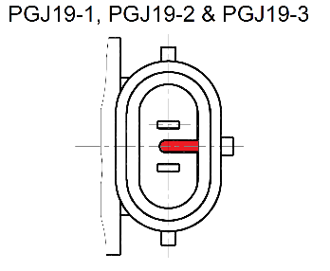
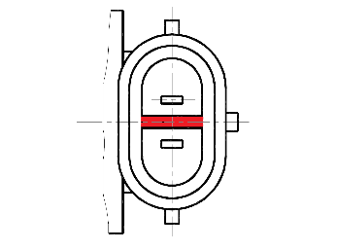
Electrical key “details cap/connector”
Source
H11 (traditional)
H11/LED (substitute)
For
illustration
only
C5W
Connector
Key-element
Holder
Connector
Key-element
C5W/LED
H11 uses cap-holder system PGJ19-2
H11/LED uses cap-holder system PGJX19-2

Slide 3
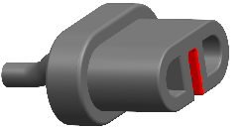
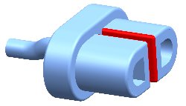
Electrical key “details holder / connector”
Source
C5W (traditional)
C5W/LED (substitute)
Connector (keyed)
H11
Holder
Connector (keyed)
H11/LED
H11 uses cap-holder system PGJ19-2
H11/LED uses cap-holder system PGJX19-2

Slide 4
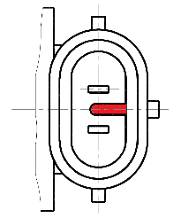
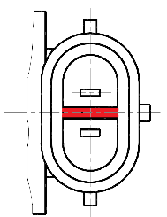
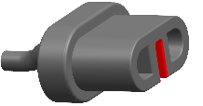
Interlock: ”operation / non-operation”
Source
H11 (traditional)
H11/LED (substitute)
For
illustration
only
H11
will not light-up (male and female connectors do no match)
Holder
male fits female connector
For
illustration
only
H11/LED
male fits female connector
male fits female connector
H11 uses cap-holder system PGJ19-2
H11/LED uses cap-holder system PGJX19-2

