Slide 1
Informal document GRPE-79-13
79th GRPE, 21-24 May 2019
Agenda item 7

Slide 2
79th UNECE GRPE session
PMP IWG Progress Report
Informal document GRPE-79-13
79th GRPE, 21-24 May 2019
Agenda item 7
Geneva, 21th -24th May 2019
UNITED NATIONS

Slide 3
PMP meetings in 2018
2019-01-10: PMP 49th (GRPE Geneva summary)
2019-02-26 Webconference
2019-04-03/04: PMP 50th (Brussels)
NEXT F-2-F MEETING: PMP 51st 29th – 30th October 2019 (Location: JRC Ispra - tbc)

Slide 4
EXHAUST PARTICLE EMISSIONS

Slide 5
Main activities
Sub-23nm
PN-PEMs 10 nm
Raw exhaust sampling
Round Robin PNC (Particle Number Counter)
Horizon 2020 projects
Particle emissions from gas engines
WLTP low temperature PN testing
Effect of fuel on PN

Slide 6
Sub23 nm
In the 49th PMP meeting held on the 10th January 2019 the European Commission asked to finalize the work on the sub-23 nm particle measurement by developing a test procedure by June 2020 in view of the post-Euro 6/VI standards
In the 50th PMP meeting the following main points have been addressed:
  Adaptated or optimized system ?
  Evaporation tube or catalytic stripper?
  PN-system calibration material/generation method
  CPC counting efficiency
  It has been decided, also on the basis of the available data, that the best option is to adapt the current methodology.
  A few points are still open and need additional data/discussion

Slide 7
Sub23 nm
  A working document has been prepared with the current text of the test procedure as laid down in GTR n.15 and proposed modifications
  The document has been circulated to the members of the group asking for inputs/comments by end of May
  The JRC will collect the inputs and prepare a summary that will be discussed in a next webconference

Slide 8
Sub23 nm Round Robin
Main purpose: Monitoring particle emissions of new engine/after-treatment technologies.
Assessment of the repeatability/reproducibility of the proposed particle counting methodology by means of a “round robin”.
Two systems with CS and 10nm CPC were circulated
Each lab PMP system plus a 10nm CPC (was circulated)
One golden vehicle (Opel Astra GDI – no GPF)
  The PMP group would have preferred 6d technology for the golden vehicle, this was not available in the program timing and will need investigation later
7 EU labs completed. Extension to China / Japan from June 2019

Slide 9
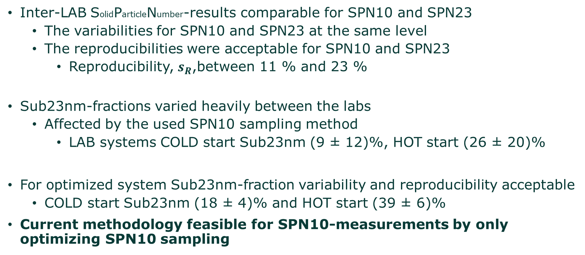
Sub23 nm Round Robin
Inter-LAB SolidParticleNumber-results comparable for SPN10 and SPN23
  The variabilities for SPN10 and SPN23 at the same level
  The reproducibilities were acceptable for SPN10 and SPN23
    Reproducibility, $s_{R}$,between 11 % and 23 %
Sub23nm-fractions varied heavily between the labs
  Affected by the used SPN10 sampling method
    LAB systems COLD start Sub23nm (9 ± 12)%, HOT start (26 ± 20)%
For optimized system Sub23nm-fraction variability and reproducibility acceptable
  COLD start Sub23nm (18 ± 4)% and HOT start (39 ± 6)%
Current methodology feasible for SPN10-measurements by only optimizing SPN10 sampling

Slide 10
Extension of methodology to PN-PEMS
Based on laboratory PMP systems penetrations, the PN-PEMS penetrations will be defined
Newly adjusted PN-PEMS systems (and calibrated) will be tested at JRC at the end of the year
Instrument manufacturers have already confirmed that such systems are ready
The 50% margin has to be re-tested

Slide 11
PN Counting from Raw Exhaust via Fixed Dilution
Objective: Raw exhaust sampling via fixed dilution for type approval of heavy duty engines
The exercise covers:
CNG, DPF regenerations, high bio-fuels
Crankcase (open system) emissions connected to tailpipe
Only calibrated systems (especially 10 nm CPCs)
European timeline from week 41/2018 to week 27/2019 covering 6 OEMS
Extension to China (VECC and CAAM) and USA under consideration

Slide 12
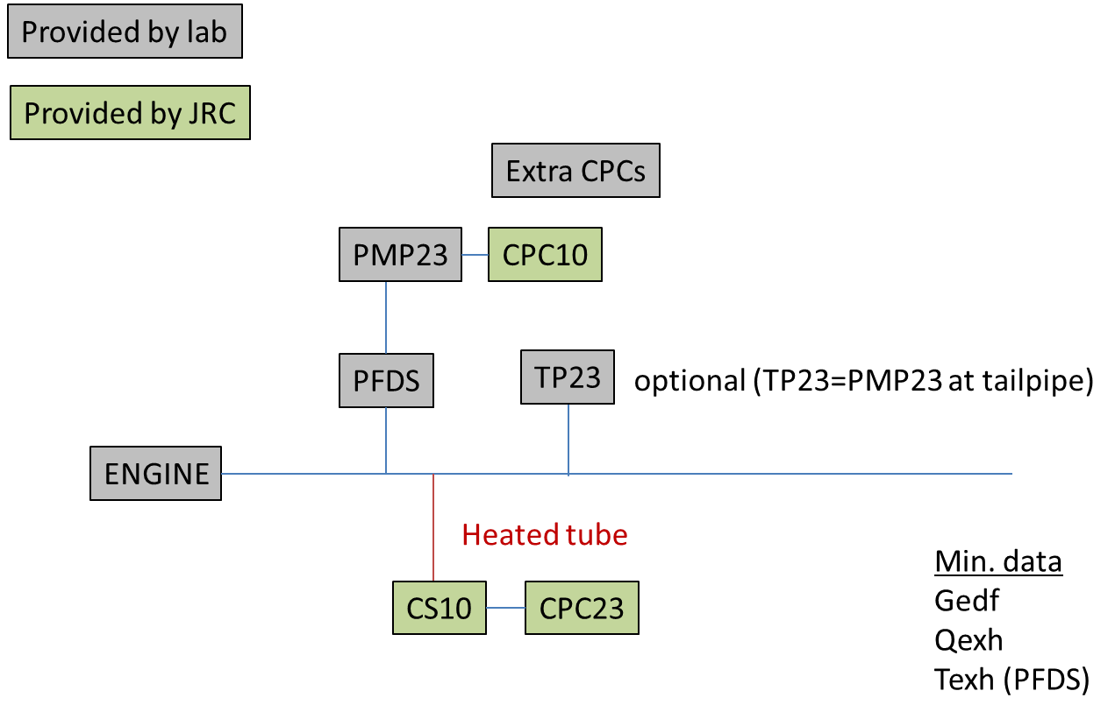
Setup
A well designed experimental programme has been agreed between JRC and ACEA
Objectives:
Assess raw exhaust sampling for type approval
  Uncertainty TP vs CVS or PFDS
  Robustness of TP systems
  Technical specifications
Sub-23 nm
  Support PMP

Slide 13
Next steps
Preliminary results at OEM1 show good results:
  Excellent comparability partial flow – raw exhaust for both 23 and 10 nm CPCs
  No artifacts from crankcase emissions
System with (cold) pre-diluter is also tested at some OEM

Slide 14
NON-EXHAUST PARTICLE EMISSIONS

Slide 15
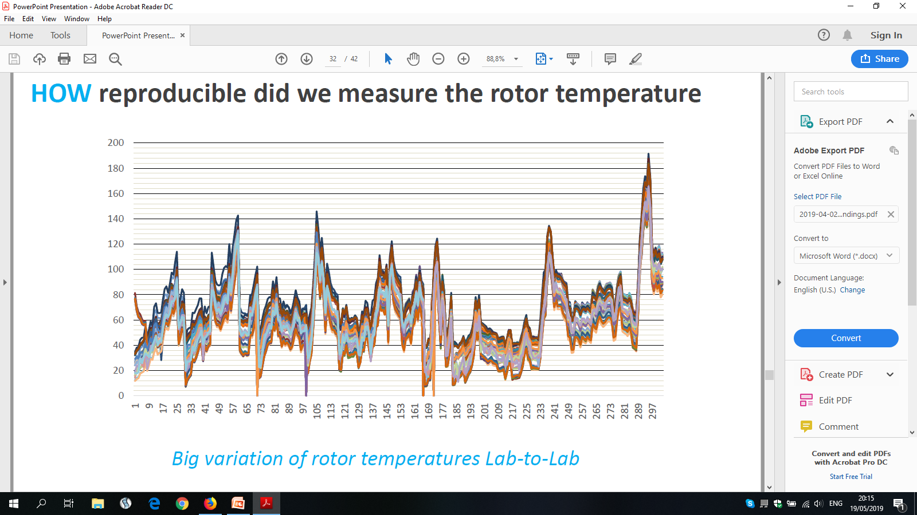
BRAKE PARTICLE EMISSIONS
COMMON METHOD FOR MEASURING BRAKE WEAR PARTICLES
STEP 1 – DEVELOPMENT OF A NEW REAL-WORLD BRAKING CYCLE
The development of the novel cycle has been concluded and the cycle has been evaluated through an extensive Round Robin campaign
The results of the RR were presented to the 50th PMP Meeting and will be released in a report form in the next months
There are some differences in the recorded brake temperatures between the labs mainly due to different air cooling speed adjustment
Lab-to-lab variation of the rotor temperature for all 303 braking events of the cycle

Slide 16
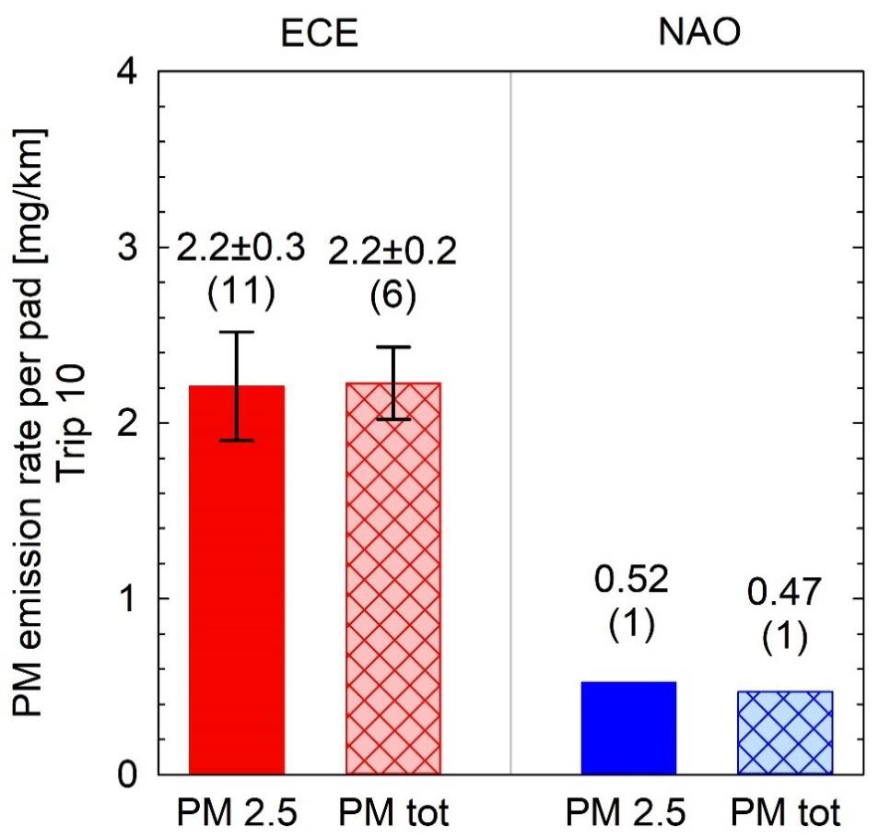
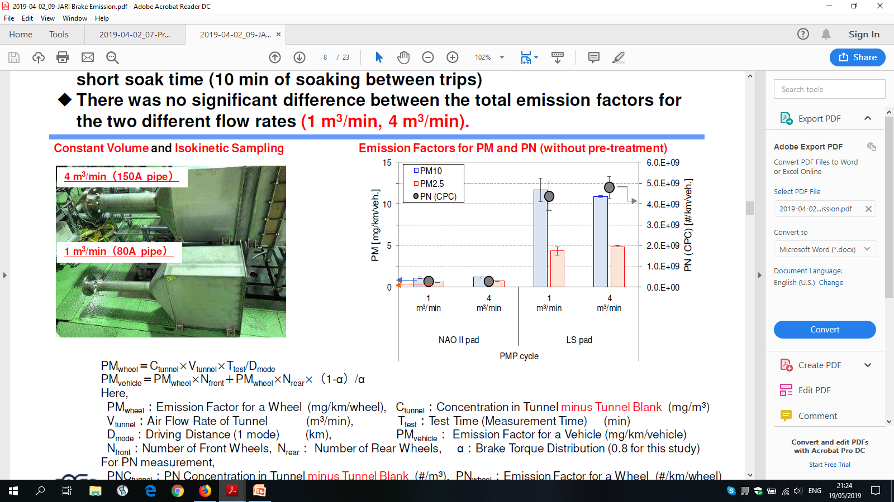
BRAKE PARTICLE EMISSIONS
COMMON METHOD FOR MEASURING BRAKE WEAR PARTICLES
STEP 2 – DEFINITION OF MINIMUM REQUIREMENTS FOR THE EMISSIONS MEASUREMENT
PM₁₀, PM_{2.5} as well as PN brake particle emissions are being investigated within TF2
Results presented to the 50th PMP Meeting suggest different PM emission levels as well as different particle size distributions for different types of pads (NAO vs. Low-Met)
TF2 is currently assessing ¡. the influence of different types of pads on emissions, ¡¡. volatile removal for PN measurement, ¡¡¡. reduction of soak times
Mamakos et al. 2019
50th PMP Meeting
Hagino et al. 2019
50th PMP Meeting
PM and PN brake emissions from different types of pads

Slide 17
TYRE WEAR PARTICLE EMISSIONS
CURRENT STATUS AND FUTURE OUTLOOK
No experimental results were presented to the 50th PMP Meeting. Results from two on-going campaigns had been presented to the 48th PMP Meeting
The EC has mandated the development of a methodology for measuring tyres abrasion rate. DG-GROW will lead this task
After the development of the methodology the PMP could investigate the relationship between tyre wear PM emissions and their abrasion rate
For the time being the PMP will continue monitoring on-going projects and published data regarding the physical nature and size distribution of particle emissions from tyre/road wear

Slide 18
PMP NEXT STEPS

Slide 19
PMP Mandate
Current mandate expires in June 2019
The PMP group has submitted an updated draft version of the ToR (informal document ….) and requests a new mandate with the following main concrete objectives:
  Sub 23 nm exhaust particles:
    Develop by June 2020 a methodology to measure sub-23 nm particle
      Provide robust data for the validation of direct raw exhaust sampling for PN measurement for HD engines
      Development of a suggested common test procedure for sampling and assessing brake wear particles both in terms of mass and number

Slide 20
Non-exhaust PARTICLE EMISSIONS
NEXT STEPS – PROPOSED ToR Brakes and Tyres
Validation of the developed novel test cycle (publication of the report) and application to the investigation of brake wear particle PM and PN emissions
Definition of the minimum requirements for brake wear particles generation, sampling and measurement (TF2 – Possible timeline end of 2019)
Validation of the proposed approach for the measurement and characterization of brake wear particles (Possible Round Robin activity – Possible timeline mid of 2020)
Continue monitoring on-going projects and published data regarding the physical nature and size distribution of particle emissions from tyre/road wear

Slide 21
Any questions?
You can find the PMP leadership team at
Chair : Giorgio Martini - giorgio.martini@ec.europa.eu
Technical Secretary – Rainer rvogt@ford.com

