Slide 1
Transposition of GTR15 (WLTP) and GTR19 (Evap) into UN Regulations Update for GRPE from WLTP Transposition Task Force May 2019
Informal document GRPE-79-19
79th GRPE, 21-24 May 2019
Agenda item 3(b)

Slide 2
Post-78th GRPE Update
WebEx and Face to Face meetings held
Good progress made towards resolving open issues, including:
Reference fuels for Level 2
Ambient Temperature Correction Test
Dual-axis dynamometer requirements
Remaining open issues include, amongst others:
Conformity of Production
Type 5 test (Durability)
Scope of UNR
Coastdown temperature
Type approval documentation
}
Task Forces working actively to develop requirements for regional and top levels

Slide 3
Ongoing and future work plan
Continued working on draft regulatory texts
Texts not yet at a stage to present as separate Informal Documents
Latest drafts have been uploaded to UNECE Transposition wiki page:
https://wiki.unece.org/display/trans/04+-+Drafts+of+Regulatory+Texts+for+79th+GRPE
Task Force meeting planned for 20th June 2019 - drafting
Additional meetings to be arranged before 28th IWG (Sept 2019)
All outstanding items to be resolved before or at the 28th IWG
Final drafting in October 2019.
Submission of Working documents by 21st October.

Slide 4
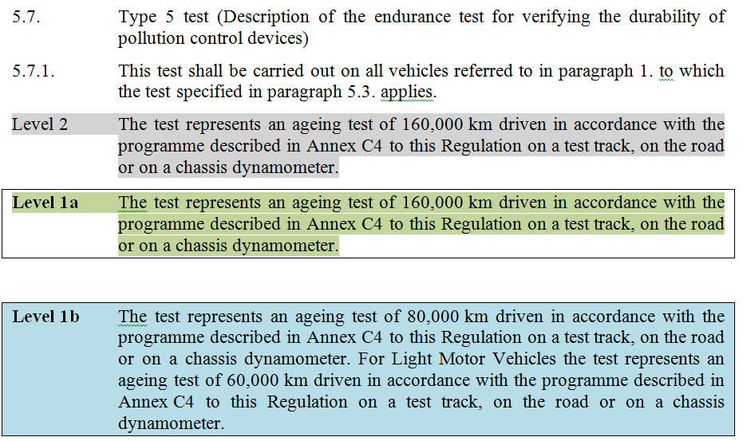
Principle for drafting
Some text common to all levels (no shading in example below)
Level specific text – delete as appropriate for the level being drafted
Example below of draft text to illustrate this concept

Slide 5
The four slides which follow illustrate the principles for how Series of Amendments (SoA) would ‘work’ when the UNR is introduced and then updated at later stages when any ‘major’ changes are made which would trigger the need for a new SoA Information on slides which follow is based on ‘Approach 2’ to transposition, i.e.: SoA 00 = Level 1a and Level 1b SoA 01 = Level 2 Slides only cover ‘major’ changes – not ‘minor’ changes which would be dealt with in the usual way through Amendments/Supplements and Corrigenda (e.g. UNR83 Revision 5 - Amendment 7)

Slide 6
Approach 2 – Introduction of UNR WLTP
6 months + administrative period
6 months + administrative period
Original version of UNR WLTP (L1a/L1b) and its 01 series of amendments (L2) are simultaneously adopted by WP.29/AC.1
Entry into force of 00 series (regional levels 1a and 1b) of UNR WLTP.
… but not yet applicable due to Introductory Provisions*
Entry into force of 01 series (top Level 2) of UNR WLTP.
Subject to mutual recognition
00 series now applicable
* The original version of the Regulation could contain introductory provisions as was the case for UNRs 116 and 117
e.g. “As from the date of entry into force of this Regulation, Contracting Parties shall not grant type approvals according to this Regulation until [the date of entry into force of the 01 series of amendments].” [Source: GRPE-73-26]
Discussion point
Could there be a situation where ‘Special provisions’ are needed in order to allow approvals to be granted to regional level before top level is in force?

Slide 7
Approach 2 – Principle for introducing a major amendment to L1a &/or L1b and also to L2
6 months + administrative period
6 months + administrative period
02 series of UNR WLTP (L1a/L1b) and 03 series of amendments (L2) are simultaneously adopted by WP.29/AC.1
Entry into force of 02 series (regional levels 1a and 1b) of UNR WLTP.
… but not yet applicable due to Introductory Provisions
Entry into force of 03 series (top Level 2) of UNR WLTP.
Subject to mutual recognition
02 series now applicable
00 series
Regional levels 1a and 1b
01 series
Top Level 2
02 series
Regional levels 1a and 1b
03 series
Top Level 2
04 series
Regional levels 1a and 1b
05 series
Top Level 2
Originals
1st round of amendments
(as shown in top diagram)
2nd round of amendments
Example – if a new test is added to either of L1a and L1b, or both, and also to L2.

Slide 8
Approach 2 – Principle for introducing a major amendment to L2 only
6 months + administrative period
02 series of UNR WLTP (L2) is adopted by WP.29/AC.1
Entry into force of 02 series (Level 2) of UNR WLTP.
Subject to mutual recognition
00 series
Regional levels 1a and 1b
01 series
Top Level 2
00 series
Regional levels 1a and 1b
02 series
Top Level 2
Originals
1st round of amendments
No change

Slide 9
Approach 2 – Principle for introducing a major amendment to L1 only
6 months + administrative period
02 series of UNR WLTP (L2) is adopted by WP.29/AC.1
Entry into force of 02 series (Level 2) of UNR WLTP.
Subject to mutual recognition
00 series
Regional levels 1a and 1b
01 series
Top Level 2
02 series
Regional levels 1a and 1b
03 series
Top Level 2
Originals
1st round of amendments
No change in content but new series created so that L2 remains the most recent SoA

Slide 10
Working Documents for 80th GRPE
UNR WLTP 00 Series
Level 1a (Europe regional option)
Level 1b (Japan regional option)
UNR WLTP 01 Series
Level 2 (Top level requiring mutual recognition)
UNR 83 08 Series
Will require a demonstration of approval to UNR WLTP so that the Type 1, Type 4 and Type 5 are covered
RDE will now be in a separate ‘UNR RDE’ and not UNR 83 08 series

Slide 11
Thank you for your attention
Questions?
Contact information
Rob Gardner, TRL Ltd on behalf of the European Commission (Task Force Leader)
rgardner@trl.co.uk

