Slide 1
Update from RDE IWG GRPE May 2019 From the sponsors: European Union Japan Korea
Informal document GRPE-79-20-Rev.1
79th GRPE, 21-24 May 2019
Agenda item 3(c)

Slide 2
Background
During GRPE meeting in June 2018, EU, Japan and Korea requested the creation of an RDE IWG and the proposal was accepted.
Creation of RDE IWG accepted by AC.3 in its June 2018 meeting

Slide 3
Meetings
The group met already on:
11-12 September 2018 in Brussels
27-28 November 2018 in Brussels
9 January 2019 in Geneva
1-2 April 2019 in Tokyo
22 May 2019 in Geneva
And planned next meeting for 9-10 July 2019 in Vienna and in 30-31 October in Seoul.

Slide 4
4th Meeting
Presentation by JRC on key factors, key parameters and set of boundary conditions that characterize the European RDE package 4, RDE monitoring exercise conducted by the JRC and EMROAD basic principles.
OICA presentation on Cumulative Positive Altitude Gain
JRC presentation on Data collection

Slide 5
4th Meeting
US EPA presentation on principles to develop Light-Duty RDE for US
India presentation on on-going RDE activities in India
RDE GTR draft review

Slide 6
5th Meeting
Presentation by China on RDE legislation in China and future activities
Presentation by US EPA on Comparison between test cycles
JRC presentation on Data collection
Review of definitions
Review of Korea proposal on city driving

Slide 7
Detailed task list-1
Driving and emission data collection: 1 June 2019
Evaluation of Temperature and Altitude boundaries using regional needs: first delivery by 1 April 2019 meeting in Tokyo Ongoing
Evaluation of cumulative altitude gain: 1 April 2019 DONE
Introduction of certification lab cycles other than WLTP (FTP, MIDC,…): first delivery on 1 October 2019, final delivery end 2019 FIRST PRESENTATION by US on 5th meeting

Slide 8
RDE Boundary Conditions Cumulative Positive Altitude Gain
$$cpAG=cumulative positive altitude gain$$
Moderate road gradients
$$cpAG=\frac{500 m}{100 km}$$
End
Start
± 100 m
Occasionally high gradients
Start
$$cpAG=\frac{1000 m}{100 km}$$
End
± 100 m
pot. energy gain
energy dissipation
$$NTE Limit \left[\frac{mg or \#}{km}\right]$$
Repeated high gradients
$$\frac{km}{h}$$
Start
$$cpAG=\frac{1500 m}{100 km}$$
End
drive
brake
± 100 m

Slide 9
RDE Boundary Conditions Cumulative Positive Altitude Gain
Note: Vehicle km by altitude data was provided by Emisia in 2012 and resulted in cumulative positive altitude gain being added in the second RDE package, Regulation (EU) 2016/646.
Limit derivation for the cumulative positive altitude gain.

Slide 10
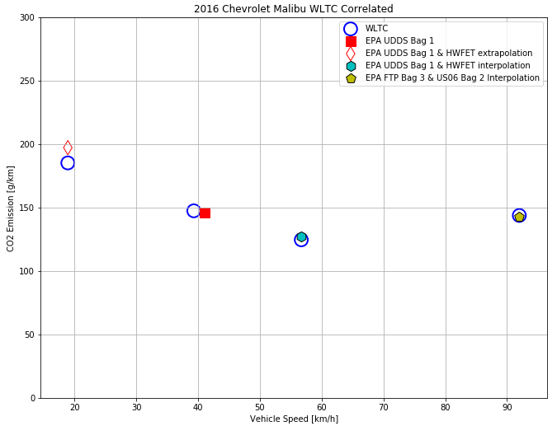
Linear Interpolation and Extrapolation of U.S. Cycles Compared to WLTC
US EPA and JRC started conducting comparison tests, between WLTC and US cycles.
JRC will also test Indian cycle.

Slide 11
Detailed task list-2
Evaluation of trip composition: first delivery April meeting, final for June 2019 ONGOING
Annex on uncertainty of measurements: October 2019
Evaluation of trip severity/trip dynamics: First delivery for June 2019
Evaluation of emissions corrections and moderate/extended conditions: October 2019
Drafting of GTR: already started, informal for January 2020 GRPE ONGOING

Slide 12
Example of divergences in Regional Legislation
China RDE reference to EU RDE ,but make some changes according to own conditions.
Items |  | Requirements
Test procedure & PEMS requirements |  | Package 1,2
Boundary Condition | Altitude | Moderate: [0m, 700m]
 |  | Extended: (700m, 1300m]
 |  | Enhance extended: (1300m~2400m]
 | Temperature | Moderate: [0℃, 30℃]
 |  | Extended: [-7℃, 0℃) or (30℃, 35℃]
Data post-process | ICE, NOVC-HEV | Package 2 Moving Average Window Method
 | OVC-HEV | Package 3
Conformity Factors | NOx, PN | 2.1
* Extended factor: 1.6 Enhanced extended factor: 1.8
Notes:
China 6 RDE generally refers to EU RDE but make some changes according to our own driving conditions. The test procedures and PEMS requirements are referred to Europe Package 1 and 2. Trip requirements are the same as European. Regarding the boundary conditions, considering the geography condition in China, we add the enhance extended altitude up to 2400m and gave 1.8 factor. The temperature condition sits the same with European by now, but we will evaluate the possibility for further extension based on PEMS operation and uncertainty.
Regarding the data processing, we adopted the moving average window method in package 2 for ICE and NOVC-HEV, use package 3 CO2 based method for OVC-HEV determination.
The CFs are temporary set to 2.1. Considering the type I limit, the RDE limit is comparable to Euro 6d.

Slide 13
EU-RDE Trip Parameters (1)
Parameter | EU Settings | Reason
Total trip duration | [90-120 min] | Minimum size of the data set required to achieve statistical significance and coverage of the operating conditions (urban/rural/motorway or speed bins)
Cold start duration Cold start operational requirements | [max 5 min] | Defines the maximum cold start duration Ensures that the vehicle is conditioned properly and driven “normally” during the cold start phase to avoid excessively low or high emissions
Minimum distances Distance shares for the U/R/M conditions | [min 16 km] [34/33/33% ±5%] | Minimum coverage of the operating conditions (urban/rural/motorway or speed bins). Each operating condition is likely to cover various areas of the engine map, thermal conditions of the engine system and driving dynamics (e.g. more dynamics in the city)
Cumulative altitude gain Difference between start and end points | [max 1200 m] [<=100 m] | Ensures that the whole trip is not uphill or downhill and that the energy consumption used for “climbing” remains within EU normal values Ensures “Energy consumption neutrality” and (almost) forces a round trip.

Slide 14
EU-RDE Trip Parameters (2)
Parameter | EU Settings | Reason
Urban average speed Motorway speed above 145 km/h Motorway speed above 100 km/h Urban stop time | [15-40 km/h] [<=3% of motorway time] [>=5 min] [6-30 %] | Operating conditions which could cause (for some technologies) emissions levels which are not comparable to the average RDE emissions: Very low urban average speeds may include non-representative shares of vehicle idling – High urban average speeds are not representative for EU urban driving. Most EU member states have motorway speed limits between 100 and 130 km/h (except Germany). Emissions driving at high speeds is possible up to 145 km/h without invalidating the tests. Emissions control at higher speeds is also ensured through provisions on emissions control strategies. Minimum coverage of “real” motorway driving (See above) Limit the idling time during the test (potential effects on distance specific emissions, possible effects on cold start, etc…)

Slide 15
EU-RDE Trip Parameters (2)
Parameter | EU Settings | Reason
Overall driving dynamics | 50% of U/R/M windows within the tolerances | The vehicle CO2 emissions encompass the effects of the driver’s behavior, the vehicle payload, the wind, the road grade The severity of the driving conditions is assessed using the vehicle RDE CO2 emissions in comparison with the ones from the reference cycle (WLTP) First at an intermediate scale using the MAW method; Second at the trip scale for the final emissions calculation.
Excess of absence of driving dynamics | Below or above the limit curves | Additional kinematic indicators were introduced to assess: The presence of excessive driving dynamics (e.g. a few strong accelerations) using the statistics of instantaneous Speed*Acceleration (VxA) product. The absence of driving of driving dynamics (e.g. constant speed driving using a cruise control in an excessive manner) using the Relative Positive Acceleration (RPA). NB: To assess such effects, the MAW CO2 was not found sensitive enough.

Slide 16
Upcoming Meetings
6th meeting 9-10 July 2019, Austria
7th meeting in 30-31 October 2019, Korea
8th meeting and Informal document in time for January 2020 GRPE meeting
9th meeting in February 2020 to prepare working document
10th meeting with Working document in June 2020 GRPE meeting

Slide 17
Summary:
Work progresses well although there is still a lot to be done to ensure that regional aspects are covered adequately
Very ambitious deadline but engagement of participants is good
We create a database on RDE measurements that will be widely available
Already working on a draft GTR

Slide 18
Thank you for your attention! From the sponsors: European Union Japan Korea

