Slide 1
Submitted by the expert from the Republic of Korea
Informal document GRSG-117-32 117th GRSG, 8-11 October 2019
Agenda item 7 (a)
Camera monitor system issues in Korea
2019. 10. 8
Kil ho Mang(KATRI)

Slide 2
Contents
Current situation
Test facility
CMS test on vehicle
Couclusion
Q & A

Slide 3
Current situation
○ (2016.06.18) Camera monitor system regulation released in R46
○ (2017.01.09) Camera monitor system is added to KMVSS 50
○ (2017.10.10) Test procedure for Camera monitor system completed
→ (There was no test facility)
○ (recent) Considering for installation of test facility for CMS
→ Completely installed in July 2020
○ Main issues
- CMS test facility installation
- Is vehicle level test for CMS needed or not?

Slide 4
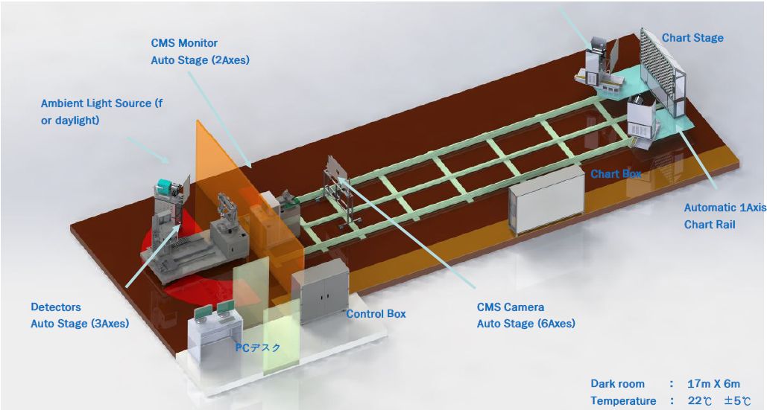
Test facility
○ Basic concept for installation(keep discussing)
→

Slide 5
Test facility
○ Information of instruments(summary)
- Environment : Darkroom(brightness adjustable space)
- Detector
▪ Checking luminance value(point or area)
→ In case of area detecting, software will be used
- Light sources for testing
▪ For monitor(uniformity), chart and point light sources
- Goniometer
- Software(Image analysis and calculation)

Slide 6
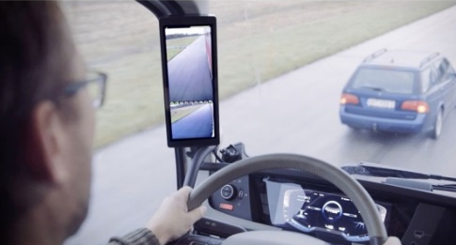
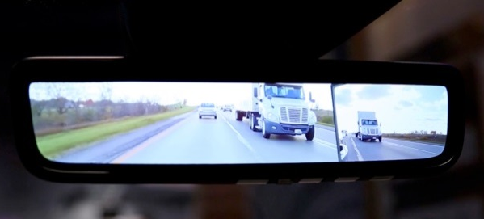
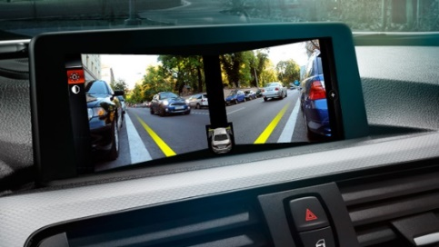
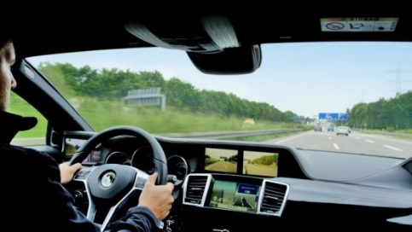
CMS test on vehicle
○ Reason for why CMS test on vehicle is needed
- Limitation(monitor, driver’s eye position… not considered)
- Efficiency of test(UN R 46 including rearward visibility)
- There can be different test result(no one knows)

Slide 7
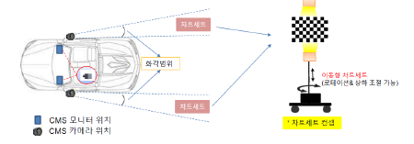
CMS test on vehicle
○ Test for comparison for vehicle test
- Basic concepts
① All x, y, z coordinates are needed for positioning
② Portable light source and testing charts
③ Sensor position : E points(originated on R-point)

Slide 8
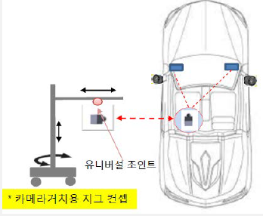
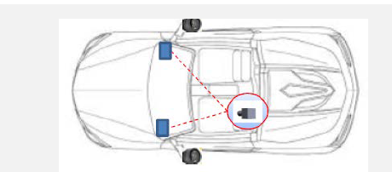
CMS test on vehicle
○ Test for comparison for vehicle test
- Test procedure
① Put detector on driver’s eye point(R-point proving)
② Adjust detector’s angle by rotating(after checking monitor angle)
③ CMS performance test

Slide 9
Couclusion
○ Limitations
- Portable light source for monitor test is needed(positioned in vehicle)
- Flicker, Frame late, Image formation time, System latency
▪ Those tests must be confirmed possible or not on the vehicle
○ After installation, you can visit KATRI and see the facility
○ Comparison test for CMS will be discussed
- CMS test(on the vehicle vs only component)
- Test result comparison between KATRI and other institute(same model)

Slide 10
Q & A
Kil ho Mang
helper@kotsa.or.kr

