Slide 1
Regulation ECE R79-03 ACSF C 2-Step HMI
Submitted by the experts from OICA
Informal document GRVA-04-03
4th GRVA, 24-27 September 2019
Provisional agenda item 6(a)
Justification for the timing between
First action and Lane Change Manoeuvre at 7 seconds

Slide 2
Context
OICA presented amendment GRVA-02-24 in 2nd session of GRVA in January 2019, introducing an alternative to ACSF C with a 2-step HMI. This alternative will keep the same performance requirements as ACSF C 1-step HMI.
Conclusion of GRVA-02:
OICA shall present a formal document for GRVA session of September 2019
This document shall be based on GRVA-02-24 and include a requirement stating that a vehicle shall not be equipped ACSF C 1-step HMI and ACSF C 2-step HMI.
OICA shall also justify the need for 7 seconds between the start of the lane change procedure until the start of the lane change manoeuvre.

Slide 3
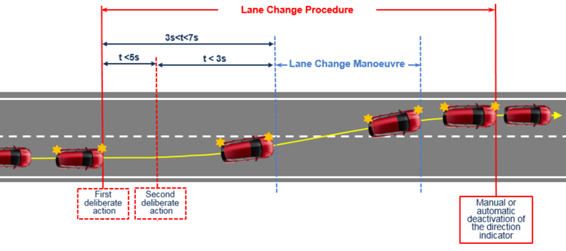
Context
March. 2019 / Karim YAHIA

Slide 4
Amendment proposal
Paragraph 5.6.4.6.4., amend to read:
"5.6.4.6.4. The lateral movement of the vehicle towards the intended lane shall not start earlier than 1 second after the start of the lane change procedure. Additionally, the lateral movement to approach the lane marking and the lateral movement necessary to complete the lane change manoeuvre shall be completed as one continuous movement.
The lane change manoeuvre shall not be initiated before a period of 3.0 seconds and not later than 5.0 seconds after the deliberate action of the driver described in paragraph 5.6.4.6.2. above.
The lane change manoeuvre shall be initiated either automatically or by a second deliberate action of the driver.
A vehicle shall not be equipped with both these means of initiation.”
4

Slide 5
Justification for the 7 seconds

Slide 6
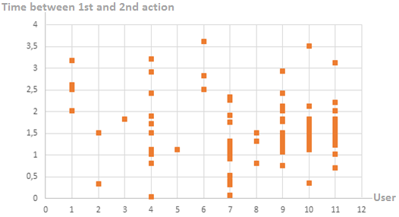
First Study – Time between 1st and 2nd action
Measurement conditions :
Lane Change Assist Prototype (2-step HMI)
Number of users driving on highway: 11
Number of recordedassisted lane changes : 91
For each activation of the Lane
Change Assist, we have measured
the time between the 1st and
the 2nd action of the driver
Time between the first and the second deliberate action
* 3 seconds is the maximum timing between the second deliberate action and the lane change manoeuvre
March. 2019 / Karim YAHIA

Slide 7
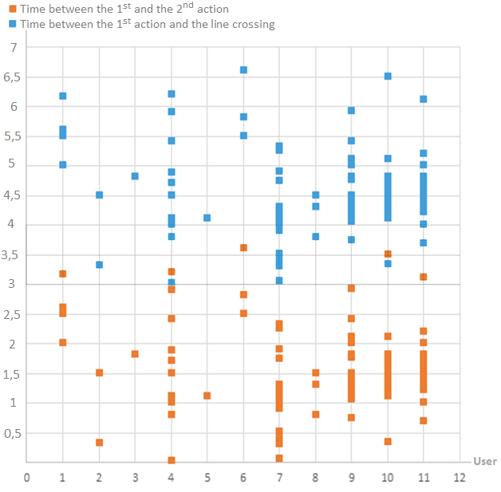
Results
with 5 seconds, ~25% of the LC abort !!
7 seconds are needed !!
Time between the First and the second deliberate action + 3 seconds*
+3s
Time between the first and the second deliberate action
* 3 seconds is the maximum timing between the second deliberate action and the lane change manoeuvre
March. 2019 / Karim YAHIA

Slide 8
Conclusion
The measures and tests we have performed for the ACSF C 2-step HMI show that :
There will be a significant percentage (up to 23%) of lane change manoeuver aborted if the time between the 1st action and the line crossing is limited to 5 seconds
A system designed to allow the lane change manoeuvre up to 7 seconds after the 1st action :
results in a good controllability
results in a good availability of the function
OICA then propose limiting the timing between the first deliberate action and the Lane Change Manoeuvre to 7 Seconds
March. 2019 / Karim YAHIA

Slide 9
Thank you for your attention
March. 2019 / Karim YAHIA

