Slide 1
Electric Vehicles and the Environment (EVE IWG)
Submitted by the EVE informal working group
Informal document GRPE-81-32
81st GRPE, 9-12 June 2020
Agenda item 9(b)
Report to GRPE 81st Session

Slide 2
Original Mandate (Part B of 2nd Mandate)
Hybrid power determination
Targeted establishment of a power determination GTR by AC.3 in the Global Registry in November 2019 with flexibility to extend by up to 1 year based on results of validation testing
In-vehicle battery durability
Continue research on EV battery performance and durability
Return to AC.3 with recommendation for next steps (such as GTR development) or conclusion of topic
Method of stating energy consumption
Find another group within UNECE framework to assume leadership of the topic, with support of EVE IWG, with the Group of Experts on Energy Efficiency (GEEE) was identified as an initially promising option

Slide 3
Updates to Mandate and Current Status
Hybrid power determination
The initial mandate envisioned the GTR as an Annex to GTR No. 15, but in March 2019 AC.3 approved the decision to instead develop it as a standalone GTR
In November 2019, the mandate for the GTR was extended by one year to complete additional testing to address validation concerns with the first phase test results
The draft GTR was submitted in March 2020 and is available as formal document GRPE/2020/12.
An informal document has been issued that amends GRPE/2020/12.
In-vehicle battery durability
The EVE IWG presented a timeline proposal at the January 2020 GRPE with recommendations to approve the new mandate at AC.3 in March
The EVE IWG is presenting the probable framework of a Phase 1 GTR and commenting on the timeline and open issues remaining
Method of stating energy consumption
The Group of Experts on Energy Efficiency (GEEE) has committed in their most recent mandate to assume leadership of the work with a one year timeline.
Interaction with these groups is led by the Secretary of GRPE

Slide 4
Status of Power Determination GTR
The proposed GTR was submitted to the GRPE secretary in March 2020 (working document GRPE/2020/12)
The drafting group has continued to resolve a few remaining open issues
An informal document amends GRPE/2020/12 to account for these revisions

Slide 5
Current power determination GTR timeline
Timeline for power determination GTR
June 2020: Final working document for GRPE
November 2020: Approval by AC.3

Slide 6
Status of In-Vehicle Battery Durability
Review of general goals of a durability GTR:
Establish minimum durability requirements
Prevent substandard products from entering the market
Allow continued development of the GTR as the industry evolves
Implement a data collection mechanism for improving the GTR in the future

Slide 7
Status of In-Vehicle Battery Durability
The EVE IWG reported on a potential solution for a durability GTR at the January 2020 GRPE
The future durability GTR was expected to include:
Minimum performance requirement (PR)
State of Health monitor (SOH)
In service conformity checks (ISC)
Adoption of vehicle normal usage indices (NUI)
EVE leadership senses that the level of interest in this work is rapidly increasing, as evidenced by EVE attendance and new expressions of interest by manufacturer organizations
California Air Resources Board (CARB) has communicated to EPA that they are also considering in-vehicle durability requirements and they may begin participating in the EVE
Alliance for Automotive Innovation is now regularly participating in EVE meetings

Slide 8
Status of In-Vehicle Battery Durability
The initial proposal included a multi-phase approach:
Phase 1
Minimum performance requirement (PR) established by consensus
Require battery state of health (SOH) and normal usage indices (NUI) to be recorded by vehicle (e.g. on OBD)
In-service conformity (ISC) test which will include a way to consider usage of vehicle and a statistical method
SOH and NUI to be readable for ISC, and to provide source of data for improving GTR in the future
Phase 2 (refines PR and uses NUIs to evaluate usage at ISC)
The performance requirement would be refined
The in-service conformity test would be refined by improving the statistical method and using NUI from vehicle to determine which vehicles are eligible to be in the sample
i.e. Vehicles with NUI that indicate non-“normal” usage are eliminated from ISC

Slide 9
Current DRAFT framework for Phase 1
Minimum performance requirement (MPR)
Percentage retention of certified range [or capacity] “x” years and/or “y” distance
MPR is applicable to all manufacturers
Individual manufacturers can declare a better performance (declared PR, or DPR)
Onboard battery state-of-health (SOH) metric
Definition of SOH = (Remaining range / certified range) [or based on capacity?]
OEMs responsible for their own algorithm
Readable by responsible authority (via OBD or similar)
In-service conformity (ISC) and data collection
Part A: Establish reliability of SOH metric
Small sample of 3-10 vehicles via ISC
Use checklist/survey to exclude vehicles with abnormal usage
Measure range via range test used for type approval (commonly, WLTC)
Verify accuracy of SOH metric by comparing to measured range
Part B: Determine conformity with MPR / DPR
Large sample of unspecified number of vehicles (may remove need for NUIs)
Routine collection of SOH metric, e.g. at safety inspections or via telematics
Determine conformity by reference to collected SOH
Establish mechanism for ongoing data collection to inform Phase 2
Primarily SOH collection
Identify simple NUIs that can be implemented now, if any
Discussion may be started in Phase 1 under limited samples

Slide 10
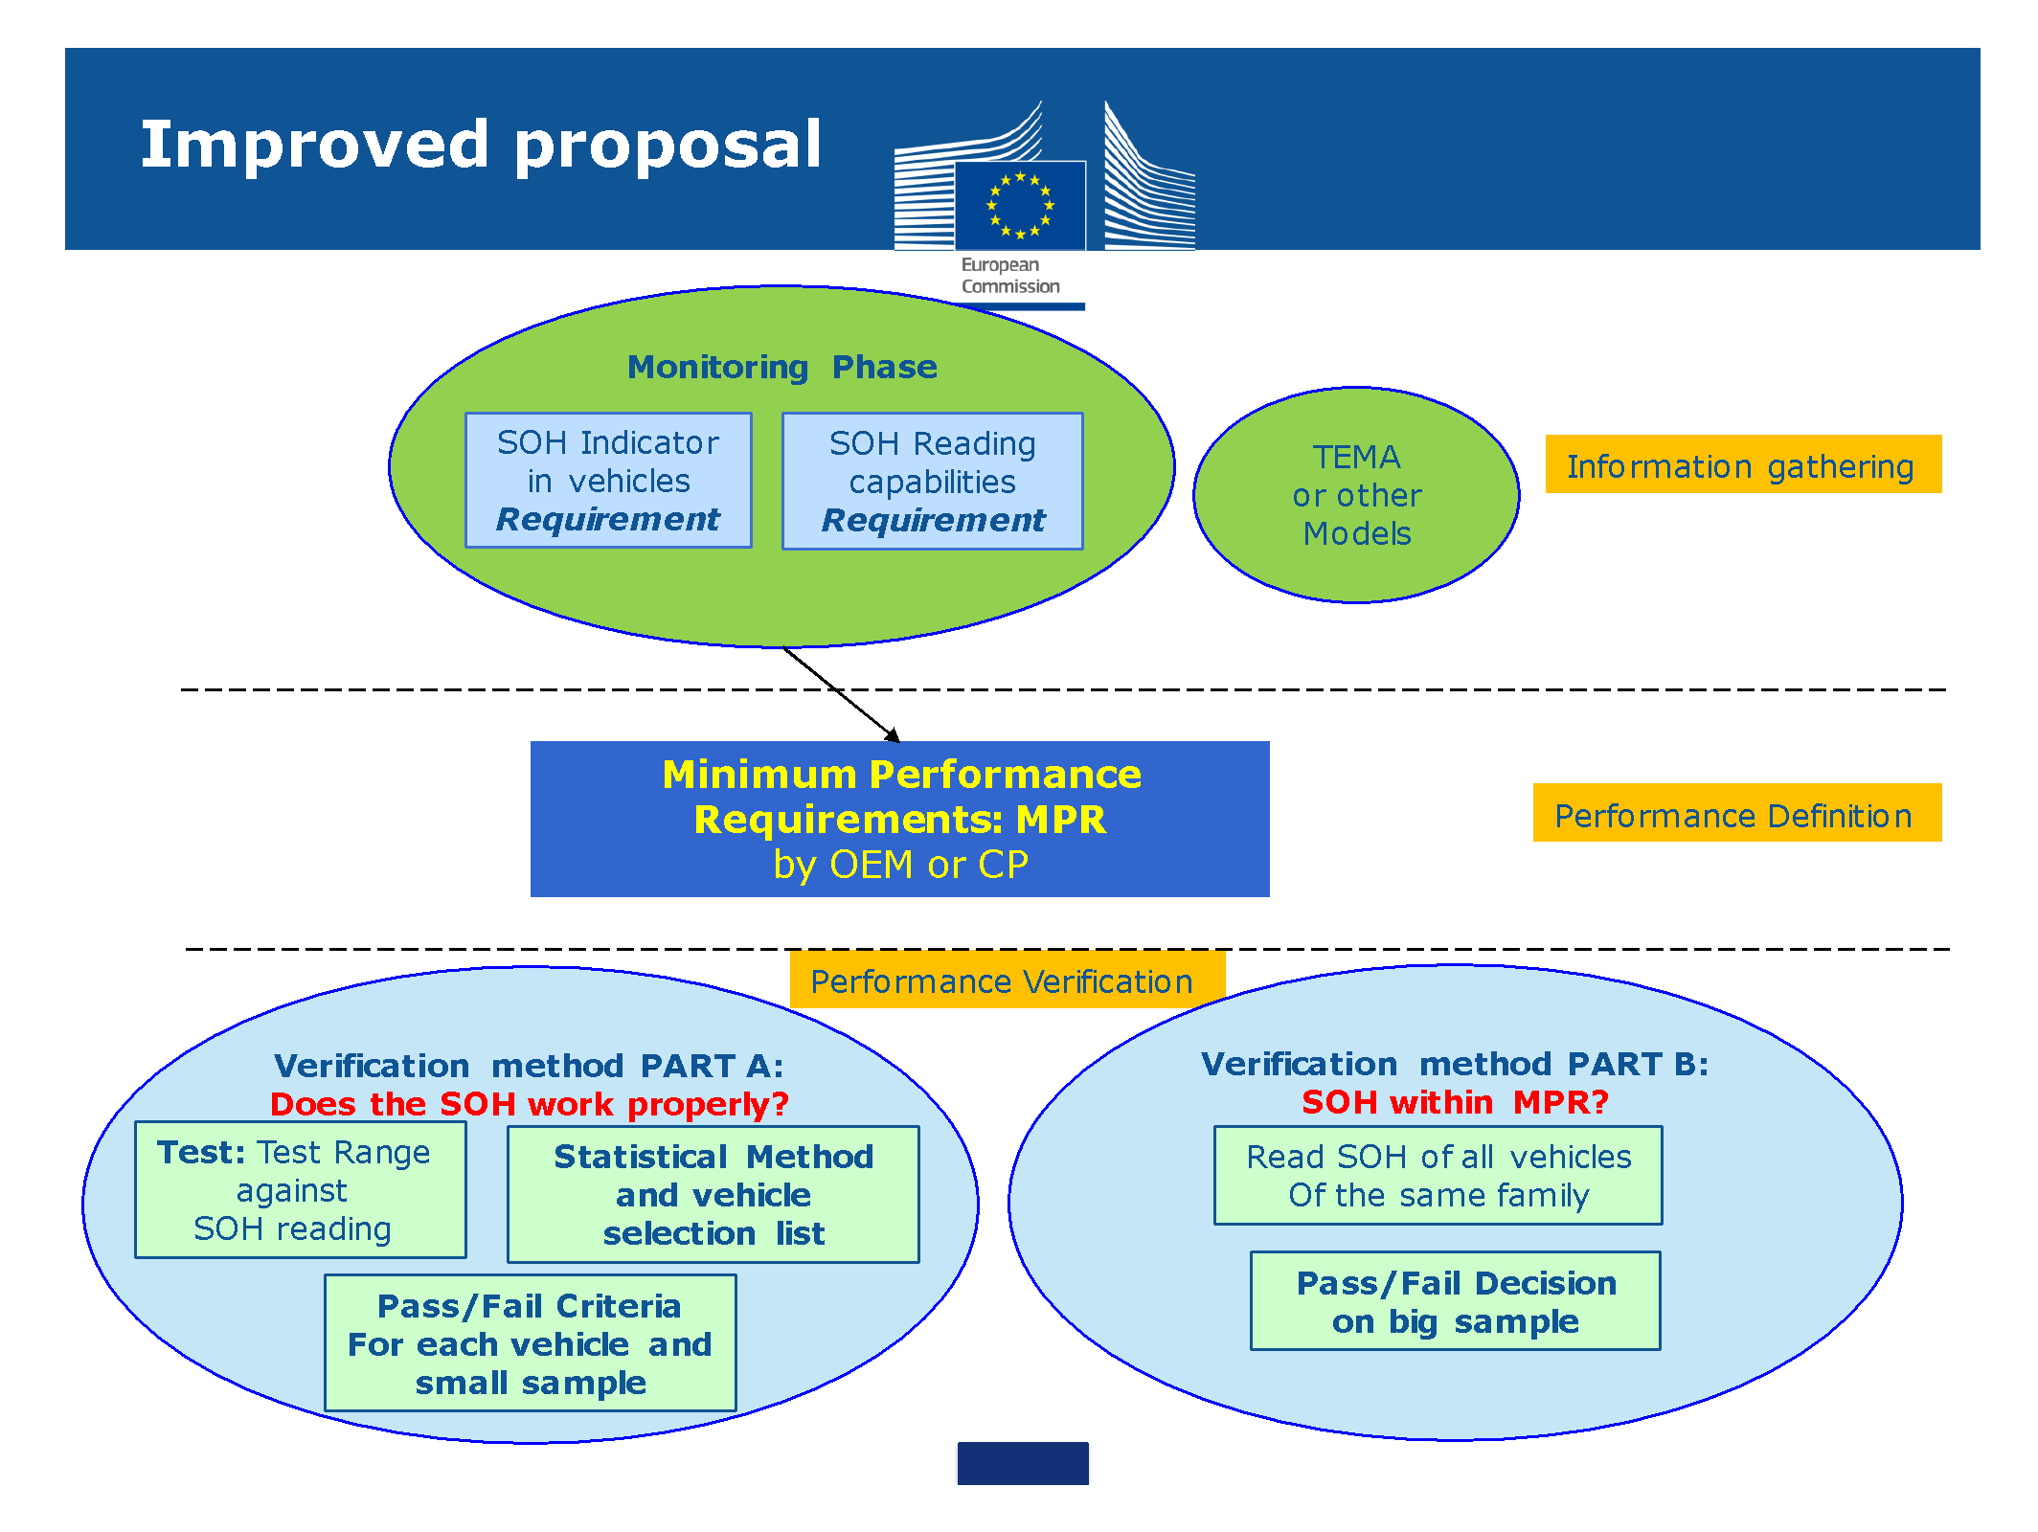
Durability Process for SOH and MPR

Slide 11
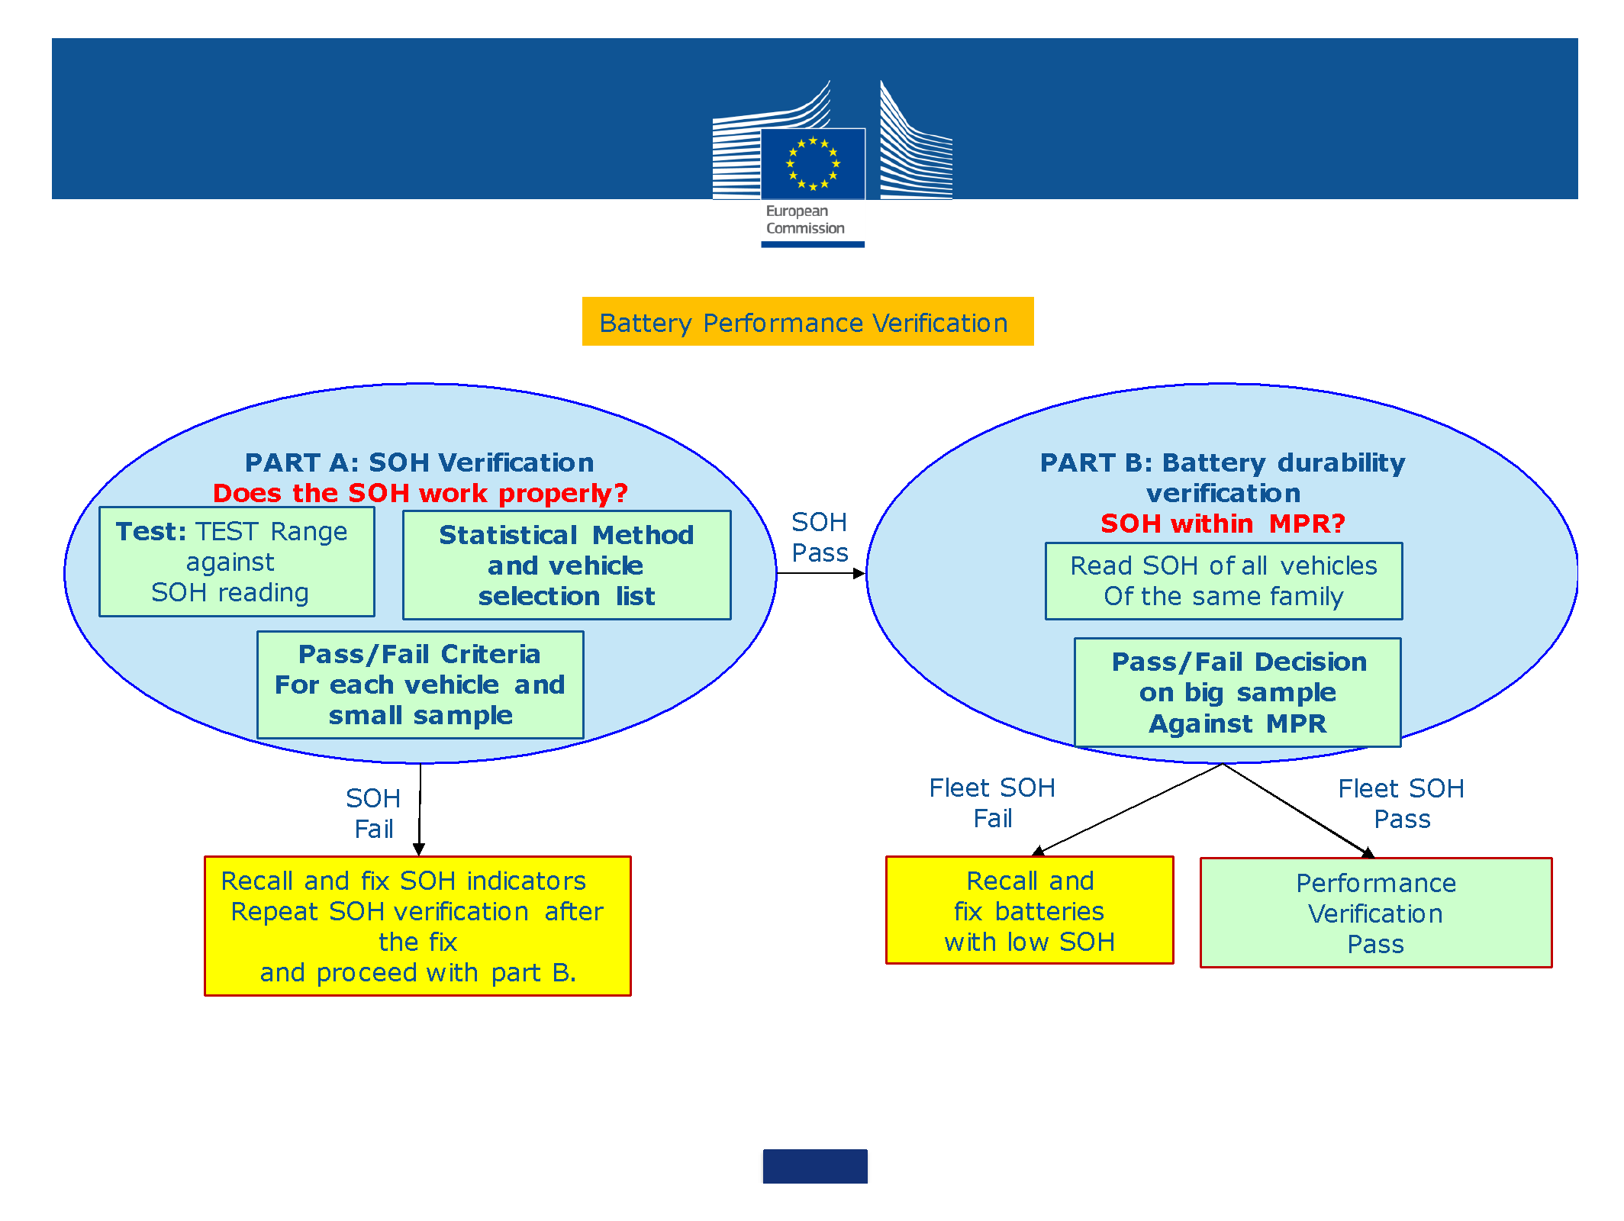
Durability Process for SOH and MPR

Slide 12
Original proposed mandate timeline
(i) March 2020: Approval of mandate from AC.3
(ii) January 2020 – June 2020: EVE IWG formulates new drafting group, and begins drafting GTR with elements agreed upon by EVE IWG
(iii) June 2020: EVE IWG provides update to GRPE outlining details of draft outline of GTR
(iv) June 2020 – December 2020: EVE begins validation testing of relevant aspects of the proposed procedure, assesses results and makes changes to GTR
(v) January 2021: EVE IWG submits first draft proposal for the GTR as an informal document to January 2021 session of GRPE for further discussion and recommendation.
(vi) January 2021- March 2021
a. EVE revises draft proposal based on recommendations from GRPE
b. Transmission of the draft GTR as an informal document twelve weeks before the June 2021 session of GRPE;
c. Endorsement of the draft GTR based on an informal document by GRPE.
(vii) June 2021: EVE presents the final GTR to GRPE
(viii) November 2021: establishment of the GTR by AC.3 in the Global Registry.
(ix) January 2021-January 2024: EVE IWG continues information gathering on possible modifications to the GTR and develops amendments to the GTR for consideration by WP.29 and AC.3, as deemed appropriate.

Slide 13
Requirements to meet proposed schedule
The proposed schedule is very ambitious
EVE IWG plans to increase cadence of meetings to improve the chances of meeting the schedule
EVE feels that the proposed schedule may be achievable, conditional on many developments, including (most notably) the following:
Ability to reach consensus on the remaining details of Phase 1, among a growing group of stakeholders who have recently expressed interest in the work
Availability and suitability of any existing regulatory text (e.g., ISC statistical method and questionnaire/survey) that can be adapted to the GTR
No need to develop prescribed NUI algorithms
No need for a technical validation program
Any prior notice needed to establish outside services to support the program (e.g. application for any new OBD PIDs)
Mandate request includes possibility of an additional year if necessary

Slide 14
Possible references for ISC development
Criteria for vehicle selection (Part A):
Could be modeled on existing survey such as “Selection of Vehicles for In Service Conformity Emissions Testing”, e.g. Appendix 1 of Commission Regulation (EU) 2018/1832
With added questions specific to vehicle and battery usage
Will require agreement on questions that adequately indicate potential for abnormal battery degradation
Statistical procedure:
Could be modeled on practices and decision charts described in 5.10 of above

Slide 15
Next Steps For Electrified Vehicle Durability
Reach final consensus on the framework of Phase 1
Finalize membership of drafting group and identify any needed task forces and their leaders
Identify and adapt existing text that may be useful for the GTR
Begin drafting GTR with elements agreed upon
Many significant open issues remain, and more are likely to be identified as this process continues

Slide 16
Method of Stating Energy Consumption
Proposed path forward for method of stating energy consumption
EVE remain available as experts on EV performance to support this work under leadership of GEEE
The EVE IWG and GEEE met at January 2020 GRPE to discuss the roles of both groups and the areas of focus for each group
EVE IWG and the GEEE proposed to have a joint workshop depending on funding resources for further planning

Slide 17
EVE Meetings
Regular meetings concurrent with GRPE each January and June
24-25 October 2017 – Vienna, Austria
27-28 March 2018 – Tokyo, Japan
16-18 October 2018 – Ottawa, Canada
8-10 April 2019 – Stockholm, Sweden
8-9 October 2019 – Brussels, Belgium
23-24 March 2020– USA (teleconference due to COVID)
Monthly EVE teleconferences starting in late June 2020
Fall 2020 –TBD (Asia?)
Spring 2021 – TBD (Europe?)

