Slide 1
Informal document GRSG-119-32 (119th GRSG, 6th - 9th October 2020) Agenda item 6.
Proposal for Supplement 11 to the 02 series of amendments to UN Regulation No. 66 (Strength of superstructure (buses))
to the document ECE/TRANS/WP.29/GRSG/2020/22

Slide 2
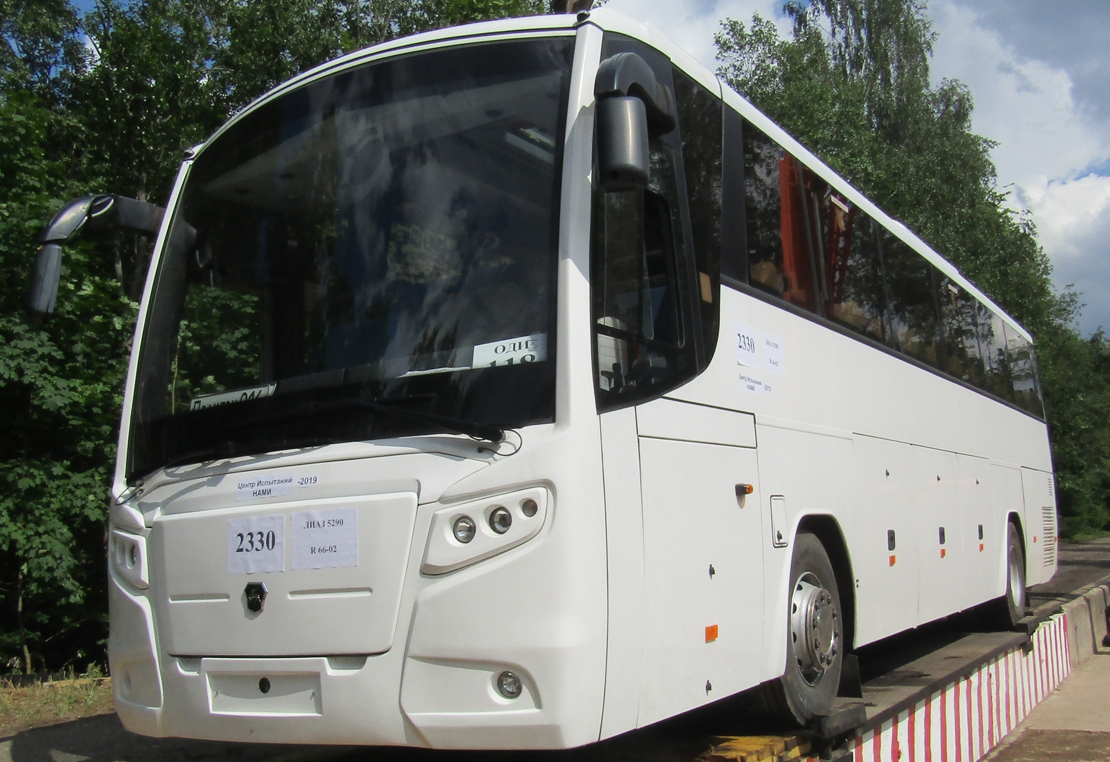
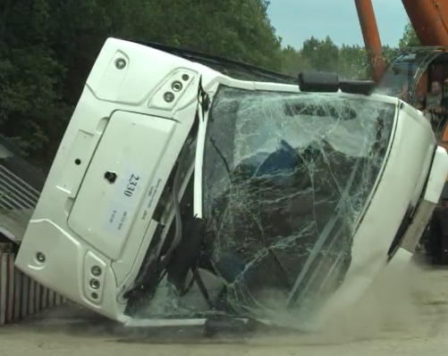
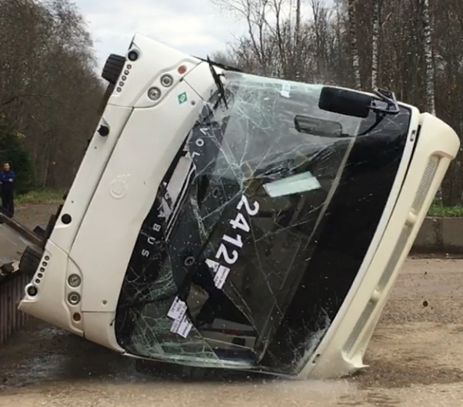
A bus of M3 category, class III
A rollover test on a complete vehicle was performed in accordance with the provisions of Annex 5 to UN Regulation No. 66-02.
The objective of the test was to assess the compliance of the vehicle with regard to ensuring the integrity of the residual space that shall be kept in the passenger compartment, crew and driver’s compartment(s) to ensure a greater likelihood of survival of passengers, driver and crew in the event of a vehicle rollover.

Slide 3
Identified damage
Intrusion of individual structural elements (luggage racks) into the residual space of the vehicle
Detachment of passenger seats was identified *
Displacement and movement of window breaking devices and fire extinguishers in the compartment was also identified
* Not a subject to evaluation as part of the compliance assessment pursuant to UN Regulation No. 66-02

Slide 4
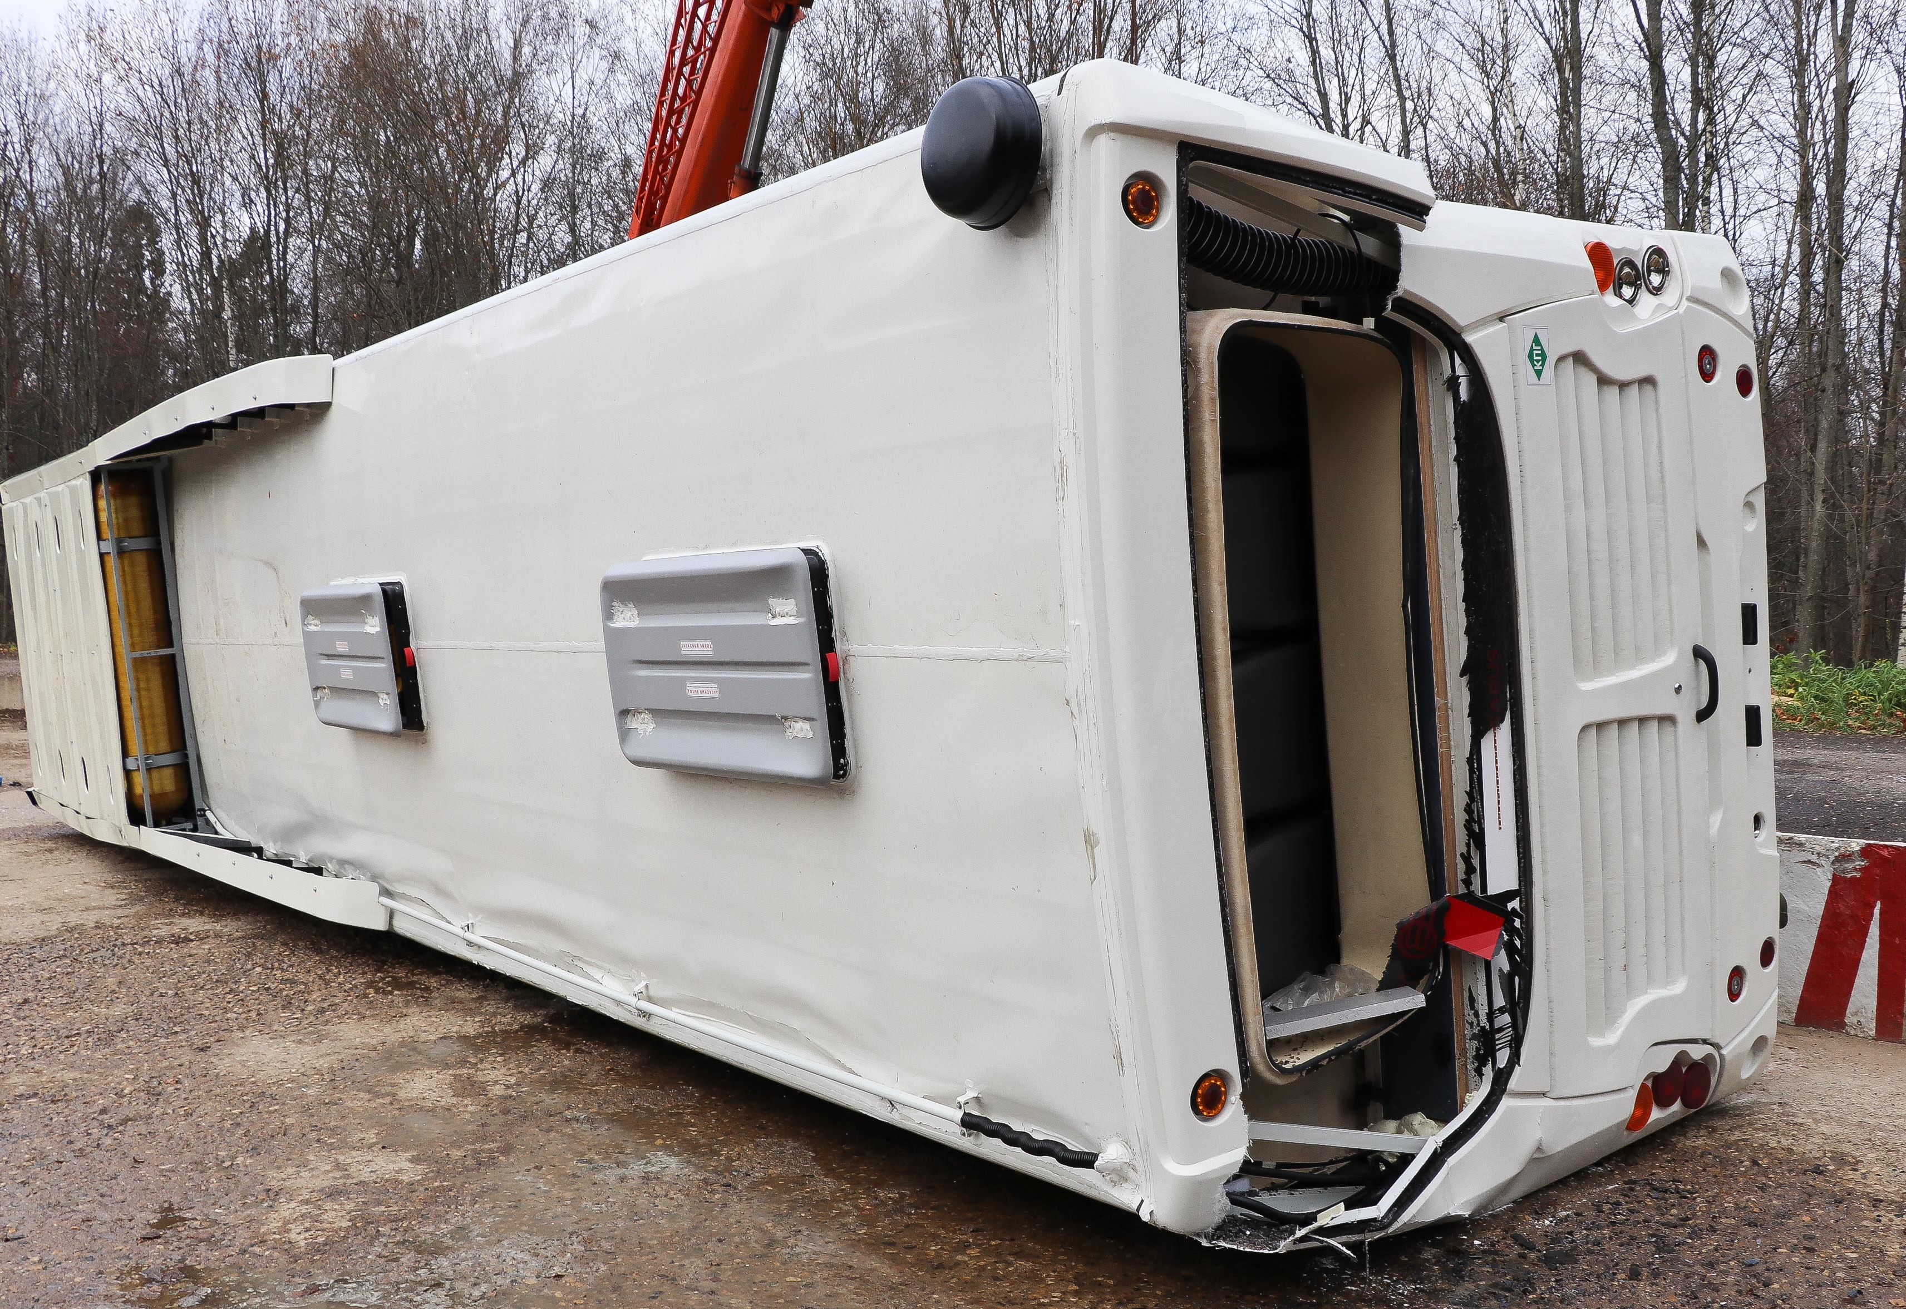
Identified damage
The emergency hatches failed to open in accordance with the instructions marked on them *
* Not a subject to evaluation as part of the compliance assessment pursuant to UN Regulation No. 66-02

Slide 5
Conclusions
1) Rollover test on representative body sections and/or Quasi-static calculations or computer simulations stipulated in UN Regulation No. 66-02 not all cases can be considered as equivalent to the rollover test method on a complete vehicle:
Rollover test on representative body sections
=
Quasi-static calculations or computer simulations
=
Rollover test on a complete vehicle
2) At the load resulting from an M3 category vehicle overturning, detachment of passenger seats is possible. However, existing provisions of UN Regulations (not only No. 66) do not provide for the assessment of seat strength in this type of overloading.
3) Assessment of opening the emergency hatches in accordance with UN Regulation No. 107 is carried out on the complete, undamaged vehicle. It is necessary to assess the accessibility and the possibility of opening the hatches after full-scale tests in accordance with UN Regulation No. 66, when the bus has overturned to its side.

Slide 6
Suggestions
Submit complete buses for testing
After testing, assess the following:
a) opening of the emergency hatches;
b) damage of the seat anchorages;
c) potentially injury-causing objects did not enter the survival space of passengers and were not moving within it.
Implementation of this Appendix shall be optional, but if the applicant has received approval without assessment provided for in the Annex 5 - Appendix 1, national requirements may be applied by Contracting Parties. This proposal is drawn up to be similar to paragraph 1.4. of paragraph 1. “Scope” of UN Regulation No. 144.

Slide 7
Sergey Maslennikov

